Slide 1

How To Think About Learning On The Internet
Eric S. Rabkin
Arthur F. Thurnau Professor Emeritus,
Professor Emeritus of English Language and Literature, and
Professor Emeritus of Art & Design
University of Michigan
Brasilia, 05 August 2015

Slide 2

How To Think About Learning On The Internet - Overview
A Mosaic
Context Motives Resources
Twelve Tiles
Why Learn? Fun and Profit
Real Work Is Better Than Homework
The Learning Environment
From Foraging to Collaboration
See One, Do One, Teach One
Top-Down and Bottom-Up and
Something-In-Between
Questions of Scale
Questions of Community
Authentication
Authorization
Ownership
Access

Slide 3
How To Think About Learning On The Internet
Context
Personal
“They have mouths, but they speak not; eyes have they, but they see not.”
Lev Vygotsky’s Zone of Proximal Development
Social
Actual
past: Geni
present: Department of English
future: Cornell New Student Reading Project
Virtual: Goodreads
Physical
Accessiliblity: WAVE
Mobility: Biology field work apps
Temporal
Just in Time: Weather Underground (with historical data)
Just in Case: Portuguese conjugation tables (v. translate.google.com)
Recency: Arithmetic game
Frequency: A Word A Day
Persistence: Animal Diversity Web

Slide 4
How To Think About Learning On The Internet
Motives
Pleasure: Internet Movie Database
Profit: Symptom Checker
Intrinsic Drives: TED talks
Extrinsic Drives: Continuing Medical Education
How are MOOCs used?

Slide 5
How To Think About Learning On The Internet
Resources
One-way: Merriam Webster Dictionary
Two-way:
Machine-driven: University of Michigan Library
Intrinsic Drives: Amazon reviews
All-way:
  Machine-driven: Google Books Ngram Viewer
  (Frankenstein, Sherlock Holmes, Albert Einstein: 1800-2000; English)
  Human-driven: Wikipedia

Slide 6
How To Think About Learning On The Internet
Why Learn? Fun and Profit (Dulce et utile)
Who can blend usefulness and sweetness wins every
Vote, at once delighting and teaching the reader.
–Horace (c. 19 BCE), Ars Poetica (The Art of Poetry)
Sweet (repair, maintain, grow): Online Etymology Dictionary
Sweet & Useful (repair, maintain, grow) New York Times (including archive)
Useful (repair, maintain, grow): Khan Academy

Slide 7
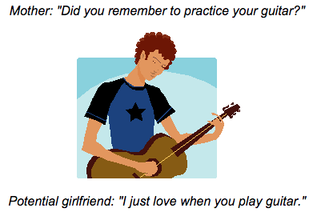
How To Think About Learning On The Internet
Real Work Is Better Than Homework

Slide 8
How To Think About Learning On The Internet
The Learning Environment
World: Wall Street Journal and El Pais
Wer Ald: etymology
Genre: What is a grade?; “The Shortest Way with the Dissenters”
Culture: “Muslims in Moscow Work to Break Stereotype”; censorship; Facebook

Slide 9
How To Think About Learning On The Internet
From Foraging to Collaboration
Collecting information: U. S. Census; WolframAlpha
Evaluating information: Snopes.com; Harvard Guide to Using Sources
Manipulating information: WordItOut; Science Fiction titles
Sharing information: SETI@home; The Genre Evolution Project
Fostering collaboration: Meetup; WordPress; Google apps; Personify

Slide 10
How To Think About Learning On The Internet
See One, Do One, Teach One
Experiential Education: Worth1000
Guided Practice: Apprennet
Structured: Eighteenth Century England
Ad hoc: Professor Rabkin’s Closet

Slide 11
How To Think About Learning On The Internet
Top-Down and Bottom-Up and Something-in-Between
Top-down: Arizona State University Online; edX
Bottom-up: w3schools.com; Citizen Journalism
Something-in-Between: Allrecipes.com; Huffington Post

Slide 12
How To Think About Learning On The Internet
Questions of Scale
Independent study: duolingo
Work group: Prism
MOOC: 22 minutes to an answer

Slide 13
How To Think About Learning On The Internet
Questions of Community
Anonymity: pros and cons
Pre-exisiting or self-organizing: Technology and the Humanities
Voluntary or mandatory: RoadScholar
Inclusive or exclusive: Humanist Discussion Group
Posting for fun and profit: SFFaudio

Slide 14
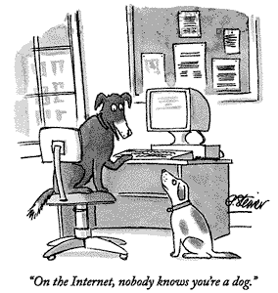
How To Think About Learning On The Internet
Authentication
Identity: We Take Your Class
Who cares? Fox News U.S. Republican debate (6 Aug 2015)

Slide 15
How To Think About Learning On The Internet
Authorization
Group membership: Secure Materials server
Expertise: PMC (Post Modern Culture)
Experience points: Quora
Thumbs up or down: Reddit
Moderators and Trolls: Conflict at Reddit
Leonard Nimoy, vegetarian

Slide 16
How To Think About Learning On The Internet
Ownership
Copyright: Stanford Copyright and Fair Use Center
Creative Commons: re-use and attribution licenses
Coercion: turnitin (plagiarism checker)
Public Domain: definition

Slide 17
How To Think About Learning On The Internet
Access
Physical: Adaptive Technology
Educational: Me desculpe, mas eu não falo Português
Financial: Georgia Tech Online M.S. in Computer Science
Social: Internet filters at Home and at the Public Library
Legal: A Prisoner’s Dilemma

