Slide 1
Lecture 22
Outsourcing and Offshoring
Econ 340
Notes:
Add Schuman

Slide 2
Announcements
Lists of Terms and Acronyms are now available to help you study
  Go to course website under Handouts
  All may be found in my Glossary, also online, from which I mostly cut and pasted

Slide 3
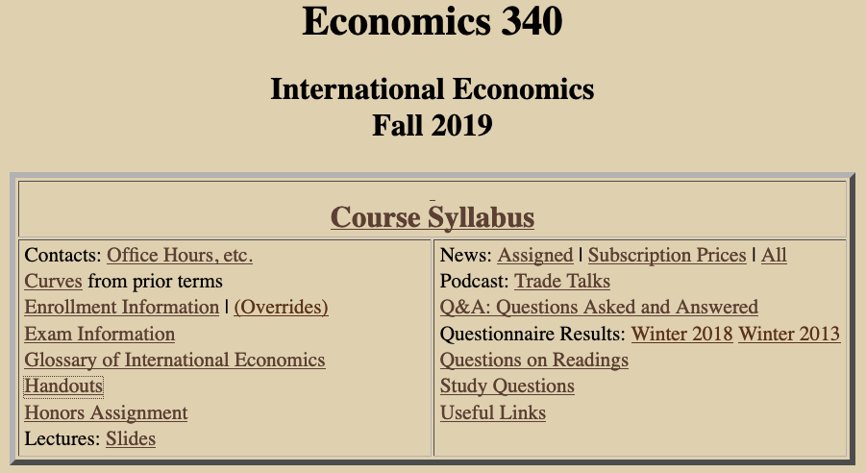

Slide 4


Slide 5
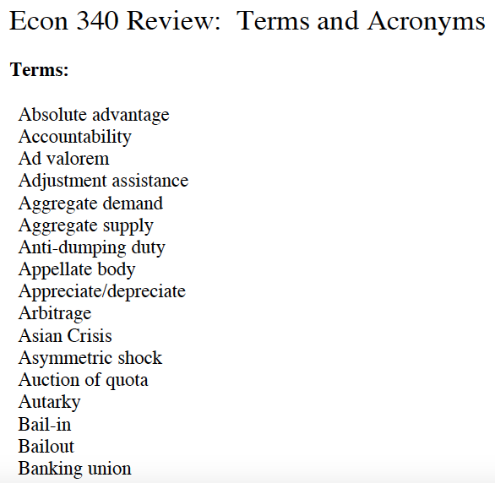

Slide 6
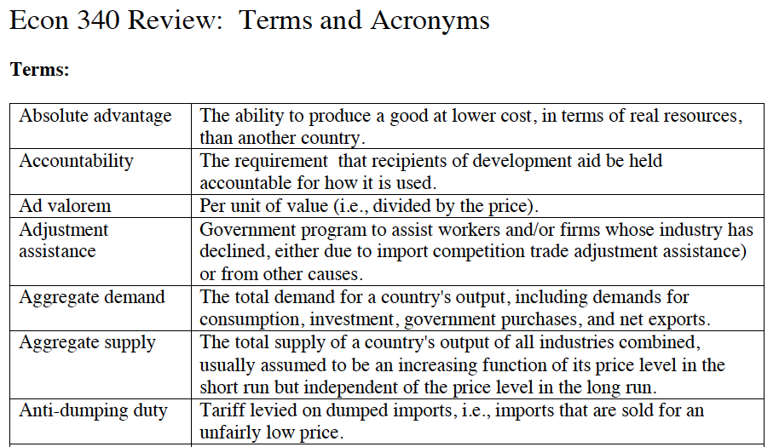

Slide 7


Slide 8


Slide 9
Outline:
Outsourcing and Offshoring
Definitions of OS
Causes of OS
Effects of OS
Facts about OS
Policies

Slide 10
Definitions
Outsourcing = Movement of an activity to outside of firm
(Not necessarily outside country)
Offshoring = Movement of an activity to outside of country
(Not necessarily outside firm)
  Could be
    Subsidiary abroad (FDI)
    Subcontracting with another firm
    Arm’s-length trade
  Often refers to services
  Sometimes called “trade in tasks”

Slide 11
Definitions
Both could be called:
OS = OutSourcing / OffShoring
I’ll use “OS” here to refer only to OffShoring, since that’s the one that is clearly international

Slide 12
Clicker Question
Which of the following is offshoring?
  A US toy manufacturer imports steel from Brazil.
  A Canadian tractor producer contracts with a Toronto company to make wheels that it used to make itself.
  A German maker of air conditioners stops making the condensers in Munich and opens a plant in the Czech Republic to make them.
  All of the above.
  None of the above.
✓

Slide 13
Outline:
Outsourcing and Offshoring
Definitions of OS
Causes of OS
Effects of OS
Facts about OS
Policies

Slide 14
Causes of OS
Blinder identifies two causes of the increase in OS over recent decades:
  New technologies
    Information
    Communication
  Entry of new populations into world economy
    China
    India
    Former Soviet states
  These make OS possible for jobs that can be done at a distance

Slide 15
Causes of OS
Otherwise, causes of OS are same as causes of other trade
  Activities are offshored if they can be done more cheaply elsewhere
  Thus OS occurs due to
    Comparative Advantage
      Due to technology differences
      Due to factor-endowment differences
    Economies of Scale

Slide 16
Outline:
Outsourcing and Offshoring
Definitions of OS
Causes of OS
Effects of OS
Facts about OS
Policies

Slide 17
Effects of OS
Disagreements
  Bivens (not assigned), like other trade skeptics,
    is largely negative
    He defines offshoring as “substituting foreign for domestic labor”
  Many mainstream trade economists
    see offshoring as ordinary trade
    are largely positive
  Blinder (a very well-respected macro economist)
    sees OS as beneficial overall
    but worries about effects on US labor

Slide 18
Effects of OS
Effects that are Like trade:
  All of the effects of trade that we have studied, are valid for this. OS is trade.
  Thus
    Countries as a whole gain, due to comparative advantage, economies of scale, etc.
    Some people within the countries lose – especially those whose jobs are lost
    Theory says that “scarce factors” are hurt by trade, and thus also by offshoring.

Slide 19
Effects of OS
Effects that are Unlike trade
    i.e., effects that don’t occur with other trade, or at least weren’t mentioned
  Increased insecurity: workers feel more threatened
    They see foreign workers doing jobs they used to do, often for the same employer
    New groups (white collar, in high-income countries) are seeing the threat
  Employers can “move jobs”; workers can’t
    Thus employers gain in bargaining over wages

Slide 20
Effects of OS
Effects that are Unlike trade
  (Possible) loss of technological advantage
    Poor countries acquire the knowledge that rich countries previously had exclusively.
    Thus
      Poor countries become more productive
      Their incomes rise
      Therefore OS helps economic development

Slide 21
Effects of OS
Effects that are Unlike trade
  (Possible) loss of technological advantage
    Terms of trade of rich countries worsen, costing them some of their gains from trade
      Thus rich countries may lose from the loss of exclusive technologies due to OS
      But what they are losing are the gains from trade. Refusing to trade would only make things worse.

Slide 22
Effects of OS
OS from US may create jobs in US
  OS can make a firm or industry viable that would not have been viable without OS
  Example: US software company, IMC.
      (IMC = Information Management Consultants. Makes software to exploit human genome research.)
    Became viable only with coding done in India.
    Later it employed six engineers in the US for every one in India.
Notes:
Source of IMC examples: Bhagwati et al., not assigned

Slide 23
Effects of OS
OS raises productivity (see Amiti and Wei)
  They estimated the causes of US productivity growth over 1992-2000
  11% of it was due to “service offshoring”
  Only 3-6% was due to imported material inputs
  Why the gain? Because firms choose to offshore the less efficient parts of what they do.

Slide 24
Effects of OS
OS threatens some occupations more than others (see Blinder’s examples)
Offshorable | Not offshorable
electronic service | personal service jobs
tax accounting | onsite auditing
computer programming | computer repair
architects | builders
radiology | pediatrics and geriatrics
lawyers who write contracts | litigators who argue cases in court

Slide 25
Clicker Question
Which of the following according to Blinder, contributed to the increase in offshoring during recent decades?
  The entry of China into the world economy.
  Advances in information technology.
  The integration of former Soviet states with countries of the west.
  All of the above.
  None of the above.
✓

Slide 26
Clicker Question
Why might one expect offshoring to increase profits relative to wages?
  Offshoring permits sellers to increase the markup of price over cost.
  Governments of countries that attract offshoring provide subsidies to firms.
  Employers can threaten to move abroad when negotiating with workers.
  Companies that offshore become monopolies.
  Offshoring reduces wages in developing countries.
✓

Slide 27
Outline:
Outsourcing and Offshoring
Definitions of OS
Causes of OS
Effects of OS
Facts about OS
Policies

Slide 28
Facts about OS
Blinder estimates that 30-40 million US jobs are potentially offshorable.
  Compare to civilian employment in Jun 2008: 145.9 million
  So Blinder is estimating that up to a quarter of US employment is potentially threatened by offshoring
  Thus it “rattles” him

Slide 29
Facts about OS
But the actual amount is still relatively small
  Brainard and Litan say OS accounts for only 2% of those who involuntarily lose their jobs. (It would be a much smaller share of all job turnover)
  But they were writing in 2004
  One more recent source, though critical of OS, seems to give an even smaller estimate.
Notes:
“recent source” is Peralta, “Outsourcing to China Cost U.S. 3.2 Million Jobs Since 2001, US News, Dec 11, 2014.

Slide 30
Facts about OS
Another source, also critical of offshoring, shows the chart on the next slide
  Their point is that a lot of US imports (about 50%) is “related party trade,” and thus OS
  But the chart does not show much growth since the data of Brainard and Litan
Notes:
“recent source” is Peralta, “Outsourcing to China Cost U.S. 3.2 Million Jobs Since 2001, US News, Dec 11, 2014.

Slide 31
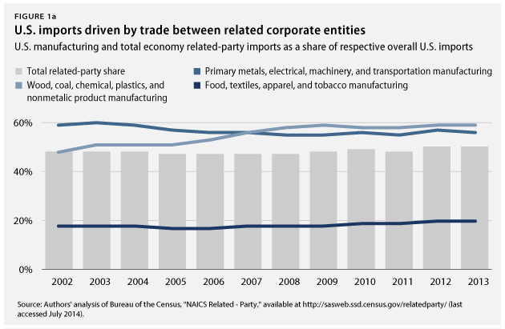
Facts about OS
Notes:
Source: Hersh and Gurwitz, “Offshoring Work Is Taking a Toll on the U.S. Economy,” Center for American Progress, July 30, 2014.
https://www.americanprogress.org/issues/economy/news/2014/07/30/94864/offshoring-work-is-taking-a-toll-on-the-u-s-economy/

Slide 32
Facts about OS
OS is moving into services
There are flows in both directions
Flows out of US are mostly low value jobs
  So far. But Blinder worries, & he sees threats to higher value jobs

Slide 33
Facts about OS
Brainard and Litan say OS is not shifting the proportion of incomes more towards profits
  See graph below

Slide 34
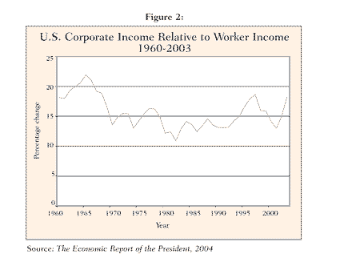

Slide 35
Facts about OS
Brainard and Litan say OS is not shifting the proportion of incomes more towards profits
  See graph below
  Other data (below) show that labor’s share
    Has declined in recent decades
    Increased in the crisis, as profits fell
    Then fell in recession

Slide 36
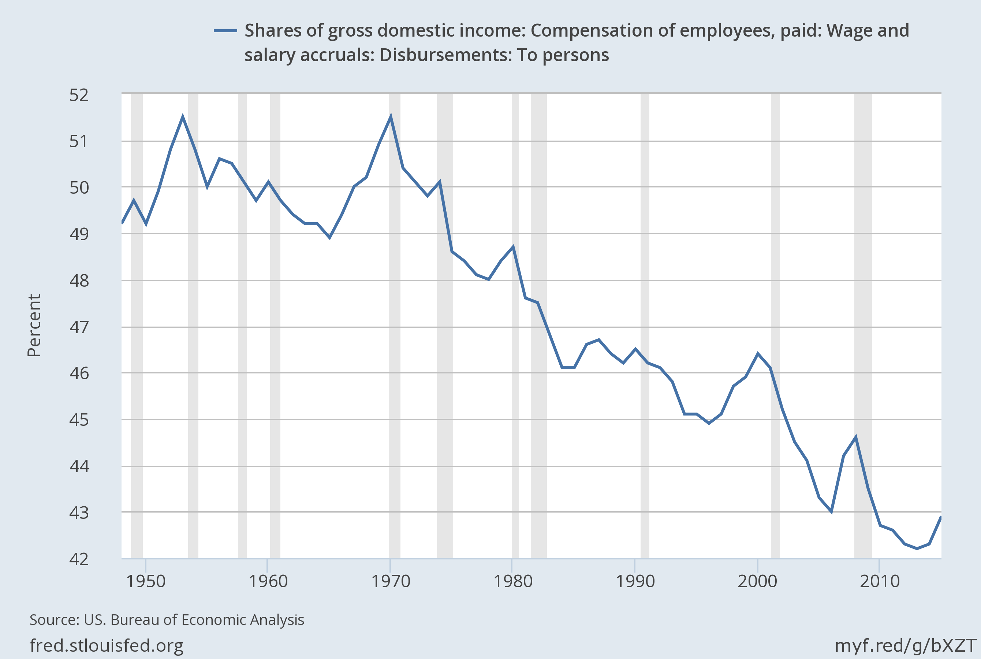
Notes:
Source: https://fred.stlouisfed.org/series/W270RE1A156NBEA#0

Slide 37
Adjusted labour income share in developed G20 countries, 1991–2013
Notes:
Source: Global Wage Report 2014/15: International Labour Organization, 2015. Figure 10
(Report for 2016/17 doesn’t have this. Only four such graphs, separately, for China, Mexico, Portugal, and US.)

Slide 38
Tom Friedman’s View of OS
Tom Friedman (author of The World Is Flat)
CEOs no longer think of outsourcing (or offshoring) at all, because
  They don’t think of “in” or “out”
  Things are “Made in the World”
  They produce “anywhere through global supply chains “

Slide 39
Tom Friedman’s View of OS
Friedman thinks the US has advantages that will let us prosper in this new world:
  protection for intellectual property
  secure capital markets
  government funding for science
  strength in logistics (FedEx, UPS)

Slide 40
Facts about OS
Recently, some offshoring has been reversing (see Economist):
  Some companies are bringing operations back to the US
  Called “reshoring”

Slide 41
Facts about OS
Examples of reshoring
  General Electric has “returned production of fridges, washing machines and heaters from China back to Kentucky.”
  Lenovo is starting to make PCs in North Carolina
  GM is shifting its IT back to Detroit
  Apple is making some Macs in the US

Slide 42
Facts about OS
Reasons for reshoring
  China’s cost advantage is shrinking due to
    Rising wages
    Appreciating currency (until recently)
  Increased use of automation (robots) has reduced reliance on labor
  Production abroad is increasingly to serve foreign markets, not to export back to US

Slide 43
Facts about OS
Most recently – see Schuman NYT 2016
  While US did lose jobs to China before 2011, now China itself is losing jobs:
    Due to its slowing economy
    To
      Its neighbors
      Back to the US

Slide 44
Facts about OS
Most recently – see Schuman NYT 2016
  While US did lose jobs to China before 2011, now China itself is losing jobs
  Why?
    Wages in China are 29% higher than 3 years ago
    Wages are lower in
      Vietnam (1/2)
      Bangladesh (1/4)
    Costs in China are now about the same as in US

Slide 45
Facts about OS
Most recently – see Schuman NYT 2016
  While US did lose jobs to China before 2011, now China itself is losing jobs
  Why?
  Where are jobs from China going?
    To neighboring low-wage countries
    Back to US: Survey found 24% of US manufacturers “reshoring” or planning to
    Apple’s manufacturer, Foxconn, is building 12 new factories in India

Slide 46
Clicker Question
What fraction, according to Brainard & Litan writing in 2004, of involuntary unemployment was due to offshoring?
  None. Outsourcing has no effect on employment.
  None. Outsourcing actually causes employment to increase.
  Less than five percent.
  Between ten and twenty percent.
  More than half.
✓

Slide 47
Clicker Question
Why is China now losing jobs instead of gaining them?
  Reshoring.
  Unshoring.
  Offshoring.
  Endshoring.
  Upshoring.
✓

Slide 48
Clicker Question
Which of the following is not one of the reasons that Friedman thinks the US will prosper in the new world of offshoring?
  Protection of intellectual property.
  Low wages.
  Secure capital markets.
  Government funding for science.
  Strength in logistics.
✓

Slide 49
Outline:
Outsourcing and Offshoring
Definitions of OS
Causes of OS
Effects of OS
Facts about OS
Policies

Slide 50
Policies Suggested for OS
Get more data
Expand adjustment assistance
Invest more in education
Require transparency by publicly owned firms.
Remove artificial (i.e., tax) incentives that encourage OS.

Slide 51
Policies Suggested for OS
Trump:
  Provide tax incentives to keep production here (as done in fall 2016 for Carrier)
  Threaten a tax on exports back to US from OS factories
  Good ideas? NO!

Slide 52
A final note on Outsourcing
http://www.youtube.com/watch?v=rYaZ57Bn4pQ

Slide 53
Next Time
(Last Lecture; Next-to-Last Class)
Environment, Labor Standards, and Trade
  The Issues
  Environment
    Examples
    Policies
    International Problems
    Role of the WTO
  Labor Standards
    Fundamental ILO Conventions
    United States Role
    Issues

