Slide 1
Lecture 22 Outsourcing and Offshoring
Econ 340
Notes:
Add Schuman

Slide 2
Outline: Outsourcing and Offshoring
Definitions of OS
Causes of OS
Effects of OS
Facts about OS
Policies

Slide 3
Definitions
Outsourcing = Movement of an activity to outside of firm
(Not necessarily outside country)
Offshoring = Movement of an activity to outside of country
(Not necessarily outside firm)
Could be
Subsidiary abroad (FDI)
Subcontracting with another firm
Arm’s-length trade
Often refers to services
Sometimes called “trade in tasks”

Slide 4
Definitions
Both could be called:
OS = OutSourcing / OffShoring
I’ll use “OS” here to refer only to OffShoring, since that’s the one that is clearly international

Slide 5
Outline: Outsourcing and Offshoring
Definitions of OS
Causes of OS
Effects of OS
Facts about OS
Policies

Slide 6
Causes of OS
Blinder identifies two causes of the increase in OS over recent decades:
New technologies
Information
Communication
Entry of new populations into world economy
China
India
Former Soviet states
These make OS possible for jobs that can be done at a distance

Slide 7
Causes of OS
Otherwise, causes of OS are same as causes of other trade
Activities are offshored if they can be done more cheaply elsewhere
Thus OS occurs due to
Comparative Advantage
Due to technology differences
Due to factor-endowment differences
Economies of Scale

Slide 8
Outline: Outsourcing and Offshoring
Definitions of OS
Causes of OS
Effects of OS
Facts about OS
Policies

Slide 9
Effects of OS
Disagreements
Bivens (not assigned), like other trade skeptics,
is largely negative
He defines offshoring as “substituting foreign for domestic labor”
Many mainstream trade economists
see offshoring as ordinary trade
are largely positive
Blinder (a very well-respected macro economist)
sees OS as beneficial overall
but worries about effects on US labor

Slide 10
Effects of OS
Effects that are Like trade:
All of the effects of trade that we have studied, are valid for this. OS is trade.
Thus
Countries as a whole gain, due to comparative advantage, economies of scale, etc.
Some people within the countries lose – especially those whose jobs are lost
Theory says that “scarce factors” are hurt by trade, and thus also by offshoring.

Slide 11
Effects of OS
Effects that are Unlike trade
i.e., effects that don’t occur with other trade, or at least weren’t mentioned
Increased insecurity: workers feel more threatened
New groups (white collar, in high-income countries) are seeing the threat
Employers can “move jobs”; workers can’t
Thus employers gain in bargaining over wages

Slide 12
Effects of OS
Effects that are Unlike trade
(Possible) loss of technological advantage
Poor countries acquire the knowledge that rich countries previously had exclusively.
Thus
Poor countries become more productive
Their incomes rise
Therefore OS helps economic development

Slide 13
Effects of OS
Effects that are Unlike trade
(Possible) loss of technological advantage
Terms of trade of rich countries worsen, costing them some of their gains from trade
Thus rich countries may lose from the loss of exclusive technologies due to OS
But what they are losing are the gains from trade. Refusing to trade would only make things worse.

Slide 14
Effects of OS
OS from US may create jobs in US
OS can make a firm or industry viable that would not have been viable without OS
Example: US software company, IMC.
(IMC = Information Management Consultants. Makes software to exploit human genome research.)
Became viable only with coding done in India.
Later it employed six engineers in the US for every one in India.
Notes:
Source of IMC examples: Bhagwati et al., not assigned

Slide 15
Effects of OS
OS raises productivity (see Amiti and Wei)
They estimated the causes of US productivity growth over 1992-2000
11% of it was due to “service offshoring”
Only 3-6% was due to imported material inputs
Why the gain? Because firms choose to offshore the less efficient parts of what they do.

Slide 16
Effects of OS
OS threatens some occupations more than others (see Blinder’s examples)
Offshorable | Not offshorable
electronic service | personal service jobs
tax accounting | onsite auditing
computer programming | computer repair
architects | builders
radiology | pediatrics and geriatrics
lawyers who write contracts | litigators who argue cases in court

Slide 17
Outline: Outsourcing and Offshoring
Definitions of OS
Causes of OS
Effects of OS
Facts about OS
Policies

Slide 18
Facts about OS
Blinder estimates that 30-40 million US jobs are potentially offshorable.
Compare to civilian employment in Jun 2008: 145.9 million
So Blinder is estimating that up to a quarter of US employment is potentially threatened by offshoring
Thus it “rattles” him

Slide 19
Facts about OS
But the actual amount is still relatively small
Brainard and Litan say OS accounts for only 2% of those who involuntarily lose their jobs. (It would be a much smaller share of all job turnover)
But they were writing in 2004
One more recent source, though critical of OS, seems to give an even smaller estimate.
Notes:
“recent source” is Peralta, “Outsourcing to China Cost U.S. 3.2 Million Jobs Since 2001, US News, Dec 11, 2014.

Slide 20
Facts about OS
Another source, also critical of offshoring, shows the chart on the next slide
Their point is that a lot of US imports (about 50%) is related party trade, and thus OS
But the chart does not show much growth since the data of Brainard and Litan
Notes:
“recent source” is Peralta, “Outsourcing to China Cost U.S. 3.2 Million Jobs Since 2001, US News, Dec 11, 2014.

Slide 21
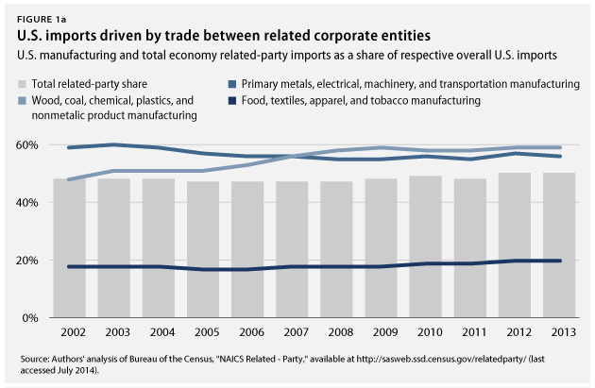
Facts about OS
Notes:
Source: Hersh and Gurwitz, “Offshoring Work Is Taking a Toll on the U.S. Economy,” Center for American Progress, July 30, 2014.
https://www.americanprogress.org/issues/economy/news/2014/07/30/94864/offshoring-work-is-taking-a-toll-on-the-u-s-economy/

Slide 22
Facts about OS
OS is moving into services
There are flows in both directions
Flows out of US are mostly low value jobs
So far. But Blinder worries & sees threats to higher value jobs

Slide 23
Facts about OS
Brainard and Litan say OS is not shifting the proportion of incomes more towards profits
See graph below

Slide 24
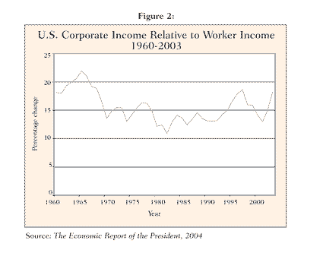

Slide 25
Facts about OS
Brainard and Litan say OS is not shifting the proportion of incomes more towards profits
See graph below
Other data (below) show that labor’s share
Has declined in recent decades
Increased in the crisis, as profits fell
Then fell in recession

Slide 26
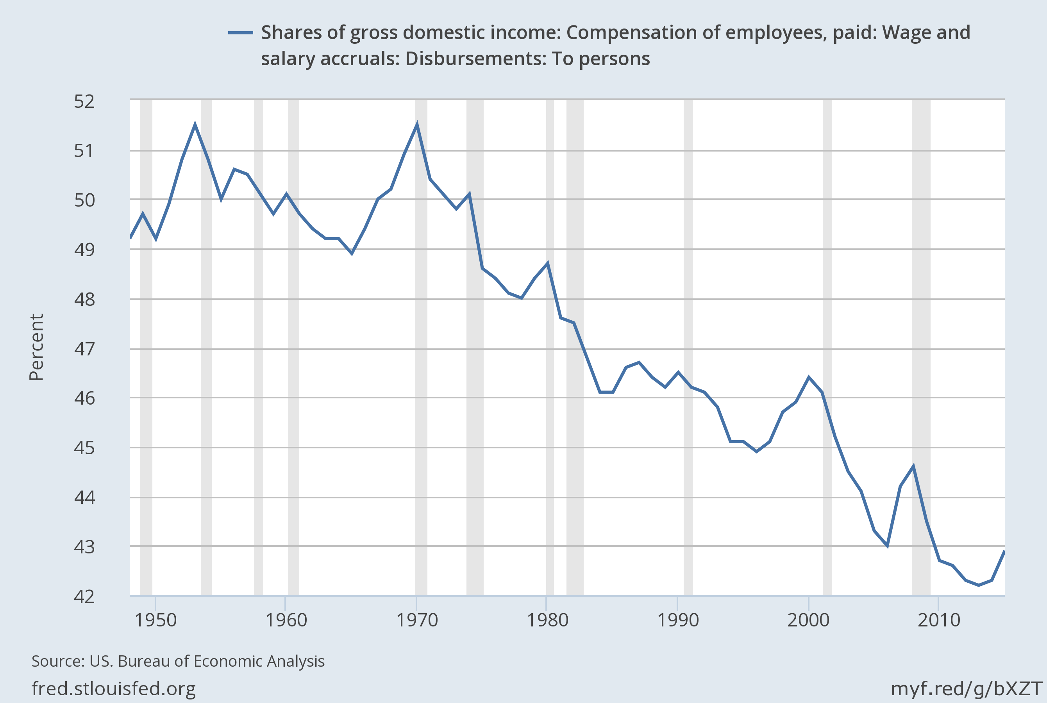
Notes:
Source: https://fred.stlouisfed.org/series/W270RE1A156NBEA#0

Slide 27
Adjusted labour income share in developed G20 countries, 1991–2013
Notes:
Source: Global Wage Report 2014/15: International Labour Organization, 2015. Figure 10
(Report for 2016/17 doesn’t have this. Only four such graphs, separately, for China, Mexico, Portugal, and US.)

Slide 28
Tom Friedman’s View of OS
Tom Friedman (author of The World Is Flat)
CEOs no longer think of outsourcing (or offshoring) at all, because
They don’t think of “in” or “out”
Things are “Made in the World”
They produce “anywhere through global supply chains “

Slide 29
Tom Friedman’s View of OS
Friedman thinks the US has advantages that will let us prosper in this new world:
protection for intellectual property
secure capital markets
government funding for science
strength in logistics (FedEx, UPS)

Slide 30
Facts about OS
Recently, some offshoring has been reversing (see Economist):
Some companies are bringing operations back to the US
Called “reshoring”

Slide 31
Facts about OS
Examples of reshoring
General Electric has “returned production of fridges, washing machines and heaters from China back to Kentucky.”
Lenovo is starting to make PCs in North Carolina
GM is shifting its IT back to Detroit
Apple is making some Macs in the US

Slide 32
Facts about OS
Reasons for reshoring
China’s cost advantage is shrinking due to
Rising wages
Appreciating currency (until recently)
Increased use of automation (robots) has reduced reliance on labor
Production abroad is increasingly to serve foreign markets, not to export back to US

Slide 33
Facts about OS
Most recently – see Schuman NYT 2016
While US did lose jobs to China before 2011, now China itself is losing jobs:
Due to its slowing economy
To
Its neighbors
Back to the US

Slide 34
Facts about OS
Most recently – see Schuman NYT 2016
While US did lose jobs to China before 2011, now China itself is losing jobs
Why?
Wages in China are 29% higher than 3 years ago
Wages are lower in
Vietnam (1/2)
Bangladesh (1/4)
Costs in China are now about the same as in US

Slide 35
Facts about OS
Most recently – see Schuman NYT 2016
While US did lose jobs to China before 2011, now China itself is losing jobs
Why?
Where are jobs from China going?
To neighboring low-wage countries
Back to US: Survey found 24% of US manufacturers “reshoring” or planning to
Apple’s manufacturer, Foxconn, is building 12 new factories in India

Slide 36
Outline: Outsourcing and Offshoring
Definitions of OS
Causes of OS
Effects of OS
Facts about OS
Policies

Slide 37
Policies Suggested for OS
Get more data
Expand adjustment assistance
Invest more in education
Require transparency by publicly owned firms.
Remove artificial (i.e., tax) incentives that encourage OS.

Slide 38
Policies Suggested for OS
Trump:
Provide tax incentives to keep production here (as done in fall 2016 for Carrier)
Threaten a tax on exports back to US from OS factories
Good ideas? NO!

Slide 39
A final note on Outsourcing
http://www.youtube.com/watch?v=rYaZ57Bn4pQ

Slide 40
Next Time (Last Lecture; Next-to-Last Class)
Environment, Labor Standards, and Trade
The Issues
Environment
Examples
Policies
International Problems
Role of the WTO
Labor Standards
Fundamental ILO Conventions
United States Role
Issues

