Slide 1
Lecture 19
International Policies for Economic Development: Trade
Econ 340

Slide 2
Outline: International Policies for Economic Development: Trade
The Main Issues of Development
The Washington Consensus
Special Problems of Developing Countries
Pros and Cons of Tariffs Used by Developing Countries
  The Infant Industry Argument
  Primary-Product Specialization
  Growth and Exports / Import Substitution
Pros and Cons of Subsidies Used by Developed Countries
Policy Recommendations

Slide 3
Outline: International Policies for Economic Development: Trade
The Main Issues of Development
The Washington Consensus
Special Problems of Developing Countries
Pros and Cons of Tariffs Used by Developing Countries
  The Infant Industry Argument
  Primary-Product Specialization
  Growth and Exports / Import Substitution
Pros and Cons of Subsidies Used by Developed Countries
Policy Recommendations

Slide 4
The Issues
The Two Main Issues:
  Should developing countries be open to international trade?
  Should developing countries be open to international capital movements?
  (both financial and FDI)
Answers are not easy and obvious
  Even though the standard advice of IMF, World Bank and most economists today is:
  YES to both

Slide 5
Outline: International Policies for Economic Development: Trade
The Main Issues of Development
The Washington Consensus
Special Problems of Developing Countries
Pros and Cons of Tariffs Used by Developing Countries
  The Infant Industry Argument
  Primary-Product Specialization
  Growth and Exports / Import Substitution
Pros and Cons of Subsidies Used by Developed Countries
Policy Recommendations

Slide 6
The Washington Consensus
This is a list of policies and institutions that were said to be pushed upon developing countries by
  The IMF
  The World Bank
  United States agencies that deal with developing countries
    USAID (US Agency for International Development)
    US Treasury Department
The name “Washington Consensus” was coined by economist John Williamson in 1989
  He intended it “to refer to the lowest common denominator of policy advice being addressed by the Washington-based institutions to Latin American countries as of 1989.”

Slide 7
The Washington Consensus:
The Policies
Fiscal Discipline
  Don’t spend too much
Public Expenditure Priorities
  Spend intelligently
Tax Reform
  Lower marginal tax rates and broaden tax base
Financial Liberalization
  Allow financial markets to function competitively
Exchange Rates
  Have a competitive (not overvalued) exchange rate

Slide 8
The Washington Consensus:
The Policies
Trade Liberalization
  Reduce tariffs and NTBs
Foreign Direct Investment
  Let it in
Privatization
  Turn state-owned enterprises into private firms
Deregulation
  Remove unnecessary regulation of industries
Property Rights
  Define and enforce clear property rights

Slide 9
Outline: International Policies for Economic Development: Trade
The Main Issues of Development
The Washington Consensus
Special Problems of Developing Countries
Pros and Cons of Tariffs Used by Developing Countries
  The Infant Industry Argument
  Primary-Product Specialization
  Growth and Exports / Import Substitution
Pros and Cons of Subsidies Used by Developed Countries
Policy Recommendations

Slide 10
Special Problems of Developing Countries
First, what to call developing countries
  “LDCs” used to be = Less Developed Countries
  “LDCs” now also = “Least Developed Countries”
    Poorest of the poor
    On a list of 47 at the United Nations (as of November 2018)
  Developing Countries (a more optimistic name)
  LICs = Low Income Countries (vs. MICs, HICs = Middle, High Income Countries)
  Third World (slightly obsolete)
  (Used to be called “backward” countries)

Slide 11
Special Problems of Developing Countries
The defining and most basic problem of developing countries: Low per capita income (low GDP per person)
  Compared to US in 1990
  (the data I happen to have)
  real per capita incomes were only
    7% in China, India, Pakistan, Bangladesh
    Even less in much of Africa
    Less than 15% in Brazil, Turkey, Thailand, etc
  There were hardly any countries in the “middle,” between the poorest and Europe/US

Slide 12
China (1134) + India (850)
Chart 4:
1990 Population Distribution of Per Capita National Income
Excluding China and India
350
Pakistan (112)
Bangladesh (108)
300
Indonesia (178)
US
(250)
250
Iran (56)
France (57)
200
Nigeria (96)
Thailand (56)
Japan (124)
Turkey (56)
W. Germany (63)
1990 Population, Millions
Brazil (149)
150
100
Mexico (82)
UK
(57)
Philippines (61)
Italy (58)
50
0
1
3
5
7
9
11
13
15
17
19
21
23
25
27
29
31
33
35
37
39
41
43
45
47
49
2-Percentiles of 1990 Per Capita National Income

Slide 13
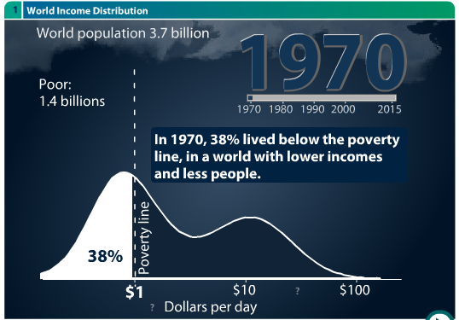
Data from Gapminder.org

Slide 14
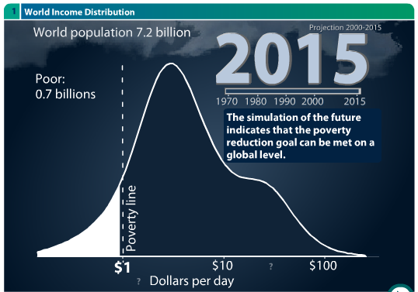
Data from Gapminder.org

Slide 15
Special Problems of Developing Countries
Developing countries tend not to have
  Physical Capital
  Technology
  Human Capital
  Infrastructure
  Markets (especially markets for capital)

Slide 16
Special Problems of Developing Countries
Developing countries also tend not to have
  “Economic Freedoms”
    Rule of law (property, contracts)
    Sound money
    Open markets
    Transparent & accountable government regulations

Slide 17
Special Problems of Developing Countries
Developing countries do not have enough
  “Intangible Capital ” (See Bailey)
    Combines human capital and value of institutions
    Components:
      trust among people in a society
      efficient judicial system
      clear property rights
      effective government
    Contributions to explaining intangible capital:
      Rule of law 57%
      Education 36%

Slide 18
Special Problems of Developing Countries
Developing countries do tend to have
  Overpopulation
  Poor health and sanitation
  Corruption

Slide 19
Outline: International Policies for Economic Development: Trade
The Main Issues of Development
The Washington Consensus
Special Problems of Developing Countries
Pros and Cons of Tariffs Used by Developing Countries
  The Infant Industry Argument
  Primary-Product Specialization
  Growth and Exports / Import Substitution
Pros and Cons of Subsidies Used by Developed Countries
Policy Recommendations

Slide 20
Pros and Cons of Tariffs Used by Developing countries
Con: Same advantages of free trade as for developed countries
  Efficiency gains from exploiting comparative advantage
  Improved competition, variety, scale economies, productivity
  Trade may promote growth through exports
Pro: Developing countries are “behind” and therefore “can’t compete”

Slide 21
Outline: International Policies for Economic Development: Trade
The Main Issues of Development
The Washington Consensus
Special Problems of Developing Countries
Pros and Cons of Tariffs Used by Developing Countries
  The Infant Industry Argument
  Primary-Product Specialization
  Growth and Exports / Import Substitution
Pros and Cons of Subsidies Used by Developed Countries
Policy Recommendations

Slide 22
Infant Industry Argument
The argument
  Developing country firms
    lack experience,
    thus are not productive,
    therefore cannot survive in world markets
  So they need protection in order to
    give them time gain experience and to learn
    to become more productive and competitive

Slide 23
Infant Industry Argument
Is it valid?
  Yes, when there really is “learning by doing”
  AND if capital markets are imperfect
    Otherwise firms could borrow to cover their losses while they become competitive (just as firms in developed countries routinely do)
  OR if the learning accrues to workers who then
    Leave their firms
    And become competitors

Slide 24
Infant Industry Argument
Problems (even if these conditions are met)
  Protection should be temporary
    But that’s very hard to do
    Protected industries don’t willingly give it up
  Protection is second best
    It would be more efficient (and thus better for country) to use a more direct policy instead of a tariff:
      Subsidize production
      Subsidize loans

Slide 25
Infant Industry Argument
Domestic Market in LDC
Example
  Suppose that costs are so high that, at world price P_{W}, country does not produce at all.
  So with free trade, Q=0.
  But that by sustaining production at Q₀ for 3 years …
P
S⁰
P_{W}
D
Q₀
Q

Slide 26
Infant Industry Argument
Domestic Market in LDC
Example
  … by sustaining production at Q₀ for 3 years,
  Costs will fall from S⁰ to S¹ for 30 years
P
S⁰
S¹
P_{W}
D
Q₀
Q

Slide 27
Infant Industry Argument
Domestic Market in LDC
Example
  By raising price to P₁ using a tariff t for 3 years
  Output is Q₀ for 3 years
  and then, because S shifts down, output is Q₁ for 30 years
P
S⁰
P₁
S¹
t
P_{W}
D
Q₀
Q₁
Q

Slide 28
Infant Industry Argument
Domestic Market in LDC
Example
  Cost: Usual Dead Weight Loss from tariff for 3 years
  Benefit: Producer surplus for 30 years
  Combination of these may be positive
P
S⁰
P₁
S¹
t
P_{W}
D
Q₀
Q₁
Q

Slide 29
Infant Industry Argument
Domestic Market in LDC
Example
  But subsidy s=t achieves same result without raising price to demanders
  Thus cost is smaller but benefit is the same
P
S⁰
P₁
S¹
s
P_{W}
D
Q₀
Q₁
Q

Slide 30
Outline: International Policies for Economic Development: Trade
The Main Issues of Development
The Washington Consensus
Special Problems of Developing Countries
Pros and Cons of Tariffs Used by Developing Countries
  The Infant Industry Argument
  Primary-Product Specialization
  Growth and Exports / Import Substitution
Pros and Cons of Subsidies Used by Developed Countries
Policy Recommendations

Slide 31
Other Objections to Free Trade in Developing Countries
Countries are forced by trade (comparative advantage) to specialize in Primary Products
  These are (it is argued)
    Low-tech (thus no future)
    Competitive (thus no profit)
    Subject to competition from synthetic substitutes
    Of low “demand elasticity”
      Unclear what this means, but presumably income elasticity
        So that demand rises little as world income rises
      Claimed implication: demand rises less rapidly than demand for manufactures

Slide 32
Other Objections to Free Trade in Developing Countries
Countries are forced by trade to specialize in Primary Products
  Supposed conclusion: Declining Terms of Trade
    This has sometimes been true, but not always
    Primary product prices rose in middle 2008
    Prices have fallen since then
    Overall, it does look like primary product prices do tend to fall over time

Slide 33
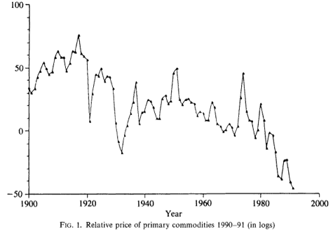
Notes:
Source: Bleaney, Michael and David Greenaway, “Long-Run Trends in the Relative Price of Primary Commodities and in the Terms of Trade of Developing Countries,” Oxford Economic Papers, New Series, Vol. 45, No. 3 (Jul., 1993), pp. 349-363.

Slide 34
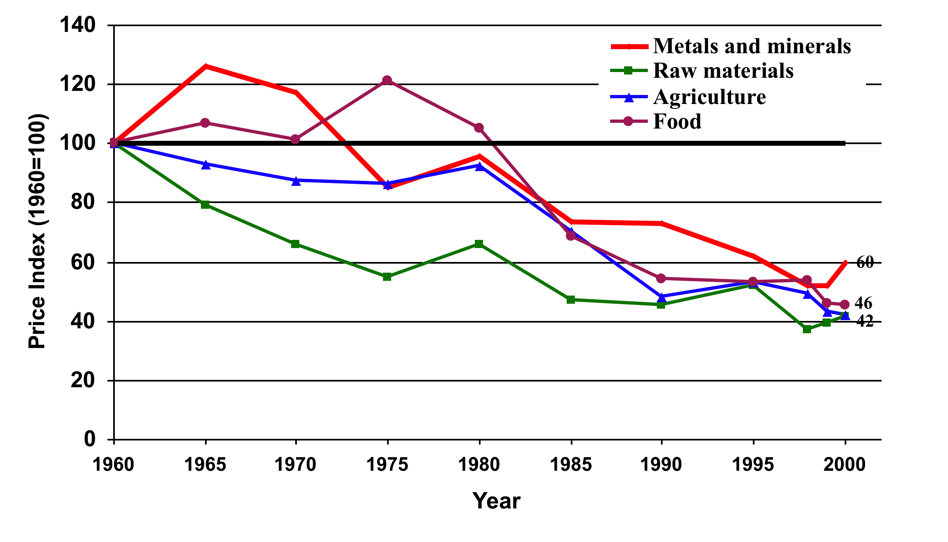
World Commodity Prices, 1960-2000
(Index, 1960=100, 3-year moving averages)
Source: World Bank, World Development Indicators, 2001
Notes:
From David Lam’s 534 lecture 2

Slide 35
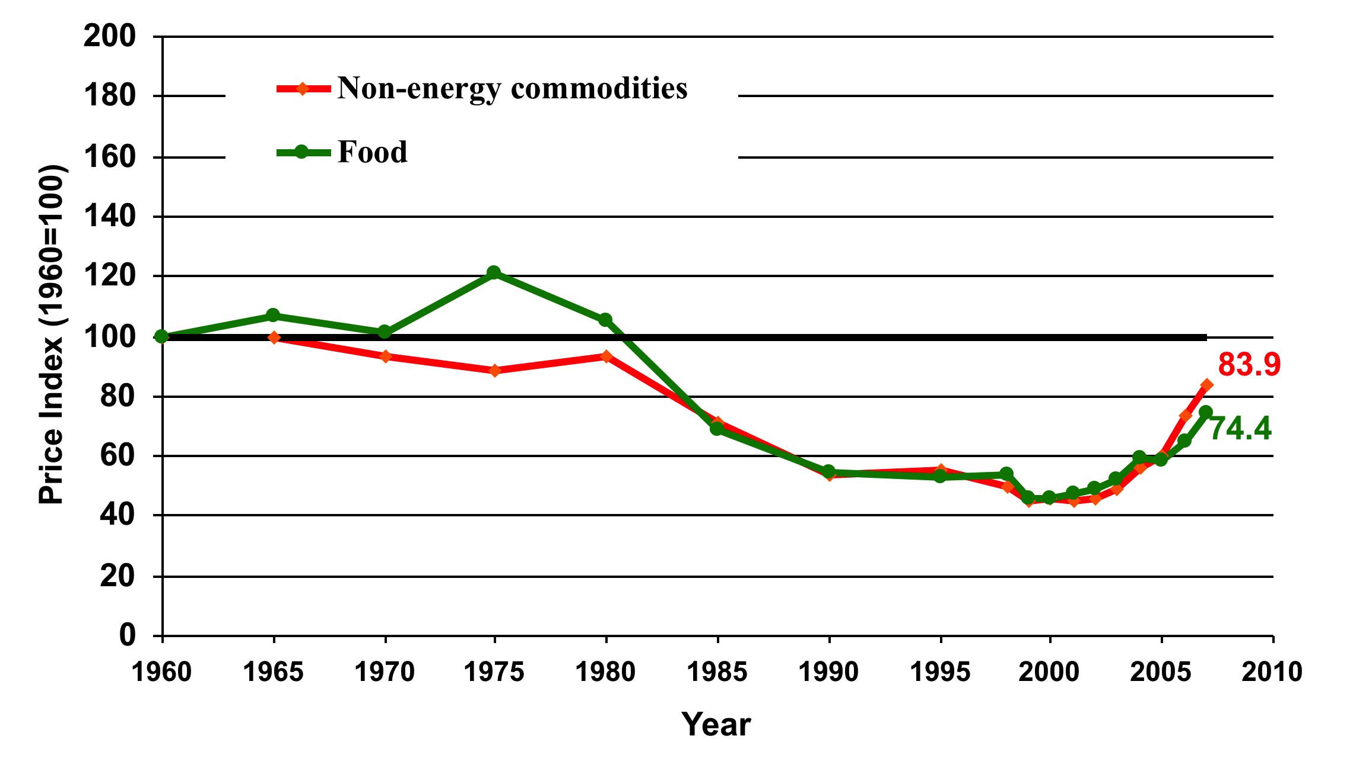
Petroleum and Non-energy Commodity Prices,1960-2007
(Index, 1960=100)
Source: World Bank, World Development Indicators, 2001; IMF commodity prices

Slide 36
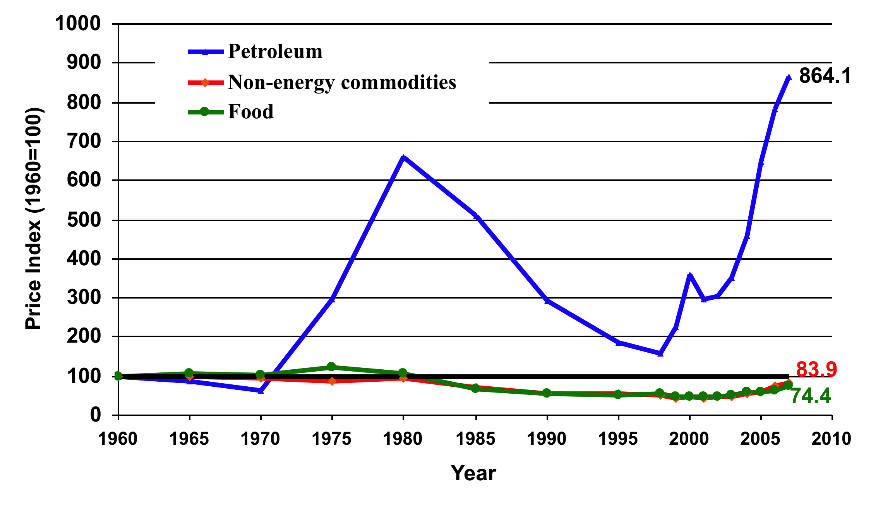
Petroleum and Non-energy Commodity Prices,1960-2007
(Index, 1960=100)
Source: World Bank, World Development Indicators, 2001; IMF commodity prices

Slide 37
Outline: International Policies for Economic Development: Trade
The Main Issues of Development
The Washington Consensus
Special Problems of Developing Countries
Pros and Cons of Tariffs Used by Developing Countries
  The Infant Industry Argument
  Primary-Product Specialization
  Growth and Exports / Import Substitution
Pros and Cons of Subsidies Used by Developed Countries
Policy Recommendations

Slide 38
Exports and Growth
How exports may help growth
  Economies of scale: Produce for world market to achieve higher scale
  Stimulate adoption of international best-practice technologies
    Not necessary for firms protected by tariff
  Finance imports of higher-tech capital goods
  Encourage inward FDI to produce for export – bringing capital and technology

Slide 39
Track Record of Import Substitution
In 1950s, two opposing strategies were perceived:
  “Import Substitution”: Use tariffs and NTBs to protect industries, substituting for imports
  “Export Promotion”: Free trade and other policies to encourage exports
Most developing countries, and their economist advisors, favored Import Substitution

Slide 40
Track Record of Import Substitution
Early examples of Import Substitution
  That did well
    United States in 19th century
    Japan after World War II
  That did poorly
    India
    South America

Slide 41
Track Record of Import Substitution
Examples of Export Promotion
  The “Four Tigers” all did well
    Hong Kong
    South Korea
    Taiwan
    Singapore
  Later examples did well until crisis of 1997:
    Thailand
    Indonesia
    Philippines
    …
And most recovered rapidly after 1997.

Slide 42
Outline: International Policies for Economic Development: Trade
The Main Issues of Development
The Washington Consensus
Special Problems of Developing Countries
Pros and Cons of Tariffs Used by Developing Countries
  The Infant Industry Argument
  Primary-Product Specialization
  Growth and Exports / Import Substitution
Pros and Cons of Subsidies Used by Developed Countries
Policy Recommendations

Slide 43
Pros and Cons of Subsidies Used by Developed Countries
Many developed countries subsidize agriculture
  Economists agree that this usually hurts them more than it benefits their own farmers
  But the issue here: How does it affect developing countries?
  Examples
    US and EU
    Cotton, Sugar

Slide 44
Pros and Cons of Subsidies Used by Developed Countries
Foreign Effects of Subsidies: Recall from Lecture 6 on Nontariff Barriers
  Export subsidies
    Push down world prices,
    and thus
    Help foreign consumers
    Hurt foreign competing producers
    Help other countries that are net importers
    Hurt other countries that are net exporters
  Production subsidies have the same effects abroad as export subsidies

Slide 45
Pros and Cons of Subsidies Used by Developed Countries
Cotton Subsidies
  Countries whose exports were more than 50% cotton in 2001 (& GDP/capita 2005):
    Benin ($1100)
    Burkina Faso ($1200)
    Chad ($1400)
    Mali ($1200)
    Togo ($1600)

Slide 46
Pros and Cons of Subsidies Used by Developed Countries
Cotton Subsidies (See FAO)
  Costs of production in West Africa are among the lowest in the world
  Costs in US are 3 times higher than Africa
  US cotton farmers get about $4 billion a year in subsidies
  From 1998 to 2001,
    US cotton production grew 40%
    US cotton exports doubled
    World cotton prices fell to record lows

Slide 47
Pros and Cons of Subsidies Used by Developed Countries
Africa opposes US and EU farm subsidies
  Cotton is just one example
  Rich-country subsidies in many products hurt poor farmers throughout Africa
  It was African countries, especially cotton exporters, who derailed the Doha Round negotiations in Cancun

Slide 48
Pros and Cons of Subsidies Used by Developed Countries
But it’s not that simple: Consumers benefit from subsidies
  Many developing countries are primarily consumers, not producers, of many subsidized agricultural products
  The poor in these countries will be hurt if subsidies are removed (See Baker)

Slide 49
Outline: International Policies for Economic Development: Trade
The Main Issues of Development
The Washington Consensus
Special Problems of Developing Countries
Pros and Cons of Tariffs Used by Developing Countries
  The Infant Industry Argument
  Primary-Product Specialization
  Growth and Exports / Import Substitution
Pros and Cons of Subsidies Used by Developed Countries
Policy Recommendations

Slide 50
Policy Recommendations to Assist Developing Countries
Developed countries:
  Remove tariffs on developing country exports
    See Copenhagen Consensus
      Completing the Doha Round would have done this and more
      High on their list of policies because costs are political, not economic
    But some say gain is small (See Baker)

Slide 51
Policy Recommendations to Assist Developing Countries
Developed countries:
  Remove subsidies?
    Most developing countries want this
    But need to watch out for developing country consumers of subsidized products

Slide 52
Policy Recommendations to Assist Developing Countries
Developing countries:
  Reduce tariffs?
    Yes, in most cases
    Possible exceptions: infant industries, if conditions are met and subsidy not available
  Subsidize exports?
    Not clear
    Countries that did this successfully were usually just offsetting overvalued exchange rate

Slide 53
Policy Recommendations to Assist Developing Countries
Other trade-related policy recommendations:
  Curtail Anti-Dumping
    See Prusa on spread of AD to developing countries
  Relax intellectual property protection
    WTO TRIPs Agreement hurts developing countries (See Baker)
    Need more flexibility to assist them

Slide 54
Next Time
International Policies for Economic Development: Financial
  Choice of Exchange Rate Regime
  Pros and Cons of Free Capital Movements and Capital Controls
  (How) Should Others Help?

