Slide 1
Lecture 18 Preferential Trading Arrangements and the NAFTA
Econ 340
Notes:
Delete Kanter-Jolly
Add Villarreal & Fergusson, Brown

Slide 2
Outline: Preferential Trading Arrangements and the NAFTA
What Are PTAs?
Examples
European Union (EU)
North American Free Trade Agreement (NAFTA)
Effects of PTAs
Not the Same as Free Trade
Trade Creation
Trade Diversion
Market Diagram Illustration
NAFTA
History
Analysis
What Happened?
NAFTA Renegotiation and USMCA

Slide 3
What Are PTAs?
A Preferential Trading Arrangement (PTA) is a trade policy that favors one country over another
Most obvious cases: Charge a lower, or zero, tariff on imports from one country while charging a higher tariff on imports from another
Also called a Regional Trade Agreement (RTA – the term used by the Gerber textbook and by the WTO) when a group of countries in a region do this with each other
Term is used even when the countries are not near each other

Slide 4
What Are PTAs?
In WTO (and GATT), the MFN principle would prohibit this
All members are supposed to be charged a country’s MFN (Most Favored Nation) tariff
However, some exceptions are explicitly permitted in rules of GATT & WTO

Slide 5
Outline: Preferential Trading Arrangements and the NAFTA
What Are PTAs?
Examples
European Union (EU)
North American Free Trade Agreement (NAFTA)
Effects of PTAs
Not the Same as Free Trade
Trade Creation
Trade Diversion
Market Diagram Illustration
NAFTA
History
Analysis
What Happened?
NAFTA Renegotiation and USMCA

Slide 6
Examples of Legal PTAs
Permitted by WTO:
Free Trade Areas (FTAs)
Members have zero tariffs against each other on essentially everything (also Customs Unions and Common Markets, which include FTAs)
GSP = Generalized System of Preferences
Developed countries have lower (not usually zero) tariffs on some goods from developing countries

Slide 7
Examples of Legal PTAs
Permitted by WTO:
Also
Anti Dumping Duties (higher tariff against some than against others)
Countervailing Duties (ditto)
Note: “safeguards” tariffs are also permitted,
But they are not normally PTAs; they are supposed to be nondiscriminatory

Slide 8
Examples of PTAs
Variations on FTAs
FTA:
Two or more countries set zero tariffs on all (or almost all) imports from each other
Keeping their old (presumably different) tariffs against outside countries
Must include “rules of origin” (ROOs)
ROO = criteria that must be met, regarding location of production, for a good to cross a border tariff-free within the FTA
Otherwise, all trade would enter through lowest-tariff country

Slide 9
Examples of PTAs
Variations on FTAs
Customs Union (CU)
= FTA + Common External Tariffs (on each good)
(no need for ROOs)
Common Market
= CU + free movement of factors (capital and labor) among members

Slide 10
Examples of PTAs
European Union (EU)
A Customs Union
Originally among 6 countries (France, Germany, Italy, Belgium, Netherlands, Luxembourg)
Called, then, the “European Economic Community” (EEC)
Later
Became a Common Market
Grew intermittently to 15 countries
then, to 25 in 2004, to 27 in 2007
and, in 2013, to 28 (adding Croatia)
Changed name
First to “European Community” (EC)
Then later to “European Union”

Slide 11
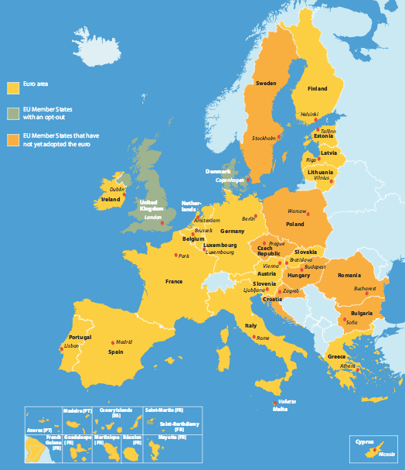
EU Members
Austria
Belgium Bulgaria Croatia Czech Repub.
Cyprus Denmark
Estonia
Finland
France
Germany
Greece Hungary
Ireland
Italy
Latvia
Lithuania
Luxembourg
Malta
Netherlands Poland
Portugal Romania
Slovakia
Slovenia
Spain Sweden U.K.
Notes:
http://europa.eu/european-union/about-eu/money/euro_en

Slide 12
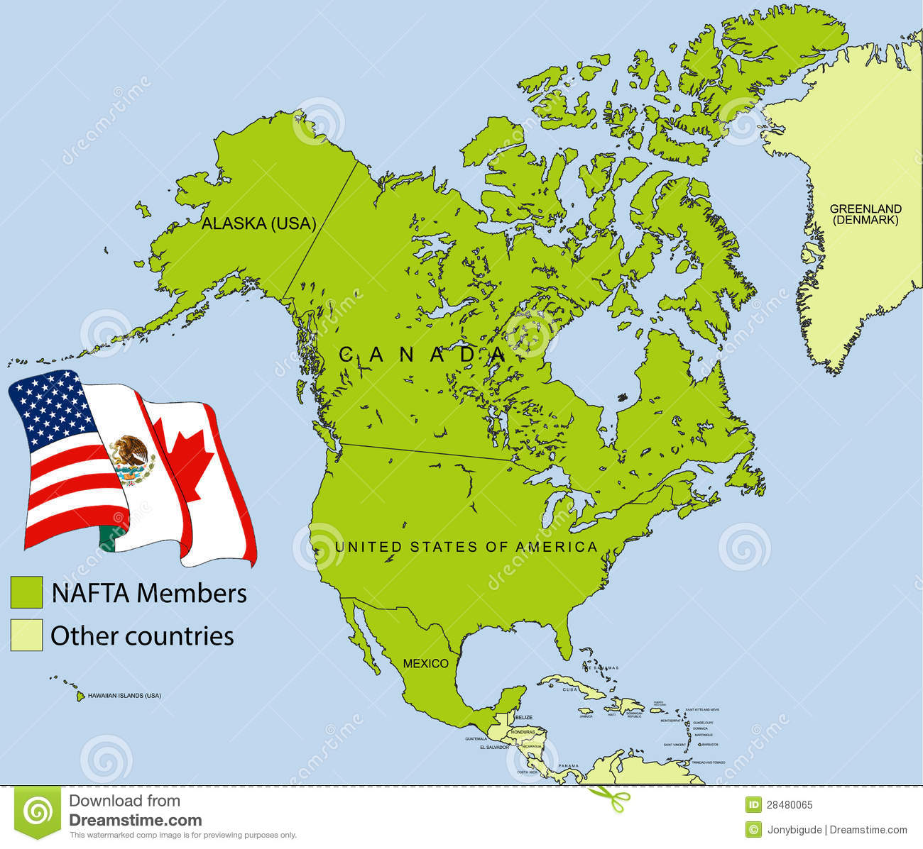
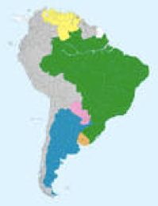
Examples of PTAs
North American Free Trade Area (NAFTA)
US, Canada, Mexico
Started in 1994
More on this later
Mercosur
Customs union in South America
Includes Brazil, Argentina, Paraguay, Uruguay, Venezuela

Slide 13
Examples of PTAs
US also now has smaller FTAs with
Israel (since 1985)
2-country FTAs with Australia, Bahrain, Chile, Jordan, Morocco, Oman, Peru, Singapore
A contentious FTA was CAFTA (Central American Free Trade Agreement), approved 2005
Somewhat recently, 3 more (Colombia, Panama, and S. Korea)
Negotiated 2007
Approved late 2011
Went into effect in 2012
US was to be part of TPP under Obama, but no longer.
There are more than 400 FTAs and similar arrangements that have been notified to the WTO

Slide 14
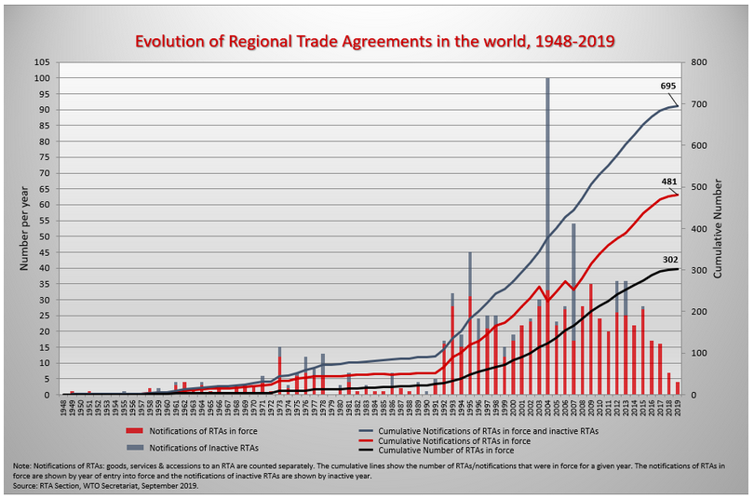
Regional Trade Agreements (RTAs) Notified to GATT/WTO
Notes:
http://www.wto.org/english/tratop_e/region_e/regfac_e.htm

Slide 22
Outline: Preferential Trading Arrangements and the NAFTA
What Are PTAs?
Examples
European Union (EU)
North American Free Trade Agreement (NAFTA)
Effects of PTAs
Not the Same as Free Trade
Trade Creation
Trade Diversion
Market Diagram Illustration
NAFTA
History
Analysis
What Happened?
NAFTA Renegotiation and USMCA

Slide 23
Effects of PTAs
They are NOT the same as multilateral free trade, when a country eliminates tariffs against all other countries
The name “free trade area” is misleading
It is likely that countries outside a PTA will lose from it
Even the members of the PTA may lose from it!

Slide 24
Effects of PTAs
Two main effects of a PTA
Trade Creation
= Importing from the partner what you would otherwise produce at home
Trade Diversion
= Importing from the partner what you would otherwise import from another (“third”) country

Slide 25
Effects of PTAs
Welfare effects of one country reducing its tariff on a good from a partner country:
Importing country
Gains from trade creation
Loses from trade diversion (we’ll see why shortly)
Partner country gains regardless
Rest of world
Loses from trade diversion
Not much affected by trade creation

Slide 26
Effects of PTAs
Reasons
Trade creation is much like true free trade
At zero tariff, import from partner only if its cost is lower
Thus resources are used more efficiently
Trade diversion is not like true free trade
What was imported from 3rd country, not partner, when both paid the same tariff, must have cost more in the partner than in the 3rd country
Switching to the partner is a switch to a higher cost source for the good

Slide 27
Effects of PTAs
With trade diversion, importing country is paying more for the good
The importing person is not paying more, since the person doesn’t pay a tariff on imports from the partner
But the importing country got to keep the tariff revenue on imports from 3rd countries
Thus the price a person paid on import from 3rd country was higher than the price the country paid

Slide 28
Effects of PTAs
Example
Suppose that, before NAFTA
The US imported sugar subject to a 25% tariff
The cost of sugar was
$8 in Haiti
$9 in Mexico
US sugar importers would pay, with the tariff,
1.25×8=$10.00 from Haiti
1.25×9=$11.25 from Mexico
So they buy from Haiti
The importers pay $10.00
The US government keeps $2.00 of that
So the US as a country pays only $8.00

Slide 29
Effects of PTAs
Example
Now with NAFTA
the tariff on sugar from Mexico becomes zero
US sugar importers would pay,
1.25×8=$10.00 from Haiti
$9.00 from Mexico
So they buy from Mexico
The importers pay $9.00
The US government gets nothing
So the US as a country pays $9.00

Slide 30
Effects of PTAs
EXAMPLE: | Without NAFTA | With NAFTA
a. Price in Haiti | $8 | $8
b. Price in Mexico | $9 | $9
c. Tariff on Haiti | 25% | 25%
d. Tariff on Mexico | 25% | 0%
e. Price from Haiti [(1+c)×a] | $10.00 | $10.00
f. Price from Mexico [(1+d) ×b] | $11.25 | $9.00
g. Imports come from | Haiti | Mexico
h. Importers pay | $10.00 | $9.00
i. Government gets | $2.00 | 0
j. Country’s net cost [h−i] | $8.00 | $9.00
Trade Diversion
US Loss from Trade Diversion

Slide 31
Outline: Preferential Trading Arrangements and the NAFTA
What Are PTAs?
Examples
European Union (EU)
North American Free Trade Agreement (NAFTA)
Effects of PTAs
Not the Same as Free Trade
Trade Creation
Trade Diversion
Market Diagram Illustration
NAFTA
History
Analysis
What Happened?
NAFTA Renegotiation and USMCA

Slide 32
Effects of PTAs
Market-diagram Illustration
Suppose Country A can import a good from either Country B or Country C at prices
P_{C} < P_{B}
And Country A has a tariff greater than the price difference:
t > (P_{B} − P_{C})
What happens when Country A forms a PTA with high-cost Country B, lowering its tariff to zero on imports from Country B?

Slide 33
Effects of PTAs
Before FTA
Market in Country A
P
P_{C}+t < P_{B}+t, so
S^{A}
P_{B}+t
A imports from C
P_{C}+t
With FTA
P_{B}
P_{B}< P_{C}+t, so
P_{C}
A imports from B
D^{A}
Q

Slide 34
Effects of PTAs
Market in Country A
FTA of Country A and Country B:
P
S^{A}
Trade Creation
P_{C}+t
a
c
Welfare effects
Producers lose −a
Consumers gain +(a+b+c+d)
Gov’t loses −(c+e)
Net +(b+d)−e
P_{B}
b
d
e
P_{C}
D^{A}
Q
Trade Diversion

Slide 35
Effects of PTAs
Market in Country A
FTA of Country A and Country B:
P
S^{A}
Trade Creation
P_{C}+t
a
c
Implication:
Country A can lose from the FTA in this market, if
e > (b+d)
(as it is in this picture)
P_{B}
b
d
e
P_{C}
D^{A}
Q
Trade Diversion

Slide 36
Outline: Preferential Trading Arrangements and the NAFTA
What Are PTAs?
Examples
European Union (EU)
North American Free Trade Agreement (NAFTA)
Effects of PTAs
Not the Same as Free Trade
Trade Creation
Trade Diversion
Market Diagram Illustration
NAFTA
History
Analysis
What Happened?
NAFTA Renegotiation and USMCA
Skip this, to slide 68

Slide 37
NAFTA - History
Before NAFTA, US had
US-Canada Auto Pact
Signed 1965
Free trade between US and Canada in cars and car parts
US-Canada FTA
1989
Prompted by
US frustration with multilateral negotiations
Canadian frustration with US AD and CVD policies

Slide 38
NAFTA - History
Before NAFTA,
Mexico had
High tariffs, like most developing countries
Had begun to reduce them in 1980s
Even after reductions, Mexican tariffs were much higher than US tariffs
Maquiladora Arrangements with Mexico
Low tariffs on US imports from Mexico of goods processed there from US inputs
Initially restricted to border region

Slide 39
NAFTA - History
NAFTA Negotiations
Done by Bush (Sr.) administration, 1991-2
Extended US-Canada FTA to include Mexico
Covered many issues in addition to trade
Investment
Intellectual Property
Services
Agreement was reached under Bush, but was not yet approved by Congress before 1993

Slide 40
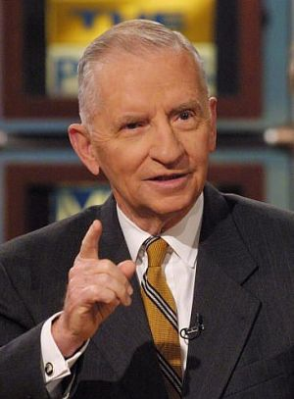
NAFTA - History
NAFTA Debate (around 1992 US election)
Those opposed
Labor unions (feared lost jobs and lower wages)
Some environmental groups (feared dirty industries)
Ross Perot (ran for president)
Feared firms would move to Mexico:
“Great sucking sound”
Some Democrats

Slide 41
NAFTA - History
NAFTA Debate (around 1992 US election)
Those in favor
Bush (Sr.) administration
Clinton (Bill) (but with reservations about labor and environment)
Most of the business community
Most economists (Not all)

Slide 42
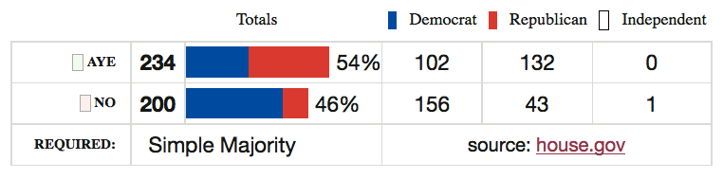
NAFTA - History
After Clinton won election
Clinton negotiated Side Agreements on Labor and Environment
NAFTA was approved (very narrowly) by Congress Nov 1993

Slide 43
NAFTA - History
Jan 1, 1994: NAFTA took effect
What happened?
Not much, at first
Then, almost a year later, the “Peso Crisis”

Slide 44
NAFTA - History
Peso Crisis (also called “Tequila Crisis”)
Mexico’s exchange rate had been pegged
Resisted depreciation during 1994 due to Mexican presidential election in late ‘94
Two assassinations in also 1994 disrupted Mexico
Late 1994 (after Mexican election)
Crisis hit
Peso devalued
Devaluation had devastating effects on the Mexican economy

Slide 45
Outline: Preferential Trading Arrangements and the NAFTA
What Are PTAs?
Examples
European Union (EU)
North American Free Trade Agreement (NAFTA)
Effects of PTAs
Not the Same as Free Trade
Trade Creation
Trade Diversion
Market Diagram Illustration
NAFTA
History
Analysis
What Happened?
NAFTA Renegotiation and USMCA

Slide 46
NAFTA - Analysis
Before NAFTA
Many studies examined likely effects
Some, from both sides of the debate, used spurious analysis to support their views
Example: All imports from Mexico are viewed as costing jobs
On the positive side, advocates of NAFTA did the same with US exports, presumed to rise a lot because of Mexico’s high tariffs
Brown reading notes one study that overstated the benefits and understated the costs

Slide 47
NAFTA - Analysis
Before NAFTA
Best academic studies (including “Michigan Model”) predicted
Positive, but very small, benefit to the US
Negligible disruption of US labor markets
Positive, somewhat larger, benefit to Mexico
Significant disruption in some Mexican markets
Nobody predicted Peso Crisis

Slide 48
NAFTA - Analysis
Reasons for small predicted effects on US
US MFN tariffs were already very low
Much trade with Mexico was already at even lower tariffs, under Maquiladora system
US trade with Mexico was big, but not all that big, compared to size of US economy

Slide 49
NAFTA - Analysis
The issue that raised concern
Mexican wages were only about 1/10 of US wages
Seemed obvious to many (e.g., Ross Perot) that employers would move to Mexico
Answer
Mexican wages were low for a reason: low productivity
If this had not been true, jobs would already have moved, given our already low tariffs

Slide 50
Outline: Preferential Trading Arrangements and the NAFTA
What Are PTAs?
Examples
European Union (EU)
North American Free Trade Agreement (NAFTA)
Effects of PTAs
Not the Same as Free Trade
Trade Creation
Trade Diversion
Market Diagram Illustration
NAFTA
History
Analysis
What Happened?
NAFTA Renegotiation and USMCA

Slide 51
NAFTA – What Happened
Peso Dropped One Year After
NAFTA
Mexico Exchange Rate
Peso Crisis
Quarterly 1988-2004
0.5
0.4
$/peso
0.3
0.2
0.1
0
Q1 1988
Q2 1989
Q3 1990
Q4 1991
Q1 1993
Q2 1994
Q3 1995
Q4 1996
Q1 1998
Q2 1999
Q3 2000
Q4 2001
Q1 2003
Q2 2004
Notes:
Source of data in slide and following: IMF IFS online

Slide 52
NAFTA: What Happened - Mexico Reserves Dropped at Once
NAFTA
Peso Crisis

Slide 53
NAFTA: What Happened - Mexico GDP Fell after Peso Crisis
NAFTA
Mexico Real GDP
Peso Crisis
1993=100
160
140
120
100
80
60
40
20
0
Q1 1988
Q2 1989
Q3 1990
Q4 1991
Q1 1993
Q2 1994
Q3 1995
Q4 1996
Q1 1998
Q2 1999
Q3 2000
Q4 2001
Q1 2003
Q2 2004

Slide 54
NAFTA: What Happened - Mexico Imports Fell after Crisis
NAFTA
Peso Crisis

Slide 55
NAFTA: What Happened - Mexico Wages Fell after Crisis
NAFTA
Peso Crisis

Slide 56
NAFTA: What Happened - Mexico Real Wages Plummeted!
NAFTA
Peso Crisis

Slide 57
NAFTA: What Happened - US Unemployment: No effect (or fell)
NAFTA
Peso Crisis

Slide 58
NAFTA: What Happened - US Trade: Continued growth
NAFTA
Peso Crisis

Slide 59
NAFTA: What Happened - US Real Wage: No Change
NAFTA
Peso Crisis

Slide 60
NAFTA: What Happened Trade Grew, More To US than From
NAFTA
Peso Crisis

Slide 61
NAFTA: What Happened
Skipped to here from slide 43
Posen (see reading) says
“For every 100 jobs US manufacturers created in Mexican manufacturing, they added nearly 250 jobs at their larger US home operations”
Unemployment in US was actually lower after NAFTA than before (until the 2008 financial crisis)
Fears of Mexican farmers crossing border into US haven’t happened:
border apprehensions have fallen since 2000,
as have most estimates of illegal immigration
Critics say NAFTA cost 45,000 jobs a year.
That may be true
But this is only 0.1% of normal job turnover in the US, where 4m-6m workers leave or lose jobs per month)

Slide 62
NAFTA: What Happened
Villarreal & Fergusson (see reading) say
“In reality, NAFTA did not cause the huge job losses feared by the critics or the large economic gains predicted by supporters.”
“The net overall effect of NAFTA on the U.S. economy appears to have been relatively modest, primarily because trade with Canada and Mexico accounts for a small percentage of U.S. GDP.”
“However, there were worker and firm adjustment costs as the three countries adjusted to more open trade and investment among their economies.”

Slide 63
NAFTA: What Happened
DeLong (see reading) notes that
The shift from manufacturing to services is just one of many such shifts that have happened in history
From hunter-gatherers to agriculture
And then horses, fertilizer, mechanization
From agriculture to manufacturing
Estimates of any jobs lost (shifted really) due to NAFTA were a tiny fraction of US employment
The decline in US manufacturing employment did not start, or even speed up, with NAFTA

Slide 64
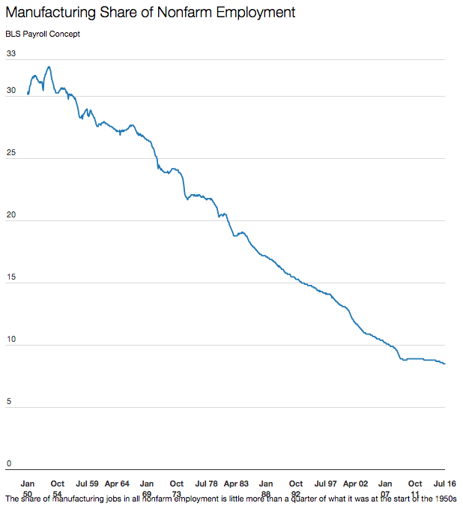
NAFTA
Jan 1950
Jul 2016

Slide 65
NAFTA: What Should Happen?
During 2008 primary campaign, Obama (& Clinton) argued for “renegotiating NAFTA”
Early on, said NAFTA was “devastating” and “a big mistake”
Obama later said only that he would “open up a dialogue” with Canada and Mexico
Wanted stronger agreements on labor and environmental standards
After 2008
Obama administration did not tamper with NAFTA
NAFTA was not an issue in the 2012 campaign
Did negotiate TPP=Trans-Pacific Partnership, FTA that included Canada and Mexico

Slide 66
NAFTA: What Should Happen?
Faux (see reading) says
NAFTA has
Caused a larger wage gap between US and Mexico
Turned US bilateral trade surplus into deficit
Driven 2 million Mexican farmers off the land (due to US subsidies)
Caused illegal immigration from Mexico to double
Reason: Mexico is “run by a small elite of crony capitalists” who were strengthened by NAFTA
Argues for a deal that would
Create a “fund for investment in Mexico” (like what EU did for Spain, Portugal, Ireland, Greece)
In exchange, require “guarantees for free trade unions, enforceable minimum wages, and an increase in education and other social spending”

Slide 67
NAFTA: What Should Happen?
Donald Trump, before election
Trump opposed NAFTA as early as 1993
“The Mexicans want it, and that doesn't sound good to me.”
Called NAFTA “The single worst trade deal ever approved in this country”
Donald Trump, after election
Called for renegotiation of NAFTA, as promised
May 18, 2017, Trump formally launched renegotiation
Aug 16, 2017, negotiations began

Slide 68
Outline: Preferential Trading Arrangements and the NAFTA
What Are PTAs?
Examples
European Union (EU)
North American Free Trade Agreement (NAFTA)
Effects of PTAs
Not the Same as Free Trade
Trade Creation
Trade Diversion
Market Diagram Illustration
NAFTA
History
Analysis
What Happened?
NAFTA Renegotiation and USMCA

Slide 69
NAFTA Renegotiation Issues
Trade imbalances: Trump wants deficits to fall
Rules of origin: tighten them
Dispute mechanisms: keep or remove
Chapter 11: Investor-State Dispute Settlement (ISDS)
Chapter 19: Dumping and CVD
Dairy and poultry (Canada’s policies)
Sunset clause
New issues (digital trade, state-owned enterprises, labor standards)

Slide 70
USMCA
Outcome of the Renegotiation
May 18, 2017: Renegotiation began
Aug 27, 2018: Agreement reached between US and Mexico
Sep 30, 2018: Agreement reached with Canada to join USMCA
USMCA = U.S.-Mexico-Canada Trade Agreement

Slide 71
USMCA
Features of USMCA
Auto rules of origin
Required North American content raised from 62.5% to 75%
40-45% content must be from labor paid $16/hr or more (but does not rise with inflation)

Slide 72
USMCA
Features of USMCA
New rules (similar to TPP) on
Intellectual property
Environment
Labor
Financial services
Digital trade

Slide 73
USMCA
Features of USMCA
Sunset clause? Not exactly
Revisit deal after 6 years
If happy, extend for 10 more
If not, new negotiations

Slide 74
USMCA
Features of USMCA
Canadian dairy
Canada will increase permitted imports of dairy from US, to 3.6% of its market
Canada to cease selling some dairy ingredients abroad at low prices and will tax exports over over some threshold

Slide 75
USMCA
Features of USMCA
Currencies
Commitment to “refrain from competitive devaluations and targeting exchange rates”

Slide 76
USMCA
Features of USMCA
Trade with China
Countries must inform US 3 months before beginning trade negotiations with any “non-market economy” (i.e., China)
If agreement with such economy is reached, US can terminate USMCA with six months notice.

Slide 77
USMCA
Features of USMCA
Chapter 19
Keeps this dispute settlement system for trade remedies such as anti-dumping
Does not apply them to “national-security-based” tariffs

Slide 78
USMCA
Features of USMCA
Chapter 11 (ISDS)
Removes this for disputes between US and Canada
Keeps it for disputes with Mexico

Slide 79
USMCA
“Side letter” of USMCA
Promise to shield Canada Mexico from future “national-security-based” tariffs (i.e., cars) (not enforceable)

Slide 80
USMCA
NOT a Feature of USMCA
Removal of US recent tariffs on steel and aluminum from Canada and Mexico
But these were eventually removed anyway, May 17, 2019

Slide 81
USMCA
Prospects for approval
Must be approved by all three legislatures
Canada: Dairy will resist, but approval assured
Mexico: Ratified June 19, 2019
US: Contentious, Democrats in House want changes

Slide 82
USMCA
Importance of USMCA
Trump: “It’s not NAFTA redone, it’s a brand-new deal”
NYT: “a consequential set of revisions”
Economist: “a modest revision”, “inferior to the agreement it replaces”
Bown: deal to “result in less trade, not more”

Slide 83
Next Time
International Policies for Economic Development: Trade
The Issues
Washington Consensus
Pros and cons of free trade for developing countries
Policy recommendations

