Slide 1
Lecture 17
European Monetary Unification and the Euro
Econ 340
Notes:
Delete F17: Solomon, Barber, Forelle & Walker
Add F17: Baldwin et al.

Slide 2


Slide 3
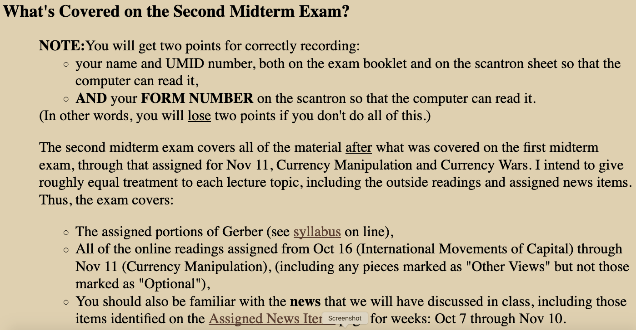

Slide 4
Outline: European Monetary Unification and the Euro
What Is It?
History of the EMU
Need for Convergence
Pros and Cons of Unification
  Why Adjustment Is Hard
  Winners and Losers under EMU
What Happened?
The Eurozone Crisis

Slide 5
What Is It?
The move to a common currency for a group of countries of Europe
  Originally 12 countries
  Now 19, with addition of Lithuania Jan 1 2015
Purpose: To further the economic integration of Europe that
  Began with the European Economic Community (a customs union – see next time)
  And is today called the European Union (EU)

Slide 6
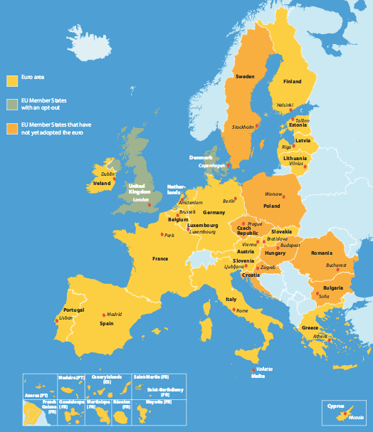
Euro Zone Members
Austria
Belgium
Cyprus
Estonia
Finland
France
Germany
Greece
Ireland
Italy
Latvia
Lithuania
Luxembourg
Malta
Netherlands
Portugal
Slovakia
Slovenia
Spain
Notes:
http://europa.eu/european-union/about-eu/money/euro_en

Slide 7
Clicker Question
Which of the following countries does use the euro?
  Poland
  Slovenia
  Sweden
  Switzerland
  United Kingdom
✓

Slide 8
Clicker Question
Which of the following countries does not use the euro?
  Cyprus
  Denmark
  France
  Greece
  Lithuania
✓

Slide 9
What Is It?
The currency is shared by all 19 countries and is not controlled by any one of them
It is controlled by the European Central Bank (ECB), based in Frankfurt, Germany
The group of countries is called the
Economic and Monetary Union (EMU)
(Also, informally, the Eurozone)

Slide 10
Outline: European Monetary Unification and the Euro
What Is It?
History of the EMU
Need for Convergence
Pros and Cons of Unification
  Why Adjustment Is Hard
  Winners and Losers under EMU
What Happened?
The Eurozone Crisis

Slide 11
History of the EMU
Before 1973:
  All these currencies were pegged to the US dollar
After 1973:
  The Bretton-Woods system collapsed and major currencies stopped pegging to US$
  By default, currencies began to float
  Europe, because of its large internal trade, found exchange rate movements especially troublesome

Slide 12
History of the EMU
After 1973:
  Europe tried several arrangements to get greater stability
    Wide-band peg to $ with narrower peg to each other: “Snake in the tunnel”
E
Tunnel
Snake
time

Slide 13
History of the EMU
After 1973:
  Europe tried several arrangements to get greater stability
    Narrow peg to each other with no peg to $: “Floating snake”
E
time

Slide 14
History of the EMU
1979
  European Monetary System (EMS) established
  Features:
    An Exchange Rate Mechanism (ERM) of exchange
    rates pegged to each other within ±2.25% bands
    Provision for adjusting the pegs when needed
    A basket of currencies forming the European Currency Unit (ECU) that floated with respect to outside currencies
    Capital controls
  Did it work?
    Inflation rates differed, but their differentials gradually fell
    There were 11 currency realignments during 1979-87
Much like Bretton Woods

Slide 15
History of the EMU
1989: First official statement of the goal of moving toward a common currency
1991, December: Maastricht Treaty
  Agreement on greater unification of member countries, forming the “European Union”
  Also included the terms for adopting the common currency

Slide 16
History of the EMU
1992: Crisis
  Denmark voted NO to the Maastricht Treaty
  Speculative attacks on currencies forced some to drop out of ERM
1993:
  ERM widened bands to ±15%
  Prospects for EMU looked bleak
  Denmark ratified Treaty but “opted out” of the euro; UK also opted out
  Germany was last country to ratify Maastricht Treaty

Slide 17
Outline: European Monetary Unification and the Euro
What Is It?
History of the EMU
Need for Convergence
Pros and Cons of Unification
  Why Adjustment Is Hard
  Winners and Losers under EMU
What Happened?
The Eurozone Crisis

Slide 18
Need for Convergence
Difficulties of adopting common currency
  If countries have different rates of inflation
    High-inflation countries will lose markets to low-inflation countries
    Exchange rates won’t adjust (a la PPP) to correct for differences
  If countries have different interest rates
    Capital will flow to high-interest rate countries seeking higher return
    Uncertainty about exchange rate won’t offset this
  Temptation to run budget deficits when able to borrow from other countries

Slide 19
Need for Convergence
Difficulties of adopting common currency
  These suggest that success with a common currency requires countries to have similar
    Inflation rates
    Interest rates
    Budget deficits
    Government debts
  Achieving this was called “convergence” and was required in the Maastricht Treaty before a country could adopt the euro

Slide 20
Need for Convergence
Maastricht Convergence Criteria
  National currency in ERM for 2 years
  Budget deficit < 3% of GDP
  Government debt < 60% of GDP
  Inflation < 1.5% above average of lowest 3
  Long-term interest rates < 2% above average of lowest 3
How well were they doing?
  Following graphs from 1998 article
Notes:
Source: Michael W. Klein, “European Monetary Union,” New England Economic Review, Federal Reserve Bank of Boston, Mar/Apr 1998, pp. 4-12.

Slide 21
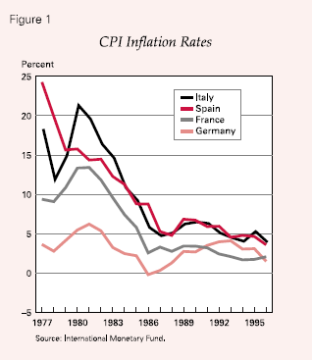
Notes:
Source: Michael W. Klein, “European Monetary Union,” New England Economic Review, Federal Reserve Bank of Boston, Mar/Apr 1998, pp. 4-12.

Slide 22
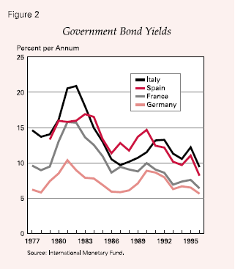
Notes:
Source: Michael W. Klein, “European Monetary Union,” New England Economic Review, Federal Reserve Bank of Boston, Mar/Apr 1998, pp. 4-12.

Slide 23
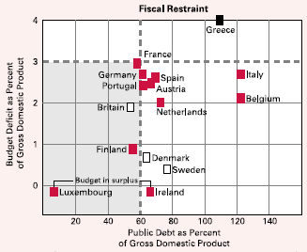
- 1997
Notes:
Source: Michael W. Klein, “European Monetary Union,” New England Economic Review, Federal Reserve Bank of Boston, Mar/Apr 1998, pp. 4-12.

Slide 24
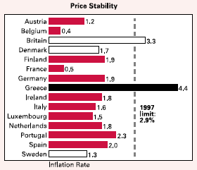
- 1997
Notes:
Source: Michael W. Klein, “European Monetary Union,” New England Economic Review, Federal Reserve Bank of Boston, Mar/Apr 1998, pp. 4-12.

Slide 25
Maintaining Convergence
Stability and Growth Pact (SGP)
  Agreed in 1996 that members of the Eurozone would
    Keep their budget deficits below 3% of GDP
    Pay fines if they broke this limit
As we’ll see later, this has been a problem!
Notes:
Source: Michael W. Klein, “European Monetary Union,” New England Economic Review, Federal Reserve Bank of Boston, Mar/Apr 1998, pp. 4-12.

Slide 26
Timetable
May 1998: Membership was set
  Based on convergence
  All of the then 15 EU members, except
    UK, Denmark, Sweden – who opted out
    Greece – who failed to converge (Greece did enter soon after)
Jan 1, 1999: Euro was launched (except notes/coins)
  Value of euro = 1 ECU as of midnight Dec 31, 1998 = $1.18
  Currencies “irrevocably” linked
  Single monetary policy: ECB (European Central Bank)
  New public debt issued in euros
  Financial markets started using euro
Jan 1, 2002: Notes/coins started circulating
Jul 1, 2002: National notes/coins retired

Slide 27
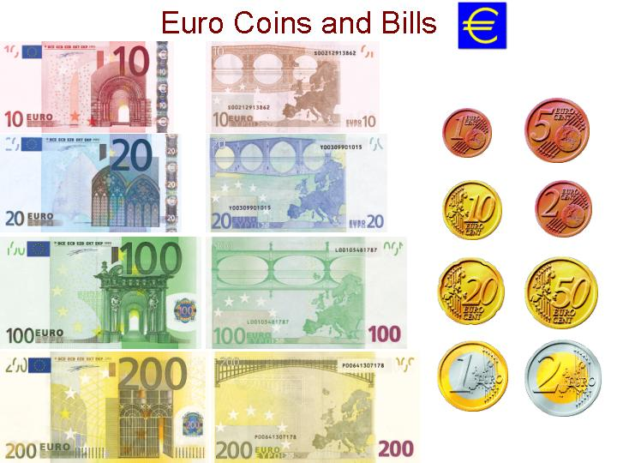

Slide 28
The euro notes and coins
Note what does not appear:
  People
  Actual buildings and places
Purpose was to treat all members equally
Result was that the currency lacks personality
People don’t much like it, and they miss their old national currencies.
See Kulish

Slide 29
Members
As of 2002, EU had 15 members, of whom 12 adopted the euro
Belgium
Austria
France
Finland
Luxembourg
Italy
Netherlands
Germany
Portugal
Ireland
Greece
Spain
BAFFLING PIGS

Slide 30
Members
And 3 did not
Denmark
Sweden
Kingdom
United
DUKS

Slide 31
Members
Since 2002, the Eurozone has become:
BAFFLING PIGS +
SCLELMS?
Cyprus (2008)
Malta (2008)
Slovenia (2007)
Estonia (2011)
Latvia (2014)
Slovakia (2009)
Lithuania (20015)

Slide 32
Clicker Question
Which of the following was not one of the Maastricht Convergence Criteria?
  Budget deficit < 3% of GDP
  Government debt < 60% of GDP
  Inflation < 1.5% above average of lowest 3
  Growth rate of per capita GDP above 1%
  Long-term interest rates < 2% above average of lowest 3
✓

Slide 33
Clicker Question
Which of the following was one of the Baffling Pigs, but as of 1997 had both budget deficit and public debt above the maxima specified in the Maastricht Convergence Criteria?
  Denmark
  Finland
  Greece
  Italy
  United Kingdom
✓

Slide 34
Clicker Question
Whose face appears on the €100 note?
  Charles de Gaulle
  Benito Mussolini
  Benjamin Franklin
  Winston Churchill
  Nobody
✓

Slide 35
Outline: European Monetary Unification and the Euro
What Is It?
History of the EMU
Need for Convergence
Pros and Cons of Unification
  Why Adjustment Is Hard
  Winners and Losers under EMU
What Happened?
The Eurozone Crisis

Slide 36
Pros and Cons of Unification
Proponents expected
  Complete the internal market
  Improved competition & efficiency
  Arbitrage across national borders
  New era of prosperity
  Stable prices
  Fiscal discipline
  Lower interest rates
    thus higher investment
      Stronger growth
  More jobs

Slide 37
Pros and Cons of Unification
Opponents expected
  Division of the EU (baffling pigs vs. duks)
  Loss of sovereignty
  Little popular support
  Regulatory & other costs
  Difficulties of adjustment to asymmetric shocks
    (As had happened before, e.g., with German unification and discovery of North Sea Oil)

Slide 38
Outline: European Monetary Unification and the Euro
What Is It?
History of the EMU
Need for Convergence
Pros and Cons of Unification
  Why Adjustment Is Hard
  Winners and Losers under EMU
What Happened?
The Eurozone Crisis

Slide 39
Pros and Cons of Unification
Why adjustment is hard
  Like states in the US, countries in Eurozone have
    No exchange-rate tool
    No separate monetary policies
    Very limited fiscal policies (due to SGP)
  Unlike US states, however, in Eurozone
    Labor is less mobile across countries
    Wages are less flexible, due to social policies
    No mechanism for fiscal transfers among countries

Slide 40
Pros and Cons of Unification
Without adjustment
  When one country is hit with a shock that others are not (i.e., an “asymmetric shock”),
    Its markets don’t adjust (rigid wages)
    Its people don’t move
    It has fewer policies to deal with this
    Other countries don’t help

Slide 41
Outline: European Monetary Unification and the Euro
What Is It?
History of the EMU
Need for Convergence
Pros and Cons of Unification
  Why Adjustment Is Hard
  Winners and Losers under EMU
What Happened?
The Eurozone Crisis

Slide 42
Winners and Losers from EMU
Winners
  Multinational companies: their costs of operating in multiple countries were reduced
  Europe’s biggest banks were expected to gain, through consolidation across borders
  Consumers, able to comparison-shop across borders
Losers
  Small firms (e.g. shops, restaurants), for whom changeover was costly, with little benefit

Slide 43
Clicker Question
Which of the following is not a reason why adjustment in the euro zone is difficult?
  No mechanism for fiscal transfers
  Countries cannot individually depreciate their currencies
  Countries are constrained from using fiscal expansion
  Labor market policies impede wage adjustment
  Labor is too mobile among countries
✓

Slide 44
Outline: European Monetary Unification and the Euro
What Is It?
History of the EMU
Need for Convergence
Pros and Cons of Unification
  Why Adjustment Is Hard
  Winners and Losers under EMU
What Happened?
The Eurozone Crisis

Slide 45
What Happened?
Euro started (Jan 1, 1999) at 1.18 $/€
Now (Nov 6, 2019) it is 1.11 $/€
So euro has simply fallen, right?
Hardly! It’s not that simple.

Slide 46
What Happened since 1999?
“Parity”
From IMF, International Financial Statistics
Notes:
Euro.xls

Slide 47
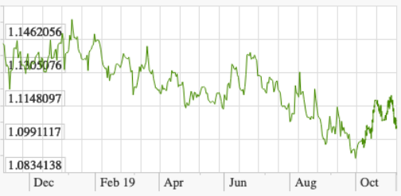
What Happened over the Last Year?
US $ per €
5.5%
From X-Rates.com

Slide 48
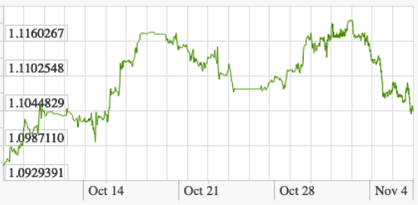
What Happened over the Last Month?
US $ per €
2.1%
From X-Rates.com

Slide 49
What Happened?
Euro fell, after its creation by about 25% to 2001
Then it rose by 2004 back to slightly above where it started
By 2008 it had risen to over $1.50, only to fall in 2009
From 2004 to 2014, it stayed at or above $1.20
It then fell to about $1.10, then $1.05 where it stayed until early 2017.
Some thought it would go below “parity” of $1.00, but instead it rose to over $1.20 and is now back down to $1.11

Slide 50
What Happened?
Why all this change? I don’t think we know, for the changes that happened over most of this period.
The fall since 2014 – from over $1.30 in 2013 to about $1.05 two years ago – was due to
  Weakness of the Eurozone economies
  The ECB’s use of “Quantitative Easing” to lower interest rates and stimulate the economy
  The US Fed’s interest rate increase and signals that it would raise them further
Why did it rise, then fall, over the last two years? Some would say because of Trump

Slide 51
What Happened?
Has the euro worked well for Europe?
  There were problems, even in the early years
    Many in Europe perceived that prices rose when converted to euros
    Several countries broke the limit of the SGP
      Portugal: suffered criticism but was not fined
      France, Germany
        Too big even to criticize
        Instead EU revised the SGP
      In the last decade, the PIGS (Portugal, Ireland, Greece, & Spain)
        Or PIIGS, including Italy

Slide 52
What Happened?
Has the euro mattered for the US?
  Not much
  When the euro fell initially, it made it hard for US to compete
  In 2007-8, with euro’s rise,
    US benefited as sellers
    US was hurt as consumers and as tourists

Slide 53
What Happened?
Has the euro mattered for the US?
  There used to be talk of central banks switching from dollars to euros as reserves
    So far, little sign that this is happening

Slide 54
Clicker Question
When did the exchange-market value of the euro reach its lowest against the dollar?
  1999
  2000
  2008
  2015
  2018
✓

Slide 55
Clicker Question
Which of the following countries are members of the Eurozone who have been fined for violating the Stability and Growth Pact?
  France
  Germany
  Greece
  All of the above
  None of the above
✓

Slide 56
Outline: European Monetary Unification and the Euro
What Is It?
History of the EMU
Need for Convergence
Pros and Cons of Unification
  Why Adjustment Is Hard
  Winners and Losers under EMU
What Happened?
The Eurozone Crisis

Slide 57
The Eurozone Crisis
The crisis consisted of (see Baldwin et al.)
  News of Greek debt, and concerns about Greece’s ability to manage it
  Increased interest rates in Greece and other Eurozone countries, threatening debt problems there as well
  Bailouts by EU, ECB, and IMF (the “Troika”)
  Concern that the Eurozone might break up
  Commitment by ECB’s Draghi to “Do whatever it takes” to save the eurozone.

Slide 58
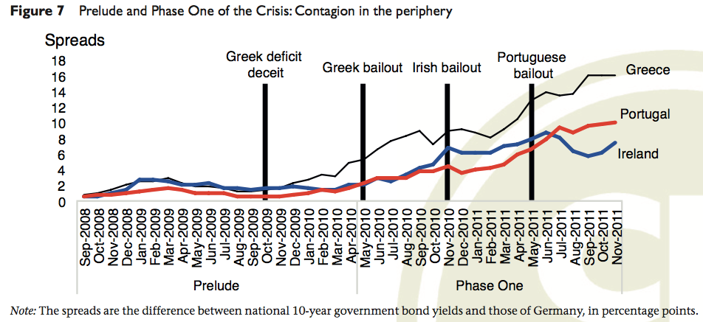
The Eurozone Crisis: Timing
Source: Baldwin et al., “Rebooting the Eurozone”

Slide 59
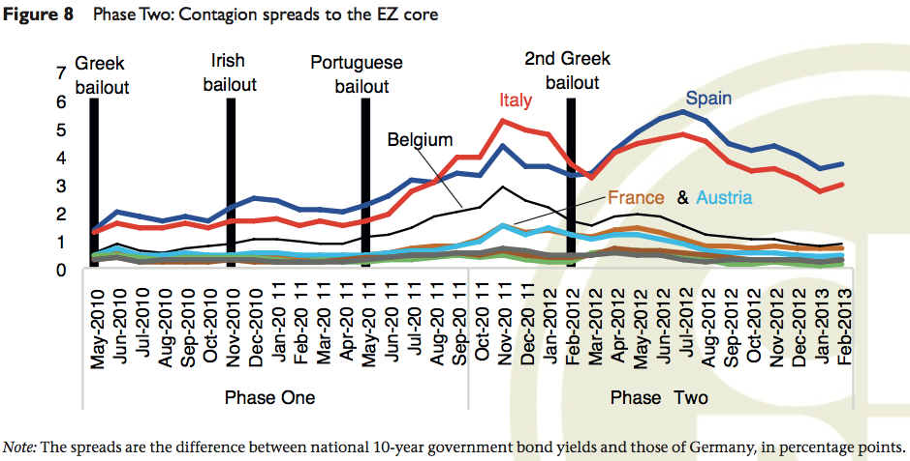
The Eurozone Crisis: Timing
Source: Baldwin et al., “Rebooting the Eurozone”

Slide 60
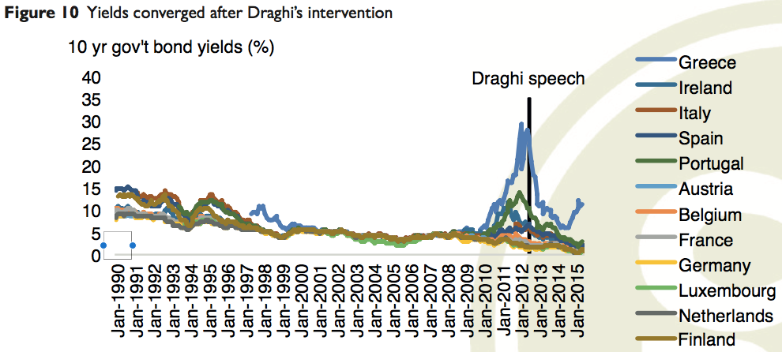
The Eurozone Crisis: Timing
Note that Greece was not solved, and crisis may not be over.
Source: Baldwin et al., “Rebooting the Eurozone”

Slide 61
What Happened?
The problem of Eurozone imbalances
  The common currency fostered current-account imbalances
  Surplus countries lent to deficit countries
  Without institutions (banking union, fiscal union) to assist adjustment, loss of confidence could cause “sudden stop” of creditors’ willingness to lend
  That set the stage for crisis.

Slide 62

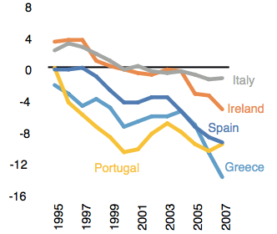
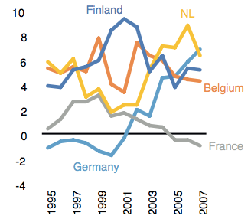
The Eurozone Crisis: Timing
Peripheral EZ Members
Core EZ Members
Source: Baldwin et al., “Rebooting the Eurozone”

Slide 63
What Happened?
The problem of Greece (started in 2010)
  Greek government deficits had been over 10% of GDP
    (compare SGP limit of 3%)
  Greek debt rose to about 160% of GDP
    (compare SGP limit of 60%)
  Markets feared default; speculators attacked both Greek bonds & euro
  EU (esp Germany) were reluctant to help (& was prohibited by Lisbon Treaty)
  Greek austerity caused massive protests

Slide 64
What Happened?
The Euro Zone today
  In process of negotiating a mechanism to
    Provide loans to member countries in trouble
    Put pressure on them for austerity:
      Cut spending
      Raise taxes
    Form “banking union” to safely manage bank failures
  These mechanisms are still not in place

Slide 65
What Happened?
The Euro Zone today
  Still trying to solve the problem of Greek debt
  Tradeoff between
      Bailout money from others to pay it off
        Favored by weaker EU countries (e.g., France)
      Cutting value of bonds to private sector holders
        Called “haircut” (also “bail-in”)
        Also called “Private-sector involvement” (PSI)
        Favored by stronger EU countries (e.g., Germany)

Slide 66
What Happened?
The Euro Zone today
  Fear that if not solved,
    Greece would default
    Speculators would attack other weak countries’ bonds
    Greece and others will be forced to leave the euro
  These concerns seemed to have abated in 2014, but then Greece elected a government opposed to the terms of the bailout.
  Greece is still struggling, now under another new government, and fears of crisis in the Eurozone have lessoned but not disappeared

Slide 67
What Happened?
The Euro Zone today, per the Smaghi reading
  Crises are caused by
    “Doom loop” where banks hold government debt, and doubts about the latter cause bank runs
    “Perverse loop” (Smaghi’s term) where fear of exit from the euro causes capital outflow that makes exit more likely
  Smaghi recommends a formal procedure for exiting the euro, and that it be combined with exiting the EU
    That, he says, would discourage those who want to exit the euro

Slide 68
Clicker Question
What happened to settle the markets during the Eurozone Crisis?
  Rich countries agreed to bail out the poor countries
  The euro was allowed to float on the exchange markets
  The United States made large payments into the European Stability Fund
  The ECB President promised to do whatever it takes to save the euro
  Greece stopped using the euro and returned to the drachma
✓

Slide 69
Next Time (after exam)
Preferential Trading Arrangements and the NAFTA
  What are they?
  Their effects
  NAFTA
  Other

