Slide 1
Lecture 16 Currency Manipulation and Currency Wars
Econ 340

Slide 2
News: Nov 4-10
RCEP nears completion, but India withdraws -- WSJ: 11/4 | Canvas | NYT: 11/4 | Canvas | FT: 11/4 | Canvas | Economist: 11/9
RCEP, the Regional Comprehensive Economic Partnership, was to be a 16-country free trade agreement organized by ASEAN, the Association of Southeast Asian Nations, and pushed by China. Its negotiation is nearing completion, but India has now decided not to sign.
The 16 countries were to be the 10 nations of ASEAN plus the six with which ASEAN already has FTAs: Australia, China, India, Japan, New Zealand, and South Korea. Negotiations began soon after the Trans-Pacific Partnership began negotiations and have proceeded slowly until now. By including China, which was not in the TPP, RCEP was seen as a counter to the US-centered TPP until Trump pulled out of TPP.
At a summit in Bangkok, Thailand, India has now announced that it will not join, fearing a flood of imports from China. But the other 15 countries said they had concluded most negotiations and expect to sign the agreement in early 2020.
US trade deficit reported -- NYT: 11/5 | Canvas | FT: 11/5 | Canvas
FT reports that the US trade deficit for September was the smallest since April, as trade with China shrank due to the trade war.
On the other hand, NYT reports that the US trade deficit for the first nine months of 2019 rose by over 5% compared to the same period in 2018.
NYT Headline: "Trump Vowed to Shrink the Trade Gap. It Keeps Growing."
China ends ban on beef and pork from Canada -- WSJ: 11/5 | Canvas | FT: 11/5 | Canvas
China had banned these meats from Canada 4 months ago, claiming that export certificates had been falsified. Many believed that the ban was in retaliation for Canada arresting an executive from China's company Huawei, at the request of the US.
China's decision comes amid a severe shortage of pork in China, which has been hit by swine fever that has destroyed much of its pork. Increased imports from US, Brazil, and Argentina were not enough to stop the price of pork in China from doubling.
China continues to have restrictions on other Canadian exports, including canola seed and soybeans, and it continues to detain two Canadians.

Slide 3
News: Nov 4-10
RCEP nears completion, but India withdraws
RCEP, the Regional Comprehensive Economic Partnership, was to be a 16-country free trade agreement organized by ASEAN, the Association of Southeast Asian Nations, and pushed by China. Its negotiation is nearing completion, but India has now decided not to sign.
The 16 countries were to be the 10 nations of ASEAN plus the six with which ASEAN already has FTAs: Australia, China, India, Japan, New Zealand, and South Korea. Negotiations began soon after the Trans-Pacific Partnership began negotiations and have proceeded slowly until now. By including China, which was not in the TPP, RCEP was seen as a counter to the US-centered TPP until Trump pulled out of TPP.
At a summit in Bangkok, Thailand, India has now announced that it will not join, fearing a flood of imports from China. But the other 15 countries said they had concluded most negotiations and expect to sign the agreement in early 2020.

Slide 4
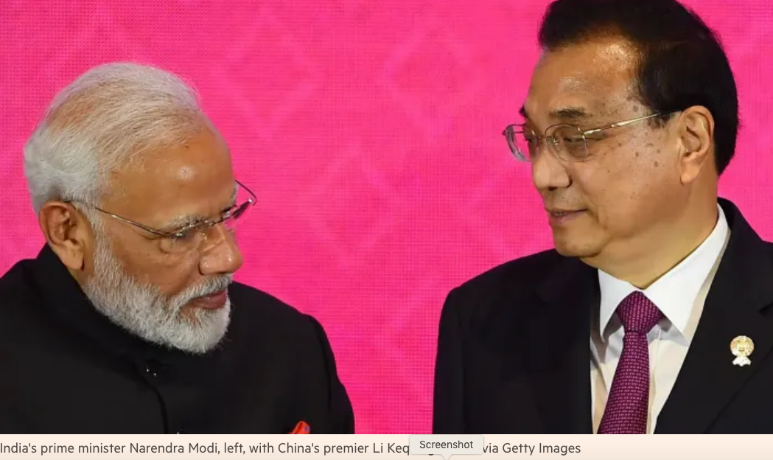

Slide 5
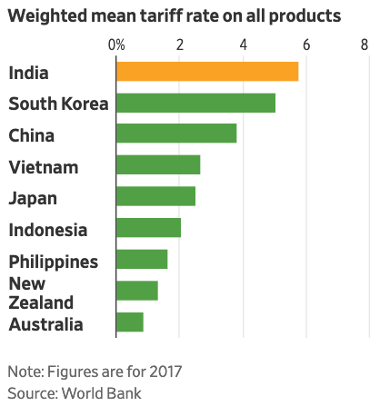

Slide 6
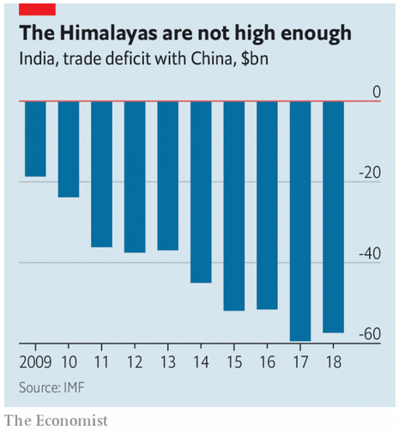

Slide 7
News: Nov 4-10
US trade deficit reported
FT reports that the US trade deficit for September was the smallest since April, as trade with China shrank due to the trade war.
On the other hand, NYT reports that the US trade deficit for the first nine months of 2019 rose by over 5% compared to the same period in 2018.
NYT Headline: "Trump Vowed to Shrink the Trade Gap. It Keeps Growing."

Slide 8
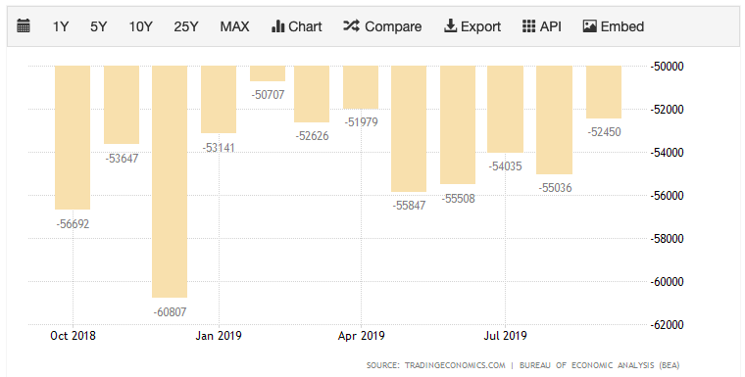
Notes:
https://tradingeconomics.com/united-states/balance-of-trade

Slide 9
News: Nov 4-10
China ends ban on beef and pork from Canada
China had banned these meats from Canada 4 months ago, claiming that export certificates had been falsified. Many believed that the ban was in retaliation for Canada arresting an executive from China's company Huawei, at the request of the US.
China's decision comes amid a severe shortage of pork in China, which has been hit by swine fever that has destroyed much of its pork. Increased imports from US, Brazil, and Argentina were not enough to stop the price of pork in China from doubling.
China continues to have restrictions on other Canadian exports, including canola seed and soybeans, and it continues to detain two Canadians.

Slide 10
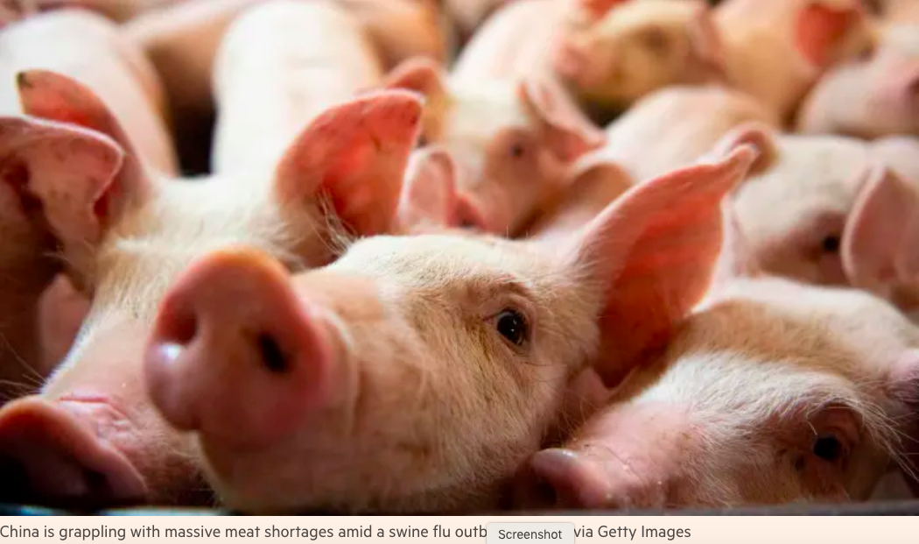

Slide 11
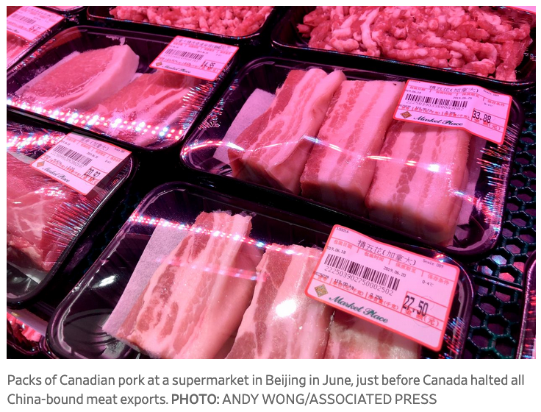

Slide 12
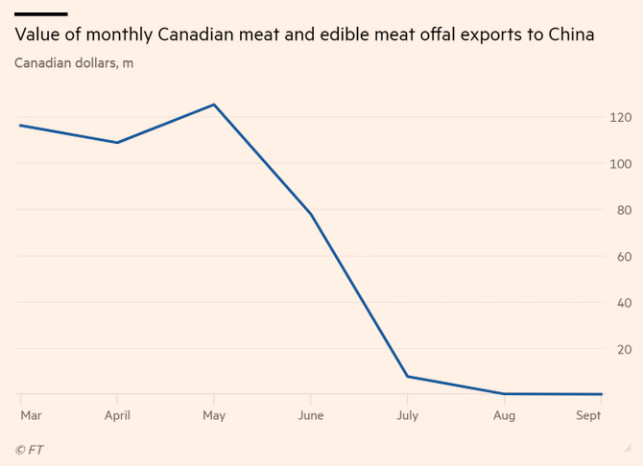

Slide 13
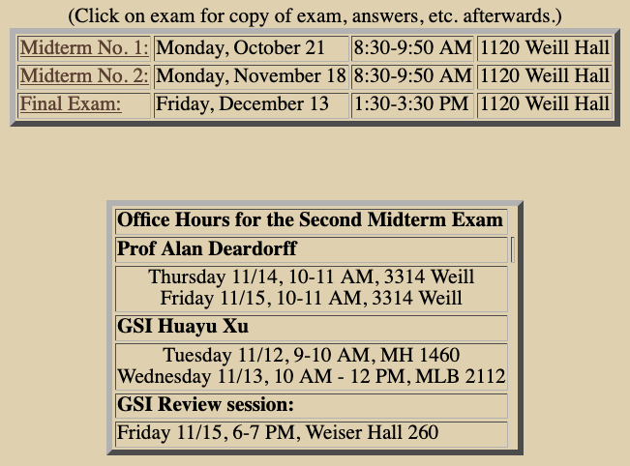

Slide 14
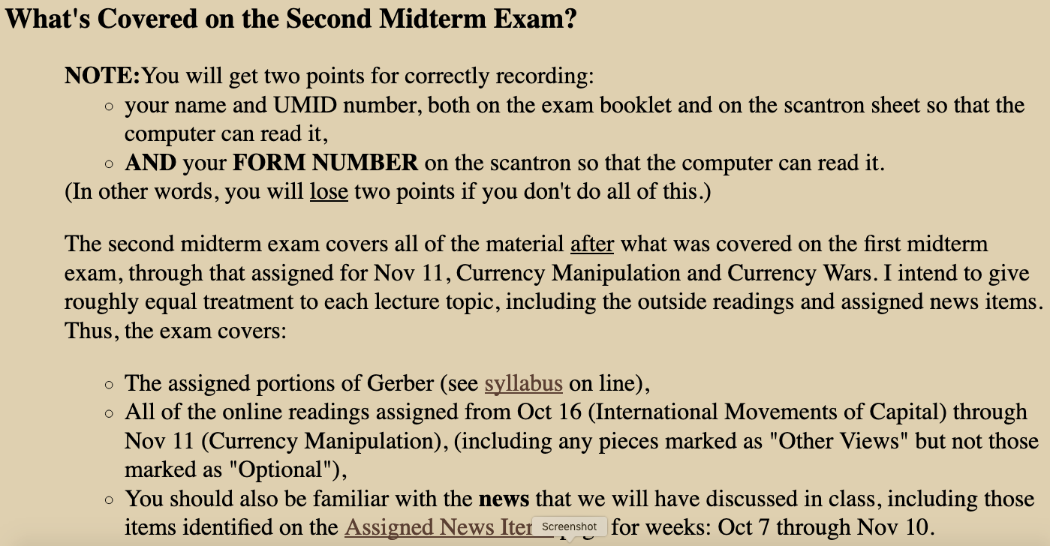

Slide 15
Outline: Currency Manipulation and Currency Wars
Currency Manipulation
What it is
Chinese currency manipulation
Other currency manipulation
Currency Wars
History
Currency war today?
Currency war effects

Slide 16
Outline: Currency Manipulation and Currency Wars
Currency Manipulation
What it is
Chinese currency manipulation
Other currency manipulation
Currency Wars
History
Currency war today?
Currency war effects

Slide 17
Currency Manipulation
Currency Manipulation
Usually defined as intervention intended to reduce the value of a country’s own currency
In order to make its exports more competitive, and
Discourage imports
Other countries object to it, because it reduces their exports
Congress requires the US Treasury Department to report twice a year on currency manipulation

Slide 18
Currency Manipulation
Currency Manipulation
Many have accused China, especially, of currency manipulation over the years
Trump promised, during the campaign, to label China a currency manipulator “on his first day in office.” He did not.
Had he done so, according to one source, it
would have authorized “the US to do nothing except negotiate with Beijing over the renminbi, which it is already doing.”

Slide 19
Currency Manipulation
Currency Manipulation
In September 2018, Trump told Reuters: “I think China's manipulating their currency, absolutely. And I think the euro is being manipulated also.”
In October 2018 and again in May 2019, the fourth and fifth such reports under Trump did not label China a currency manipulator
In August 2019, without such a report, the US Treasury did label China a currency manipulator
Since 2013, Treasury has issued a report every April/May and October. No second report has appeared yet this year.
Notes:
https://seekingalpha.com/article/4207807-trump-renews-charges-chinese-currency-manipulation
https://www.nytimes.com/2018/10/17/business/china-currency-manipulation.html

Slide 20
Currency Manipulation
The Trade Facilitation and Trade Enforcement Act of 2015 requires
Treasury to report twice a year on foreign exchange rate policies of major US trading partners.
Major trading partners are those that conduct at least $55 billion of trade with the US per year
The Act’s Criteria, to be a currency manipulator, a country must have
A significant bilateral trade surplus with the US
A material currency account surplus (multilateral)
Engaged in persistent one-sided intervention in the foreign exchange market

Slide 21
Currency Manipulation
The Treasury’s Criteria: To be labelled a currency manipulator, a country must
(As of May 2019, per Treasury Department Report)
Run a bilateral trade surplus with the United States exceeding $20 billion over the past 12 months;
Run a global current account surplus exceeding 2 percent of the country’s GDP over the past 12 months; and
Engage repeatedly in net foreign exchange purchases exceeding 2 percent of the country’s GDP over the past 12 months.
Notes:
https://home.treasury.gov/system/files/206/2019-05-28-May-2019-FX-Report.pdf

Slide 22
Currency Manipulation
Treasury’s May 2019 Report:
No country met all three criteria
Seven countries met criteria #1 and #2:
Germany, Ireland, Italy, Japan, Korea*, Malaysia, Singapore, and Vietnam
One country, Singapore, met criteria #2 & #3
China met only criterion #1, but its bilateral surplus was so large that Treasury kept it on its “monitoring list”
*Korea met only one in May 2019, but had met two in six previous reports, and so was included.
Notes:
https://home.treasury.gov/system/files/206/2019-05-28-May-2019-FX-Report.pdf

Slide 23


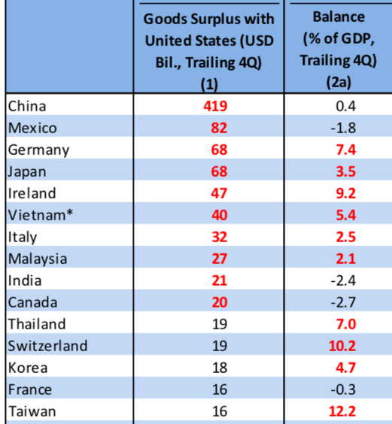
Notes:
https://home.treasury.gov/system/files/206/2019-05-28-May-2019-FX-Report.pdf
Table 2

Slide 24
Clicker Question
Which of the following is not required for a country to be named a currency manipulator by the US Treasury Department?
It conducts substantial trade with the US
It has a bilateral trade surplus with the US
It holds large amounts of US dollar assets
It has a current account surplus
It repeatedly purchases foreign exchange
✓

Slide 25
Clicker Question
Over the last 20 years, how many countries have been named as currency manipulators in the semi-annual Treasury reports?
0
1
2
3
4
✓
Treasury did name China a currency manipulator in August 2019, but that was not in one of those reports.

Slide 26
Outline: Currency Manipulation and Currency Wars
Currency Manipulation
What it is
Chinese currency manipulation
Other currency manipulation
Currency Wars
History
Currency war today?
Currency war effects

Slide 27
Chinese Currency Manipulation
Most often accused of currency manipulation is China
What has been its experience?
Look at the data on
The exchange rate
China’s reserves
Recall that: in order to push down your currency, you must
Buy foreign currency
And thus add to reserves
Notes:
https://home.treasury.gov/system/files/206/2019-05-28-May-2019-FX-Report.pdf

Slide 28
Chinese Currency Manipulation
Note first how a floating exchange rate, without manipulation, performs over time
Then compare to the Chinese currency, the renminbi (aka, yuan)
Notes:
https://home.treasury.gov/system/files/206/2019-05-28-May-2019-FX-Report.pdf

Slide 29
How a Floating Exchange Rate Behaves US$/euro Exchange Rate
It moves up and down a lot.

Slide 30
China’s Exchange Rate, US$/Yuan, 2000-2005
The exchange rate did not change at all between 2000 and 2005
Notes:
China currency.xlsx
From IMF, IFS

Slide 31
And reserves more than quadrupled!
Notes:
See China Currency.xlsx

Slide 32
Chinese Currency Manipulation
During 2000-2005
China intervened to keep its rate constant
Since it was adding to reserves, it must have been
Buying dollars
Keeping the yuan below its market clearing value
Thus China was manipulating
But it did not push the yuan down
It was only keeping it from rising

Slide 33
China’s Exchange Rate, US$/Yuan, 2000-2008
The yuan appreciated steadily between 2005 and 2008
Notes:
China currency.xlsx
From IMF, IFS

Slide 34
Reserves continued to rise, to almost $2 trillion
Notes:
See China Currency.xlsx

Slide 35
Chinese Currency Manipulation
During 2005-2008
China allowed the yuan to rise
In response to pressure from US and others
But China’s reserves continued to rise, indicating that it was still buying dollars.
Was it manipulating?
Yes: yuan was below its market value
But only to slow its rise

Slide 36
China’s Exchange Rate, US$/Yuan, 2000-2014
The yuan stopped rising in 2008, then rose slowly
Notes:
China currency.xlsx
From IMF, IFS

Slide 37
Reserves mostly rose after 2008, to over $4 trillion in 2014
Notes:
See China Currency.xlsx

Slide 38
Chinese Currency Manipulation
During 2008-2014
The financial crisis of 2008 slowed down both
The appreciation of the renminbi, and
The growth of reserves
But both continued after a pause
Why did the appreciation pause?
“Flight to safety” led US $ to appreciate
China let ¥ rise with $, but not faster
Was it manipulating?
Yes, to keep it from rising faster than $

Slide 39
Chinese Currency Manipulation
Then all changed in 2014

Slide 40
China’s Exchange Rate, US$/Yuan, 2000-2017
The yuan reached its peak in 2013, and began to fall in 2015
Notes:
China currency.xlsx
From IMF, IFS

Slide 41
From 2014-16, China’s reserves were falling
Notes:
See China Currency.xlsx

Slide 42
Chinese Currency Manipulation
Conclusion:
China did intervene extensively 2000-2014,
Sometimes to keep the yuan from moving,
Other times to slow its rise
But since 2014, until 2017,
Although the yuan was falling in value until 2017,
This was in spite of Chinese intervention, not because of it
They sold close to $1 trillion of reserves, slowing its fall (over $1 trillion as of March 2017)

Slide 43
Chinese Currency Manipulation
During 2014-2017
China’s currency fell by about 12%
But so did China’s reserves, by $1 trillion
Was China intervening? Yes!
But was it manipulating? No!
It was intervening to slow the fall, not to cause it.

Slide 44
China’s Exchange Rate, US$/Yuan, 2000-2019
Most recently, the yuan has moved up in 2017, down in 2018/19
Notes:
China currency.xlsx
From IMF, IFS

Slide 45
While reserves have moved little
Notes:
See China Currency.xlsx

Slide 46
Chinese Currency Manipulation
Since 2017
China’s currency has moved up and down, much more like a normal floating exchange rate
Its reserves have changed little
Is China manipulating? No

Slide 47
Clicker Question
When has the dollar value of the Chinese currency fallen over time at the same time that China was adding to its reserves?
2000-2005
2005-2008
2008-2014
20014-2019
Never (within 2000-2019)
✓

Slide 48
Clicker Question
Many have said that a ¥/$ exchange rate of 7.0 is significant. Approximately what value of the $/¥ exchange rate does that correspond to?
0.10
0.12
0.14
0.16
0.18
✓
More exactly, 0.143

Slide 49
China’s Exchange Rate, US$/Yuan, 2000-2019
Notes:
China currency.xlsx
From IMF, IFS

Slide 50
Outline: Currency Manipulation and Currency Wars
Currency Manipulation
What it is
Chinese currency manipulation
Other currency manipulation
Currency Wars
History
Currency war today?
Currency war effects

Slide 51
Other Currency Manipulation
The Economist in March 2017 devised a measure of currency manipulation based on
Current account balances
Foreign asset purchases relative to GDP

Slide 52
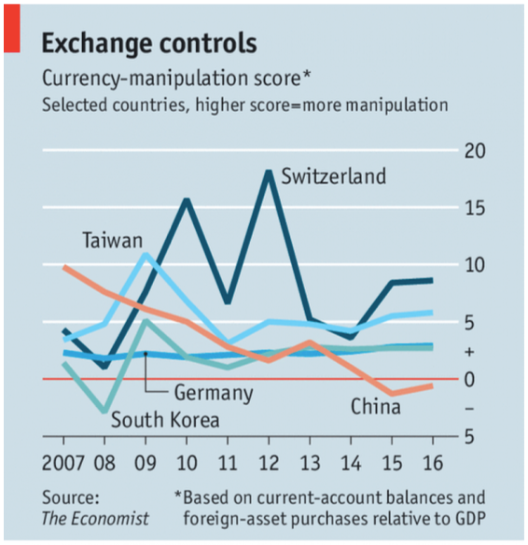

Slide 53
Other Currency Manipulation
They found that
China’s manipulation score was
High in 2007
Declining since
Negative since 2014
Score was positive for Germany, South Korea, and Taiwan
Highest for Switzerland
But based on prices, the Swiss franc was the most over-valued, not under-valued.
That’s why the Swiss were intervening.
Manipulation may be justified.

Slide 54
Other Currency Manipulation
In June 2019, Trump accused the European Central Bank of acting to deliberately weaken the euro
His basis: ECB President Draghi’s statement that “additional stimulus would be required.”
Does that make sense?
Yes: Reducing interest rates tends to weaken the currency
The ECB’s interest rate was already below zero

Slide 55
Other Currency Manipulation
Is monetary policy currency manipulation?
Not by normal definitions
Most would say that countries with weak economies
Are right to lower interest rates,
Even though that will depreciate their currencies

Slide 56
Other Currency Manipulation
In 2010, Brazil’s finance minister complained that
The US and others were using monetary expansion (due to the recession)
This was causing the dollar and other currencies to fall
Hurting Brazil and other emerging economies
He didn’t call it “currency manipulation” but he did complain of a “currency war,” a term that he coined.

Slide 57
Clicker Question
When, according to the economist index, did China cease having a positive currency manipulation index
2016
2015
2010
2005
China has never had a positive index
✓

Slide 58
Outline: Currency Manipulation and Currency Wars
Currency Manipulation
What it is
Chinese currency manipulation
Other currency manipulation
Currency Wars
History
Currency war today?
Currency war effects

Slide 59
Currency Wars
Currency war defined:
Competitive currency depreciations
Multiple countries engaging in currency manipulation
Competitive devaluations of pegged exchange rates

Slide 60
Outline: Currency Manipulation and Currency Wars
Currency Manipulation
What it is
Chinese currency manipulation
Other currency manipulation
Currency Wars
History
Currency war today?
Currency war effects

Slide 61
Currency War History
1930s (See Mihm reading)
Competitive devaluations accompanied the higher tariffs of the trade war
One after another countries left the gold standard and let their currencies depreciate
Unlike tariffs, which may be targeted at individual countries, currencies affect all other countries
Thus a currency war can’t be confined to a pair of countries

Slide 62
Currency War History
1934 US Silver Purchase Act*
Roosevelt administration bought large amounts of silver
At the time, China was on a silver standard (defining their currency in terms of silver)
By buying silver, the US pushed up its price, and thus the value of China’s currency
*Source: Hanke, Steve, “U.S. Currency Wars With China—Past And Present,” Forbes, August 6, 2019.
Notes:
https://www.forbes.com/sites/stevehanke/2019/08/06/us-currency-wars-with-chinapast-and-present/#1ba55ea36da3

Slide 63
Currency War History
1971 Nixon Shock*
President Nixon suddenly ended dollar convertibility to gold, his purpose being to
Stop countries pegging to the dollar and
Let the dollar depreciate
*Source: Wolf, Martin, “Currencies clash in new age of beggar-my-neighbour,” Financial Times, September 28, 2010.
Notes:
https://www.ft.com/content/9fa5bd4a-cb2e-11df-95c0-00144feab49a

Slide 64
Currency War History
1985 Plaza Accord*
After the US dollar had appreciated about 50% during 1980-85, governments (France, West Germany, Japan, US, UK) met at Plaza Hotel in NYC
Agreed to push for dollar depreciation
*Source: Wolf, Martin, “Currencies clash in new age of beggar-my-neighbour,” Financial Times, September 28, 2010.
Notes:
https://www.ft.com/content/9fa5bd4a-cb2e-11df-95c0-00144feab49a

Slide 65
Currency War History
2010 Response to Great Recession*
Guido Mantega, finance minister of Brazil:
“We’re in the midst of an international currency war, a general weakening of currency. This threatens us because it takes away our competitiveness.”
He was responding to
Monetary expansion by US and others
Currency intervention by others
*Source: Wolf, Martin, “Currencies clash in new age of beggar-my-neighbour,” Financial Times, September 28, 2010.
Notes:
https://www.ft.com/content/9fa5bd4a-cb2e-11df-95c0-00144feab49a

Slide 66
Clicker Question
Why, in a currency war, do countries depreciate their currencies instead of appreciating them?
Countries lack the power to appreciate
An appreciation would help other countries
The IMF has rules against appreciation
A depreciation will help them to export
A depreciation increases their wealth
✓

Slide 67
Clicker Question
Why was US purchase of silver considered and act of currency war?
China defined its currency in terms of silver
Others needed silver for their coins
The US was trying to monopolize the world’s holdings of silver
Countries in Asia needed silver for tooth fillings
Having more silver raised the value of US currency
✓

Slide 68
Outline: Currency Manipulation and Currency Wars
Currency Manipulation
What it is
Chinese currency manipulation
Other currency manipulation
Currency Wars
History
Currency war today?
Currency war effects

Slide 69
Currency War Today?
2019 News headlines with “currency war”
None before June 22
June 22, Economist: “Low interest rates and sluggish growth may lead to currency wars"
Since June 22, many:
6/27, 7/1, 7/15, 8/5, 8/6, 8/7, 8/8, 8/9 (3),8/10, 9/3,

Slide 70
Currency War Today?
2019 Current signs of looming currency war (See Prasad)
Some countries have cut interest rates to weaken their currencies (India, New Zealand, Thailand)
Trump has threatened to devalue the dollar (not clear how)
News of possible currency war proliferates as
US labels China a currency manipulator
China (lets its?) currency depreciate past 7 ¥/$
Trump calls on Fed to lower interest rates

Slide 71
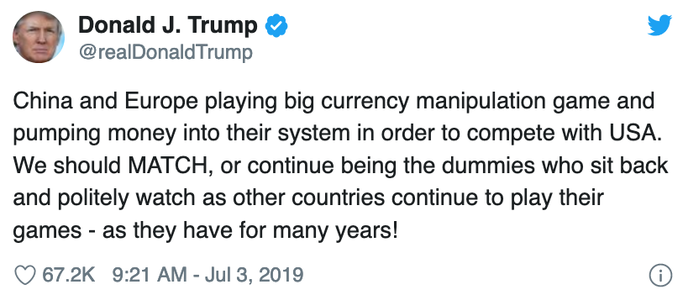
Currency War Today?

Slide 72
Clicker Question
Why did President Trump tweet that “We should … continue being dummies”?
By acting irrational, the US scares other countries into doing what we want
He did not. The “…” in the quotation replaces the word “not”
He was opposing getting into a currency war
He meant that as the alternative that we should not do
✓

Slide 73
Outline: Currency Manipulation and Currency Wars
Currency Manipulation
What it is
Chinese currency manipulation
Other currency manipulation
Currency Wars
History
Currency war today?
Currency war effects

Slide 74
Currency War Effects
Prasad argues that currency war would actually cause dollar to rise, due to uncertainty and “flight to safety”
Note too that while people speak of a “US-China currency war,” neither country can depreciate only with respect to the other.
Their depreciations will hurt others, who will likely respond in kind.

Slide 75
Currency War Effects
If all countries participate, each depreciating by the same percentage, then
Exchange rates do not change
Only effect is the movement of assets into central bank reserves

Slide 76
Currency War Effects
If only some countries participate (or participants depreciate by different amounts) then
Those who depreciate most get increased exports
Stimulating their economies to higher incomes and/or prices
Those who depreciate least get reduced exports
Weakening incomes and prices there
Ideally, countries may use different macro policies to handle these effects

Slide 77
Currency War Effects
Currency War versus Trade War
The tariffs of a trade war distort choices, cause inefficiencies, and reduce welfare
The currency depreciations of a currency war need not distort anything, especially if macro policies adjust for any differences
Thus, if given a choice, I’d prefer a currency war

Slide 78
Clicker Question
What harm will it do if all countries depreciate their currencies by, say 20%?
Countries will cease to import
Consumers will prefer domestic products
World wealth will fall by 20%
Stock markets will crash
No harm.
✓

Slide 79
Next Time
The Euro
What is it?
History of European monetary integration
Pros and cons of currency unification
Effects on US
What happened?

