Slide 1
Lecture 15 International Macroeconomics
Econ 340
Notes:
Delete Perry and Krugman
Add Economist “More Spend, Less Thrift”

Slide 3
Outline: International Macroeconomics
Recall Macro from Econ 102
Aggregate Supply and Demand
Policies
Effects ON the Exchange Market
Expansion
Interest Rate
Effects OF the Exchange Market
Depreciation effects via Trade
Depreciation effects via Net Wealth
Effects THOUGH the Exchange Market

Slide 4
Recall Macro from Econ 102
Aggregate Supply and Demand Determine
Y = GDP = Output = Income
This in turn implies level of Employment
P = Price level

Slide 5
Recall Macro from Econ 102
Long-run Aggregate Supply
P
LRAS
SRAS
Short-run Aggregate Supply
Aggregate Demand
Natural Rate of Output
AD
( = Output at Natural Rate of Unemployment)
Y^{N}
Y
Y

Slide 6
Recall Macro from Econ 102
Macroeconomic Policies
Monetary Expansion = Increase in Money Supply (M)
Open market operations: purchase bonds
Reserve requirement: reduce it
Discount rate: reduce it
Usually indicated by Fed target for Federal Funds Rate
Fiscal Expansion
Increase government purchases (G)
Reduce taxes (or increase transfers) (T)
All of these have the effect of
Increasing aggregate demand
Shifting AD curve to the right
They differ in effects on interest rate (i):
ΔM>0 lowers i
ΔG>0, ΔT<0 raise i

Slide 7
Recall Macro from Econ 102
P
LRAS
SRAS
Long-run change
Short-run change
AD′
AD
Y^{N}
ΔM>0, ΔG>0, or ΔT<0,

Slide 8
Recall Macro from Econ 102
Macroeconomic Policies
Contractionary policies (ΔM<0, ΔG<0, or ΔT>0) are just the opposite
All have only temporary effects on output and employment, but lasting effects on price level
Policies can be useful (if done right) for dealing with temporary problems such as a recession

Slide 9
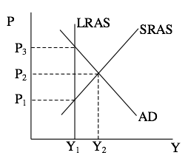
Clicker Question
If the aggregate supply and demand curves in the figure below describe the situation in an economy at some point in time, we would expect at that time to see
More unemployment than normal
GDP at its long-run level
Output at Y₁
Prices rising
Price level at P₁
✓

Slide 10
Outline: International Macroeconomics
Recall Macro from Econ 102
Aggregate Supply and Demand
Policies
Effects ON the Exchange Market
Expansion
Interest Rate
Effects OF the Exchange Market
Depreciation effects via Trade
Depreciation effects via Net Wealth
Effects THOUGH the Exchange Market

Slide 11
Effects ON the Exchange Market
Non-Monetary Expansion
Y rises
P rises
i rises
We’ll always assume that the interest rate effect is larger, because capital today is very mobile
Three cases to consider:
Floating exchange rate
Pegged exchange rate at overvalued rate
Pegged exchange rate at undervalued rate
⇒ imports rise
⇒ D€ shifts right
⇒ capital inflow
⇒ S€ shifts right

Slide 12
US Non-Monetary Expansion:
Floating Exchange Rate
E = $/€
S€⁰
(Due to Δi>0)
S€¹
E⁰
E¹
D€¹
(Due to ΔY>0, ΔP>0)
D€⁰
Q€
ΔG>0, ΔT<0
⇒Causes dollar to appreciate

Slide 13
US Non-Monetary Expansion:
Pegged Exchange Rate - Overvalued
E = $/€
S€⁰
S€¹
I⁰
(I¹ < I⁰)
E*
D€¹
I¹
D€⁰
Q€
ΔG>0, ΔT<0
⇒Less intervention (sells)

Slide 14
US Non-Monetary Expansion:
Pegged Exchange Rate - Undervalued
E = $/€
S€⁰
I⁰
S€¹
E*
I¹
D€¹
D€⁰
Q€
ΔG>0, ΔT<0
⇒More intervention (buys)

Slide 15
Effects ON the Exchange Market
Summary: Non-Monetary Expansion
Results: Effects of non-monetary expansion
Floating exchange rate appreciates
Pegging the exchange rate becomes easier
If reserves were falling (overvalued case) they now fall less rapidly
If reserves were rising (undervalued case) they now rise more rapidly

Slide 16
Effects ON the Exchange Market
Monetary Contraction (i.e., rise in interest rate)
Y falls
P falls
i rises
Assume again that the interest rate effect is larger
Same three cases
Will only show floating case; others are similar
⇒ imports fall
⇒ D€ shifts left
⇒ capital inflow
⇒ S€ shifts right

Slide 17
US Monetary Contraction:
Floating Exchange Rate
E = $/€
S€⁰
(Due to Δi>0)
S€¹
E⁰
E¹
D€⁰
(Due to ΔY<0, ΔP<0)
D€¹
Q€
ΔM<0
⇒Causes dollar to appreciate

Slide 18
Effects ON the Exchange Market
Summary: Monetary Contraction
Assuming (always) that the interest-rate effect on capital flows is larger than the income and price effects on trade
Monetary contraction has essentially the same effects on the exchange market as a non-monetary (e.g., fiscal) expansion
Reason:
Only the interest rate really matters, due to assumption that capital flows dominate
And both fiscal expansion and monetary contraction raise the interest rate

Slide 19
Clicker Question
Which of the following, in the US, would cause the US dollar to depreciate?
Non-monetary expansion under a floating exchange rate
Non-monetary expansion under a pegged exchange rate
Monetary expansion under a floating exchange rate
Monetary expansion under a pegged exchange rate
None of the above, as the US dollar is a reserve currency
✓

Slide 20
Clicker Question
If a country with a pegged exchange rate is losing international reserves and is in danger of running out, which of the following actions will slow the outflow?
Monetary contraction
Tax increase
Reduction in government spending
Currency appreciation
None of the above. Once started, an outflow cannot be stopped
✓

Slide 21
Clicker Question
In the graph, China’s currency is floating. Which of the following macro changes by China would cause the curves to shift as shown?
Monetary expansion
Non-monetary expansion
Monetary contraction
Non-monetary contraction
Currency appreciation
E = ¥/$
S’$
✓
S$
E₀
Opposite of the non-monetary expansion shown above. Contraction causes income and imports to fall, reducing D$. Fiscal contraction reduces interest rate, reducing capital inflow and S$.
D$
D’$
Q$

Slide 22
Outline: International Macroeconomics
Recall Macro from Econ 102
Aggregate Supply and Demand
Policies
Effects ON the Exchange Market
Expansion
Interest Rate
Effects OF the Exchange Market
Depreciation effects via Trade
Depreciation effects via Net Wealth
Effects THOUGH the Exchange Market

Slide 23
Effects OF the Exchange Market
Under a pegged exchange rate, the exchange market has little effect on the economy unless the pegged rate itself is changed
Exception: without sterilization, domestic money supply is sensitive to trade and capital flows
Under a floating exchange rate, movement of the exchange rate can matter a lot

Slide 24
Effects OF the Exchange Market
Thus, in both cases, we want to know effects of changing the exchange rate
We’ll look only at an exchange depreciation
(Usually called a “devaluation” when a pegged exchange rate is depreciated)

Slide 25
Effects OF the Exchange Market
Two Major Effects of Exchange-Rate Depreciation
Trade Effect
Depreciation makes country’s goods cheaper
Wealth Effect
Depreciation makes country’s assets cheaper

Slide 26
Effects OF the Exchange Market
Trade Effect of Depreciation
ΔE>0
Stimulates exports
(they are cheaper to foreigners)
Retards imports
(they are more expensive for domestic buyers)
Thus depreciation increases aggregate demand (AD)
Stimulates economy
P
LRAS
SRAS
AD′
AD
Y^{N}

Slide 27
Effects OF the Exchange Market
Wealth Effect of Depreciation
If assets and liabilities are in same currency, then little effect
If assets and liabilities are in different currencies, one home and the other foreign, then BIG EFFECT

Slide 28
Effects OF the Exchange Market
A common case of Wealth Effect, especially in
Developing countries in the past
Many countries more recently in financial crises
Countries have borrowed abroad to finance domestic investment
Assets are in home currency
Liabilities are in foreign currency
Then depreciation causes a huge drop in net wealth

Slide 29
Effects OF the Exchange Market
Example: Effect of 20% depreciation of Mexican peso (p): E=10p/$ → 12p/$
Case 1: Assets and liabilities both in pesos
Case 2: Assets in pesos but liabilities in $

Slide 30
Effects OF the Exchange Market
Before E = 10 p/$
After E = 12 p/$
Case 1:
in pesos
in $
in $
Assets
1000 p
= (100 $)
≈ 80 $
Initial
Liabilities
−900 p
= (−90 $)
≈ −72 $
Net Wealth
100 p
= (+10 $)
+8 $
20% loss of net worth
(in $)

Slide 31
Effects OF the Exchange Market
Before E = 10 p/$
After E = 12 p/$
Case 2:
in pesos
in $
in $
Assets
1000 p
= (100 $)
≈ 80 $
Initial
Liabilities
−900 p =
−90 $
= −90 $
Net Wealth
100 p
= (+10 $)
−10 $
Bankrupt!

Slide 32
Effects OF the Exchange Market
Wealth Effect of Depreciation
This is exactly what happened to lots of developing countries when they had an Exchange Crisis and their currencies suddenly depreciated
The wealth effect overwhelms any beneficial effect that the country might otherwise feel from a boost in exports

Slide 33
Effects OF the Exchange Market
Wealth Effect of Depreciation
It is also what happened in 2008 to
Iceland
Latvia
Perhaps others in Eastern Europe
They had liabilities denominated in euros, and then their own currencies fell.
(It is not what is happened in 2010 to Greece. Their debt and assets were both in euros, and they had no currency of their own. They just borrowed more than they could repay.)

Slide 34
Notes:
Source: IMF IFS

Slide 35
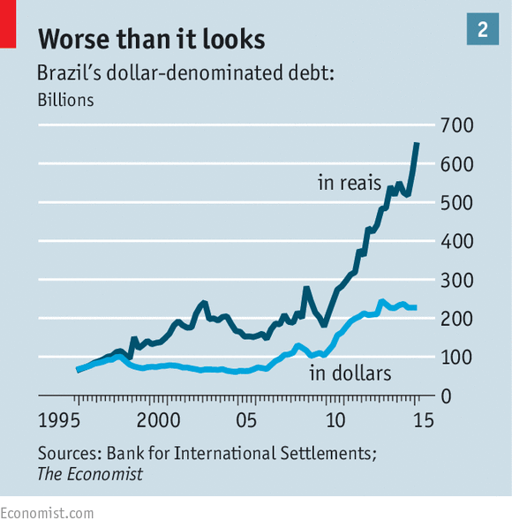
Another recent example: Brazil
Notes:
Source: IMF IFS

Slide 36
Effects OF the Exchange Market
More recent large depreciations
Argentina
Turkey

Slide 37
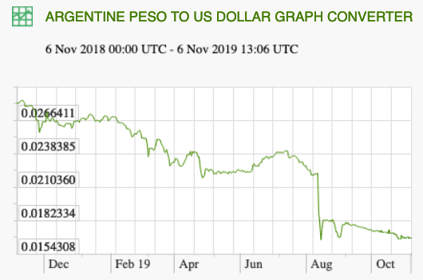
38%

Slide 38
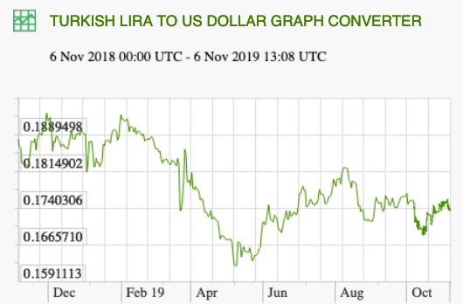
16%
There was a much bigger drop in July 2018

Slide 39
Effects OF the Exchange Market
Example of a different sort: Appreciation of the Chinese Yuan (aka renminbi)
For many years, the yuan was pegged to the US dollar
On July 21, 2005, China
Changed to pegging to a basket of currencies
The yuan appreciated by 2%
After that it rose by about another 20%
The increase stopped at the start of the financial crisis, in July 2008
It rose slowly since then, for a while and then fell more recently (as we saw in the graph last time)

Slide 40
Effects OF the Exchange Market
Effects of the Yuan Appreciation
(See reading by Stiglitz)
Change was gradual, rising only about 6% per year
Wealth effect
For US, negligible, since our debt is in dollars
For China, there was some decline in yuan value of their dollar assets

Slide 41
Effects OF the Exchange Market
Effects of any Yuan Appreciation
Trade effect
Effects on prices
US goods become cheaper to China
Chinese goods become dearer to US
(But note, from Stiglitz: Chinese exports to the US have 70-80% import content; thus yuan matters little)
Helps US sales, hurts Chinese sales

Slide 42
Effects OF the Exchange Market
Effects of the Yuan Appreciation
Other effects
Helps China fight inflation and excessive monetary expansion and credit growth
Permits increased consumption in China

Slide 43
Effects OF the Exchange Market
Are these the actual reasons for the yuan appreciations of 2005-12?
No
US had been
Pressing China for years to stop holding down the value of the yuan
Threatening increased protection against Chinese exports
Idea was that appreciation would reduce the Chinese bilateral trade surplus with the US, & thus reduce the US deficit
China refused to be bullied, but perhaps it was

Slide 44
Effects OF the Exchange Market
Will a further Yuan Appreciation Change the US Trade Balance?
Probably not
To do so, it would have to change US saving and investment
It’s not clear why an appreciation would do that
One possibility (see Stiglitz, writing in 2005)
Chinese spending increases
They stop financing the US current account deficit
US interest rates rise
US housing bubble bursts
US spending would fall
(First 2 didn’t happen; second 2 did.)

Slide 45
Effects OF the Exchange Market
Most recently, the Chinese yuan depreciated in 2016, instead of appreciating, as it had been doing for years.
It rose in 2017 but has been depreciating again recently.

Slide 46
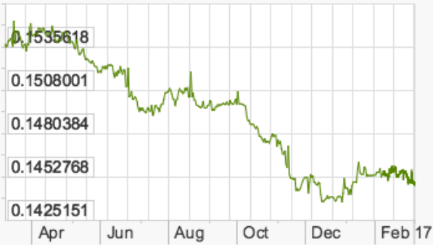
US$/Yuan 2016-17
6.6%

Slide 47
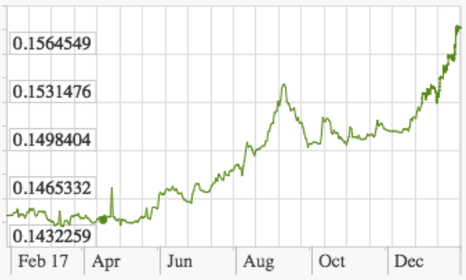
US$/Yuan 2017
9.2%

Slide 48
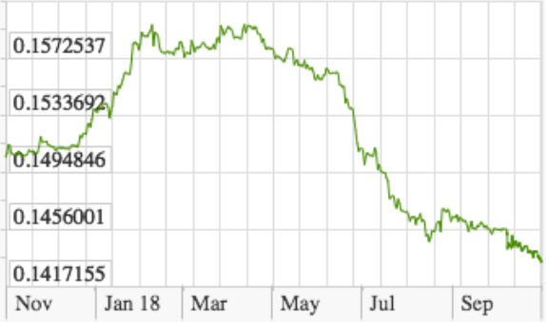
US$/Yuan 2018
9.7%

Slide 49
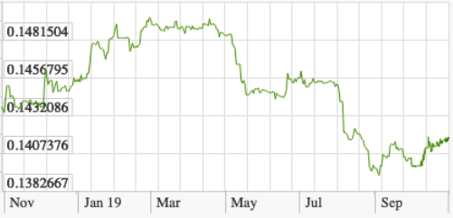
US$/Yuan 2019
7.2%

Slide 50
China’s Exchange Rate, US$/Yuan, 2000-2019
Notes:
China currency.xlsx
From IMF, IFS

Slide 51
Effects OF the Exchange Market
The depreciation in 2016 was done deliberately by the Chinese central bank
Purpose was, initially, to discourage those who had been bringing funds into China.
But for most of this period it was trying to slow down the depreciation that the market was causing.

Slide 52
Effects OF the Exchange Market
Another Example: The Depreciation of the US Dollar
Quite aside from what happened to the yuan, the US dollar depreciated over several years
Mann and Plück, writing in 2005, say that it fell by 25%
What were the effects of the fall?

Slide 53
Effects OF the Exchange Market
Notes:
Source: IMF IFS, “Dollar vs Five 2000-17.xlsx”

Slide 54
Effects OF the Exchange Market
Effects of the Dollar Depreciation
Did this help the US trade balance? No!
For more reasons see Mann and Plück
Lots of US imports come from countries whose currencies didn’t appreciate (China, Thailand), or even depreciated (Mexico)
“Pass-through” is low in the US market: 10% fall in $ only causes 2.5 - 4.0% rise in import prices
Note that the dollar depreciated less vis a vis China than vis a vis Canada & euro.

Slide 55
Clicker Question
In the Great Depression of the 1930s, countries used “competitive devaluations” of their currencies. What did they expect these devaluations to do?
Expand aggregate supply
Expand aggregate demand
Reduce the value of their debts
Reduce the value of their assets
Force other countries to devalue also
✓

Slide 56
Clicker Question
If you knew that your country’s currency, the drachma, was about to depreciate, in which of the following cases would that help you most (or hurt you least)?
Your debts and assets are both in drachmas
Your debts are in drachmas and assets in dollars
Your debts are in dollars and assets in drachmas
Your debts and assets are both in dollars
✓

Slide 57
Clicker Question
Why, in the graph, was Brazil’s debt rising more in reals than in dollars?
Its currency, the real, was depreciating
Its currency, the real, was appreciating
Its currency, the dollar, was depreciating
Its currency, the dollar, was appreciating
✓

Slide 58
Outline: International Macroeconomics
Recall Macro from Econ 102
Aggregate Supply and Demand
Policies
Effects ON the Exchange Market
Expansion
Interest Rate
Effects OF the Exchange Market
Depreciation effects via Trade
Depreciation effects via Net Wealth
Effects THOUGH the Exchange Market

Slide 59
Effects THROUGH the Exchange Market
The issue here:
Do macroeconomic effects get transmitted to other countries, and if so how?
i.e., does an expansion, for example, in one country cause an expansion or a contraction in other countries?

Slide 60
Effects THROUGH the Exchange Market
The answer: Although many exceptions are possible, it is usually true that changes in one country cause changes in the same direction in others:
Expansion here → expansion there
Inflation here → inflation there
High interest rates here → high interest rates there

Slide 61
Effects THROUGH the Exchange Market
Example: How a recession in US can cause recession Canada
Fall in aggregate demand in US (due to non-monetary contraction such as a fall in investment) leads to
Fall in US income, leads to
Fall in Canadian exports to US, leads to
Fall in Canadian income
To see these links in more detail…

Slide 62
US Investment Falls
US Income Falls
US Imports Fall
US Interest Rate Falls
US Dollar Depreciates
US Imports Fall More
Canadian Exports Fall
Canadian AD Falls
Canadian Income Falls

Slide 63
Effects THROUGH the Exchange Market
We saw some of this dramatically in the global financial crisis of 2008:
Crisis started in US
Effects were transmitted to the world
Exception: US dollar did not depreciate immediately; it appreciated at first. (Due to “flight to safety.”)

Slide 64
Effects THROUGH the Exchange Market
The lesson from this is that countries’ macro policies and macro performance matter for other countries
See Economist, “More Spend, Less Thrift”
Countries that run large surpluses
In both government budgets and current account
Impose costs on other countries.
“Seemingly prudent budgeting in economies like Germany’s produce dangerous strains globally.”

Slide 65
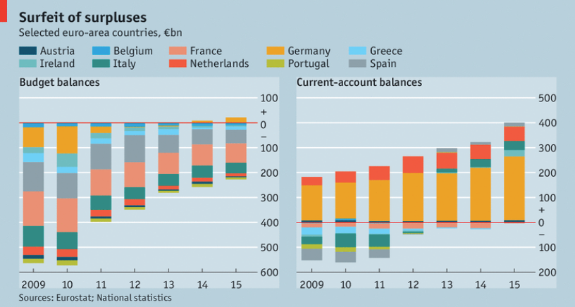

Slide 66
Effects THROUGH the Exchange Market
Why is one country’s surplus harmful to others?
Because it means that the country is buying less, in particular from other countries, and this puts downward pressure on their economies.
This has been especially problematic recently, because interest rates have been so low that monetary authorities haven’t had scope for offsetting it.

Slide 67
Clicker Question
How would you expect the government of Mexico to view the tax cut enacted in 2017 by the US, and why?
They like it, because it gives the US less money to build a wall
They don’t like it, because it will benefit Americans at their expense
They like it, because it will stimulate the Mexican economy
They don’t like it, because it makes their enemy, Trump, more popular
✓

Slide 68
Next Time
Currency Manipulation and Currency Wars
What are they?
History

