Slide 1
Econ 340
Lecture 13
Exchange Rates
Notes:
Replace with new Big Mac piece

Slide 2
Outline: Exchange Rates
In What Forms Are Exchange Rates Reported?
  Bilateral Nominal Rates
  Multilateral (Trade-Weighted) Rates
  Real Rates
  Forward Rates
What Determines Exchange Rates?
  Markets
  Governments/Central Banks
Theories of Exchange Rates
  Purchasing Power Parity
  Asset Theory
  Supply and Demand Model

Slide 3
Forms of Exchange Rates
What Is an Exchange Rate?
  The price of one currency in terms of another
  Examples
    Recent rates for the US $ vs the € (euro) and ¥ (yen) were
 | Oct 22, 2019 | Oct 23, 2018
$/ € | 1. 1150 | 1.1471
€/$ | 0.8969 | 0. 8718
$/ ¥ | 0.00921 | 0.00889
¥/$ | 108.60 | 112.44
Notes:
WSJ: http://online.wsj.com/mdc/public/page/2_3021-forex.html?mod=2_0032

Slide 4
Forms of Exchange Rates
What Is an Exchange Rate?
  Rates are reported both ways, which can be confusing:
    i.e., “The Japanese yen rose today from 95 to 90”
    Makes sense because the numbers are understood to be ¥/$, not $/¥, so the change from 95 to 90 is in fact a rise in the value of the yen

Slide 5
Forms of Exchange Rates
Sources of Exchange Rates
  Wall Street Journal
    Each day includes a table with rates for yesterday and the day before for a few dozen currencies
    Also used to report forward rates and trade-weighted indexes for major currencies (see later)
  IMF, online and in various publications
  x-rates.com flexible tool for rates in various forms

Slide 6
Forms of Exchange Rates
Bilateral Nominal Exchange Rates
  These are what we normally see: the actual rate between a pair of currencies
    Don’t need to say “bilateral” or “nominal” except when comparing to something other than these.
  Note that the size of an exchange rate means very little
    Whether euro is worth more, or less, than a dollar is not important
    That the yen is worth about one US cent means nothing
    But see reading on “Currency Envy”. People do care!

Slide 7
Outline: Exchange Rates
In What Forms Are Exchange Rates Reported?
  Bilateral Nominal Rates
  Multilateral (Trade-Weighted) Rates
  Real Rates
  Forward Rates
What Determines Exchange Rates?
  Markets
  Governments/Central Banks
Theories of Exchange Rates
  Purchasing Power Parity
  Asset Theory
  Supply and Demand Model

Slide 8
Forms of Exchange Rates
Multilateral Exchange Rates
  Bilateral rates only tell value of a currency relative to a single other currency
  If you want the overall value of a currency, you need an index relative to many others
  An index requires weighting by the importance of the other currencies
  Typically, multilateral exchange rates are “trade weighted” (weighted by bilateral exports and/or imports between the countries)

Slide 9
Source: Federal Reserve, “Broad Index” based on a large group of currencies, monthly data
Notes:
http://www.federalreserve.gov/releases/h10/summary/

Slide 10
Forms of Exchange Rates
Interpretation
  From the graph, until 2002 the dollar rose relative to other currencies
    By 2002 it was 4 times higher than in 1973
    Why?
  We’ll see later that rates of inflation (of prices) are important for exchange rates
  This suggests looking at real exchange rates, as well as nominal

Slide 11
Outline: Exchange Rates
In What Forms Are Exchange Rates Reported?
  Bilateral Nominal Rates
  Multilateral (Trade-Weighted) Rates
  Real Rates
  Forward Rates
What Determines Exchange Rates?
  Markets
  Governments/Central Banks
Theories of Exchange Rates
  Purchasing Power Parity
  Asset Theory
  Supply and Demand Model

Slide 12
Forms of Exchange Rates
Real Exchange Rates
  Like real wages or real incomes, a real exchange rate is simply
    Corrected for inflation,
    or equivalently
    Deflated by (i.e., divided by) a price index
  But an exchange rate involves two currencies: Whose prices do you use?
    Answer: Both!

Slide 13
Forms of Exchange Rates
Real Exchange Rates
  Let
    E = €/$ be the euro/dollar nominal exchange rate
    P^{e} = price level (index) in Europe (€ per EU-good)
    P^{u} = price level (index) in US ($ per US-good)
  Then Real Exchange rate is
  R = EP^{u}/P^{e}
  Note that this divides each currency by its own price level:
  R= (€/$)(P^{u}/P^{e}) = (€/P^{e}) / ($/P^{u})
=(€/$) ($/US-good)/(€/EU-good)
= (EU-good/US-good)

Slide 14
Source: Federal Reserve, “Broad Index” based on a large group of currencies, monthly data
Notes:
http://www.federalreserve.gov/releases/h10/Summary/indexbc_m.txt
Dollar Index Broad Real 2007.xls

Slide 15
Forms of Exchange Rates
Real Exchange Rates
  From the graph, note that
    The rise in the dollar 1973-2002 was not real
    Decline of the dollar since 2002 was real
    So was the brief rise (during the crisis), and then fall
    And so was the rise after mid-2014
    And the fall during 2017 and rise during 2018
    But the real value of the dollar today is not unusually low or high
      It is basically at its long-term average

Slide 16
Outline: Exchange Rates
In What Forms Are Exchange Rates Reported?
  Bilateral Nominal Rates
  Multilateral (Trade-Weighted) Rates
  Real Rates
  Forward Rates
What Determines Exchange Rates?
  Markets
  Governments/Central Banks
Theories of Exchange Rates
  Purchasing Power Parity
  Asset Theory
  Supply and Demand Model

Slide 17
Forms of Exchange Rates
Forward Exchange Rates
  These are rates of exchange for later, not today
    (Rates for exchange today are called “spot rates.” That’s what we’ve been looking at so far.)
    In a forward market, no money changes hands today; a forward exchange is a contract, for both buyer and seller to transact
      1 month from now
      3 months from now
      6 months from now
Most common forward contracts; rates used to be reported in WSJ

Slide 18
Forms of Exchange Rates
Forward Exchange Rates
  Example (from WSJ) for 3/3/14:
  Here, the Australian $ costs (today) less for future delivery than for spot delivery. That is, it is selling at a “forward discount”. The Swiss franc costs more for future delivery than spot, and so is at a “forward premium.”
  Each maturity is a separate market.
 | US$/A$ | US$/Sfr
Spot | 0.8937 | 1.1323
1 Month Forward | 0.8917 | 1.1326
3 Month Forward | 0.8882 | 1.1332
6 Month Forward | 0.8828 | 1.1342

Slide 19
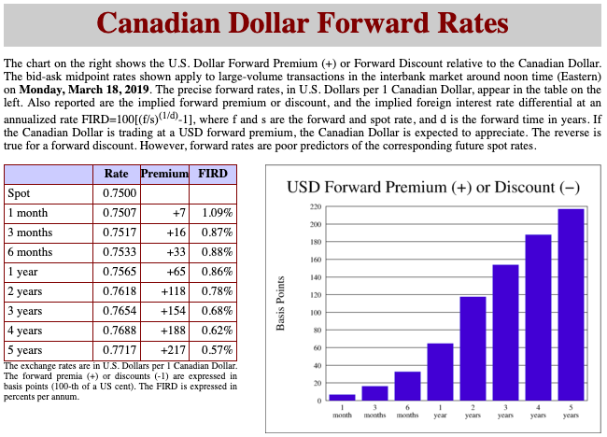
Source: Werner Antweiler, Sauder School of Business, University of British Columbia
Notes:
http://fx.sauder.ubc.ca/CAD/forward.html

Slide 20
Forms of Exchange Rates
Forward Exchange Rates
  Who uses the forward market, and why?
    Traders, who wish to “hedge” (i.e., avoid risk)
    Speculators, who wish to bet that the spot rate will change (i.e., they take on risk)
    There are also specialists who make a profit from discrepancies involving the forward rate, the spot rate, and interest rates in the two countries; this is called “covered interest arbitrage”

Slide 21
Outline: Exchange Rates
In What Forms Are Exchange Rates Reported?
  Bilateral Nominal Rates
  Multilateral (Trade-Weighted) Rates
  Real Rates
  Forward Rates
What Determines Exchange Rates?
  Markets
  Governments/Central Banks
Theories of Exchange Rates
  Purchasing Power Parity
  Asset Theory
  Supply and Demand Model

Slide 22
What Determines Exchange Rates?
Two things determine exchange rates:
  Markets; i.e., supply and demand
    Like any other price
    We’ll look at the markets later today
  Governments and/or Central Banks
    This is true IF they intervene in the markets, which they often do
    We’ll look at such intervention in the next lecture

Slide 23
What Determines Exchange Rates?
We’ll look at 3 theories of exchange rates:
  PPP = Purchasing Power Parity
    Very useful, but mostly wrong
    Works best, if ever, only in the very long run
  Asset Theory (not in textbook)
    Always right! But useless
  Supply and Demand Model
    Best for understanding what has happened
    Not much help in predicting the future
    (Nothing is much help in predicting! We’ll see why.)

Slide 24
Outline: Exchange Rates
In What Forms Are Exchange Rates Reported?
  Bilateral Nominal Rates
  Multilateral (Trade-Weighted) Rates
  Real Rates
  Forward Rates
What Determines Exchange Rates?
  Markets
  Governments/Central Banks
Theories of Exchange Rates
  Purchasing Power Parity
  Asset Theory
  Supply and Demand Model

Slide 25
Purchasing Power Parity
The PPP Theory:
  If one country’s prices are rising faster than another’s, then the currency of the first should depreciate:
  As a country’s goods get more expensive, its currency should get less expensive
    Thus keeping it competitive
Exchange rate reflects relative purchasing powers of two currencies

Slide 26
Purchasing Power Parity
The Prediction of PPP:
  For the bilateral exchange rate between currencies of two countries, A and B
  A’s rate of currency depreciation
  = A’s rate of price inflation
  minus
  B’s rate of price inflation

Slide 27
Purchasing Power Parity
PPP is used to guess whether a currency is
“Overvalued” (i.e., worth more than it “should be”)
or
“Undervalued” (worth less than it “should be”)
E.g., if a currency has not depreciated in spite of the country having higher inflation than others, we say that its currency is now overvalued

Slide 28
Purchasing Power Parity
Implication of PPP: The Real Exchange Rate should be constant
Recall: R = EP^{u}/P^{e} where E = €/$
If E falls at the same rate that the rise in P^{u} exceeds the rise in P^{e}, then R is constant
Does it work? Look again at graph of real value of the dollar…

Slide 29
Source: Federal Reserve, “Broad Index” based on a large group of currencies, monthly data
Trade-Weighted Dollar Index (Real)
PPP fails
PPP restored
Departures from PPP last several years
Notes:
http://www.federalreserve.gov/releases/h10/Summary/indexbc_m.txt
Dollar Index Broad Real 2007.xls

Slide 30
Purchasing Power Parity
Which Prices Should One Use for PPP?
  Most would say to use the CPI = Consumer Price Index
  The Economist (for fun) uses the price of the MacDonald’s Big Mac hamburger
    See reading: “The Big Mac Index” July 2019
    The message here: price of the Big Mac can be an indicator of whether a currency is over- or under-valued.
      The Big Mac costs more than in the US in only a few countries, which suggests that the US dollar is over-valued.
      In an earlier report, they noted that, measured in burgers, US GDP was 3,682 billion and China’s GDP was 3,931 billion. Thus China’s economy was already larger than the US, measured in burgers, because the burger was cheaper there.

Slide 31
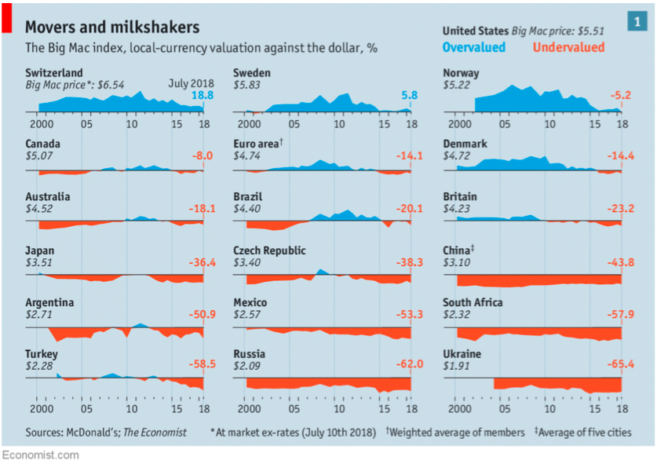
Currencies from Big Mac Index July 2018 (similar to 2019, but easier to display)

Slide 32
Purchasing Power Parity
Another message also from an earlier report of the Big Mac Index:
  Exchange rates of poor countries tend to be low, compared to PPP, while those of rich countries tend to be high.
    Reason: prices of some goods, including a hamburger, depend heavily on local inputs (rents, wages) that tend to be lower in poor countries.
    Therefore it is best to only compare countries with similar incomes.
    You can get a sense of that from several above.
    Also, see the following graph from July 2011:

Slide 33
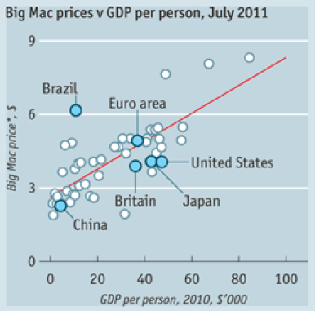

Slide 34
Outline: Exchange Rates
In What Forms Are Exchange Rates Reported?
  Bilateral Nominal Rates
  Multilateral (Trade-Weighted) Rates
  Real Rates
  Forward Rates
What Determines Exchange Rates?
  Markets
  Governments/Central Banks
Theories of Exchange Rates
  Purchasing Power Parity
  Asset Theory
  Supply and Demand Model

Slide 35
Asset Theory of the Exchange Rate
The Asset Theory:
  Reason: Attempts to move assets quickly would swamp the market
Exchange rate adjusts to eliminate the motive to shift assets between currencies

Slide 36
Asset Theory of the Exchange Rate
The Asset Theory:
  Implication
  Reason: If it were not, then
    Huge amounts of money would try to flow toward the currency that is expected to appreciate
    Market would be in disequilibrium (D>S)
    Exchange rate would instantly appreciate until it equaled what people expected
Exchange rate must already be whatever people think it is about to be

Slide 37
Asset Theory of the Exchange Rate
The Asset Theory:
  Implications:
    Rates change whenever expectations of rates change
    Rates are very volatile
    Rates do respond to normal economic forces (like shifts in supply and demand below),
      but they respond as soon as those forces are expected,
      they don’t wait for the shifts themselves.
    Rates also respond to “investor psychology,” which may be irrational (e.g., herd behavior)

Slide 38
Outline: Exchange Rates
In What Forms Are Exchange Rates Reported?
  Bilateral Nominal Rates
  Multilateral (Trade-Weighted) Rates
  Real Rates
  Forward Rates
What Determines Exchange Rates?
  Markets
  Governments/Central Banks
Theories of Exchange Rates
  Purchasing Power Parity
  Asset Theory
  Supply and Demand Model

Slide 39
Supply and Demand Model of the Market for Foreign Exchange
Market is for two currencies, so it is arbitrary which currency we consider as
  the one that is being traded, and
  the one that is being used to pay for it

Slide 40
Supply and Demand Model of the Market for Foreign Exchange
To fix these, we will consider the market from the perspective of a domestic country
  Trading a foreign currency
  Paid for with its own currency
  Hence it really is the market for foreign exchange

Slide 41
Supply and Demand Model of the Market for Foreign Exchange
We say foreign “exchange” rather than foreign “currency”
  This is not the market for holding currency, such as you studied in Econ 102 (e.g., the Money Market)
  It is the market for exchanging one currency for another,
    usually with the intention of using the acquired currency to buy goods or other assets, not to hold it.

Slide 42
Supply and Demand Model of the Market for Foreign Exchange
In graphs below,
  own currency is $ and
  foreign currency is €
  Thus it is the market for (foreign currency) € in terms of (home currency) $
But
  you should be able to do this with any two currencies
  Including having the dollar as another country’s foreign currency

Slide 43
Supply and Demand Model of the Market for Foreign Exchange
E = $/€
S€ = Supply of €
Price of € =
(Exchange Rate)
E⁰
Equilibrium Exchange Rate
D€ = Demand for €
Q€ = Quantity of €

Slide 44
Supply and Demand Model of the Market for Foreign Exchange
Sources of Supply of €
  US Exports (i.e., Europe’s imports)
  US Capital Inflows (i.e., Europe’s outflows)
  Other
    US investment income receipts
    Transfers into US
    Etc.
  (Thus, all credits in the Balance of Payments)

Slide 45
Supply and Demand Model of the Market for Foreign Exchange
Sources of Demand for €
  US Imports (i.e., Europe’s exports)
  US Capital Outflows (i.e., Europe’s inflows)
  Other
    US investment income payments
    Transfers out
    Etc.
  (Thus all debits in the Balance of Payments)

Slide 46
Supply and Demand Model of the Market for Foreign Exchange
Use of the model
  Figure out how an event will change one or more of these sources of supply and demand
  Shift the curve or curves accordingly
  Read from the diagram what happens to the exchange rate

Slide 47
Supply and Demand Model of the Market for Foreign Exchange
Use of the model
  Note that the price in the diagram, E=$/€, is the price of foreign currency, not the dollar
  Thus
  if E rises that is a dollar depreciation
  if E falls that’s a dollar appreciation
  This can be confusing. Remember, this is the market for, and E is the price of, foreign exchange

Slide 48
Supply and Demand Model of the Market for Foreign Exchange
Implications of the Model
  US Tariff Increase on lots of goods
    (e.g., Nixon’s 10% surcharge on imports in 1971
    or a broad tariff increase now to add jobs)
    Reduces demand for imports
    Reduces demand for €
    Shifts D€ left

Slide 49
US Tariff Increase
E = $/€
S€⁰
E⁰
E¹
D€⁰
D€¹
Q€
Causes dollar to appreciate
  (which hurts exports)

Slide 50
Supply and Demand Model of the Market for Foreign Exchange
Implications of the Model
  Could apply to Trump’s tariffs, especially on China.
    Model says dollar should appreciate.
    It did over the last two years:

Slide 51
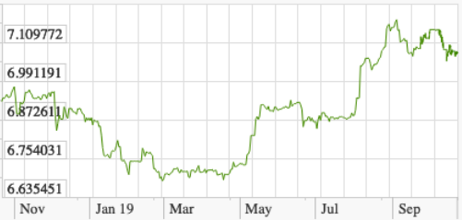
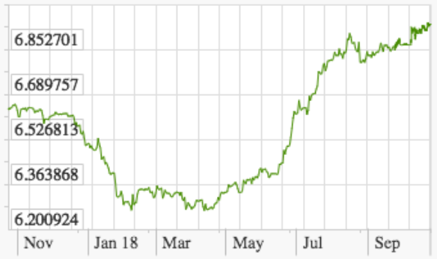
Source: X-Rates.com
Renminbi per dollar:
Sep 2018
Sep 2019
Sep 2017

Slide 52
Supply and Demand Model of the Market for Foreign Exchange
Implications of the Model
  US Interest Rate Increase
    Makes US bonds more attractive
    Causes increased capital inflow to US
    Increases demand for $ and thus supply of €
    Shifts S€ right
  This also causes the $ to appreciate
    As it has done recently, with the Fed raising interest rates

Slide 53
US Interest Rate Increase
E = $/€
S€⁰
S€¹
E⁰
E¹
D€⁰
Q€
Causes dollar to appreciate

Slide 54
Supply and Demand Model of the Market for Foreign Exchange
Implications of the Model
  Other examples of changes that will also cause the US dollar to appreciate (you should be able to argue and demonstrate these also):
    Increase in demand for US exports
    Fall in foreign interest rates
    Increase in perceived riskiness of foreign assets
    Fall in US transfer payments to foreigners
  Opposites of all these will cause dollar to depreciate

Slide 55
Next Time
Pegging the Exchange Rate
  How it’s done
  Who does it
  Effects of pegging

