Slide 1
Lecture 12 The Balance of Trade and International Transactions
Econ 340
Notes:
Deleted Feldstein
Added Mankiw

Slide 2
News: Oct 14-27
South Korea Agrees to drop developing country status in WTO -- FT: 10/25 | Canvas
The WTO gives special privileges to "developing countries," but lets countries self-identify as that. President Trump has complained about that, arguing that many such countries are now high-income.
South Korea, such a relatively high-income country, this week responded to the Trump Administration's pressure and agreed to drop that designation.
The action is expected to put pressure on other countries also to give up developing-country status. Countries that Trump had identified in July as having "unsupportable" developing country designations include China, as well as South Korea, Hong Kong (not a country), Singapore, Qatar and the United Arab Emirates.
The US will stop preferential treatment for exports from Thailand -- FT: 10/26 | Canvas
The US, like other developed countries, applies the Generalized System of Preferences to most developing countries. This means applying tariffs on many of their exports (though not all) that are lower than the MFN tariffs they applies to richer countries.
The Trump administration has announced that it will suspend that preferential treatment for $1.3 billion of exports from Thailand, including all seafood products. The reason given for this the failure of Thailand to enforce worker rights.
"The country has faced criticism from the US and EU for its tolerance of human trafficking, forced labour, and modern-day slavery, notably in the seafood and fishing industries — practices Thai authorities and companies have since taken steps to combat."
World Bank issues its latest country ranking of Doing Business -- WSJ: 10/25 | Canvas | Economist: 10/24 | FT: 10/23 | Canvas
The World Bank published an annual ranking of countries by the ease of "Doing Business" in them. This year's ranking just came out.
Some notable features of the latest ranking: China moved from 78th to 31st in the last three years, now topping France. India has risen steadily and now tops Luxembourg. New Zealand continues to top the rankings, and Somalia is at the bottom.
The ranking has become in indicator that many leaders and countries, especially in the developing world, strive to work their way up in. As a result, it is argued to be less useful than when it originated, as countries are able to game the system once they know the criteria.
British Prime Minister seeks Brexit extension -- NYT: 10/19 | Canvas | FT: 10/20 | Canvas
Earlier in the week, Boris Johnson reached agreement with the EU on Brexit. The agreement would avoid the hard border in Ireland/Northern Ireland but require a maritime border between Northern Ireland and the rest of the UK.
He took the deal to the British House of Commons, having them meet on a Saturday for the first time in over 30 years. He failed to get approval, leaving the status of the deal in the UK unclear as the October 31 deadline for exit approaches.
Late on Saturday, as required by earlier legislation, he sent an unsigned letter to the EU requesting an extension. But he also sent a letter saying that a further extension would be damaging. And it appears that he still hopes to get the deal approved by Parliament.
G20 Finance Ministers seeking to revise international tax for the digital age -- WSJ: 10/18 | Canvas | FT: 10/18 | Canvas
Countries are debating "new global rules to coordinate corporate taxes." For almost a century, the practice has been to tax corporate profits based on the physical presence of a company in a jurisdiction. This is understood to be inadequate for the modern world in which digital companies earn profits in countries without a physical presence. Those governments are unable, therefore, to tax those profits.
In response to the failure to find a coordinated approach several countries have unilaterally levied taxes on such companies, most of which are based in the United States. France led the way with a 3% tax earlier this year, informally called the "web tax," and several other countries have announced similar plans. The United States has threatened retaliation against the French tax.
The United States is, however, participating in the discussions overseen by the OECD and led by Japan, to find new practices of corporate taxation that all can agree on. The discussions are taking place in Washington, DC.

Slide 3
News: Oct 14-27
British Prime Minister seeks Brexit extension
Earlier in the week, Boris Johnson reached agreement with the EU on Brexit. The agreement would avoid the hard border in Ireland/Northern Ireland but require a maritime border between Northern Ireland and the rest of the UK.
He took the deal to the British House of Commons, having them meet on a Saturday for the first time in over 30 years. He failed to get approval, leaving the status of the deal in the UK unclear as the October 31 deadline for exit approaches.
Late on Saturday, as required by earlier legislation, he sent an unsigned letter to the EU requesting an extension. But he also sent a letter saying that a further extension would be damaging. And it appears that he still hopes to get the deal approved by Parliament.

Slide 4
News: Oct 14-27
G20 Finance Ministers seeking to revise international tax for the digital age
Countries are debating "new global rules to coordinate corporate taxes." For almost a century, the practice has been to tax corporate profits based on the physical presence of a company in a jurisdiction. This is understood to be inadequate for the modern world in which digital companies earn profits in countries without a physical presence. Those governments are unable, therefore, to tax those profits.
In response to the failure to find a coordinated approach several countries have unilaterally levied taxes on such companies, most of which are based in the United States. France led the way with a 3% tax earlier this year, informally called the "web tax," and several other countries have announced similar plans. The United States has threatened retaliation against the French tax.
The United States is, however, participating in the discussions overseen by the OECD and led by Japan, to find new practices of corporate taxation that all can agree on. The discussions are taking place in Washington, DC.

Slide 5
News: Oct 14-27
South Korea Agrees to drop developing country status in WTO
The WTO gives special privileges to "developing countries," but lets countries self-identify as that. President Trump has complained about that, arguing that many such countries are now high-income.
South Korea, such a relatively high-income country, this week responded to the Trump Administration's pressure and agreed to drop that designation.
The action is expected to put pressure on other countries also to give up developing-country status. Countries that Trump had identified in July as having "unsupportable" developing country designations include China, as well as South Korea, Hong Kong (not a country), Singapore, Qatar and the United Arab Emirates.

Slide 6
News: Oct 14-27
The US will stop preferential treatment for exports from Thailand
The US, like other developed countries, applies the Generalized System of Preferences (GSP) to most developing countries. This means applying tariffs on many of their exports (though not all) that are lower than the MFN tariffs they applies to richer countries.
The Trump administration has announced that it will suspend that preferential treatment for $1.3 billion of exports from Thailand, including all seafood products. The reason given for this the failure of Thailand to enforce worker rights.
"The country has faced criticism from the US and EU for its tolerance of human trafficking, forced labour, and modern-day slavery, notably in the seafood and fishing industries — practices Thai authorities and companies have since taken steps to combat."

Slide 7
News: Oct 14-27
World Bank issues its latest country ranking of Doing Business
The World Bank publishes an annual ranking of countries by the ease of "Doing Business" in them. This year's ranking just came out.
Some notable features of the latest ranking: China moved from 78th to 31st in the last three years, now topping France. India has risen steadily and now tops Luxembourg. New Zealand continues to top the rankings, and Somalia is at the bottom.
The ranking has become in indicator that many leaders and countries, especially in the developing world, strive to work their way up in. As a result, it is argued to be less useful than when it originated, as countries are able to game the system once they know the criteria.

Slide 8
Outline: The Balance of Trade and International Transactions
What Is the Balance of Trade?
What the Balance of Trade Does Not Mean
International Transactions
Current Account
Financial Account
What the Balance of Trade Does Mean
From Balance of Payments Accounting
From National Income Accounting

Slide 9
What Is It?
Definition: Balance of Trade
= Exports minus Imports
Defined for
Merchandise (i.e., goods)
= “Balance on Merchandise Trade”
Merchandise plus services
= “Balance on Goods and Services”
“Trade Surplus” = Bal of Trade > 0
“Trade Deficit” = Bal of Trade < 0

Slide 10
Outline: The Balance of Trade and International Transactions
What Is the Balance of Trade?
What the Balance of Trade Does Not Mean
International Transactions
Current Account
Financial Account
What the Balance of Trade Does Mean
From Balance of Payments Accounting
From National Income Accounting

Slide 11
What It Does Not Mean
Common Misinterpretations
That a deficit means we are “losing money”
This was sort of true when
All money was gold (the Gold Standard), and
There were no international capital flows
Then imports > exports meant you were spending more gold than you were earning; gold was flowing out
Today there are capital flows
A country with imports > exports can
Borrow
Sell assets to foreigners

Slide 12
What It Does Not Mean
Common Misinterpretations
That a deficit means we are “losing jobs”
It is true that
Imports are goods we don’t produce, and
Exports are goods we do produce
But whether an increase in imports means a loss of jobs depends on why imports went up
Often it is because more people are working, earning income, and buying more from abroad

Slide 13
What It Does Not Mean
Common Misinterpretations
That a deficit means we are “losing jobs”
Scott draws a direct connection from exports to jobs gained and from imports to jobs lost
He assumes that imports somehow replace domestic production.
That is sometimes true, but mostly it is not
Griswold points out that the US economy has done best when the trade deficit was growing!
True, but that doesn’t mean that the trade deficit caused us to do well
Instead, high incomes led to higher imports

Slide 14
What It Does Not Mean
Common Misinterpretations
That a deficit means other countries are misbehaving
Not at all, as we’ll see.

Slide 15
Outline: The Balance of Trade and International Transactions
What Is the Balance of Trade?
What the Balance of Trade Does Not Mean
International Transactions
Current Account
Financial Account
What the Balance of Trade Does Mean
From Balance of Payments Accounting
From National Income Accounting

Slide 16
International Transactions
To understand the trade balance, it is necessary to consider all international transactions
Trade
Financial flows
also
Transfer payments, i.e. gifts
(this is small for U.S. but large for some developing countries: e.g., foreign aid and remittances)

Slide 17
International Transactions
Transactions are divided into two* parts, called
Current Account
Financial Account
*There are also two other small items, not part of these two accounts, called
Capital Account
Statistical Discrepancy
We’ll mostly ignore these in this course

Slide 18
International Transactions
Current Account
Trade in goods
Trade in services
Investment income
Unilateral transfers (i.e, gifts, foreign aid)
Financial Account
Includes only changes in asset holdings
(Let Δ mean “change in”)
Δ US ownership of assets abroad
Δ foreign ownership of assets in US

Slide 19
International Transactions
All transactions are recorded as either
Credits (+)
If they correspond to payment into the country
E.g., exports, capital inflows
or
Debits (−)
If they correspond to payment out of the country
E.g., imports, capital outflows

Slide 20
Clicker Question
Which of the following transactions would appear as a debit in the US balance of payments?
A German imports a Ford from the US
An American takes out a loan from a Canadian bank
An American philanthropist gives money to refugees in Greece
A British corporation pays dividends to a US shareholder
A Japanese business person buys stock in GM
✓

Slide 21
Clicker Question
Which of the following transactions would appear as a debit in the financial account of the US balance of payments?
A German imports a Ford from the US
An American takes out a loan from a Canadian bank
An American philanthropist gives money to refugees in Greece
A US corporation pays dividends to a British shareholder
An American buys stock in the Japanese company, Toyota
Current; credit
Financial; credit
Current; debit
Current; debit
✓
Financial; debit

Slide 22
International Transactions
Balances
Balance of Trade
= credits minus debits on trade transactions
(merchandise only, or goods and services)
Balance on Current Account
= credits minus debits on trade, investment income, and transfers
Balance on Financial Account
= Also called net “capital inflows”

Slide 23
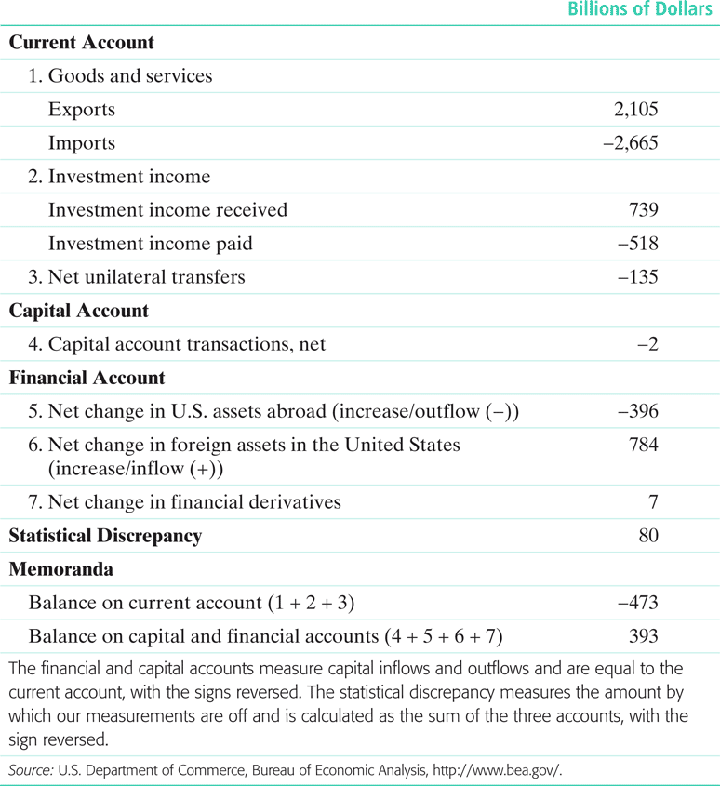
TABLE 9.3 The U.S. Balance of Payments, 2011 (Gerber 6th ed.)
Balance of payments = current account + capital account + financial account

Slide 24
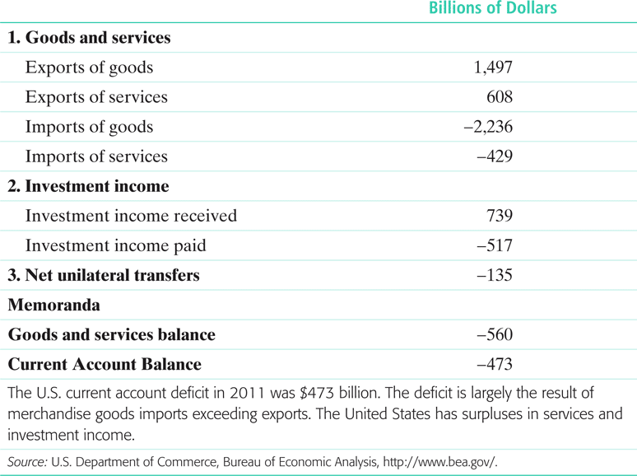
TABLE 9.2 The U.S. Current Account Balance, 2011

Slide 25
(Textbook Data)
The slides above, with data from 2011, are from Gerber 6th edition
I also have Gerber’s 7th edition, with data from 2014 – the next 2 slides
But they are reported differently and much harder to understand (in my opinion)
So I will go back to the 2011 data after the next two slides

Slide 26
The Financial Account (3 of 9)
TABLE 9.3 The U.S. Balance of Payments, 2014
Balance of payments = current account + capital account + financial account
U.S. Balance of Payments, 2014 | Billions of dollars
1. Current account balance | -390
2. Capital account balance | 0
Financial account
3a. Net acquisition of financial assets | 792
3b. Net incurrence of financial assets | 977
3c. Net change in financial derivatives | -54
4. Statistical discrepancy | 151
5. Memoranda
5a. Balance on current and capital accounts (1+2) | -390
5b. Balance on financial account (3a-3b+3c) | -239

Slide 27
The Current Account (5 of 6)
United States Current Account, 2014 | Billions of dollars, 2014
1. Goods and services exports (credit) (1a + 1b) | 2,343
1a. Goods exports | 1,633
1b. Services exports | 711
2. Primary income receipts (credit) (2a + 2b) | 823
2a. Investment income received | 816
2b. Compensation of employees received | 7
3 . Secondary income receipts (credit) | 140
4. Goods and services imports (debit) (4a + 4b) | 2,852
4a. Goods imports | 2,374
4b. Services imports | 477
5. Primary income paid (debit) (5a + 5b) | 585
5a. Investment income paid | 569
5b. Compensation of employees paid | 16
6 . Secondary income payments (debit) | 259
7. Current account balance (1+2+3-4-5-6) | -390

Slide 28
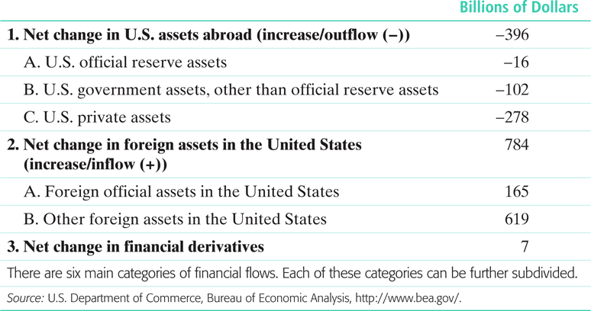
TABLE 9.4 Components of the U.S. Financial Account, 2011

Slide 29
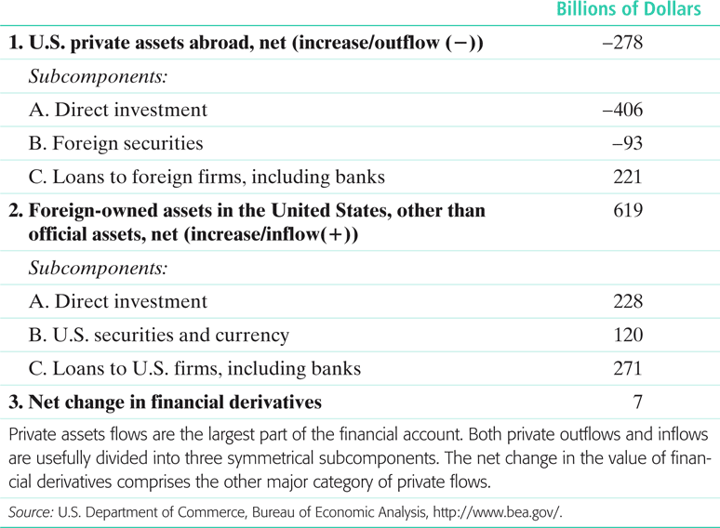
TABLE 9.5 Private Flows in the U.S. Financial Account, 2011
FDI

Slide 30
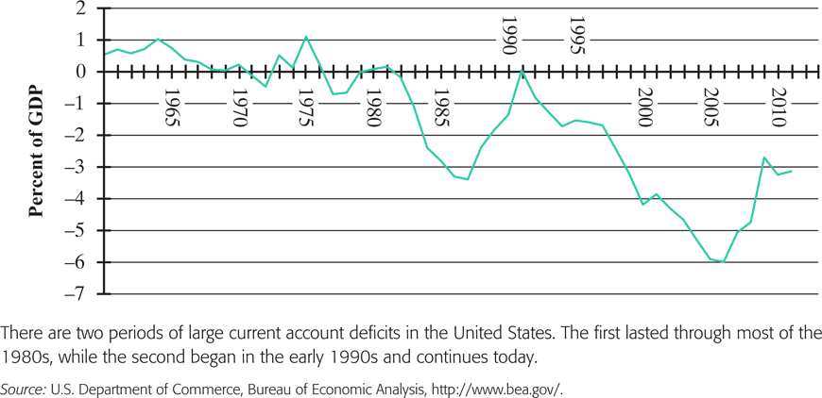
FIGURE 9.1 U.S. Current Account Balances, 1960-2011
Gerber 6th ed.
Current Account is mostly the Trade Balance, which deteriorated greatly from 1990 until 2005

Slide 31
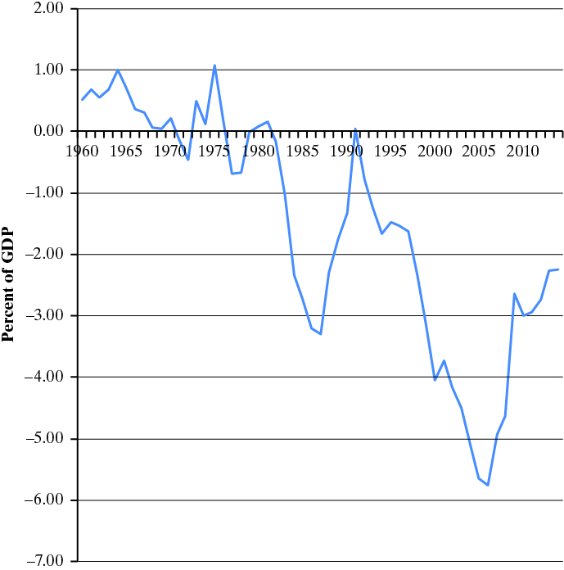
The Current Account (6 of 6)
Gerber 7th ed.
Notes:
Gerber 2018

Slide 32
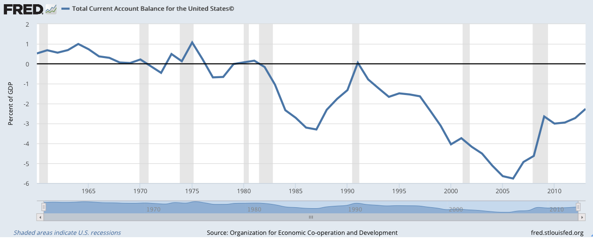
International Transactions: Data
Grey shaded strips are recessions. Note that deficits tend to:
Rise in booms
Fall in recessions
From OECD via FRED
Notes:
https://fred.stlouisfed.org/series/BPBLTT01USA188S#0
As of Jan 2018, FRED has this only through 2013.

Slide 33
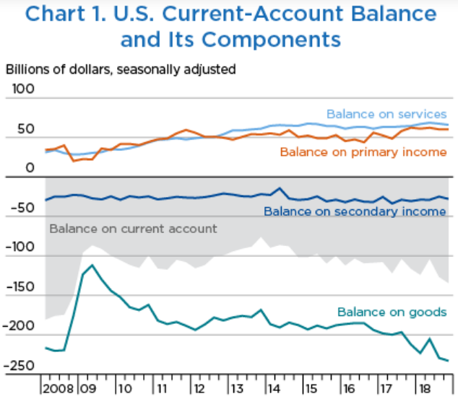
More recently, from Survey of Current Business,with details
Notes:
https://apps.bea.gov/scb/2019/04-april/0419-quarterly-international-transactions.htm

Slide 34
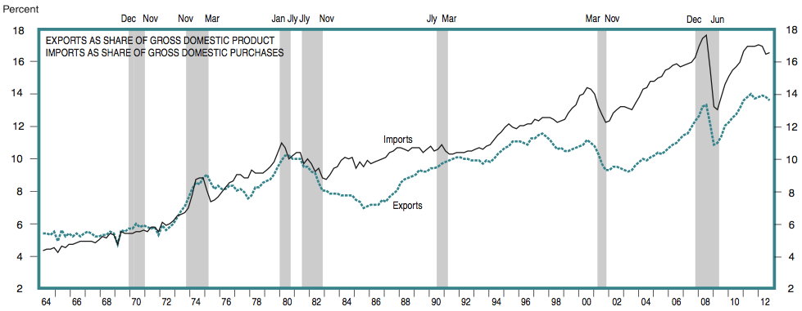
International Transactions: Data
US Export and Import Shares Since 1962
(Shaded strips are recessions)
Source: Survey of Current Business February 2013
Notes:
http://www.bea.gov/scb/toc/0213cont.htm#data_national
http://www.bea.gov/scb/pdf/2011/02%20February/D%20Pages/0211dpg_d.pdf
National Data / Charts
I haven’t been able to find this more recently.

Slide 35
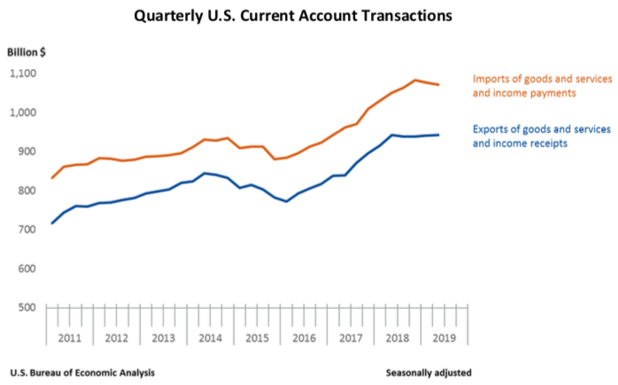
More recently, from Survey of Current Business,with details
Notes:
https://www.bea.gov/system/files/trans219-chart1.PNG

Slide 36
Clicker Question
Which of the following tends to fall in a recession?
Exports
Imports
The trade deficit
All of the above
None of the above
✓

Slide 37
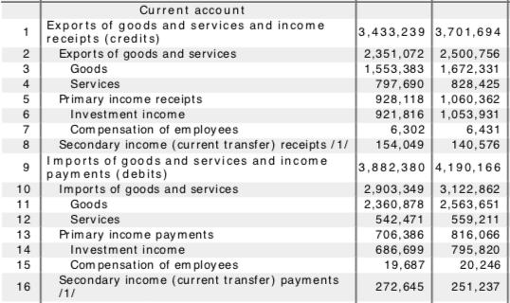
U.S. International Transactions
Current Account
Survey of
Current
Business
April
2019
$m.
Notes:
https://apps.bea.gov/scb/toc/0419cont.htm
https://apps.bea.gov/scb/2019/04-april/pdf/0419-international-transactions-tables.pdf

Slide 38
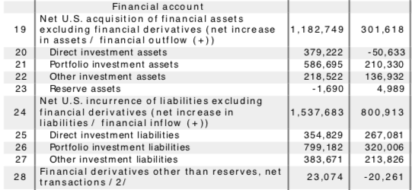
U.S. International Transactions
Financial Account
Survey of
Current
Business
April
2019
$m.
Notes:
https://apps.bea.gov/scb/
U.S. international transactions tables PDF
https://apps.bea.gov/scb/2018/10-october/pdf/1018-international-transactions-tables.pdf

Slide 39
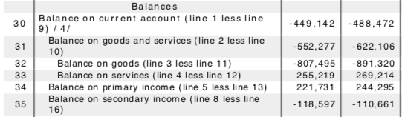
U.S. International Transactions
Balances
Survey of
Current
Business
April
2019
$m.
Notes:
https://apps.bea.gov/scb/
U.S. international transactions tables PDF
https://apps.bea.gov/scb/2018/10-october/pdf/1018-international-transactions-tables.pdf

Slide 40
Outline: The Balance of Trade and International Transactions
What Is the Balance of Trade?
What the Balance of Trade Does Not Mean
International Transactions
Current Account
Financial Account
What the Balance of Trade Does Mean
From Balance of Payments Accounting
From National Income Accounting

Slide 41
What the Trade Balance Does Mean
From Balance of Payments Accounting
It must be true that credits and debits (if they were known) would add up to zero
Reason: Every transaction, if known completely, involves two offsetting entries
Example 1: I import a book (US debit) from a London bookstore which deposits my payment into its NY bank account (US credit)
Example 2: Donald Trump (an American) borrows euros from a German (US credit) and exchanges them for dollars with an Italian who has sold stock in a US corporation (US debit)
These are only samples; infinitely many other possibilities exist, but each must add to zero

Slide 42
What Does the Trade Balance Really Mean?
From Balance of Payments Accounting
It must be true that credits and debits add up to zero
Therefore (ignoring the small “capital account” and "Statistical Discrepancy”),
Current Account Surplus
+ Financial Account Surplus
=0

Slide 43
What Does the Trade Balance Really Mean?
From Balance of Payments Accounting
It follows that
A current account deficit
Implies ⬇
A financial account surplus
(and vice versa)

Slide 44
What Does the Trade Balance Really Mean?
From Balance of Payments Accounting
Thus, a Trade Deficit
(if it is not financed by investment income and transfers, which are also parts of the current account)
implies that we are either
Borrowing from foreigners, or
Selling assets to foreigners
Financial Account Surplus

Slide 45
What Does the Trade Balance Really Mean?
Thus the large (and usually growing) current account deficit of the US, which we saw earlier, means that the US is selling off its assets and/or borrowing from foreigners
Sure enough, look at the data…

Slide 46
Notes:
BEA data graphs.xls

Slide 47
International Transactions: Data
From
Survey of
Current
Business
Became negative about 1986
Notes:
BEA data graphs.xls

Slide 48
What Does the Trade Balance Really Mean?
Put this in perspective
US current account deficit reached about $700 b. per year. US population is about 300 m. So US was selling assets and/or borrowing about $2,300 per year per person. (Less now.)
US net investment position is over $9 trillion. So our net debt to foreigners is over $30,000 per person.
$9 trillion is about 45% of US GDP; so on average each of us owes over 5 months income to foreigners.
And it’s growing.
(A student points out, correctly, that much of this debt is private, and therefore is not the responsibility of most of the population. Only the portion that is government debt deserves to be spoken of as I do in this slide.)

Slide 49
Clicker Question
If our Financial Account is in surplus, that means that
The trade balance is positive
We are lending more than we are borrowing
The US is adding to its holding of assets abroad
The rest of the world is giving us money
Our net debt to the world is rising
✓

Slide 50
Outline: The Balance of Trade and International Transactions
What Is the Balance of Trade?
What the Balance of Trade Does Not Mean
International Transactions
Current Account
Financial Account
What the Balance of Trade Does Mean
From Balance of Payments Accounting
From National Income Accounting

Slide 51
What Does the Trade Balance Really Mean?
From National Income Accounting
(I’ll do this first without government)
Recall from Econ 102
GDP = Output = Income = Y
Output:
Y = C + I + (X − M)
Income:
Y = C + S
Therefore
X − M = S − I
Where
C = Consumption
I = Investment
X = Exports
M = Imports
S = Savings

Slide 52
What Does the Trade Balance Really Mean?
From National Income Accounting
Thus, since X − M = S − I
Trade surplus ⇒ savings > investment
Trade deficit ⇒ savings < investment
If we are not saving enough to finance investment, how do we pay for it?
By borrowing from abroad, or
By selling assets
Both positive in Financial Account

Slide 53
What Does the Trade Balance Really Mean?
From National Income Accounting
(This time with government)
Even more simply
Y = C + I + G + (X − M)
implies
X − M = Y − (C + I + G)

Slide 54
What Does the Trade Balance Really Mean?
From National Income Accounting
(X − M) = Y − (C + I + G)
So a trade deficit
(X − M) < 0
means that we are spending
(C + I + G)
more than our income Y
Trade Surplus
Income
Expenditure

Slide 55
What Does the Trade Balance Really Mean?
Therefore, in spite of its name, and it’s definition, the trade balance
Is not really about trade, which is just the symptom
It is about whether we are living within our means
As Porter explains, a trade deficit means that we are consuming and investing more than we earn
When is a trade deficit good?
When the country (like a young person) is investing for the future (like a successfully developing country)
Not when it is going into debt just to finance current consumption (like the US)

Slide 56
Sample Trade Surpluses & Deficits
(Exports − Imports) / GDP
 | 2007 | 2015
Brazil | +1.5% | +0.8%
Canada |  | –0.8%
China | +8.8% | +6.1%
Costa Rica | −4.8% | −10.7%
Germany | +7.1% | +9.2%
Greece | −12.0% | −11.2%
India | −4.1% | −6.9%
Japan | +1.7% | −0.03%
Saudi Arabia | +27.0% | +10.4%
United States | −5.1% | −4.2%
Source: 2007, IMF; 2015, CIA World Fact Book (est)
Notes:
From IFS online, National Accounts data
http://www.imfstatistics.org.proxy.lib.umich.edu/imf/
(Could only have gotten for 2008; update not worth doing)

Slide 57
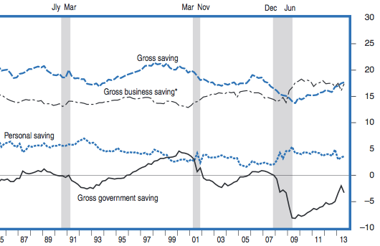
Implications of the US Trade Deficit
Who, in the US, is doing this?
Partly it has been the US government, running a deficit due to
Tax cuts
War
Stimulus
Ratio, Savings to Gross National Income
Percent
But it is also due to falling private saving
Notes:
http://www.bea.gov/scb/toc/0213cont.htm#data_national
National Data / Charts

Slide 58
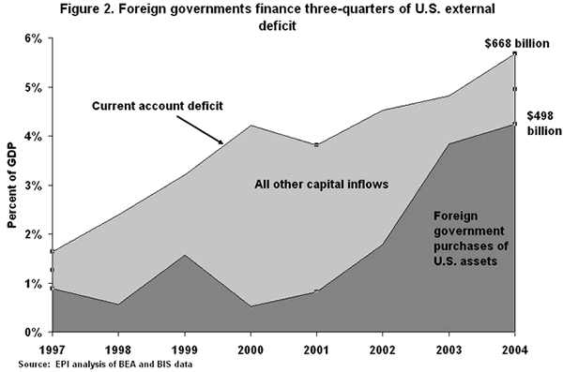
Implications of the US Trade Deficit
Who, abroad, is (or was) financing this?
Mostly foreign governments & central banks
Notes:
Source: Scott, 2005 article.

Slide 59
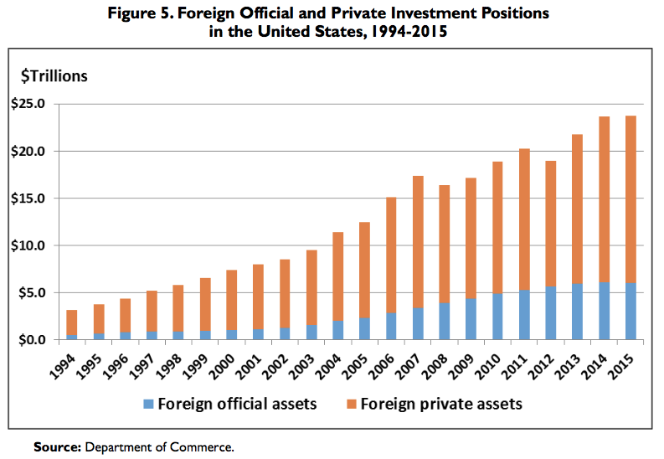
Implications of the US Trade Deficit
Who, abroad, has been financing this?
Notes:
RL33274.pdf
Financing the U.S. Trade Deficit, James K. Jackson, Congressional Research Service, October 7, 2016

Slide 60
Implications of the US Trade Deficit
Is the U.S. Deficit Sustainable?
Buffett (in 2003) says NO, as others will cease to be willing to lend to us
Some say this is sustainable:
This is a “balance” between US dis-saving and rest of world saving
US has comparative advantage in "providing wealth storage facilities"

Slide 61
Implications of the US Trade Deficit
Is the U.S. deficit a problem?
Mankiw says no.
It’s a reflection of
The attractiveness of the US as a destination for investment
Strength of the US economy
Trump’s policies of deregulation, tax cuts, and spending will increase it (and that’s OK, he says)
An increase in import tariffs would just cause
The US dollar to appreciate, and
Exports to fall

Slide 62
Implications of the US Trade Deficit
Can trade policy reduce the trade deficit?
Obstfeld (was Director of IMF Research) says no
Attempts to reduce it are like a game of “whack-a-mole”
If we reduce imports of one thing or from one place, imports of or from another will rise, and/or exports will fall
Example: Tariff to reduce imports of aluminum will reduce our exports of aircraft
Since US is at full employment, even if we hire more labor in one sector, we’ll have to employ less in another

Slide 63
Global Imbalances
This refers to
Large current account deficits by US and others
together with
Large current account surpluses by China and others

Slide 64
Global Imbalances
What can be done to change these imbalances?
US tariffs? No.
These won’t change spending
See Mankiw
What’s needed is for both
US to spend less, and
China to spend more
Porter argues for an international agreement to reduce the value of the US dollar
This was done in the “Plaza Accord” of 1985, and it worked
It’s not clear that it would work today

Slide 65
Clicker Question
The United States in both 2011 and 2014 had a surplus in its
Balance on merchandise trade
Balance on goods and services
Balance on current account
Balance on financial account
None of the above
✓

Slide 66
Next Lecture
Exchange Rates
What they are
What determines them
Simple theories of exchange rates

