Slide 1
Lecture 11
Multinationals and International Capital Movements
Econ 340

Slide 2
News: Oct 7-13
China and US reach "Phase One" deal -- WSJ: 10/12 | Canvas | NYT: 10/11 | Canvas | FT: 10/12 | Canvas
  China-US trade talks resumed in Washington and they reached a partial deal, said to be "Phase One" of more that will come later. Trump has said he wanted a "whole deal," but that did not happen. This deal will take several weeks to write and will be signed by November.
  US will postpone tariff increases that were planned for October 15, and China will increase purchases of agricultural products by $40-50 billion. Other US tariffs planned for December were not postponed.
  Not yet fully resolved and subject to further negotiations were many other isses: "including China’s enforcement of intellectual property rules, U.S. access to Chinese markets, Chinese government support for state-owned enterprises, and the fate of U.S. tariffs on nearly $360 billion worth of Chinese imports already in place."
Leaders of China and India meet to discuss trade issues. -- WSJ: 10/12 | Canvas | FT: 10/11 | Canvas
  President Xi was in India for two days of talks with Prime Minister Modi. The meeting is "likely to be dominated by trade as New Delhi seeks to reduce a huge trade deficit with China."
  A spokesman for India said "The Chinese will have to figure out ways in which to give India more market access. There are unreasonable non-tariff barriers that China imposes."
  China wants India to join RCEP, a free trade agreement it is negotiating with other Asian countries.
Currency news: euro, krona, lira -- WSJ: 10/4 | Canvas | FT: 10/7 | Canvas | FT: 10/7 | Canvas
  The euro has been falling in US dollar value for more than a year, and reached its lowest in more than two years. Reasons include interest rates (high in US, low in Eurozone), slowing European economy, and concerns about trade.
  Sweden's currency, the krona, fell against the euro to its lowest in ten years. The krona "is more global trade sensitive than almost anyone else," said an official, who attributes the fall to trade tensions.
  Turkey's currency, the lira, fell against the dollar to its lowest in more than a month after President Trump threatened to "obliterate" Turkey's economy.

Slide 3
News: Oct 7-13
China and US reach "Phase One" deal
  China-US trade talks resumed in Washington and they reached a partial deal, said to be "Phase One" of more that will come later. Trump has said he wanted a "whole deal," but that did not happen. This deal will take several weeks to write and will be signed by November.
  US will postpone tariff increases that were planned for October 15, and China will increase purchases of agricultural products by $40-50 billion. Other US tariffs planned for December were not postponed.
  Not yet fully resolved and subject to further negotiations were many other isses: "including China’s enforcement of intellectual property rules, U.S. access to Chinese markets, Chinese government support for state-owned enterprises, and the fate of U.S. tariffs on nearly $360 billion worth of Chinese imports already in place."

Slide 4
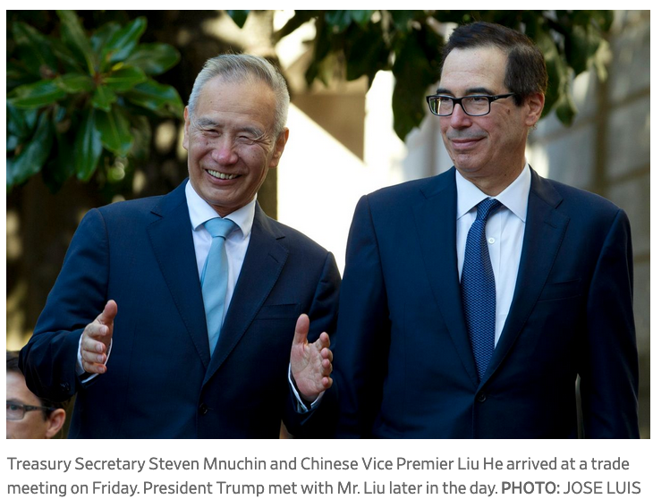

Slide 5
News: Oct 7-13
Leaders of China and India meet to discuss trade issues.
  President Xi was in India for two days of talks with Prime Minister Modi. The meeting is "likely to be dominated by trade as New Delhi seeks to reduce a huge trade deficit with China."
  A spokesman for India said "The Chinese will have to figure out ways in which to give India more market access. There are unreasonable non-tariff barriers that China imposes."
  China wants India to join RCEP, a free trade agreement it is negotiating with other Asian countries.

Slide 6
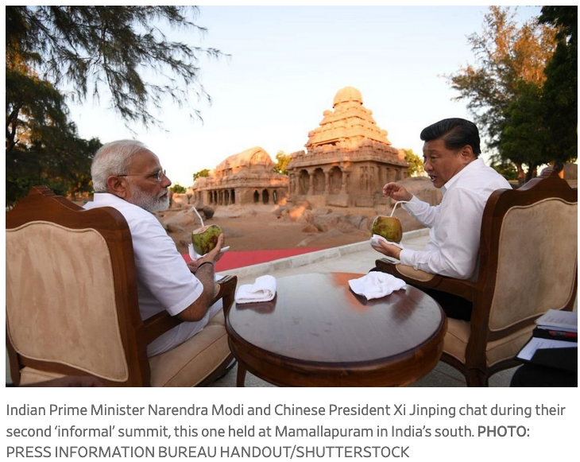

Slide 7
News: Oct 7-13
Currency news: euro, krona, lira -- WSJ: 10/4 | Canvas | FT: 10/7 | Canvas | FT: 10/7 | Canvas
  The euro has been falling in US dollar value for more than a year, and reached its lowest in more than two years. Reasons include interest rates (high in US, low in Eurozone), slowing European economy, and concerns about trade.
  Sweden's currency, the krona, fell against the euro to its lowest in ten years. The krona "is more global trade sensitive than almost anyone else," said an official, who attributes the fall to trade tensions.
  Turkey's currency, the lira, fell against the dollar to its lowest in more than a month after President Trump threatened to "obliterate" Turkey's economy.

Slide 8
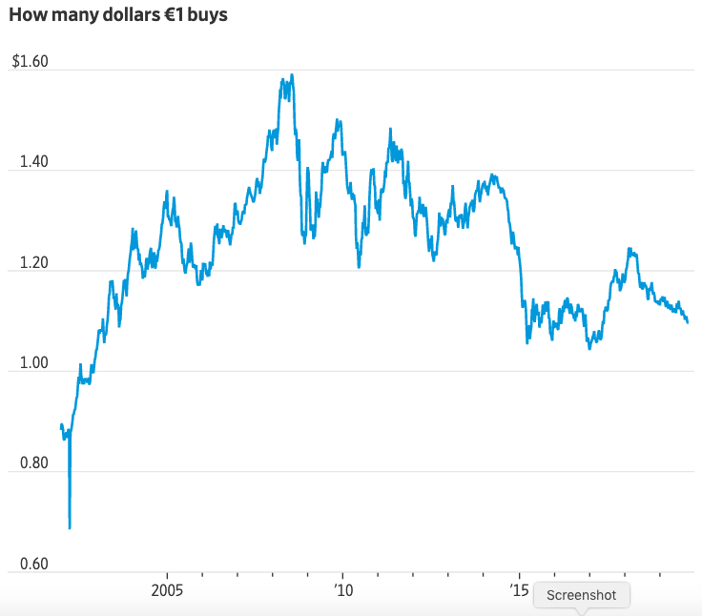

Slide 9
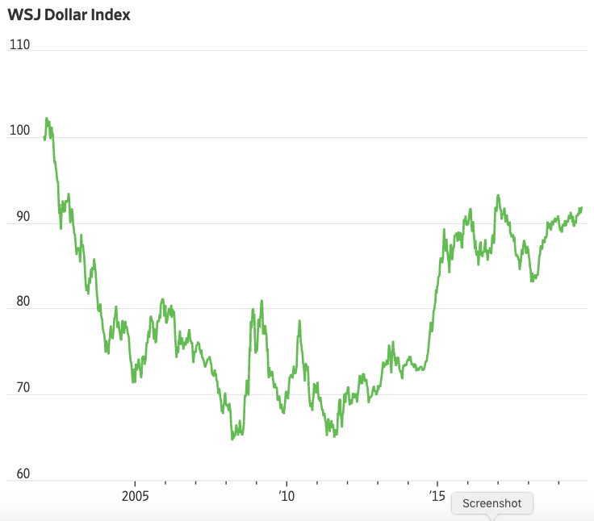

Slide 10
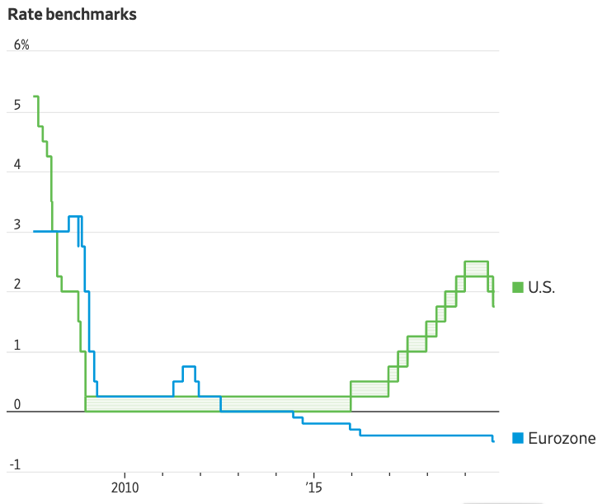

Slide 11
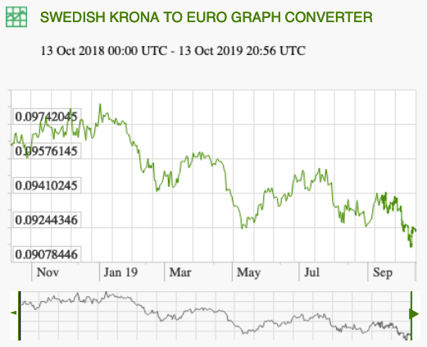

Slide 12
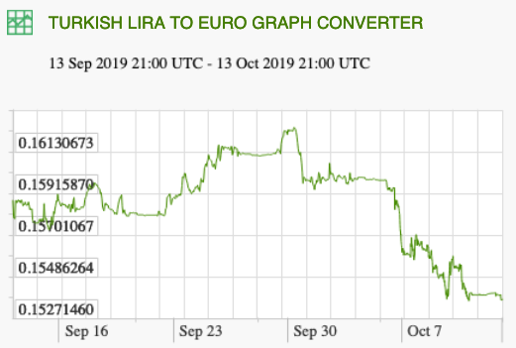

Slide 13
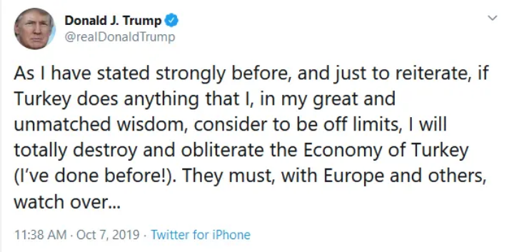

Slide 14



Slide 15
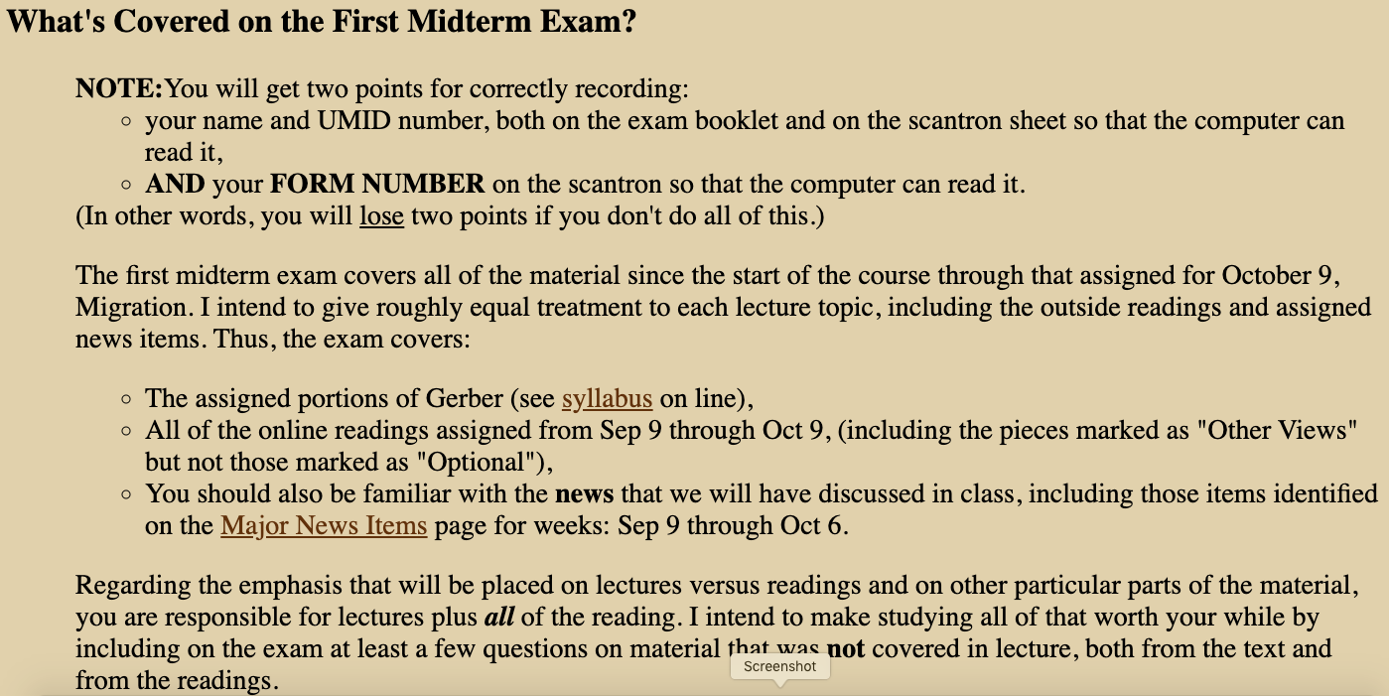

Slide 16
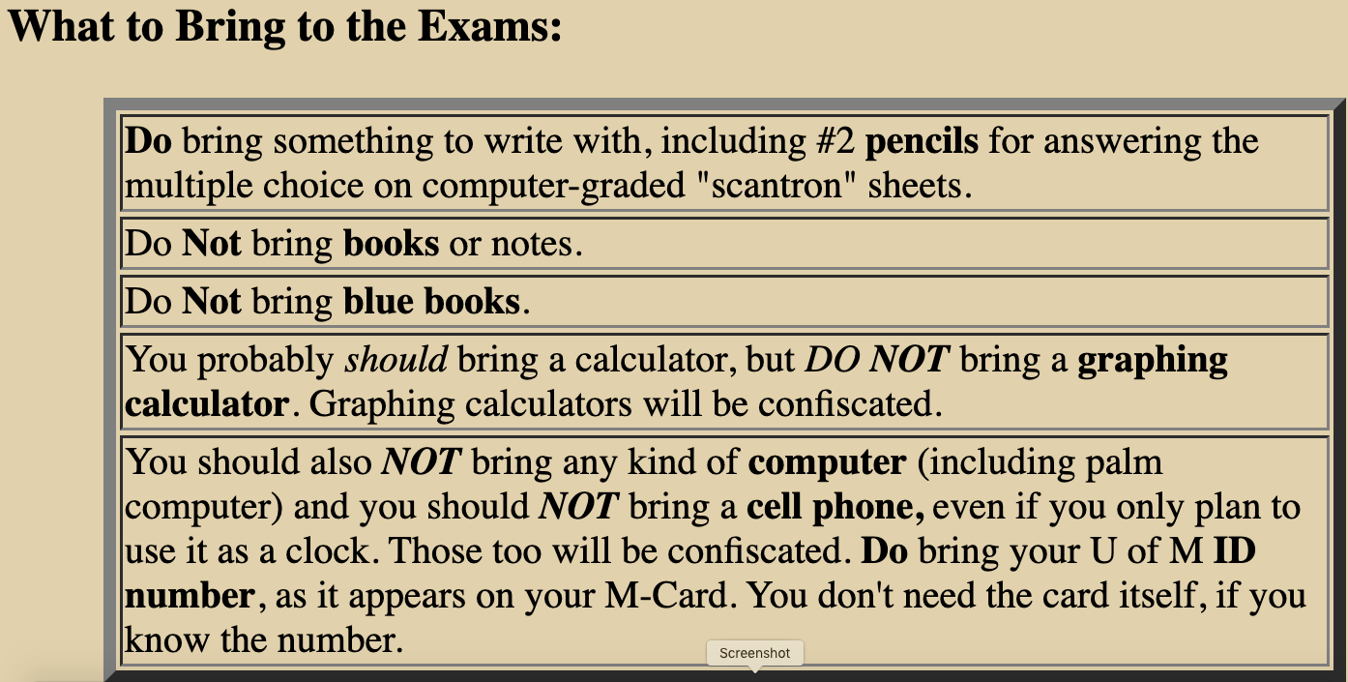

Slide 17
Outline: Multinationals and International Capital Movements
Terminology
  FDI, DFI, MNEs, MNCs
  Real Versus Financial Capital
History
Purposes Served by FDI
  Local Market versus Export
  Reasons for FDI
Who Gains and Who Loses?
  Effects that are Similar to Trade
  Effects that are Similar to Migration
  Other Effects

Slide 18
Terminology
International Capital Movement
  (or “Capital Flow”)
  = Acquisition of assets in another country
  Takes two forms
    Real
      Physical assets, land
      Ownership of companies (stocks: 10% or more)
    Financial
      Bonds, loans, bank deposits, currency
      Stocks if less than 10% ownership
FDI

Slide 19
Terminology
FDI = Foreign Direct Investment
  = DFI = Direct Foreign Investment
  = Acquisition of real assets abroad
  Results in a firm owning assets in more than one country:
MNC = Multinational Corporation
  = MNE = Multinational Enterprise
  = TNC = Transnational Corporation
  = Firm that operates (and usually owns assets) in more than one country

Slide 20
Terminology
FDI does not necessarily involve a net capital flow
  Reason: acquisition of assets abroad can also be financed locally
Thus
  Net capital flows…
    Are due to unequal savings and investment
  FDI and MNCs…
    Are due to business opportunities
  Both may sometimes also be due to incentives of taxation (see Economist on “Company Headquarters”)

Slide 21
Terminology
When FDI happens from Country A into Country B,
    (That is, when a firm based in Country A acquires assets, perhaps a subsidiary, in Country B)
  “Source Country” = Country A
  “Host Country” = Country B

Slide 22
Terminology
FDI
SOURCE
Country
HOST
Country
$
Ownership

Slide 23
Clicker Question
In which of the following would Japan be the “host country” for FDI?
  An American buys the debt of the Japanese government
  A Japanese company buys a factory in Germany
  A Japanese citizen buy US treasury bills
  A Thai corporation borrows from a Japanese bank
  A Saudi prince buys land in Tokyo
✓

Slide 24
Outline: Multinationals and International Capital Movements
Terminology
  FDI, DFI, MNEs, MNCs
  Real Versus Financial Capital
History
Purposes Served by FDI
  Local Market versus Export
  Reasons for FDI
Who Gains and Who Loses?
  Effects that are Similar to Trade
  Effects that are Similar to Migration
  Other Effects

Slide 25
History
FDI was very important in US industrialization
  E.g., British firms built the railroads in the 19th century
    Not just in U.S. Also in South America
In 20th century, until the 1980s, FDI was small, and resisted by both source and host countries
  Governments restricted capital movements and exchange of currencies
  Developing countries equated FDI with colonialism and imperialism
  Countries blamed MNCs for interfering in domestic political and military matters

Slide 26
History
Starting in 1980s, attitudes began to change
  Developing countries saw FDI as helping them grow
  Host countries saw FDI as providing employment
    Started using policies to attract FDI
  IMF and World Bank encouraged reforms that would be friendly to FDI
  US and other countries negotiated Bilateral Investment Treaties (BITs)
    Wikipedia says there are now more than 2500 BITs in force

Slide 27
Source: Lipsey 2000 (Data for 1996)

Slide 28
Note that Japan has almost disappeared here
Source: Lipsey 2000 (Data for 1996)

Slide 29
History
Sources and Destinations of FDI, 1996, $ billions
 | US | Japan | Europe | Other Asia | Latin Amer
Source | 87.8 | 23.4 | 172.1 | 48.0 | 3.8
Host | 77.0 | 0.2 | 120.1 | 78.0 | 40.1
Source: Lipsey 2000 (Data for 1996)

Slide 30
Source: UNCTAD World Investment Report 2013
Notes:
WIR 2011, Annex Table 1, Web table 1. FDI inflows, by region and economy, 1990-2010
See FDI_Inflows – WIR11….xls

Slide 31
Source: UNCTAD World Investment Report 2013
Notes:
WIR 2011, Annex Table 2, Web table 2. FDI outflows, by region and economy, 1990-2010
See FDI_Outflows – WIR11….xls

Slide 32
Source: UNCTAD World Investment Report 2013
Notes:
See FDI_Inflows – WIR11….xls

Slide 33
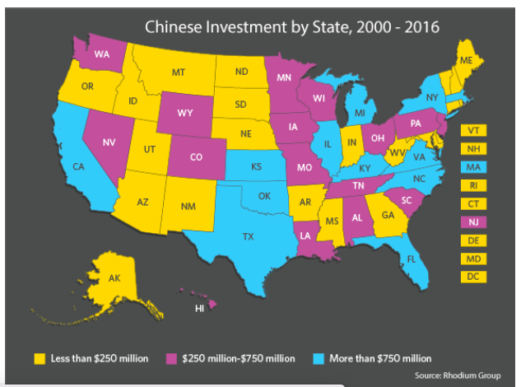
Notes:
Got this in April 2018 from an event announcement from Center for Chinese Studies. Don’t know the source.

Slide 34
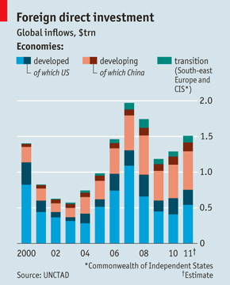
Source: Economist, Jan 28, 2012

Slide 35
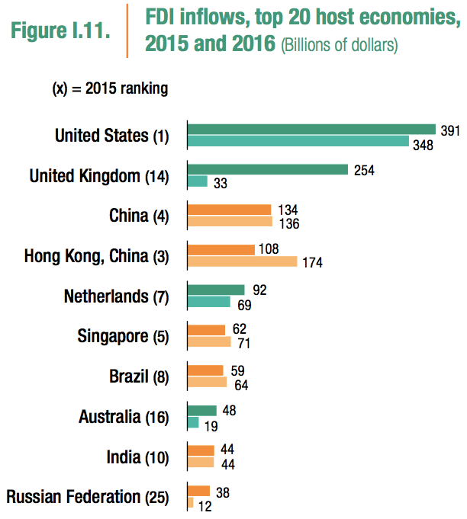
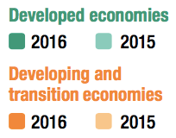
10
Source: UNCTAD (2017)
Notes:
UNCTAD, World Investment Report 2017: Investment and the Digital Economy, http://unctad.org/en/pages/PublicationWebflyer.aspx?publicationid=1782

Slide 36
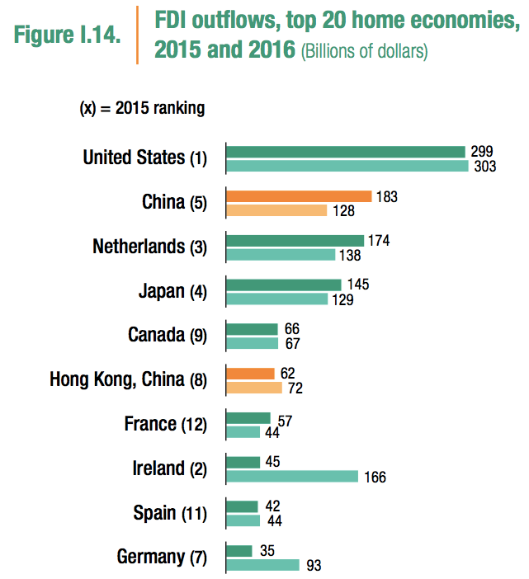
10
(“home” = “source”)
Source: UNCTAD (2017)
Notes:
UNCTAD, World Investment Report 2017: Investment and the Digital Economy, http://unctad.org/en/pages/PublicationWebflyer.aspx?publicationid=1782

Slide 37
History
Conclusions about who sends and receives FDI
  US and Europe are both huge sources and huge hosts
    (But lots of Europe’s FDI is from one to another)
  Japan is a major source of FDI and hardly hosts any at all
  Developing Asia, and especially Latin America, are mainly hosts of FDI
  China has been a large host of FDI, especially in the 90s, and is now growing rapidly also as a source.
  Africa does not appear significantly as either source or host
    But that may be changing: China’s investment there

Slide 38
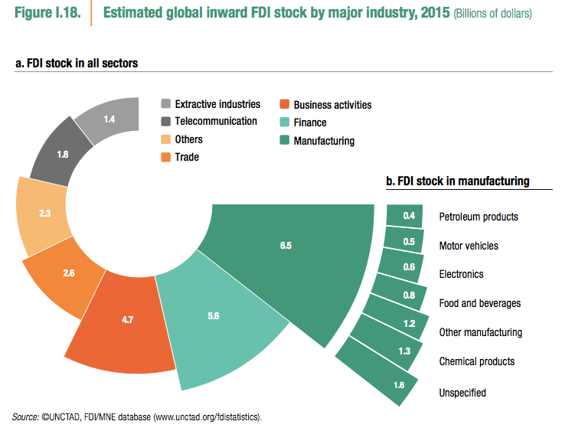
Sectors of FDI
Source: UNCTAD (2017)
Source: UNCTAD (2017)
Notes:
UNCTAD, World Investment Report 2017: Investment and the Digital Economy, http://unctad.org/en/pages/PublicationWebflyer.aspx?publicationid=1782

Slide 39
Clicker Question
What has been the role of Britain (now the UK) in FDI?
  It has been a major source of FDI both historically and today.
  It was a major source of FDI in the 19th century, but but not most recently.
  It seldom engaged in FDI historically, but has lately become one of the world’s biggest sources.
  It has never been one of the top sources for FDI.
✓
See the top-ten list on the slide above.

Slide 40
History
US has received almost as much FDI as it has sent out
  That means lots of US assets are foreign-owned
  What are they?

Slide 41


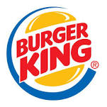







History
Some perhaps obvious foreign-owned companies and products in the US
(as of 2014)
France
Canada
UK
Netherlands
Japan

Slide 42














History
Some not-so-obvious foreign-owned companies and products in the US
Germany
Switzerland
Mexico
Italy
Notes:
Greyhound, “controlled by” British First Group, says Economist 4/4/09, p. 70.
Sara Lee: Mexico (Grupo Bimbo)

Slide 43



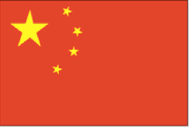


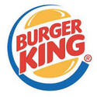


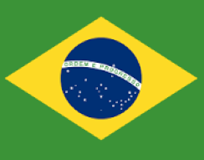





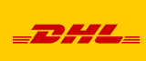
History
Luxembourg
More not-so-obvious foreign-owned companies and products in the US
China
Brazil
Notes:
Hilfiger: headquartered in Hong Kong
AMC theaters: Chinese as of 2012
Burger King, now Brazilian. 3G Capital, owns majority of Canadian Tim Hortons, which owns Burger King

Slide 44


History
Nationalities can change:
1998
2007
2009
2014
Actually (see Economist), Jeep is made by Chrysler, owned by Fiat, an Italian company that in 2014 changed its…
  legal domicile to the Netherlands
  tax residence to Britain
  main stockmarket listing to New York

Slide 45
Clicker Question
Which of the following companies is not Japanese?
  7-11
  Denny’s
  Trader Joe’s
  Sprint
✓
German

Slide 46
Outline: Multinationals and International Capital Movements
Terminology
  FDI, DFI, MNEs, MNCs
  Real Versus Financial Capital
History
Purposes Served by FDI
  Local Market versus Export
  Reasons for FDI
Who Gains and Who Loses?
  Effects that are Similar to Trade
  Effects that are Similar to Migration
  Other Effects

Slide 47
Why Do Firms Invest Abroad?
Purposes of FDI
  To sell to the Host Country
  To export from the Host country
    Back to the Source Country
    To third countries (Host = “Export Platform”)
  To obtain inputs for production elsewhere
    (Really a special case of #2)

Slide 48
Why Do Firms Invest Abroad?
Alternatives to FDI
  Trade
    To sell to Host: Export instead of producing there
    Instead of exporting from Host: Import from independent firms there
  Licensing, Subcontracting
    Have an independent firm in Host do production for you

Slide 49
Why Do Firms Invest Abroad?
Prerequisites for FDI
  Reason for an activity in a foreign country
    Something to sell (to Host-country market)
    Or something to buy (raw material or factor services)
  Both require price or cost differences, similar to trade
    Likely to require that host have comparative advantage (true if trade is nearly free)
  Reason to produce abroad & own the facility, rather than export, license, or subcontract

Slide 50
Why Do Firms Invest Abroad?
Reasons for FDI to Sell to Host
  Tariff Jumping
    Common reason for FDI instead of exporting: Trade Barriers (tariffs, quotas, VERs, etc.)
    Worth doing if extra production cost is less than the tariff
An import tariff can induce inward FDI, as exporters produce inside the host country to avoid paying the tariff

Slide 51
Why Do Firms Invest Abroad?
Reasons for FDI to Sell to Host
  Tariff Jumping
    Examples:
      Much FDI in Developing countries;
      US “Transplant” auto plants
        Really “VER jumping”
        Not the motive today

Slide 52
Why Do Firms Invest Abroad?
Reasons for FDI to Sell to Host
  Transport Costs
    Makes FDI more likely for selling to Host market: raises cost of exporting to it

Slide 53
Why Do Firms Invest Abroad?
Reasons for FDI to Sell to Host
  Providing Services
    Many services cannot be provided from a distance: Service firms must have local providers
      Example: McDonalds

Slide 54
Why Do Firms Invest Abroad?
Reasons for FDI to Sell to Host
  Firm-specific assets
    Examples: Proprietary technology, unique business model, expertise of CEO
    These give firm advantage over competitors, including local host-country firms
    Control of these assets may require ownership rather than licensing or subcontracting

Slide 55
Why Do Firms Invest Abroad?
Reasons for FDI to Export
  Lower cost, especially labor
  Access to resources
  Avoid regulations (e.g., environmental)
    This is actually not a common reason for FDI
  Minimize transport costs (in export platforms)

Slide 56
Clicker Question
How can a tariff cause FDI?
  It can’t; tariffs apply to imports, not FDI
  A producer invests in the country to which it wants to sell, in order to avoid paying a tariff
  If Mexico has a high tariff on beer, its brewers will prefer to produce in the US
  A tariff on imports of an important input to an industry will cause foreign producers in that industry to want to produce there
✓

Slide 57
Clicker Question
Which of the following acronyms is not related to FDI?
  DFI
  MNE
  MFN
  MNC
  TNC
Direct foreign investment
Multinational Enterprise
Most Favored Nation
Multinational corporation
Transnational corporation
✓

Slide 58
Outline: Multinationals and International Capital Movements
Terminology
  FDI, DFI, MNEs, MNCs
  Real Versus Financial Capital
History
Purposes Served by FDI
  Local Market versus Export
  Reasons for FDI
Who Gains and Who Loses?
  Effects that are Similar to Trade
  Effects that are Similar to Migration
  Other Effects

Slide 59
Who Gains and Who Loses
Effects that are similar to trade
  If production shifts to foreign location
    Some workers at home lose jobs (“exporting jobs”)
      Same as if production was replaced by imports
    Other workers have jobs “saved,” if employers use FDI to avoid shutting down completely
  If FDI is motivated by lower cost
    Firms and consumers gain from greater efficiency
    Effects on wages are similar to trade
    Other firms face increased competition

Slide 60
Who Gains and Who Loses
Effects that are similar to migration
  To the extent that FDI does move capital from country to country
    Host country gains capital
      Often an important source of capital growth for LDCs
    Source country loses capital
  Changes in capital alter demands for labor
    Wages rise in host country
    Wages fall in source country
  All very similar to what we said of migration

Slide 61
Clicker Question
The diagram shows supply and demand for labor in a country. Which of these curves will shift, and in which direction, if there is FDI into the country?
  Supply shifts right
  Supply shifts left
  Demand shifts right
  Demand shifts left
wage
S⁰
✓
w¹
w⁰
D¹
D⁰
Labor

Slide 62
Who Gains and Who Loses
Other Effects of FDI and MNCs
  MNCs typically differ from local firms in same industry
    Pay higher wages
    Provide better (though not always “good”) working conditions
    Use more capital-intensive methods

Slide 63
Who Gains and Who Loses
Other Effects of FDI and MNCs
  Unlike trade, FDI requires the presence of foreign people and establishments in the host country
    This may cause changes in the host-country society and culture
    Friction possible between groups

Slide 64
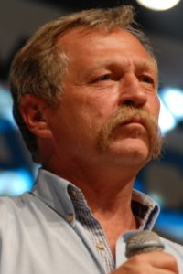
José Bové
  French farmer and anti-globalization activist who came to fame by dismantling a McDonald’s franchise in 1999
  Now a politician and (since 2009) member of the European Parliament
José Bové

Slide 65
Who Gains and Who Loses
Other Effects of FDI and MNCs
  MNCs pay taxes in both Source and Host countries
    Provides revenue for Host country government
    May be offset by inducements to invest
      E.g., “tax holidays”
    Efforts of MNCs to reduce tax burden
      Shift income to low-tax jurisdiction

Slide 66
What Determines Company Nationality?
See Economist, “Company Headquarters”
  National pride
    When Italian Fiat acquired US Chrysler, taking on the Netherlands as legal domicile was neutral
    When Burger King merged with Canada’s Tim Horton’s, it became Canadian to please Tim Horton customers
      (But later was bought by Brazil’s 3G Capital)
  Legal structure: Netherlands has undemanding laws (like Delaware)
  Tax laws and tax rates
    Low corporate tax rate favors Ireland
    Moving to get a lower tax rate is called “Tax Inversion”

Slide 67
Clicker Question
When a company moves its tax residence to a low-tax jurisdiction, on what portion of its earnings does it pay less taxes?
  Interest income
  Earnings on intangible assets
  Wages in the host country
  Wages in the source country
  Dividends
✓
    This was one of the questions posted for the Economist reading

Slide 68
Next Lecture
(After exam & Sweetland visit):
The Trade Balance
The Balance of Trade and International Transactions
  What the trade balance is
  What it means and doesn’t mean

