Slide 1
Lecture 11 Multinationals and International Capital Movements
Econ 340

Slide 2
Outline: Multinationals and International Capital Movements
Terminology
FDI, DFI, MNEs, MNCs
Real Versus Financial Capital
History
Purposes Served by FDI
Local Market versus Export
Reasons for FDI
Who Gains and Who Loses?
Effects that are Similar to Trade
Effects that are Similar to Migration
Other Effects

Slide 3
Terminology
International Capital Movement
(or “Capital Flow”)
= Acquisition of assets in another country
Takes two forms
Real
Physical assets, land
Ownership of companies (stocks: 10% or more)
Financial
Bonds, loans, bank deposits, currency
Stocks if less than 10% ownership
FDI

Slide 4
Terminology
FDI = Foreign Direct Investment
= DFI = Direct Foreign Investment
= Acquisition of real assets abroad
Results in a firm owning assets in more than one country:
MNC = Multinational Corporation
= MNE = Multinational Enterprise
= TNC = Transnational Corporation
= Firm that operates (and usually owns assets) in more than one country

Slide 5
Terminology
FDI does not necessarily involve a net capital flow
Reason: acquisition of assets abroad can also be financed locally
Thus
Net capital flows…
Are due to unequal savings and investment
FDI and MNCs…
Are due to business opportunities
Both may sometimes also be due to incentives of taxation (see Economist on “Company Headquarters”)

Slide 6
Terminology
When FDI happens from Country A into Country B,
(That is, when a firm based in Country A acquires assets, perhaps a subsidiary, in Country B)
“Source Country” = Country A
“Host Country” = Country B

Slide 7
Terminology
FDI
SOURCE
Country
HOST
Country
$
Ownership

Slide 8
Outline: Multinationals and International Capital Movements
Terminology
FDI, DFI, MNEs, MNCs
Real Versus Financial Capital
History
Purposes Served by FDI
Local Market versus Export
Reasons for FDI
Who Gains and Who Loses?
Effects that are Similar to Trade
Effects that are Similar to Migration
Other Effects

Slide 9
History
FDI was very important in US industrialization
E.g., British firms built the railroads in the 19th century
Not just in U.S. Also in South America
In 20th century, until the 1980s, FDI was small, and resisted by both source and host countries
Governments restricted capital movements and exchange of currencies
Developing countries equated FDI with colonialism and imperialism
Countries blamed MNCs for interfering in domestic political and military matters

Slide 10
History
Starting in 1980s, attitudes began to change
Developing countries saw FDI as helping them grow
Host countries saw FDI as providing employment
Started using policies to attract FDI
IMF and World Bank encouraged reforms that would be friendly to FDI
US and other countries negotiated Bilateral Investment Treaties (BITs)
Wikipedia says there are now more than 2500 BITs in force

Slide 11
Source: Lipsey 2000 (Data for 1996)

Slide 12
Note that Japan has almost disappeared here
Source: Lipsey 2000 (Data for 1996)

Slide 13
History
Sources and Destinations of FDI, 1996, $ billions
 | US | Japan | Europe | Other Asia | Latin Amer
Source | 87.8 | 23.4 | 172.1 | 48.0 | 3.8
Host | 77.0 | 0.2 | 120.1 | 78.0 | 40.1
Source: Lipsey 2000 (Data for 1996)

Slide 14
Source: UNCTAD World Investment Report 2013
Notes:
WIR 2011, Annex Table 1, Web table 1. FDI inflows, by region and economy, 1990-2010
See FDI_Inflows – WIR11….xls

Slide 15
Source: UNCTAD World Investment Report 2013
Notes:
WIR 2011, Annex Table 2, Web table 2. FDI outflows, by region and economy, 1990-2010
See FDI_Outflows – WIR11….xls

Slide 16
Source: UNCTAD World Investment Report 2013
Notes:
See FDI_Inflows – WIR11….xls

Slide 17
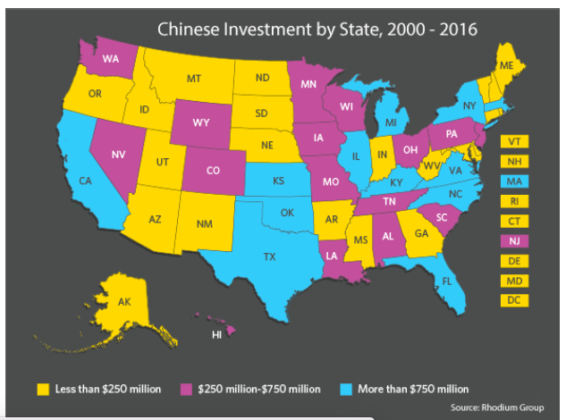
Notes:
Got this in April 2018 from an event announcement from Center for Chinese Studies. Don’t know the source.

Slide 18
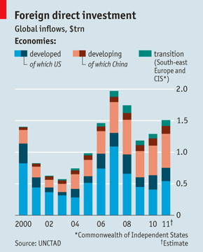
Source: Economist, Jan 28, 2012

Slide 19
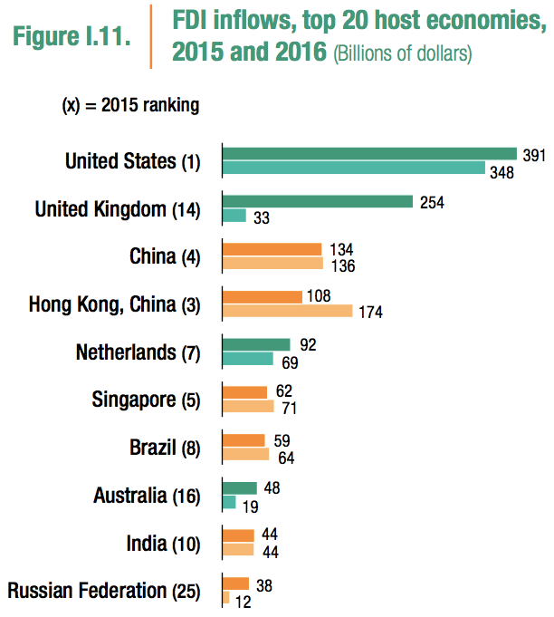
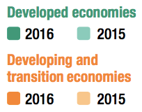
10
Source: UNCTAD (2017)
Notes:
UNCTAD, World Investment Report 2017: Investment and the Digital Economy, http://unctad.org/en/pages/PublicationWebflyer.aspx?publicationid=1782

Slide 20
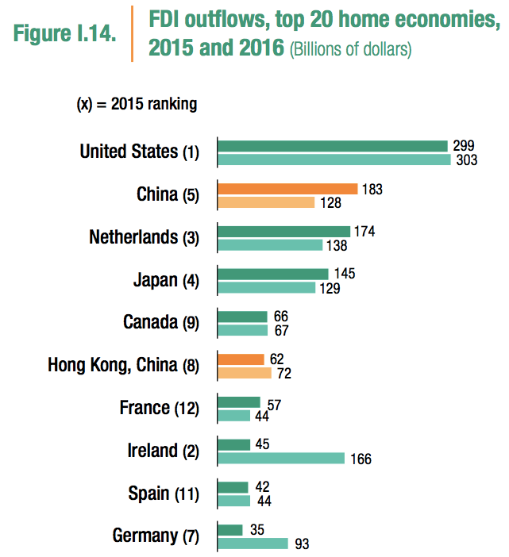
10
(“home” = “source”)
Source: UNCTAD (2017)
Notes:
UNCTAD, World Investment Report 2017: Investment and the Digital Economy, http://unctad.org/en/pages/PublicationWebflyer.aspx?publicationid=1782

Slide 21
History
Conclusions about who sends and receives FDI
US and Europe are both huge sources and huge hosts
(But lots of Europe’s FDI is from one to another)
Japan is a major source of FDI and hardly hosts any at all
Developing Asia, and especially Latin America, are mainly hosts of FDI
China has been a large host of FDI, especially in the 90s, and is now growing rapidly also as a source.
Africa does not appear significantly as either source or host
But that may be changing China’s investment there

Slide 22
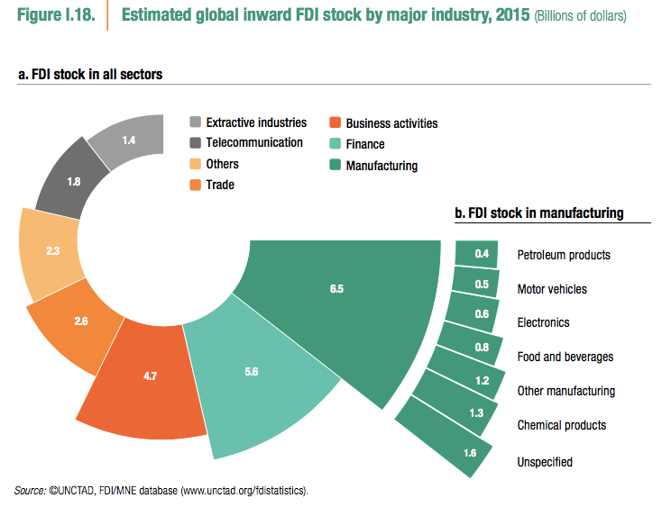
Sectors of FDI
Source: UNCTAD (2017)
Source: UNCTAD (2017)
Notes:
UNCTAD, World Investment Report 2017: Investment and the Digital Economy, http://unctad.org/en/pages/PublicationWebflyer.aspx?publicationid=1782

Slide 23
History
US has received almost as much FDI as it has sent out
That means lots of US assets are foreign-owned
What are they?

Slide 24










History
Some perhaps obvious foreign-owned companies and products in the US
(as of 2014)
France
Canada
UK
Netherlands
Japan

Slide 25














History
Some not-so-obvious foreign-owned companies and products in the US
Germany
Switzerland
Mexico
Italy
Notes:
Greyhound, “controlled by” British First Group, says Economist 4/4/09, p. 70.
Sara Lee: Mexico (Grupo Bimbo)

Slide 26



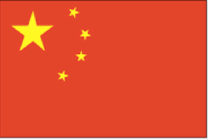





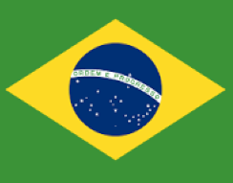





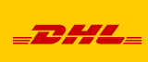

History
Luxembourg
More not-so-obvious foreign-owned companies and products in the US
China
Brazil
Hong Kong
Notes:
Hilfiger: headquartered in Hong Kong
AMC theaters: Chinese as of 2012
Burger King, now Brazilian. 3G Capital, owns majority of Canadian Tim Hortons, which owns Burger King

Slide 27


History
Nationalities can change:
1998
2007
2009
2014
Actually (see Economist), Jeep is made by Chrysler, owned by Fiat, an Italian company that in 2014 changed its…
legal domicile to the Netherlands
tax residence to Britain
main stockmarket listing to New York

Slide 28
Outline: Multinationals and International Capital Movements
Terminology
FDI, DFI, MNEs, MNCs
Real Versus Financial Capital
History
Purposes Served by FDI
Local Market versus Export
Reasons for FDI
Who Gains and Who Loses?
Effects that are Similar to Trade
Effects that are Similar to Migration
Other Effects

Slide 29
Why Do Firms Invest Abroad?
Purposes of FDI
To sell to the Host Country
To export from the Host country
Back to the Source Country
To third countries (Host = “Export Platform”)
To obtain inputs for production elsewhere
(Really a special case of #2)

Slide 30
Why Do Firms Invest Abroad?
Alternatives to FDI
Trade
To sell to Host: Export instead of producing there
Instead of exporting from Host: Import from independent firms there
Licensing, Subcontracting
Have an independent firm in Host do production for you

Slide 31
Why Do Firms Invest Abroad?
Prerequisites for FDI
Reason for an activity in a foreign country
Something to sell (to Host-country market)
Or something to buy (raw material or factor services)
Both require price or cost differences, similar to trade
Likely to require that host have comparative advantage (true if trade is nearly free)
Reason to produce abroad & own the facility, rather than export, license, or subcontract

Slide 32
Why Do Firms Invest Abroad?
Reasons for FDI to Sell to Host
Tariff Jumping
Common reason for FDI instead of exporting: Trade Barriers (tariffs, quotas, VERs, etc.)
Worth doing if extra production cost is less than the tariff
An import tariff can induce inward FDI, as exporters produce inside the host country to avoid paying the tariff

Slide 33
Why Do Firms Invest Abroad?
Reasons for FDI to Sell to Host
Tariff Jumping
Examples:
Much FDI in Developing countries;
US “Transplant” auto plants
Really “VER jumping”
Not the motive today

Slide 34
Why Do Firms Invest Abroad?
Reasons for FDI to Sell to Host
Transport Costs
Makes FDI more likely for selling to Host market: raises cost of exporting to it

Slide 35
Why Do Firms Invest Abroad?
Reasons for FDI to Sell to Host
Providing Services
Many services cannot be provided from a distance: Service firms must have local providers
Example: McDonalds

Slide 36
Why Do Firms Invest Abroad?
Reasons for FDI to Sell to Host
Firm-specific assets
Examples: Proprietary technology, unique business model, expertise of CEO
These give firm advantage over competitors, including local host-country firms
Control of these assets may require ownership rather than licensing or subcontracting

Slide 37
Why Do Firms Invest Abroad?
Reasons for FDI to Export
Lower cost, especially labor
Access to resources
Avoid regulations (e.g., environmental)
This is actually not a common reason for FDI
Minimize transport costs (in export platforms)

Slide 38
Outline: Multinationals and International Capital Movements
Terminology
FDI, DFI, MNEs, MNCs
Real Versus Financial Capital
History
Purposes Served by FDI
Local Market versus Export
Reasons for FDI
Who Gains and Who Loses?
Effects that are Similar to Trade
Effects that are Similar to Migration
Other Effects

Slide 39
Who Gains and Who Loses
Effects that are similar to trade
If production shifts to foreign location
Some workers at home lose jobs (“exporting jobs”)
Same as if production was replaced by imports
Other workers have jobs “saved,” if employers use FDI to avoid shutting down completely
If FDI is motivated by lower cost
Firms and consumers gain from greater efficiency
Effects on wages are similar to trade
Other firms face increased competition

Slide 40
Who Gains and Who Loses
Effects that are similar to migration
To the extent that FDI does move capital from country to country
Host country gains capital
Often an important source of capital growth for LDCs
Source country loses capital
Changes in capital alter demands for labor
Wages rise in host country
Wages fall in source country
All very similar to what we said of migration

Slide 41
Who Gains and Who Loses
Other Effects of FDI and MNCs
MNCs typically differ from local firms in same industry
Pay higher wages
Provide better (though not always “good”) working conditions
Use more capital-intensive methods

Slide 42
Who Gains and Who Loses
Other Effects of FDI and MNCs
Unlike trade, FDI requires the presence of foreign people and establishments in the host country
This may cause changes in the host-country society and culture
Friction possible between groups

Slide 43

José Bové
French farmer and anti-globalization activist who came to fame by dismantling a McDonald’s franchise in 1999
Now a politician and (since 2009) member of the European Parliament
José Bové

Slide 44
Who Gains and Who Loses
Other Effects of FDI and MNCs
MNCs pay taxes in both Source and Host countries
Provides revenue for Host country government
May be offset by inducements to invest
E.g., “tax holidays”
Efforts of MNCs to reduce tax burden
Shift income to low-tax jurisdiction

Slide 45
What Determines Company Nationality?
See Economist, “Company Headquarters”
National pride
When Italian Fiat acquired US Chrysler, taking on the Netherlands as legal domicile was neutral
When Burger King merged with Canada’s Tim Horton’s, it became Canadian to please Tim Horton customers
(But later was bought by Brazil’s 3G Capital)
Legal structure: Netherlands has undemanding laws (like Delaware)
Tax laws and tax rates
Low corporate tax rate favors Ireland
Moving to get a lower tax rate is called “Tax Inversion”

Slide 46
Next Lecture (After Exam): The Trade Balance
The Balance of Trade and International Transactions
What the trade balance is
What it means and doesn’t mean

