Slide 1
Lecture 10
Migration
Econ 340
Notes:
W17: Add Economist on South-South migration
F16: Added Donnan & Economist on Mariel

Slide 2
Outline: Migration
Why People Migrate
Why Wages Differ across Countries
Effects of Migration
  On Payments to Factors
    Labor
    Other
  Other Effects
Policies to Affect Migration
Facts about Migration

Slide 3
Why People Migrate
Main Reason for Migration: Better Wages
Other Reasons
  Better living conditions
  Freedom/Persecution
  Climate

Slide 4
Outline: Migration
Why People Migrate
Why Wages Differ across Countries
Effects of Migration
  On Payments to Factors
    Labor
    Other
  Other Effects
Policies to Affect Migration
Facts about Migration

Slide 5
Why Wages Differ across Countries
(These are mostly the same reasons we’ve seen before, for why countries trade)
Relative Factor Endowments
  Of labor relative to other factors, such as land, capital, natural resources
  Countries that have an abundance of these other factors tend to have
    High demand for labor, and thus
    High wage
    They are likely to attract migration

Slide 6
Why Wages Differ across Countries
Differences in Technology
  Advanced technology makes labor more productive
  Causes higher wages, and attracts migration

Slide 7
Why Wages Differ across Countries
Other causes for a country to have high wages
  Infrastructure
  Competitive and efficient markets
  Strong institutions (“Intangible wealth”)
    trust among people in a society
    an efficient judicial system
    clear property rights
    effective government

Slide 8
Why Wages Differ across Countries
Labor Unions?
Do these contribute to high wages and thus attract migration?
  This cuts both ways:
    Labor unions do seek to increase wages and improve working conditions for their members
    But one way to do that is to keep out migrant labor

Slide 9
Outline: Migration
Why People Migrate
Why Wages Differ across Countries
Effects of Migration
  On Payments to Factors
    Labor
    Other
  Other Effects
Policies to Affect Migration
Facts about Migration

Slide 10
Effects of Migration
(See Deardorff “Migration”)
Look at supply and demand
  In two countries with different wages
  What happens when labor migrates?

Slide 11
Effects of Migration
Labor markets in two countries before migration
Mexico
U.S.
w_{M}
S_{M}⁰
w_{U}
S_{U}⁰
w_{U}⁰
Incentive to migrate from Mexico to US
D_{U}
w_{M}⁰
D_{M}
L
L

Slide 12
Effects of Migration
Effect of migration on labor supplies
Mexico
U.S.
w_{M}
S_{M}¹
S_{M}⁰
w_{U}
S_{U}⁰
S_{U}¹
w_{U}⁰
D_{U}
w_{M}⁰
D_{M}
L
L
−ΔL
+ΔL

Slide 13
Effects of Migration
Effect of migration on wages
Mexico
U.S.
w_{M}
S_{M}¹
S_{M}⁰
w_{U}
S_{U}⁰
S_{U}¹
w_{U}⁰
w_{U}¹
D_{U}
w_{M}¹
Migration pulls wages closer together
Migration pulls wages closer together
w_{M}⁰
D_{M}
L
L
−ΔL
+ΔL

Slide 14
Effects of Migration
Effect of migration on welfare
Mexico
U.S.
w_{M}
S_{M}¹
S_{M}⁰
w_{U}
S_{U}⁰
S_{U}¹
w_{U}⁰
d
e
w_{U}¹
c
D_{U}
w_{M}¹
a
b
w_{M}⁰
D_{M}
L
L
−ΔL
+ΔL

Slide 15
Effects of Migration: Labor
Gain to migrants
Mexico
U.S.
w_{M}
S_{M}¹
S_{M}⁰
w_{U}
S_{U}⁰
S_{U}¹
w_{U}⁰
d
e
w_{U}¹
c
D_{U}
w_{M}¹
a
b
w_{M}⁰
D_{M}
L
L
−ΔL
+ΔL

Slide 16
Effects of Migration: Labor
Gain to workers left behind
Mexico
U.S.
w_{M}
S_{M}¹
S_{M}⁰
w_{U}
S_{U}⁰
S_{U}¹
w_{U}⁰
d
e
w_{U}¹
c
D_{U}
w_{M}¹
a
b
w_{M}⁰
D_{M}
L
L
−ΔL
+ΔL

Slide 17
Effects of Migration: Labor
Loss to competing workers already in US
Mexico
U.S.
w_{M}
S_{M}¹
S_{M}⁰
w_{U}
S_{U}⁰
S_{U}¹
w_{U}⁰
d
e
w_{U}¹
c
D_{U}
w_{M}¹
a
b
w_{M}⁰
D_{M}
L
L
−ΔL
+ΔL

Slide 18
Effects of Migration: Other
Gain to factors other than labor in US
Mexico
U.S.
w_{M}
S_{M}¹
S_{M}⁰
w_{U}
S_{U}⁰
S_{U}¹
w_{U}⁰
d
e
w_{U}¹
c
D_{U}
w_{M}¹
a
b
w_{M}⁰
D_{M}
L
L
−ΔL
+ΔL

Slide 19
Effects of Migration: All
Mexico
U.S.
d
e
c
D_{U}
a
b
D_{M}
Mexico
Workers who migrate +(b+c)
Workers who don’t migrate +a
Other factors in Mexico −(a+b)
Mexico as a whole +c
US
Workers −d
Other factors in US +(d+e)
US as a whole +e
World +(c+e)

Slide 20
Effects of Migration: Mexico
Gain to Mexico as a whole, including migrants
Mexico
U.S.
w_{M}
S_{M}¹
S_{M}⁰
w_{U}
S_{U}⁰
S_{U}¹
w_{U}⁰
d
e
w_{U}¹
c
D_{U}
w_{M}¹
a
b
w_{M}⁰
D_{M}
L
L
−ΔL
+ΔL

Slide 21
Effects of Migration: US
Gain to US as a whole, excluding migrants
Mexico
U.S.
w_{M}
S_{M}¹
S_{M}⁰
w_{U}
S_{U}⁰
S_{U}¹
w_{U}⁰
d
e
w_{U}¹
c
D_{U}
w_{M}¹
a
b
w_{M}⁰
D_{M}
L
L
−ΔL
+ΔL

Slide 22
Effects of Migration
Losers from migration
  In country of emigration: owners of factors other than labor
    Their productivity and incomes are reduced by having less labor to work with
  In the country of immigration: workers
    They compete with the incoming workers and their wage falls
Note that there are different kinds of labor. Only those most similar to the immigrants lose.
  These tend to be unskilled workers in the most common cases

Slide 23
Effects of Migration
Example: The Mariel boatlift of April 1980
    See Economist, “Immigration Economics: The Wages of Mariel”
  125,000 Cubans migrated to Miami, adding 8% to its workforce
  Economists have studied this as a “natural experiment”
  David Card in 1990 found no effect for bottom quarter of workers
  George Borjas in 2016 found substantial lowering of wage of unskilled workers (high-school dropouts)

Slide 24
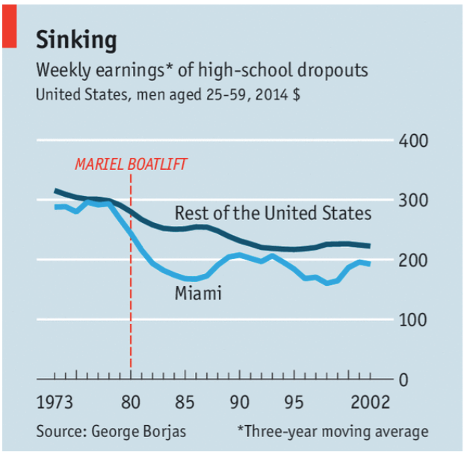

Slide 25
Effects of Migration
Wages versus other effects
  So far I have stressed effects only on wages
  Economist “Progressive Case for Immigration”
    Notes that focus on wage effects misses much that is more important
    See below for some additional effects
  But the effect on wages of the migrants themselves is huge:

Slide 26
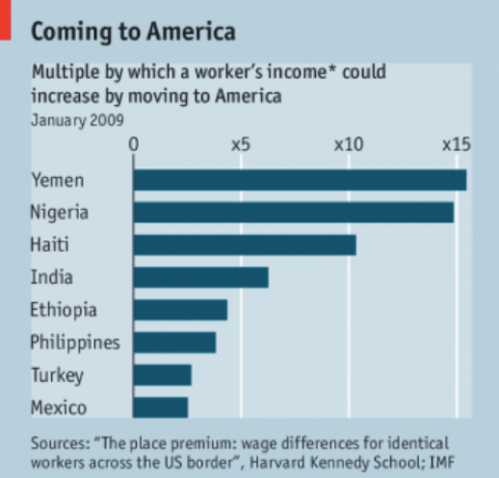
Source: Economist (2017)
Notes:
Economist, “The Progressive Case for Immigration,” The Economist, March 18, 2017. [5p] https://www.economist.com/news/finance-and-economics/21718873-whatever-politicians-say-world-needs-more-immigration-not-less

Slide 27
Outline: Migration
Why People Migrate
Why Wages Differ across Countries
Effects of Migration
  On Payments to Factors
    Labor
    Other
  Other Effects
Policies to Affect Migration
Facts about Migration

Slide 28
Effects of Migration
Other effects, not in this simple model
  Migrants
    Pay taxes
    Use government services
    Which is larger? There is debate on this
    Griswold cites study saying
      Typical immigrants and their offspring will pay $80,000 more in taxes than they will collect in government services during their lifetimes

Slide 29
Effects of Migration
Other effects, not in this simple model
  Migration changes population density; may cause congestion
    Eldredge blames immigration for
    “overcrowded schools, congested highways, deteriorating ecology and lagging infrastructure”
  Diversity: presence of immigrants adds
    Cultural enrichment
    Cultural (ethnic) frictions
      Xenophobia (fear or dislike of “others”)

Slide 30
Effects of Migration
Other effects, not in this simple model
  Many migrants carry wealth with them out of their country of origin
    Financial
    Human capital
      Raising concern about a “brain drain”
      But see Economics Focus
        Possibility of emigration provides incentive to acquire more education
        Leads to more education even at home

Slide 31
Effects of Migration
Other effects, not in this simple model
  Many migrants send money back to their country of origin
    Such “remittances” provide important income for poor countries

Slide 32
Effects of Migration
Other effects, not in this simple model
  Demographic effects
    Immigrants tend to be young and have large families
    This provides a larger young generation, whose earnings can support the elderly
      Aging population is less of a problem for the US than for Europe and Japan, because of immigration

Slide 33
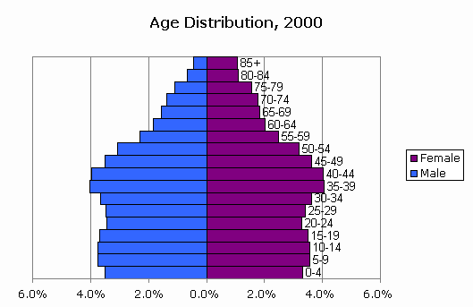
Population Pyramid: US
Notes:
Source: http://www.censusscope.org/us/chart_age.html

Slide 34
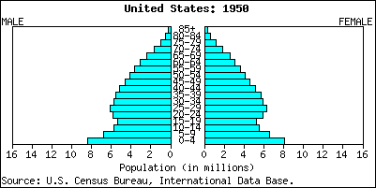
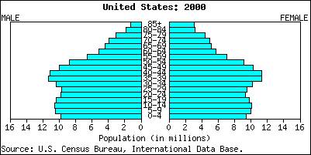
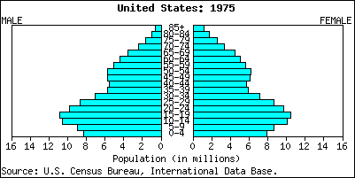
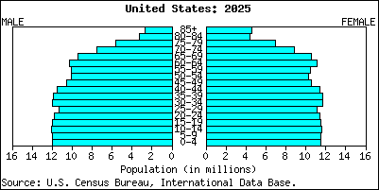
Population Pyramid: US
Notes:
Source: http://economistsview.typepad.com/economistsview/2005/09/the_changing_ag.html

Slide 35
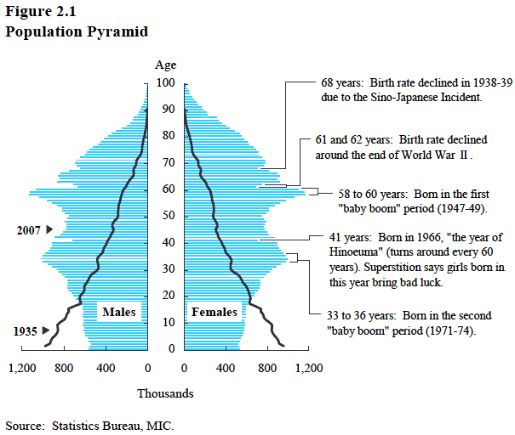
Population Pyramid: Japan
Notes:
Source: http://www.stat.go.jp/english/data/handbook/c02cont.htm

Slide 36
Outline: Migration
Why People Migrate
Why Wages Differ across Countries
Effects of Migration
  On Payments to Factors
    Labor
    Other
  Other Effects
Policies to Affect Migration
Facts about Migration

Slide 37
Policies to Affect Migration
Immigration Quotas, based on
  Race
  Country of origin
    US used to limit or ban immigrants from most of Asia, eastern & southern Europe, and Africa (see Porter)
  Income, wealth, skill
  Family connections
  US has recently debated switch from #4 to #3

Slide 38
Policies to Affect Migration
“Guest worker” Programs
  Permit workers to enter temporarily to fill a labor-market need
  Hard to enforce “temporary”

Slide 39
Policies to Affect Migration
Trade Policies
  Recall Factor Price Equalization
  If this works, it reduces the incentive for migration
  This was one motive for NAFTA: raise wages in Mexico so that fewer will try to enter the US
    As we’ll see later, Mexican wages did not rise
    Mexico-US migration fell anyway, for other reasons

Slide 40
Policies to Affect Migration
Encourage high-income immigration
  Provide larger quotas for workers likely to earn high incomes
  Deny welfare benefits to recent immigrants, so poor won’t be tempted to come

Slide 41
Policies to Affect Migration
Control the border
  Make it hard for illegal immigrants to enter
  But note the costs of doing this (See Skerry and Rockwell)
    Encourages organized crime to smuggle migrants
    These make life worse for the migrants

Slide 42
Outline: Migration
Why People Migrate
Why Wages Differ across Countries
Effects of Migration
  On Payments to Factors
    Labor
    Other
  Other Effects
Policies to Affect Migration
Facts about Migration

Slide 43
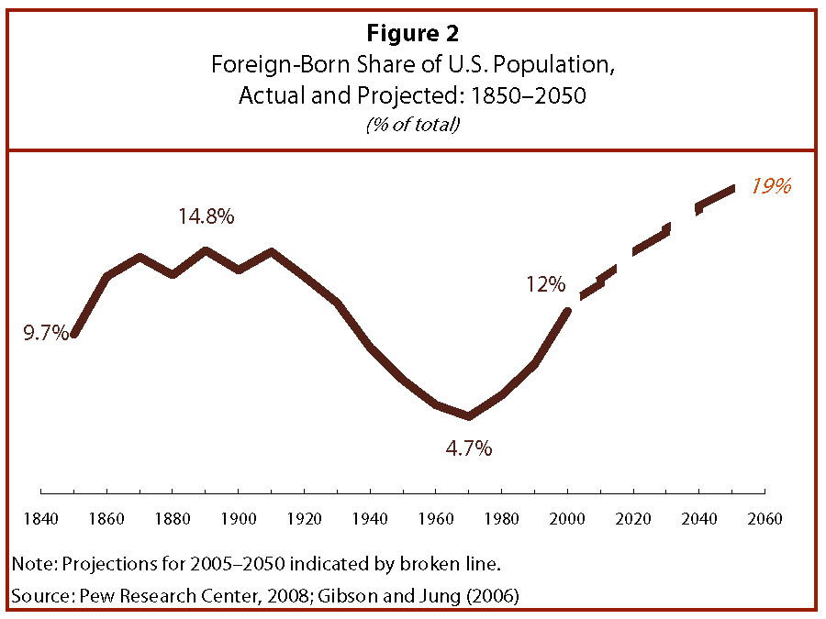
Notes:
Source: Passel and Cohn, “U.S. Population Projections, 2005-2050,” Pew Research Center, Feb 11, 2008.
http://pewresearch.org/pubs/729/united-states-population-projections

Slide 44
Facts about US Immigration
Hostility toward immigrant groups often exists, but it fades over time
Recall the hostility once felt in the U.S. toward
  Irish
  Southern Europeans (Italians, Greeks)
  Asians (“coolie labor”)
Hispanics are likely to follow the same path

Slide 45
Facts about US Immigration
But see also Borjas:
  Compared to 1970, today’s immigration is much higher
    Foreign-born share of US population
      1970: 4.7%
      2003: 12.7%
  And he argues that today’s immigrants will take longer to assimilate than earlier ones
    lower incomes and levels of education
    the decline of manufacturing to employ them
    the fact that they are less diverse ethnically
    policies and attitudes of society

Slide 46
Facts about US Immigration
Borjas is also sited among others by Porter (“Can Immigration Hurt the Economy?: An Old Prejudice Returns”)
  Immigrants from other cultures “bring their culture with them”
  They are less productive than earlier immigrants
Porter argues against these views
  Many studies show they increase productivity and output
  The critics’ arguments lack empirical support

Slide 47
Facts about US Immigration
2007 US Immigration Bill
  Pushed by Bush, McCain, favored by many Democrats
  Defeated in Congress June 2007
  Would have
    Provided legal status (& eventually citizenship) for illegal immigrants
    Increased border enforcement to reduce future illegal immigration

Slide 48
Facts about US Immigration
The Wall
  We had, before Trump, built a wall along parts of the US-Mexico the border
  Problems:
    Rivers, etc.
    Wall is often not on actual border, but inside it, cutting properties in two
    Wildlife movement

Slide 49
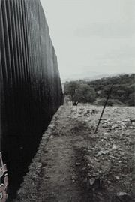
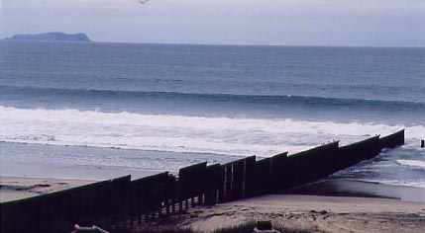

Slide 50
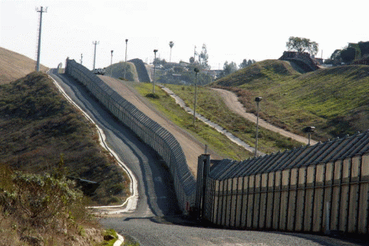

Slide 51
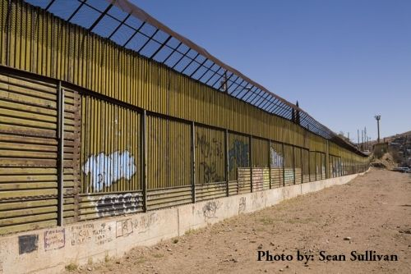

Slide 52
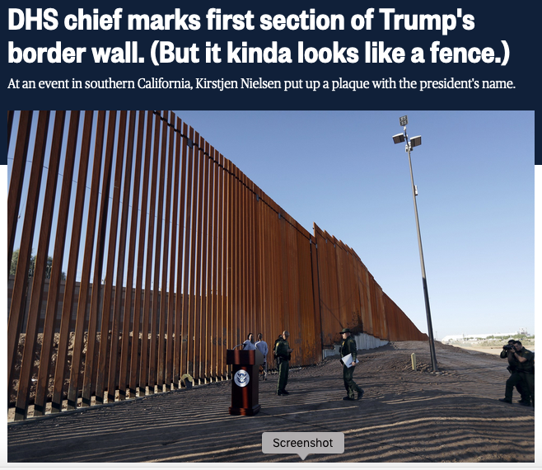
Notes:
https://www.nbcnews.com/politics/donald-trump/dhs-chief-marks-first-section-trump-s-border-wall-it-n924941

Slide 53
Facts about World Migration
See Donnan (from 2014, before the surge of refugees from Syria)
  Number of migrants was higher than ever, but not as share of population
  About 3% of global population lived outside their country of birth
  Greatest migrations today are inside countries (China)
  Budgetary cost of new migrants, while probably positive, is generally small

Slide 54
Facts about World Migration
See Economist “From South to South”
  Not all migration is from developing to developed countries
  Much migration takes place from very poor developing countries to others that are just somewhat less poor
  Why don’t they go to developed countries?
    Often they can’t afford the trip
    Less poor neighbors may be ones they can reach by bus or by walking

Slide 55
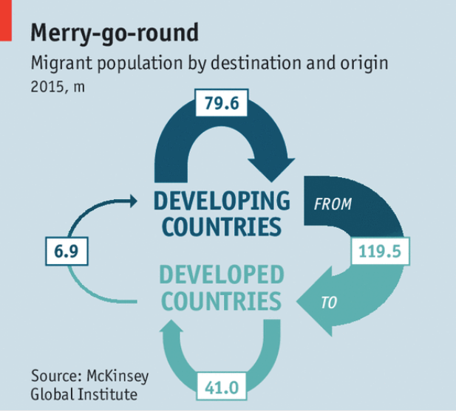

Slide 56
Facts about US Immigration
The Future?
  President Trump has already tried to take several actions
    To build the wall
    To stop immigration from certain countries

Slide 57
Next Time
International Movements of Capital
  Multinational Corporations
  Foreign Direct Investment

