Slide 1
Lecture 9 World Trade Arrangements and the WTO
Econ 340
Notes:
Added Donnan 2016 on US as bully in WTO

Slide 2
Outline: World Trade Arrangements and the WTO
International Organizations
World Trade Organization
History, as GATT
GATT Rounds
WTO Today
Functions
Current Issues
Seattle Protests and Beyond
Doha Round
Disputes
Other Issues
WTO Critiques

Slide 3
International Organizations
International Organizations Related to Trade
WTO = World Trade Organization
Formerly GATT = General Agreement on Tariffs and Trade
More on this below

Slide 4
International Organizations
International Organizations Related to Trade
OECD = Organization for Economic Cooperation and Development
Group of mostly rich countries
Collects data
Discusses reforms
36 members
Including Mexico, Korea, Czech Rep., Poland
Most recent: Lithuania, added 5 July 2018
Russia is not a member (discussions of that were postponed in 2014)

Slide 5
International Organizations
International Organizations Related to Trade
EU = European Union
Group of 28 countries, among which there is free flow of
Goods
Capital
Labor (but not yet including Croatia, which joined most recently)
Added 10 countries Jan 1, 2004
Added Romania and Bulgaria on Jan 1, 2007
Added Croatia July 1, 2013
UK voted to leave June 23, 2016 (Brexit)
Initiated the process at end of March, 2017
That started 2-year period to negotiate terms of “Brexit”
Deadline: March 29, 2019, postponed to October 31, 2019

Slide 6
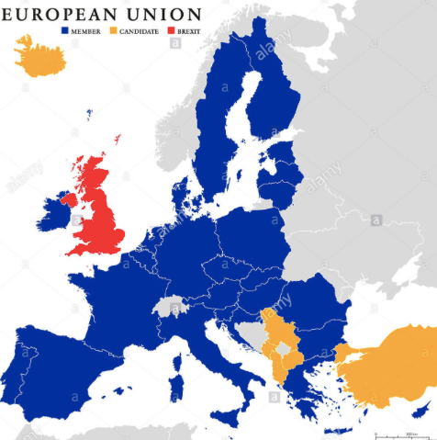
Note who is missing:
Switzerland
Norway
Former Yugoslavia except Slovenia & Croatia

Slide 7
International Organizations
International Organizations Related to Trade
NAFTA = North American Free Trade Agreement
Group of 3 countries, US, Canada, Mexico that have
Zero tariffs on each other’s exports
Rules to facilitate investment, intellectual property, etc.
We’ll learn more about it later in the course
President Trump has now renegotiated it
USMCA: United State, Mexico, Canada Agreement

Slide 8
International Organizations
United Nations (UN) Organizations
UNCTAD = UN Conference for Trade and Development
Voices views of developing countries
ILO = International Labor Organization
Promotes labor standards and rights
Has no authority to limit trade
WIPO = World Intellectual Property Organization
Promotes use and protection of intellectual property (Copyrights, Trademarks, Patents)
Also has no authority to limit trade

Slide 9
International Organizations
Non-governmental Organizations (NGOs)
Far too many to list – here are a few
Fraser Institute
Oxfam International
Third World Network
Worldgrowth.org
NGOs have been increasingly active in trying to influence trade policies and negotiations

Slide 10
Outline: World Trade Arrangements and the WTO
International Organizations
World Trade Organization
History, as GATT
GATT Rounds
WTO Today
Functions
Current Issues
Seattle Protests and Beyond
Doha Round
Disputes
Other Issues
WTO Critiques

Slide 11
World Trade Organization: History
1930s:
Tariffs raised, to high levels
1930 US Smoot-Hawley Tariff Act
Raised tariffs on 890 items
Prompted retaliation by other countries, who then also raised tariffs
Notes:
Source: Economist, “The battle of Smoot-Hawley,” December 18, 2008.

Slide 12
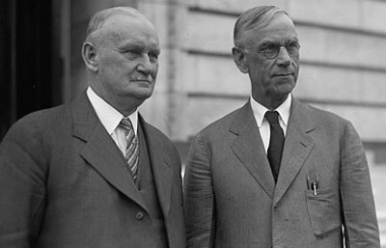
Hawley
Smoot

Slide 13
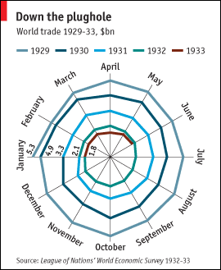
Source: Economist, “The battle of Smoot-Hawley,” December 18, 2008.

Slide 14
World Trade Organization: History
Mid-1940s:
Created IMF and World Bank at meeting in Bretton Woods, New Hampshire
US tried to create ITO = International Trade Organization
Interim agreement: GATT = General Agreement on Tariffs and Trade
When ITO failed to be approved (by US!), GATT governed trade policy by default

Slide 15
World Trade Organization: History
What GATT Does
(GATT is still the largest part of WTO)
Rules for trade policy
Forum for negotiation
Of both trade policies (e.g., tariffs) and rules
Major negotiations took place in “Negotiating Rounds”
Decisions made at occasional meetings of trade ministers: “Ministerial Meetings”

Slide 16
Outline: World Trade Arrangements and the WTO
International Organizations
World Trade Organization
History, as GATT
GATT Rounds
WTO Today
Functions
Current Issues
Seattle Protests and Beyond
Doha Round
Disputes
Other Issues
WTO Critiques

Slide 17
World Trade Organization: Rounds
Rounds of GATT Multilateral Trade Negotiations
No. | Years | Name | Accomplishments
1-5 | 1947-61 |  | Reduced tariffs

Slide 18
World Trade Organization: Rounds
Rounds of GATT Multilateral Trade Negotiations
No. | Years | Name | Accomplishments
1-5 | 1947-61 |  | Reduced tariffs
6 | 1964-67 | Kennedy | Tariffs + anti-dumping

Slide 19
World Trade Organization: Rounds
Rounds of GATT Multilateral Trade Negotiations
No. | Years | Name | Accomplishments
1-5 | 1947-61 |  | Reduced tariffs
6 | 1964-67 | Kennedy | Tariffs + anti-dumping
7 | 1973-79 | Tokyo | Tariffs + NTBs

Slide 20
World Trade Organization: Rounds
Rounds of GATT Multilateral Trade Negotiations
No. | Years | Name | Accomplishments
1-5 | 1947-61 |  | Reduced tariffs
6 | 1964-67 | Kennedy | Tariffs + anti-dumping
7 | 1973-79 | Tokyo | Tariffs + NTBs
8 | 1986-94 | Uruguay | Tariffs, NTBs, Services, Intellectual Property, Textiles, Ag., Dispute Settlement, Created WTO

Slide 21
World Trade Organization: Rounds
Rounds of GATT Multilateral Trade Negotiations
No. | Years | Name | Accomplishments
1-5 | 1947-61 |  | Reduced tariffs
6 | 1964-67 | Kennedy | Tariffs + anti-dumping
7 | 1973-79 | Tokyo | Tariffs + NTBs
8 | 1986-94 | Uruguay | Tariffs, NTBs, Services, Intellectual Property, Textiles, Ag., Dispute Settlement, Created WTO
9 | 2001-15 | Doha | FAILED: Doha Development Agenda

Slide 22
World Trade Organization: Rounds
How negotiations took place
Tariffs:
In early rounds, tariff cuts were negotiated between “principal supplier” country and “principal demander” country
Cuts are extended to all other members (MFN)
But large countries dominate this process
In recent rounds, negotiations start with a formula for tariff cuts, then negotiate exceptions
Swiss Formula: Z = AX/(A+X)
X = initial tariff rate
A = coefficient and maximum tariff rate
Z = resulting lower tariff rate
Proposed by Switzerland in Tokyo Round
Reduces high tariffs more than low tariffs

Slide 23
World Trade Organization: Rounds
How negotiations took place
Rules:
Groups of countries draft changes, then persuade others
Again, large countries dominate

Slide 24
World Trade Organization: Rounds
Do small and poor countries lose?
They need not lose, if they participate in the process
They benefit from the “rule of law”: Otherwise the large countries would be even more powerful
By grouping together, small countries can also exert bargaining power
They may well lose if they do not participate: growth of trade may exclude them
Tariffs did not fall on their major exports

Slide 25
Outline: World Trade Arrangements and the WTO
International Organizations
World Trade Organization
History, as GATT
GATT Rounds
WTO Today
Functions
Current Issues
Seattle Protests and Beyond
Doha Round
Disputes
Other Issues
WTO Critiques

Slide 26
World Trade Organization: Today
WTO Today
Established Jan 1, 1995
Members: 164
Most recent: Afghanistan 2016
Including:
China (as of 2001)
Russia (as of 2012)
Not including: Iran, Iraq, N. Korea
Headquarters: Geneva, Switzerland
(also home of ILO, WIPO, and others)

Slide 27
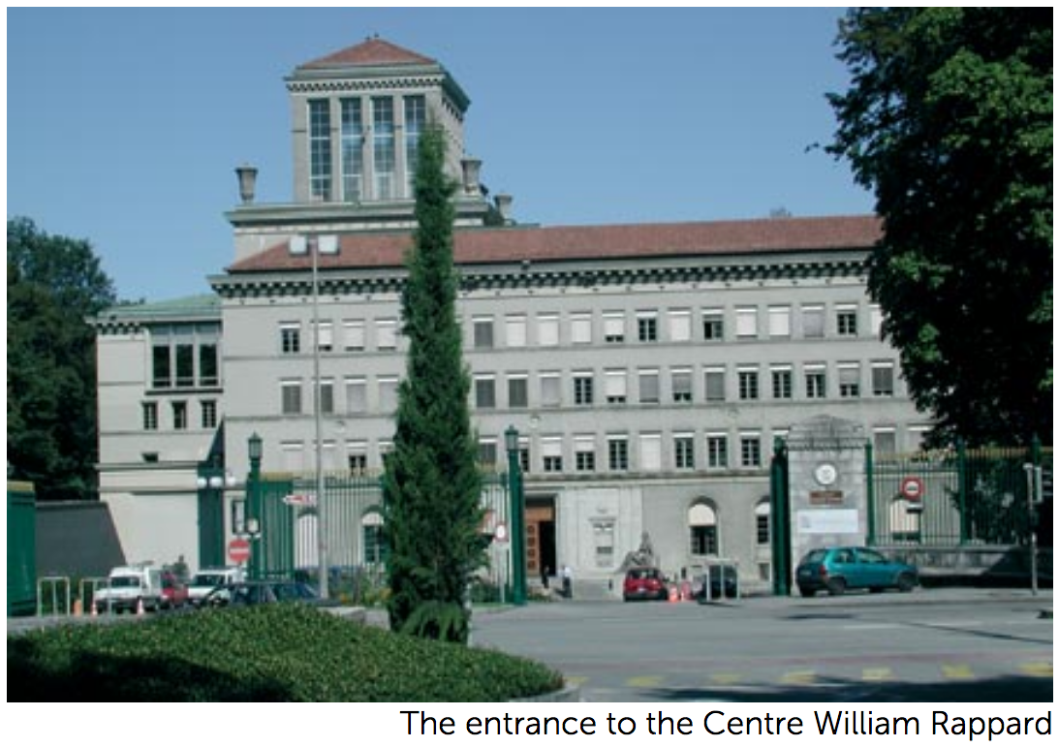

Slide 28
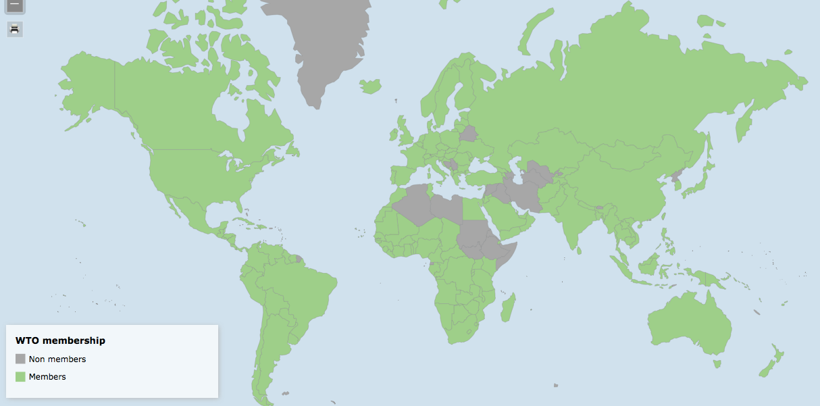
Interactive: https://www.wto.org/english/res_e/statis_e/statis_maps_e.htm

Slide 29
World Trade Organization: Today
WTO’s Three Parts
GATT (Still exists, as largest part of WTO)
GATS = General Agreement on Trade in Services
TRIPs Agreement = Trade Related aspects of Intellectual Property Rights

Slide 30
World Trade Organization: Today
WTO’s Two Basic Principles
MFN = Most Favored Nation
Each member country should treat all members as well as it treats its “most favored nation” (i.e., the member that it treats the best)
National Treatment
Once a product or seller has entered a country, it should be treated the same as products or sellers that originated inside that country
(There are many permitted exceptions to both of these principles)

Slide 31
World Trade Organization: Today
WTO Decision Making
Decisions by consensus: all countries present at ministerial meetings must agree,
Alternatively, a certain fraction, 2/3 or 3/4, of all members must agree
In practice, large and rich countries dominate this process
They first agree among themselves
(This originally done in “Green Room”, hence “Green Room Group”)
Then seek consensus based on that
Is this “democratic”?
Yes: Every country has one vote
No: Rich countries dominate decisions in practice

Slide 32
Outline: World Trade Arrangements and the WTO
International Organizations
World Trade Organization
History, as GATT
GATT Rounds
WTO Today
Functions
Current Issues
Seattle Protests and Beyond
Doha Round
Disputes
Other Issues
WTO Critiques

Slide 33
WTO Functions
See table in Deardorff
Functional Outline of the World Trade Organization
Communication
Constraints
Exceptions
Dispute Settlement

Slide 34
WTO Functions
Communication | Ministerials
 | Negotiating Rounds
 | Working Groups
 | Trade Policy Review Mechanism
 | Councils and Committees
Trade Ministers (USTR, etc.) Meet Every Two Years
Tariff Reductions; Changes in Rules

Slide 35
WTO Functions
National Treatment for Service Firms (only in some industries)
Constraints | Tariff Bindings
 | Customs Valuation
 | Product Regulations
 | Quantitative Restrictions
 | Subsidies
 | Foreign Direct Investment (TRIMS)
 | Services (GATS)
 | Intellectual Property (TRIPs)
Countries negotiate and commit to maximum tariffs
Enforce Patents, Copyrights, Trademarks

Slide 36
WTO Functions
Most commonly used
Exceptions | Anti-Dumping
 | Countervailing Duties
 | Safeguards
 | Balance of Payments Protection
 | Preferential Trade Agreements
Permitted; not required
Allows NAFTA, EU, etc.

Slide 37
WTO Functions
Standing Committee that reviews most cases
Dispute Settlement | Consultation
 | Panel Recommendation
 | Appellate Body
 | Remedy | Implementation
 |  | Compensation
 |  | Retaliation
3-person Panel Decides Case
The Ultimate Remedy: Permit Tariffs

Slide 38
Outline: World Trade Arrangements and the WTO
International Organizations
World Trade Organization
History, as GATT
GATT Rounds
WTO Today
Functions
Current Issues
Seattle Protests and Beyond
Doha Round
Disputes
Other Issues
WTO Critiques

Slide 39
WTO Current Issues
Seattle Protest and Beyond
Seattle Ministerial – December 1999
Intended to start a new Round
Protesters flocked to Seattle, with objections

Slide 40
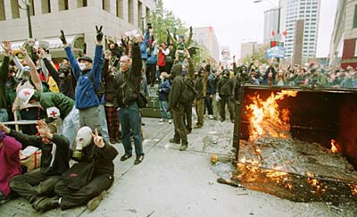

Slide 41
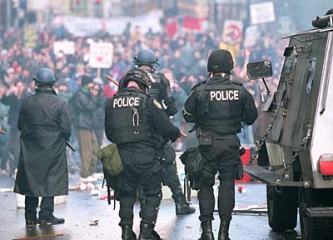

Slide 42
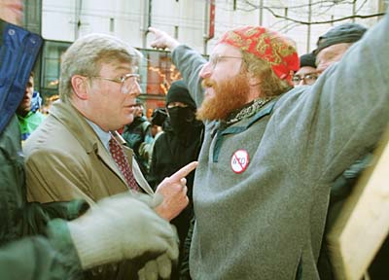

Slide 43
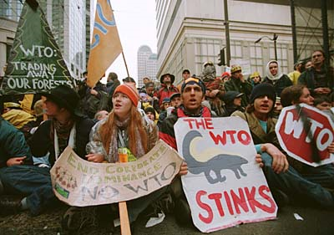

Slide 44
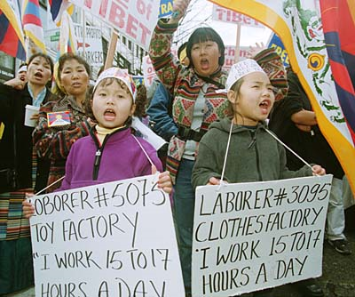

Slide 45
WTO Current Issues
Seattle Protest and Beyond
Seattle Ministerial – December 1999
Intended to start a new Round
Protesters flocked to Seattle, with objections
Labor issues
Environmental issues
Corporate dominance
Lack of transparency, democracy
Meeting ended in failure

Slide 46
Outline: World Trade Arrangements and the WTO
International Organizations
World Trade Organization
History, as GATT
GATT Rounds
WTO Today
Functions
Current Issues
Seattle Protests and Beyond
Doha Round
Disputes
Other Issues
WTO Critiques

Slide 47
WTO Current Issues
Doha Round
Began at WTO Ministerial at Doha, Qatar, Fall 2001 (after Sep 11)
Emphasis on development:
“Doha Development Agenda”
Major issues to be included
US and EU agricultural subsidies and tariffs
Developing-country tariffs on manufactures
Market access for services into developing countries

Slide 48
WTO Current Issues
Doha Round
Cancún Ministerial Sep 2003: Failed
July 2004: framework agreement achieved
Hong Kong Ministerial Dec 2005: Agreed, but on little
2006-2015: Talks stumbled along
December 2015: Nairobi Ministerial meeting
Ended without reaffirming intent to complete the Doha Round
Implicitly, that was admission that it had ended in failure

Slide 49
WTO Current Issues
What happens without Doha?
Tariffs may rise because bound tariffs won’t fall
Bound tariffs are almost twice as high as applied ones
Some argue that world trade will fall
Has it happened?
Trade stopped growing for a while, then grew again
Not clear that tariffs rose (until Trump)

Slide 50
WTO Current Issues
Other negotiations have been more successful
December 2013: Bali Ministerial salvaged a limited agreement, mainly on Trade Facilitation
July 2014: Implementation of the “Bali Package” was delayed by objections from the new India Prime Minister Modi
November 2014: Modi and Obama met and resolved the disagreement. Bali Package was adopted at WTO.
December 2015: Nairobi Ministerial agreed on several commitments, including to
Abolish export subsidies on farm exports.
December 2017: Buenos Aries Ministerial met but accomplished essentially nothing
Was more about friction between US (Trump) & others

Slide 51
WTO Current Issues
WTO has also succeeded in negotiating “plurilateral agreements”
These are agreements the members can sign or not, and are only binding on those who do
Agreements that have been negotiated:
Information Technology Agreement (with an update currently being negotiated)
Financial Services Agreement
Basic Telecommunication Services Agreement
Anti-Counterfeiting Trade Agreement

Slide 52
Outline: World Trade Arrangements and the WTO
International Organizations
World Trade Organization
History, as GATT
GATT Rounds
WTO Today
Functions
Current Issues
Seattle Protests and Beyond
Doha Round
Disputes
Other Issues
WTO Critiques

Slide 53
WTO Current Issues
WTO Disputes
There have been 590 disputes brought to the WTO since its creation in 1995 (as of 10/1/19)
Some of the more notable are (or were)
EU ban on hormone treated beef (ruled by WTO to have no scientific basis)
US shrimp-turtle import prohibition (struck down by WTO)

Slide 54
WTO Current Issues
WTO Disputes
More
Boeing-Airbus dispute over subsidies by EU and US (WTO ruled that both were using illegal subsidies)
Canada and Mexico complaint about US Country-of-Origin Labeling (COOL) law for meats (WTO ruled against US law)

Slide 55
Outline: World Trade Arrangements and the WTO
International Organizations
World Trade Organization
History, as GATT
GATT Rounds
WTO Today
Functions
Current Issues
Seattle Protests and Beyond
Doha Round
Disputes
Other Issues
WTO Critiques

Slide 56
WTO Current Issues
Other WTO Issues
Independence
US (under Obama) vetoed reappointment of a member of the Appellate Body
He had found against the US in several cases
Others worry that this will undermine the body’s independence
This made US look like a bully to others
Since then, US under Trump has blocked further appointments (see Schlesinger)
The Appellate Body may soon lack a quorum to make decisions.

Slide 57
WTO Current Issues
Other WTO Issues
China’s “market economy status” (see Schlesinger)
Because China is currently classed as a non-market economy, its prices need not be used in deciding anti-dumping cases
This leaves others free to base dumping decisions on prices in other countries, hurting China
China is arguing for market economy status, and the issue is likely to be addressed soon by the Appellate Body

Slide 58
Outline: World Trade Arrangements and the WTO
International Organizations
World Trade Organization
History, as GATT
GATT Rounds
WTO Today
Functions
Current Issues
Seattle Protests and Beyond
Doha Round
Disputes
Other Issues
WTO Critiques

Slide 59
WTO Critiques
Trump
Oct 25, 2017, on Fox interview with Lou Dobbs:
“The WTO, World Trade Organization, was set up for the benefit for everybody but us.”
“we lose the lawsuits, almost all of the lawsuits … within the WTO”
In fact, like other countries, US
Wins most of the cases it brings
Loses most the cases brought against it
Since 1995, in all cases complainant has won 90%
As complainant, US has won 91%
As respondent, US has lost 89%
But…Trump may be closer to right if we’ve been respondent much more than complainant

Slide 60
WTO Critiques
Trump
Oct 30, 2018, FT:
Donald Trump threatens to pull US out of the WTO
“If they don’t shape up, I would withdraw from the WTO,” Mr Trump said in an interview.

Slide 61
WTO Critiques
Rodrik
WTO extended GATT into “inside the border” policies that countries resist
It is not well suited to dealing with countries that are very different (China)
US would have had a hard time developing under WTO rules
WTO has been unable to adapt to change, and instead the Appellate Body has made new law

Slide 62
WTO Critiques
The future of WTO?
May slip into irrelevance as US and others ignore its rules
Or maybe these issues will prompt it to restructure itself to work better

Slide 63
Next Time
Migration
Causes
Effects
Policies

