Slide 1
Lecture 8 US Trade Policies and Institutions
Econ 340

Slide 2
Outline: US Trade Policies and Institutions
Parts of the US Government that Handle Trade
Main Features of US Trade Policies
Tariffs, Quotas, VERs
Escape Clause
Unfair Trade Laws
Trade Adjustment Assistance
Fast Track
GSP
Dumping and Anti-Dumping
Why the US Protects
Trends in US Trade Policy

Slide 3
US Trade Institutions
Why US?
That’s where we are
US is large and therefore important for the world
Many of the policies and institutions that US uses are also used by many others
We’ll see that as we go through them

Slide 4
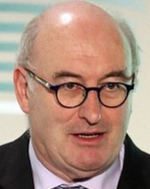
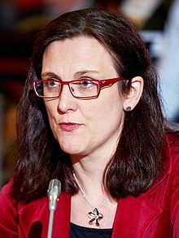
US Trade Institutions
US does NOT have a “ministry” or “department” of international trade
Most other countries do; e.g. …
Canada: Department of International Trade
Japan: Ministry of Economy, Trade and Industry (METI) (Used to be MITI)
EU: Directorate General Trade
Trade Commissioner:
Cecilia Malmström
since Nov 2014
Now Phil Hogan

Slide 5
US Trade Institutions
In US, responsibility for trade issues is spread over many entities
Congress
USTR
Commerce Department
US International Trade Commission
Export-Import Bank
and several others
Obama said several years ago that he sought to consolidate many of these in a single agency
He never did

Slide 6
US Trade Institutions
USTR = United States Trade Representative
Handles negotiations on trade issues with
Other governments
WTO
Drafts trade legislation for Congress
Does NOT set or implement trade policies

Slide 7

US Trade Institutions
Trump’s USTR is Robert Lighthizer
Cabinet-level official of US government

Slide 8
US Trade Institutions
Congress
Sets tariffs and other trade policies (thus approves trade agreements)
Two committees are responsible
House: Ways and Means
Senate: Finance
Why these?
Because trade policy was originally about collecting revenue

Slide 9
US Trade Institutions
Administrative Agencies
ITA = International Trade Administration
Part of Department of Commerce
Main Function: Determines “fairness” in unfair trade cases
Are imports “dumped”?
Are they “subsidized”?
Orientation of ITA: very much favors US businesses

Slide 10
US Trade Institutions
Administrative Agencies
ITC = USITC = United States International Trade Commission
Independent agency
Commissioners (6) are nominated by President and confirmed by Senate
After that they are on their own
Main Function: To determine “injury” in cases of
Anti-Dumping
Countervailing duties (subsidies)
Safeguards (a.k.a., Escape Clause)

Slide 11
Clicker Question
Which of the following is not one of the parts of the US government that deals with trade issues?
International Trade Administration
International Trade Commission
United States Trade Representative
Department of International Trade
The Ways and Means Committee
✓

Slide 12
Outline: US Trade Policies and Institutions
Parts of the US Government that Handle Trade
Main Features of US Trade Policies
Tariffs, Quotas, VERs
Escape Clause
Unfair Trade Laws
Trade Adjustment Assistance
Fast Track
GSP
Dumping and Anti-Dumping
Why the US Protects
Trends in US Trade Policy

Slide 13
Main Features of US Trade Policies
Tariffs, quotas, etc.
We have them (See Lakatos)
Column 2: high tariffs left over from 1930
Apply only to N. Korea and Cuba
Column 1: low tariffs negotiated since then
For all other countries, due to trade negotiations since 1934
These are the “MFN” – Most Favored Nation - tariffs on WTO members
Average US tariff before Trump was about as low as any major country

Slide 14
Main Features of US Trade Policies
Tariffs, quotas, etc.
We still have high tariffs on some products
Textiles, apparel
Agriculture
Quotas are still common in agriculture
VERs: no longer
But Trump has negotiated something like VERs
With Trump we have more high tariffs

Slide 15
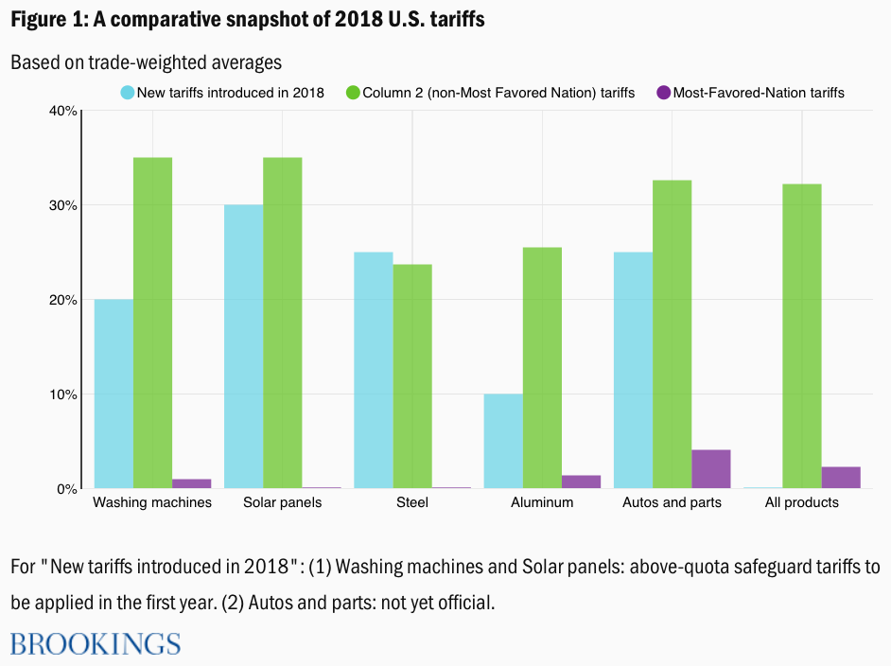
Main Features of US Trade Policies
Note what’s missing: Tariffs on China
Source: Lakatos
Notes:
Source: Lakatos, Csilla, “Back to the 1930s: Do US tariffs signal a shift to Smoot- Hawley-type protectionism?”
https://www.brookings.edu/blog/future-development/2018/07/26/back-to-the-1930s-do-us-tariffs-signal-a-shift-to-smoot-hawley-type-protectionism/

Slide 16
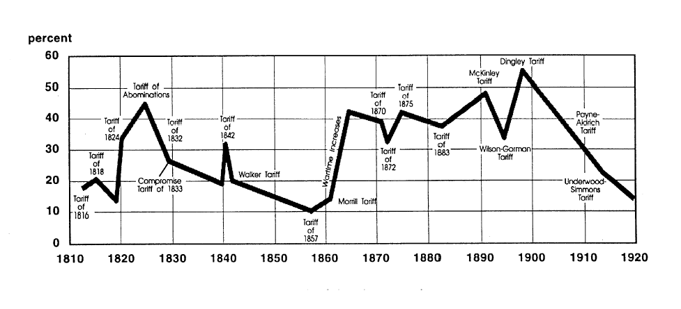
Main Features of US Trade Policies
US tariff history: 1810-1920
Today
Notes:
Source: landandfreedom.org

Slide 17
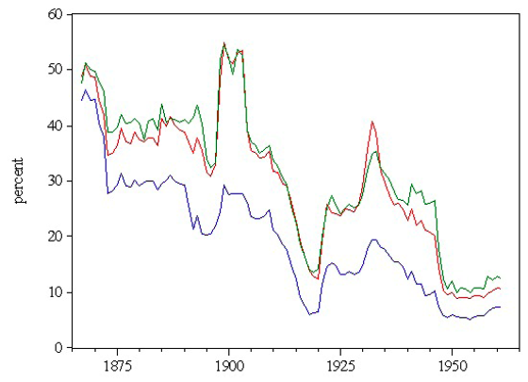
Main Features of US Trade Policies
US tariff history: 1865-1960
Average tariff
Today
Today
Notes:
Source: Irwin, Doug, “Trade Restrictiveness and Deadweight Losses from U.S. Tariffs,” 22 December 2008, Figure 1.

Slide 18
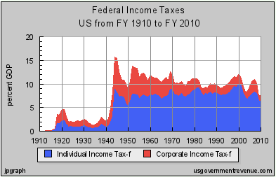
Main Features of US Trade Policies
US tariff history: 1865-1960
Why the decline? Partly due to revenues from income tax:
Notes:
Source: Irwin, Doug, “Trade Restrictiveness and Deadweight Losses from U.S. Tariffs,” 22 December 2008, Figure 1.

Slide 19
Main Features of US Trade Policies
US tariff history: 1865-1960
Trade Restrictiveness
(2 measures)
Average tariff
Today
Today
Notes:
Source: Irwin, Doug, “Trade Restrictiveness and Deadweight Losses from U.S. Tariffs,” 22 December 2008, Figure 1.

Slide 20
Main Features of US Trade Policies
Aside on “Trade Restrictiveness Index” (TRI)
Defined as the level of a uniform ad valorem tariff that would have the same overall effects as the actual tariff structure
Why TRI > Average Tariff
Tariffs are very unequal across products
Recall that dead-weight-loss rises with square of tariff
E.g.: Tariffs (0, 20) will cause twice the loss of (10, 10)

Slide 21
Clicker Question
Average US tariffs declined substantially in the early 1900s. Which of the following is one of the reasons for that?
The introduction of income tax made the US less reliant on revenue from tariffs
The World Trade Organization was created and required that tariffs be reduced
The US signed the General Agreement on Tariffs and Trade, promising to reduce tariffs
Tariffs were understood to have been a cause of the first World War
Tariffs were no longer needed, as the US had become competitive as an exporter.
✓

Slide 22
Outline: US Trade Policies and Institutions
Parts of the US Government that Handle Trade
Main Features of US Trade Policies
Tariffs, Quotas, VERs
Escape Clause
Unfair Trade Laws
Trade Adjustment Assistance
Fast Track
GSP
Dumping and Anti-Dumping
Why the US Protects
Trends in US Trade Policy

Slide 23
Main Features of US Trade Policies
Escape Clause = Section 201
Called “Safeguards” in WTO
Permits temporary protection from injurious imports
Does NOT allege that the imports are “unfair”
Eligibility is decided by USITC alone
Injury (must be serious)
Causation (must be due to imports)
Implemented by President, who may say NO.

Slide 24
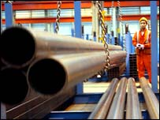
Main Features of US Trade Policies
Escape Clause
Important recent case: Steel
Bush Administration imposed safeguard tariffs on imported steel in March 2002 for 3 years
Other countries filed case against US in WTO
WTO ruled against US (import surge had abated well before we imposed tariffs)
US removed tariffs in December 2003

Slide 25
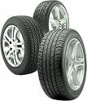
Main Features of US Trade Policies
Escape Clause
Important recent case: Tires
Obama Administration imposed safeguards tariffs on imported tires from China in September 2009: 35% 1st yr, 30% 2nd yr, 25% 3rd yr
Reason: imports had tripled over 5 yrs; 5000 jobs lost
Requested by union, not by firms. Firms were themselves producing in China.
Obama had option of saying No

Slide 26
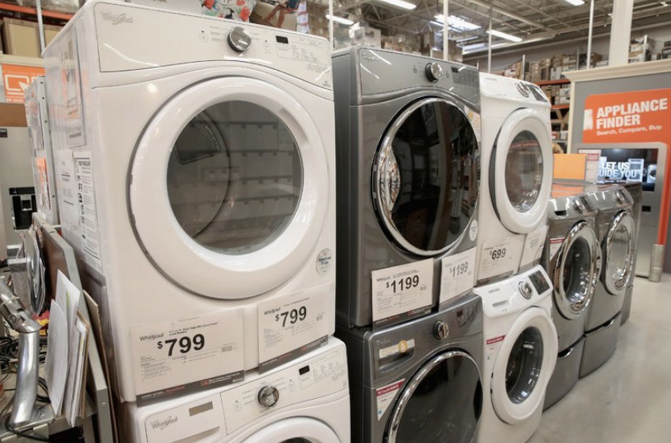
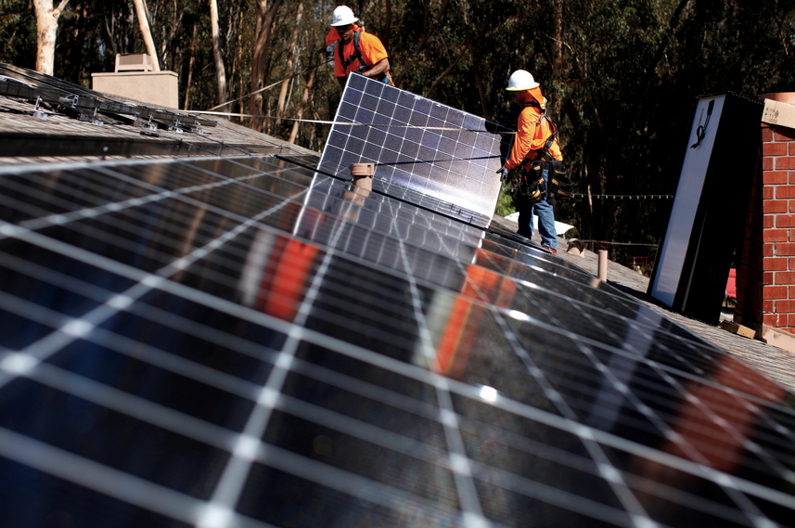
Main Features of US Trade Policies
Escape Clause
2018:
Washing machines
Solar panels
Implemented by Trump, Jan 22, 2018

Slide 27
Outline: US Trade Policies and Institutions
Parts of the US Government that Handle Trade
Main Features of US Trade Policies
Tariffs, Quotas, VERs
Escape Clause
Unfair Trade Laws
Trade Adjustment Assistance
Fast Track
GSP
Dumping and Anti-Dumping
Why the US Protects
Trends in US Trade Policy

Slide 28
Main Features of US Trade Policies
Unfair Trade Laws
Permit protection (not temporary) from “unfair” imports
Must also be injurious, but less so than for escape clause (“material injury”)
“Unfair” if
Subsidized by foreign government
“Dumped”, i.e., priced too low by firm (more on this below)

Slide 29
Main Features of US Trade Policies
Unfair Trade Laws
Fairness decided by ITA
Injury decided by USITC
President is NOT permitted to say NO
Note the recent case of Boeing vs. Bombardier (Canadian), Jan 2018
ITA affirmed subsidies
USITC denied injury
Therefore tariff was not used

Slide 30
Clicker Question
If a US industry wants to get higher tariffs on imports, which of the following might allow it to get that?
The Anti-Dumping statute
The Escape Clause
The Countervailing Duty law
All of the above
None of the above
✓

Slide 31
Clicker Question
Had we seen in the news that President Trump decided to levy an anti-dumping duty on exports of washing machines from China, what would that tell you?
The news is incorrect
China must be subsidizing exports of washing machines
Chinese washing machines are using technology stolen from the US
President Trump is trying to reduce the US trade deficit with China
A US washing machine maker has contributed to the Republican Party
Anti-dumping is decided by the ITA & USITC, and the President has no say.
✓

Slide 32
Outline: US Trade Policies and Institutions
Parts of the US Government that Handle Trade
Main Features of US Trade Policies
Tariffs, Quotas, VERs
Escape Clause
Unfair Trade Laws
Trade Adjustment Assistance
Fast Track
GSP
Dumping and Anti-Dumping
Why the US Protects
Trends in US Trade Policy

Slide 33
Main Features of US Trade Policies
Trade Adjustment Assistance (TAA)
Provides temporary help (not tariff protection) for firms and workers hurt by imports
Gives workers access to income support, relocation allowances, job search allowances, health coverage tax credit, and occupational training
As of 2002, Alternative Trade Adjustment Assistance (ATAA) also provides limited “wage insurance” for trade-displaced older workers

Slide 34
Aside: Wage Insurance
Except for ATAA, US does NOT have this
Many economists recommend it
See article by Roth
Wage Insurance would pay workers when they take a new job at a lower wage
Pays a specified fraction of the fall in wage
For limited time
Advantages over TAA
Encourages both workers and firms to re-employ workers
Need not (in principle) be limited to workers displaced by trade

Slide 35
Outline: US Trade Policies and Institutions
Parts of the US Government that Handle Trade
Main Features of US Trade Policies
Tariffs, Quotas, VERs
Escape Clause
Unfair Trade Laws
Trade Adjustment Assistance
Fast Track
GSP
Dumping and Anti-Dumping
Why the US Protects
Trends in US Trade Policy

Slide 36
Main Features of US Trade Policies
Fast Track
Now officially called Trade Promotion Authority (TPA)
Procedure, imposed by Congress on itself, requiring it to
Consider trade legislation without amendment

Slide 37
Main Features of US Trade Policies
Fast Track
Reason:
President (via USTR) must negotiate deals with other countries, then take them to Congress for approval
Deals would collapse if Congress could change them after they were signed
With Fast Track, Congress can vote yes or no, but not make changes

Slide 38
Main Features of US Trade Policies
Fast Track
History
Presidents had Fast Track without controversy 1974-94
President Clinton sought renewal but failed
President G W Bush got it, renamed TPA:
Granted in 2002, to July 1 2005
Extended to July 1 2007
Expired July 1 2007
President Obama sought it
It was very contentious
Congress approved TPA in July 2015, good until July 1 2018, later extended to July 1, 2021

Slide 39
Main Features of US Trade Policies
Fast Track
Would have been used by Obama to try to get TPP approved, but it never came up for vote
Will be available to President Trump for,
The renegotiated NAFTA, USMCA
An FTA with the UK or Japan if he succeeds in negotiating them

Slide 40
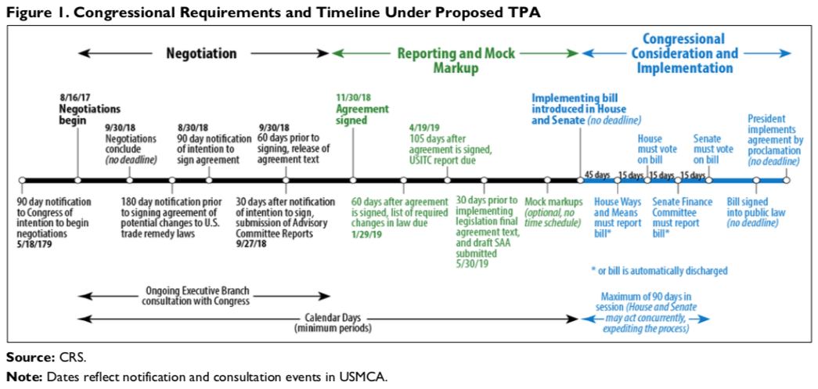
Had planned submission in September, 2019. Hasn’t happened yet

Slide 41
Outline: US Trade Policies and Institutions
Parts of the US Government that Handle Trade
Main Features of US Trade Policies
Tariffs, Quotas, VERs
Escape Clause
Unfair Trade Laws
Trade Adjustment Assistance
Fast Track
GSP
Dumping and Anti-Dumping
Why the US Protects
Trends in US Trade Policy

Slide 42
Main Features of US Trade Policies
GSP = Generalized System of Preferences
Charge lower tariffs on some exports from some developing countries than we charge other countries
Other developed countries do this too (permitted by WTO)
Glassman, “Illogical Special Trade Deals,” says we should
Deny GSP status to countries that act against US interests
Are uncooperative in trade negotiations
Fail to enforce US intellectual property rights (patents, copyrights)
Default on loans
Change US law to add flexibility in future
Trump recently (Jun 2019) removed India from GSP, prompting retaliation

Slide 43
Clicker Question
Which of the following allows the US to charge a lower tariff on exports of some countries than on others?
Fast Track
The Escape Clause
GSP
Trade Adjustment Assistance
None of the above
✓

Slide 44
Outline: US Trade Policies and Institutions
Parts of the US Government that Handle Trade
Main Features of US Trade Policies
Tariffs, Quotas, VERs
Escape Clause
Unfair Trade Laws
Trade Adjustment Assistance
Fast Track
GSP
Dumping and Anti-Dumping
Why the US Protects
Trends in US Trade Policy

Slide 45
Dumping and Anti-Dumping
Anti-Dumping (AD) was (before Trump) the most frequent trade policy
by US
and increasingly also by other countries
Dumping Defined: Selling an export at a price below the “fair price”
“Fair price” can be either
Domestic price in exporting country, or
Cost

Slide 46
Dumping and Anti-Dumping
Is dumping harmful?
Yes, to those who compete with it
But that is true of any competition
Has nothing to do with the price being “unfair”
Yes to importing country, if dumping is “predatory”
Intended to drive out all competitors,
AND then to raise price to monopoly level
Otherwise No: Importing country gains from low-priced imports, whether “unfair” or not

Slide 47
Dumping and Anti-Dumping
P
S
Effects on Welfare
Suppliers lose Demanders gain Country gains
+(b+c+d)
Dumping lowers price
P_{W}⁰
a
c
b
d
P_{W}¹
D
Q_{S}¹
Q_{S}⁰
Q_{D}⁰
Q_{D}¹
Q

Slide 48
Dumping and Anti-Dumping
Is dumping ever predatory?
Probably never
Remember that “predatory” requires
not just low price now,
but also high (monopoly) price later
Most AD cases are against multiple firms and countries (even if domestic competitors disappear, monopoly pricing is unlikely)
AD statute says nothing about showing predatory behavior or intent

Slide 49
Dumping and Anti-Dumping
Reasons for dumping (why would foreign firms ever sell exports at a low price?)
Protected home market
Tariff at home permits a high price there
Firms are price discriminating (against their own country)
Market slump: When demand is temporarily low, pricing below average cost (but not below marginal cost) is normal behavior (recall from Econ 101)
Gain a foothold in a new market: Setting price low, even below marginal cost, may make sense if
Costs are falling (with output over time)
Demand is rising (e.g., with consumers’ experience over time)

Slide 50
Clicker Question
Which of the following is considered dumping?
The US sends used plastic to be recycled in China
The Chinese government keeps prices of raw materials low by taxing their export
Canada subsidizes the production of lumber for export
A Japanese maker of cameras, protected by a tariff, sells them in the US for less than at home
A power plant in Germany releases industrial waste into the Rhine River, which flows into the Netherlands
✓

Slide 51
Outline: US Trade Policies and Institutions
Parts of the US Government that Handle Trade
Main Features of US Trade Policies
Tariffs, Quotas, VERs
Escape Clause
Unfair Trade Laws
Trade Adjustment Assistance
Fast Track
GSP
Dumping and Anti-Dumping
Why the US Protects
Trends in US Trade Policy

Slide 52
Why the US (Used to) Protect
NOT for most of the reasons we talked about earlier (revenue, optimal tariff, defense, etc.)
We use protection to benefit industries, not the whole country
Politicians care most about producers, not consumers. But producers include both
Firms
Workers
Farmers and ranchers
Use of AD (& CVD, Safeguards) is for this reason too

Slide 53
Why Trump Uses Tariffs
On washing machines and solar panels, same as above: help domestic industry
On steel and aluminum, claim was national security, but he’s proud to have restarted some producers
Section 232 of US law (see Fefer et al.)
Permits tariffs if imports “threaten to impair the national security.”
Investigated by Commerce Dept (not Defense), decided by President
Legal in WTO? We don’t know yet
Strong economy needed for national security.
See USTR, “2019 Trade Policy Agenda”

Slide 54
Why Trump Uses Tariffs
On China,
Claim has little to do with import-competing industries
Official reason is intellectual property unfair trade
Trump is also concerned about trade deficit
China thinks he wants to keep China down

Slide 55
Outline: US Trade Policies and Institutions
Parts of the US Government that Handle Trade
Main Features of US Trade Policies
Tariffs, Quotas, VERs
Escape Clause
Unfair Trade Laws
Trade Adjustment Assistance
Fast Track
GSP
Dumping and Anti-Dumping
Why the US Protects
Trends in US Trade Policy

Slide 56
Trends in US Trade Policy
Was the US a “Free Trader” before Trump?
Yes?
We have been known for that, ever since World War II
Our trade barriers were lower, slightly, than most other industrialized countries
And they were lower sooner – we led the way after WWII

Slide 57


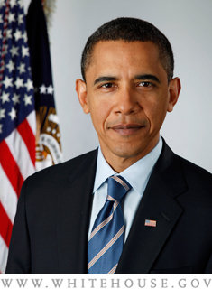

Trends in US Trade Policy
Was the US a “Free Trader”?
No?
Our barriers were far from zero
Even under Reagan, US increased
trade barriers in many sectors
Clinton argued for free trade, but also for “industrial policies” favoring sectors
Bush passed trade agreements, but also added barriers
Obama: Was critical of NAFTA as candidate, but then negotiated TPP

Slide 58
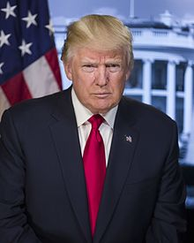
Trends in US Trade Policy
Trump?
He certainly says he is not a free trader
After 1 year he had done little
But then, in 2018, he
Pulled out of TPP
Renegotiated NAFTA
Amended US-Korea FTA
Levied tariffs on
Solar panels and washing machines
Steel and aluminum
China
So today I believe him

Slide 59

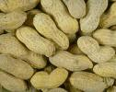



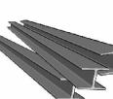
Trends in US Trade Policy
Notable US Trade Barriers before Trump
Textiles and Apparel: high tariffs (no longer quotas)
Some agriculture: high tariffs, quotas, subsidies
Sugar
Peanuts
Cotton
Dairy
VERs (no longer)
Autos
Steel
Anti-dumping
Steel (many cases)

Slide 60
Clicker Question
Which of the following reasons explains most US protection prior to Trump?
The optimal tariff argument
National defense
Discourage unhealthy consumption
Benefit producers
Revenue
✓

Slide 61
Clicker Question
On which of the following products does the US not have high barriers to imports?
Sugar
Steel
Dairy
Shirts
Cars
✓
(Yet. Tariff is only 2.5%. Trump threatens 25% tariff on cars.)
(But we do have high tariff on light trucks, 25%.)

Slide 62
Next Time
World Trade Arrangements and the WTO
What is it, and where did it come from?
What does it do?
What’s happening now?

