Slide 1
Lecture 8
US Trade Policies and Institutions
Econ 340

Slide 2
Outline: US Trade Policies and Institutions
Parts of the US Government that Handle Trade
Main Features of US Trade Policies
  Tariffs, Quotas, VERs
  Escape Clause
  Unfair Trade Laws
  Trade Adjustment Assistance
  Fast Track
  GSP
Dumping and Anti-Dumping
Why the US Protects
Trends in US Trade Policy

Slide 3
US Trade Institutions
Why US?
  That’s where we are
  US is large and therefore important for the world
  Many of the policies and institutions that US uses are also used by many others
    We’ll see that as we go through them

Slide 4
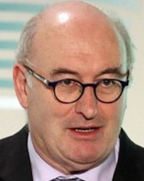
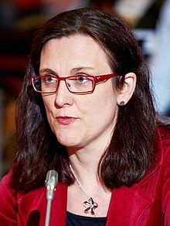
US Trade Institutions
US does NOT have a “ministry” or “department” of international trade
Most other countries do; e.g. …
  Canada: Department of International Trade
  Japan: Ministry of Economy, Trade and Industry (METI) (Used to be MITI)
  EU: Directorate General Trade
    Trade Commissioner:
    Cecilia Malmström
    since Nov 2014
    Now Phil Hogan

Slide 5
US Trade Institutions
In US, responsibility for trade issues is spread over many entities
  Congress
  USTR
  Commerce Department
  US International Trade Commission
  Export-Import Bank
  and several others
Obama said several years ago that he sought to consolidate many of these in a single agency
  He never did

Slide 6
US Trade Institutions
USTR = United States Trade Representative
  Handles negotiations on trade issues with
    Other governments
    WTO
  Drafts trade legislation for Congress
  Does NOT set or implement trade policies

Slide 7

US Trade Institutions
Trump’s USTR is Robert Lighthizer
Cabinet-level official of US government

Slide 8
US Trade Institutions
Congress
  Sets tariffs and other trade policies (thus approves trade agreements)
  Two committees are responsible
    House: Ways and Means
    Senate: Finance
  Why these?
    Because trade policy was originally about collecting revenue

Slide 9
US Trade Institutions
Administrative Agencies
  ITA = International Trade Administration
    Part of Department of Commerce
    Main Function: Determines “fairness” in unfair trade cases
      Are imports “dumped”?
      Are they “subsidized”?
    Orientation of ITA: very much favors US businesses

Slide 10
US Trade Institutions
Administrative Agencies
  ITC = USITC = United States International Trade Commission
    Independent agency
      Commissioners (6) are nominated by President and confirmed by Senate
      After that they are on their own
    Main Function: To determine “injury” in cases of
      Anti-Dumping
      Countervailing duties (subsidies)
      Safeguards (a.k.a., Escape Clause)

Slide 11
Outline: US Trade Policies and Institutions
Parts of the US Government that Handle Trade
Main Features of US Trade Policies
  Tariffs, Quotas, VERs
  Escape Clause
  Unfair Trade Laws
  Trade Adjustment Assistance
  Fast Track
  GSP
Dumping and Anti-Dumping
Why the US Protects
Trends in US Trade Policy

Slide 12
Main Features of US Trade Policies
Tariffs, quotas, etc.
  We have them (See Lakatos)
    Column 2: high tariffs left over from 1930
      Apply only to N. Korea and Cuba
    Column 1: low tariffs negotiated since then
      For all other countries, due to trade negotiations since 1934
      These are the “MFN” – Most Favored Nation - tariffs on WTO members
  Average US tariff before Trump was about as low as any major country

Slide 13
Main Features of US Trade Policies
Tariffs, quotas, etc.
  We still had high tariffs on some products
    Textiles, apparel
    Agriculture
  Quotas are still common in agriculture
  VERs: no longer
    But Trump has negotiated something like VERs
  With Trump we have more high tariffs

Slide 14
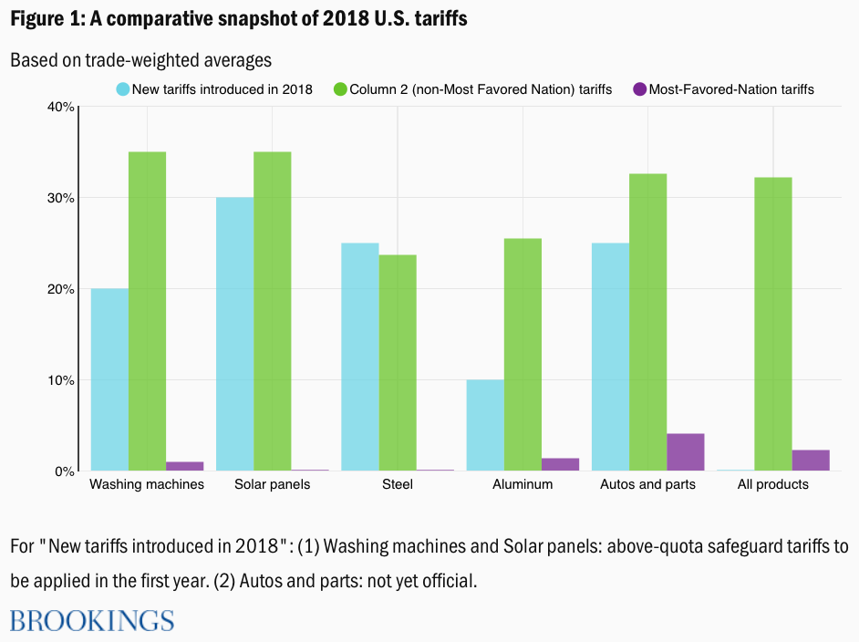
Main Features of US Trade Policies
Note what’s missing: Tariffs on China
Source: Lakatos
Notes:
Source: Lakatos, Csilla, “Back to the 1930s: Do US tariffs signal a shift to Smoot- Hawley-type protectionism?”
https://www.brookings.edu/blog/future-development/2018/07/26/back-to-the-1930s-do-us-tariffs-signal-a-shift-to-smoot-hawley-type-protectionism/

Slide 15
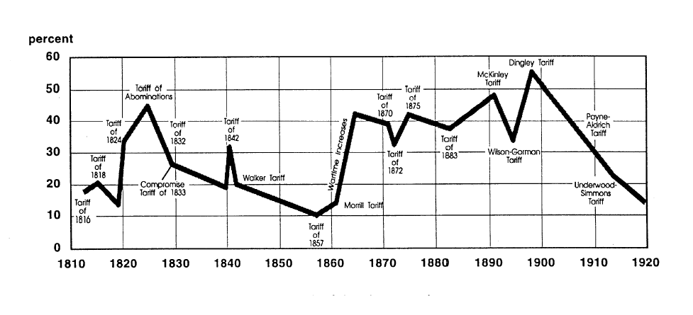
Main Features of US Trade Policies
US tariff history: 1810-1920
Today
Notes:
Source: landandfreedom.org

Slide 16
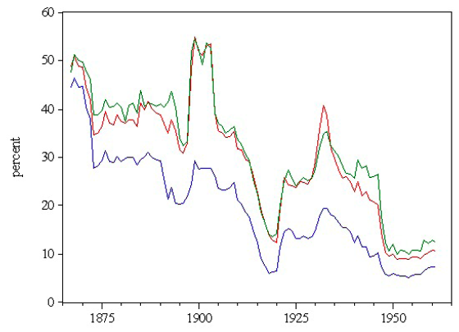
Main Features of US Trade Policies
US tariff history: 1865-1960
Average tariff
Today
Today
Notes:
Source: Irwin, Doug, “Trade Restrictiveness and Deadweight Losses from U.S. Tariffs,” 22 December 2008, Figure 1.

Slide 17
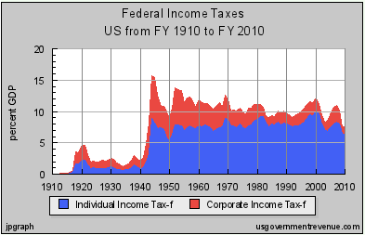
Main Features of US Trade Policies
US tariff history: 1865-1960
  Why the decline? Partly due to revenues from income tax:
Notes:
Source: Irwin, Doug, “Trade Restrictiveness and Deadweight Losses from U.S. Tariffs,” 22 December 2008, Figure 1.

Slide 18
Main Features of US Trade Policies
US tariff history: 1865-1960
Trade Restrictiveness
(2 measures)
Average tariff
Today
Today
Notes:
Source: Irwin, Doug, “Trade Restrictiveness and Deadweight Losses from U.S. Tariffs,” 22 December 2008, Figure 1.

Slide 19
Main Features of US Trade Policies
Aside on “Trade Restrictiveness Index” (TRI)
  Defined as the level of a uniform ad valorem tariff that would have the same overall effects as the actual tariff structure
  Why TRI > Average Tariff
    Tariffs are very unequal across products
    Recall that dead-weight-loss rises with square of tariff
    E.g.: Tariffs (0, 20) will cause twice the loss of (10, 10)

Slide 20
Outline: US Trade Policies and Institutions
Parts of the US Government that Handle Trade
Main Features of US Trade Policies
  Tariffs, Quotas, VERs
  Escape Clause
  Unfair Trade Laws
  Trade Adjustment Assistance
  Fast Track
  GSP
Dumping and Anti-Dumping
Why the US Protects
Trends in US Trade Policy

Slide 21
Main Features of US Trade Policies
Escape Clause = Section 201
  Called “Safeguards” in WTO
  Permits temporary protection from injurious imports
    Does NOT allege that the imports are “unfair”
  Eligibility is decided by USITC alone
    Injury (must be serious)
    Causation (must be due to imports)
  Implemented by President, who may say NO.

Slide 22
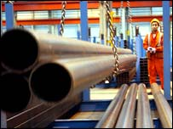
Main Features of US Trade Policies
Escape Clause
  Important recent case: Steel
    Bush Administration imposed safeguard tariffs on imported steel in March 2002 for 3 years
    Other countries filed case against US in WTO
    WTO ruled against US (import surge had abated well before we imposed tariffs)
    US removed tariffs in December 2003

Slide 23
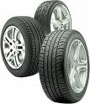
Main Features of US Trade Policies
Escape Clause
  Important recent case: Tires
    Obama Administration imposed safeguards tariffs on imported tires from China in September 2009: 35% 1st yr, 30% 2nd yr, 25% 3rd yr
    Reason: imports had tripled over 5 yrs; 5000 jobs lost
    Requested by union, not by firms. Firms were themselves producing in China.
    Obama had option of saying No

Slide 24
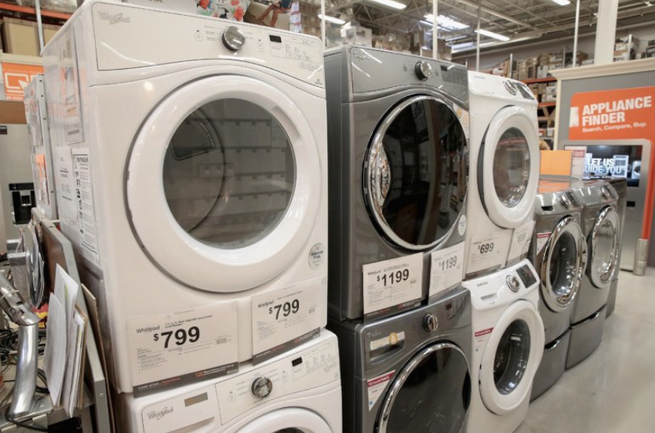
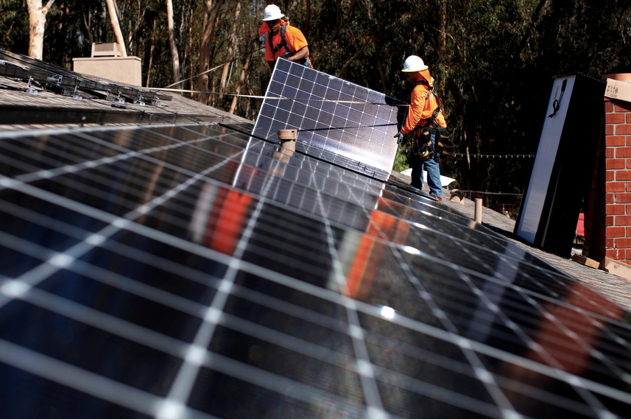
Main Features of US Trade Policies
Escape Clause
  2018:
    Washing machines
    Solar panels
Implemented by Trump, Jan 22, 2018

Slide 25
Outline: US Trade Policies and Institutions
Parts of the US Government that Handle Trade
Main Features of US Trade Policies
  Tariffs, Quotas, VERs
  Escape Clause
  Unfair Trade Laws
  Trade Adjustment Assistance
  Fast Track
  GSP
Dumping and Anti-Dumping
Why the US Protects
Trends in US Trade Policy

Slide 26
Main Features of US Trade Policies
Unfair Trade Laws
  Permit protection (not temporary) from “unfair” imports
    Must also be injurious, but less so than for escape clause (“material injury”)
    “Unfair” if
      Subsidized by foreign government
      “Dumped”, i.e., priced too low by firm (more on this below)

Slide 27
Main Features of US Trade Policies
Unfair Trade Laws
  Fairness decided by ITA
  Injury decided by USITC
  President is NOT permitted to say NO
Note the recent case of Boeing vs. Bombardier (Canadian), Jan 2018
  ITA affirmed subsidies
  USITC denied injury
  Therefore tariff was not used

Slide 28
Outline: US Trade Policies and Institutions
Parts of the US Government that Handle Trade
Main Features of US Trade Policies
  Tariffs, Quotas, VERs
  Escape Clause
  Unfair Trade Laws
  Trade Adjustment Assistance
  Fast Track
  GSP
Dumping and Anti-Dumping
Why the US Protects
Trends in US Trade Policy

Slide 29
Main Features of US Trade Policies
Trade Adjustment Assistance (TAA)
  Provides temporary help (not tariff protection) for firms and workers hurt by imports
  Gives workers access to income support, relocation allowances, job search allowances, health coverage tax credit, and occupational training
  As of 2002, Alternative Trade Adjustment Assistance (ATAA) also provides limited “wage insurance” for trade-displaced older workers

Slide 30
Aside: Wage Insurance
Except for ATAA, US does NOT have this
Many economists recommend it
  See article by Roth
Wage Insurance would pay workers when they take a new job at a lower wage
  Pays a specified fraction of the fall in wage
  For limited time
Advantages over TAA
  Encourages both workers and firms to re-employ workers
  Need not (in principle) be limited to workers displaced by trade

Slide 31
Outline: US Trade Policies and Institutions
Parts of the US Government that Handle Trade
Main Features of US Trade Policies
  Tariffs, Quotas, VERs
  Escape Clause
  Unfair Trade Laws
  Trade Adjustment Assistance
  Fast Track
  GSP
Dumping and Anti-Dumping
Why the US Protects
Trends in US Trade Policy

Slide 32
Main Features of US Trade Policies
Fast Track
  Now officially called Trade Promotion Authority (TPA)
  Procedure, imposed by Congress on itself, requiring it to
Consider trade legislation without amendment

Slide 33
Main Features of US Trade Policies
Fast Track
  Reason:
    President (via USTR) must negotiate deals with other countries, then take them to Congress for approval
    Deals would collapse if Congress could change them after they were signed
    With Fast Track, Congress can vote yes or no, but not make changes

Slide 34
Main Features of US Trade Policies
Fast Track
  History
    Presidents had Fast Track without controversy 1974-94
    President Clinton sought renewal but failed
    President G W Bush got it, renamed TPA:
      Granted in 2002, to July 1 2005
      Extended to July 1 2007
      Expired July 1 2007
    President Obama sought it
      It was very contentious
      Congress approved TPA in July 2015, good until July 1 2018, later extended to July 1, 2021

Slide 35
Main Features of US Trade Policies
Fast Track
  Would have been used by Obama to try to get TPP approved, but it never came up for vote
  Will be available to President Trump for,
    The renegotiated NAFTA, USMCA
    An FTA with the UK or Japan if he succeeds in negotiating them

Slide 36
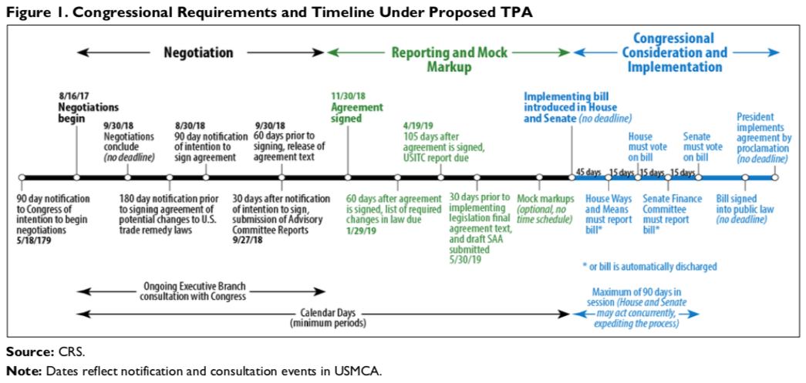
Had planned submission in September, 2019. Hasn’t happened yet

Slide 37
Outline: US Trade Policies and Institutions
Parts of the US Government that Handle Trade
Main Features of US Trade Policies
  Tariffs, Quotas, VERs
  Escape Clause
  Unfair Trade Laws
  Trade Adjustment Assistance
  Fast Track
  GSP
Dumping and Anti-Dumping
Why the US Protects
Trends in US Trade Policy

Slide 38
Main Features of US Trade Policies
GSP = Generalized System of Preferences
  Charge lower tariffs on some exports from some developing countries than we charge other countries
  Other developed countries do this too (permitted by WTO)
  Glassman, “Illogical Special Trade Deals,” says we should
    Deny GSP status to countries that act against US interests
      Are uncooperative in trade negotiations
      Fail to enforce US intellectual property rights (patents, copyrights)
      Default on loans
    Change US law to add flexibility in future
  Trump recently (Jun 2019) removed India from GSP, prompting retaliation

Slide 39
Outline: US Trade Policies and Institutions
Parts of the US Government that Handle Trade
Main Features of US Trade Policies
  Tariffs, Quotas, VERs
  Escape Clause
  Unfair Trade Laws
  Trade Adjustment Assistance
  Fast Track
  GSP
Dumping and Anti-Dumping
Why the US Protects
Trends in US Trade Policy

Slide 40
Dumping and Anti-Dumping
Anti-Dumping (AD) is the most frequently used trade policy today,
  by US
  and increasingly also by other countries
Dumping Defined: Selling an export at a price below the “fair price”
“Fair price” can be either
  Domestic price in exporting country, or
  Cost

Slide 41
Dumping and Anti-Dumping
Is dumping harmful?
  Yes, to those who compete with it
    But that is true of any competition
    Has nothing to do with the price being “unfair”
  Yes to importing country, if dumping is “predatory”
    Intended to drive out all competitors,
    AND then to raise price to monopoly level
  Otherwise No: Importing country gains from low-priced imports, whether “unfair” or not

Slide 42
Dumping and Anti-Dumping
P
S
Effects on Welfare
Suppliers lose Demanders gain Country gains
+(b+c+d)
Dumping lowers price
P_{W}⁰
a
c
b
d
P_{W}¹
D
Q_{S}¹
Q_{S}⁰
Q_{D}⁰
Q_{D}¹
Q

Slide 43
Dumping and Anti-Dumping
Is dumping ever predatory?
  Probably never
  Remember that “predatory” requires
    not just low price now,
    but also high (monopoly) price later
  Most AD cases are against multiple firms and countries (even if domestic competitors disappear, monopoly pricing is unlikely)
  AD statute says nothing about showing predatory behavior or intent

Slide 44
Dumping and Anti-Dumping
Reasons for dumping (why would foreign firms ever sell exports at a low price?)
  Protected home market
    Tariff at home permits a high price there
    Firms are price discriminating (against their own country)
  Market slump: When demand is temporarily low, pricing below average cost (but not below marginal cost) is normal behavior (recall from Econ 101)
  Gain a foothold in a new market: Setting price low, even below marginal cost, may make sense if
    Costs are falling (with output over time)
    Demand is rising (e.g., with consumers’ experience over time)

Slide 45
Outline: US Trade Policies and Institutions
Parts of the US Government that Handle Trade
Main Features of US Trade Policies
  Tariffs, Quotas, VERs
  Escape Clause
  Unfair Trade Laws
  Trade Adjustment Assistance
  Fast Track
  GSP
Dumping and Anti-Dumping
Why the US Protects
Trends in US Trade Policy

Slide 46
Why the US (Used to) Protect
NOT for most of the reasons we talked about earlier (revenue, optimal tariff, defense, etc.)
We use protection to benefit industries, not the whole country
Politicians care most about producers, not consumers. But producers include both
  Firms
  Workers
  Farmers and ranchers
Use of AD (& CVD, Safeguards) is for this reason too

Slide 47
Why Trump Uses Tariffs
On washing machines and solar panels, same as above: help domestic industry
On steel and aluminum, claim was national security, but he’s proud to have restarted some producers
  Section 232 of US law (see Fefer et al.)
    Permits tariffs if imports “threaten to impair the national security.”
    Investigated by Commerce Dept (not Defense), decided by President
    Legal in WTO? We don’t know yet
  Strong economy needed for national security.
    See USTR, “2019 Trade Policy Agenda”

Slide 48
Why Trump Uses Tariffs
On China,
  Claim has little to do with import-competing industries
  Official reason is intellectual property unfair trade
  Trump is also concerned about trade deficit
  China thinks he wants to keep China down

Slide 49
Outline: US Trade Policies and Institutions
Parts of the US Government that Handle Trade
Main Features of US Trade Policies
  Tariffs, Quotas, VERs
  Escape Clause
  Unfair Trade Laws
  Trade Adjustment Assistance
  Fast Track
  GSP
Dumping and Anti-Dumping
Why the US Protects
Trends in US Trade Policy

Slide 50
Trends in US Trade Policy
Was the US a “Free Trader” before Trump?
  Yes?
    We have been known for that, ever since World War II
    Our trade barriers were lower, slightly, than most other industrialized countries
    And they were lower sooner – we led the way after WWII

Slide 51


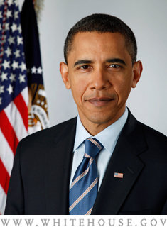

Trends in US Trade Policy
Was the US a “Free Trader”?
  No?
    Our barriers were far from zero
    Even under Reagan, US increased
    trade barriers in many sectors
    Clinton argued for free trade, but also for “industrial policies” favoring sectors
    Bush passed trade agreements, but also added barriers
    Obama: Was critical of NAFTA as candidate, but then negotiated TPP

Slide 52
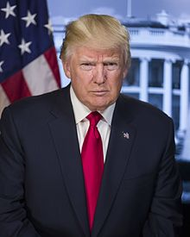
Trends in US Trade Policy
Trump?
  He certainly says he is not a free trader
  After 1 year he had done little
  But then, in 2018, he
    Pulled out of TPP
    Renegotiated NAFTA
    Amended US-Korea FTA
    Levied tariffs on
      Solar panels and washing machines
      Steel and aluminum
      China
  So today I believe him

Slide 53

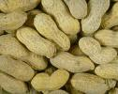



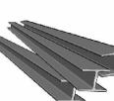
Trends in US Trade Policy
Notable US Trade Barriers before Trump
  Textiles and Apparel: high tariffs (no longer quotas)
  Some agriculture: high tariffs, quotas, subsidies
    Sugar
    Peanuts
    Cotton
    Dairy
  VERs (no longer)
    Autos
    Steel
  Anti-dumping
    Steel (many cases)

Slide 54
Next Time
World Trade Arrangements and the WTO
  What is it, and where did it come from?
  What does it do?
  What’s happening now?

