Slide 1
Lecture 3
Comparative Advantage and the Gains from Trade
Econ 340

Slide 2
News: Sep 9-15
China and US delay and reduce tariffs ahead of renewed trade talks -- WSJ: 9/13 | Canvas | NYT: 9/12 | Canvas | FT: 9/13 | Canvas
  Trump announced he would delay the next round of tariffs on China, from Oct 1 to Oct 15.
  China responded with first large purchase of soybeans in months, and state-owned firms are looking into buying more pork and soybeans, as China's government anoounced some exemptions on its tariffs against the US.
  A new round of trade talks is planned to begin in early October.
Brexit news -- WSJ: 9/13 | Canvas | NYT: 9/12 | Canvas | FT: 9/12 | Canvas
  Boris Johnson will meet with Jean-Claude Juncker, President of the European Commission, to seek a revised deal. The UK currency, the pound, rose on this news.
  Boris Johnson is considering an "all-Ireland zone" to avoid both the hard border and the Irish backstop. Northern Ireland would remain in the EU common market while the rest of the UK exits.
  France is preparing for no-deal Brexit by inspecting goods from the UK, as they would goods from China or the US. It has spent €40m on new facilities to inspect goods arriving through the Channel tunnel.
"Global Drop in Currencies" -- WSJ: 9/11 | Canvas
  WSJ article reports that many currencies have dropped in value against the US dollar since the start of the trade war.
  This is not surprising, as US tariffs lower US demand for foreign goods, and therefore for foreign currency.
  But the fall in other currencies makes their goods cheaper, increasing US imports, and "fanning the flames" of the trade war.

Slide 3
News: Sep 9-15
China and US delay and reduce tariffs ahead of renewed trade talks
  Trump announced he would delay the next round of tariffs on China, from Oct 1 to Oct 15.
  China responded with first large purchase of soybeans in months, and state-owned firms are looking into buying more pork and soybeans, as China's government anoounced some exemptions on its tariffs against the US.
  A new round of trade talks is planned to begin in early October.

Slide 4
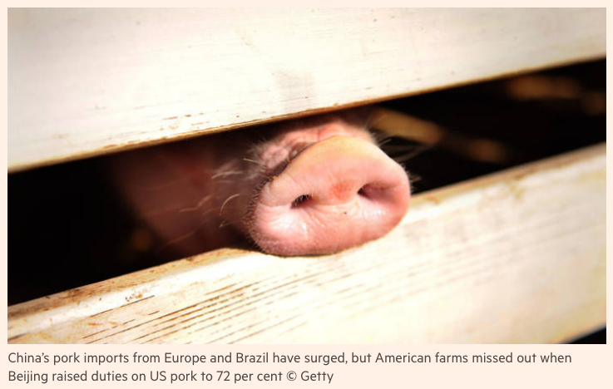

Slide 5
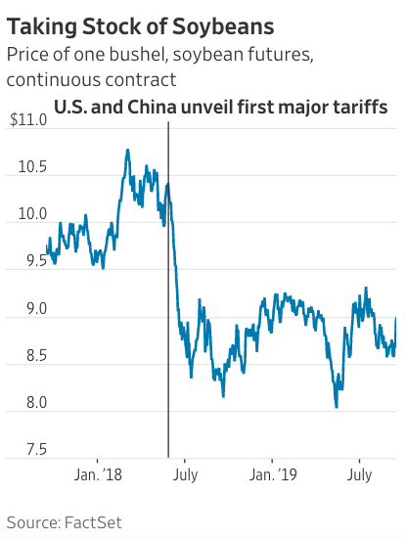
Notes:
https://www.wsj.com/articles/china-to-exclude-u-s-soybeans-and-pork-from-additional-tariffs-11568370755?mod=itp_wsj&ru=yahoo

Slide 6
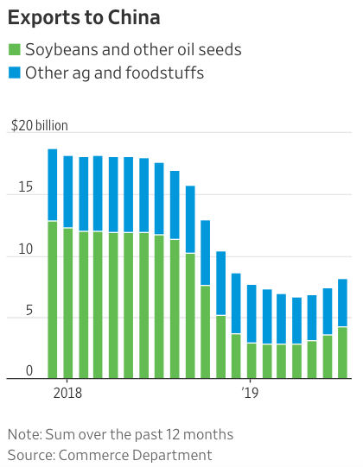
Notes:
https://www.wsj.com/articles/china-to-exclude-u-s-soybeans-and-pork-from-additional-tariffs-11568370755?mod=itp_wsj&ru=yahoo

Slide 7
News: Sep 9-15
Brexit news
  Boris Johnson will meet with Jean-Claude Juncker, President of the European Commission, to seek a revised deal. The UK currency, the pound, rose on this news.
  Boris Johnson is considering an "all-Ireland zone" to avoid both the hard border and the Irish backstop. Northern Ireland would remain in the EU common market while the rest of the UK exits.
  France is preparing for no-deal Brexit by inspecting goods from the UK, just as they would goods from China or the US. It has spent €40m on new facilities to inspect goods arriving through the Channel tunnel.

Slide 8
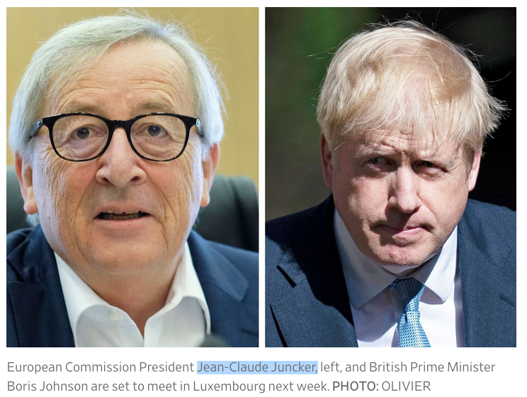

Slide 9
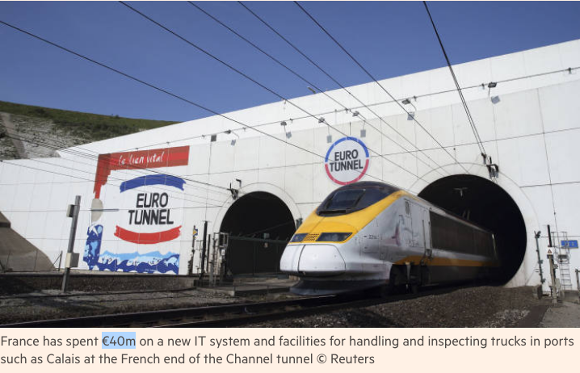

Slide 10
News: Sep 9-15
"Global Drop in Currencies"
  WSJ article reports that many currencies have dropped in value against the US dollar since the start of the trade war.
  This is not surprising, as US tariffs lower US demand for foreign goods, and therefore for foreign currency.
  But the fall in other currencies makes their goods cheaper, increasing US imports, and "fanning the flames" of the trade war.

Slide 11
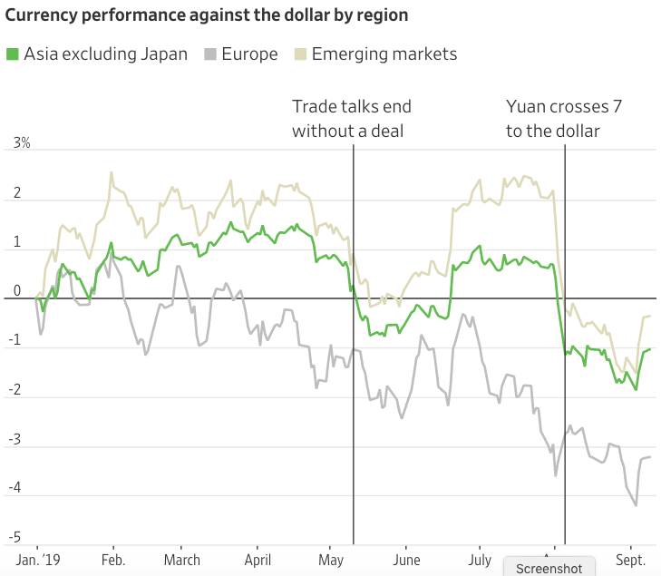

Slide 12
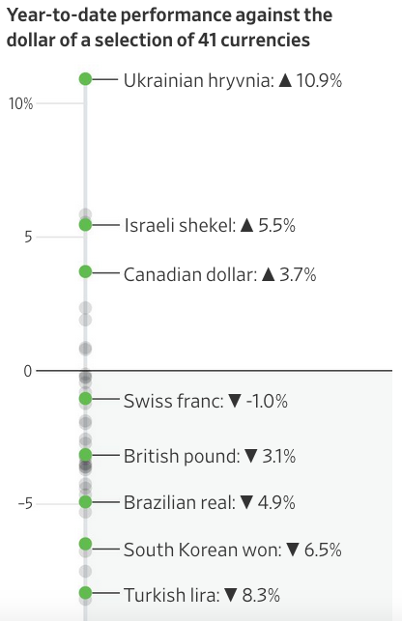
Argentine peso
Down 32.7 %

Slide 13
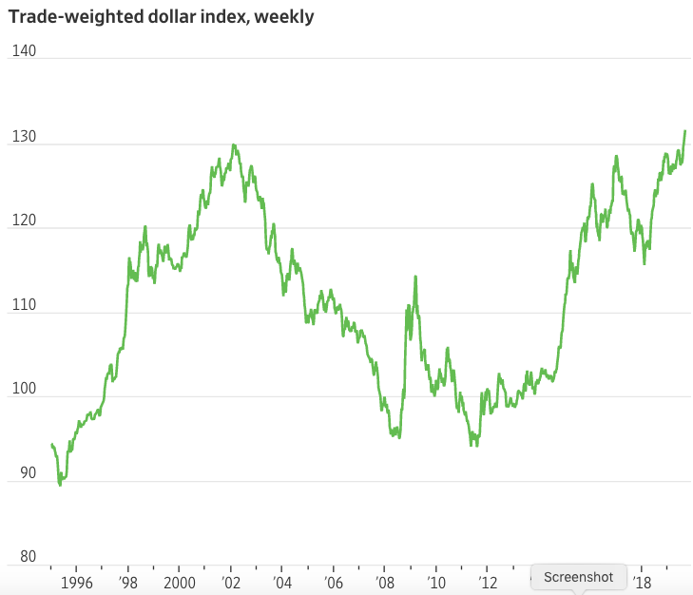

Slide 14
Outline: Comparative Advantage and the Gains from Trade
Why Countries Trade
  Price Differences
  Supply and Demand
  Determinants of Prices
Ricardian Model of Trade
  Examples
  Wages and Prices in the Ricardian Model
  Lessons from the Ricardian Model
Generality of the Gains from Trade
Identifying Comparative Advantage
Critiques of Comparative Advantage

Slide 15
Why Countries Trade
Price differences
  If prices differ by more than transport costs
    Buyers in high-price country will import
    Sellers in low-price country will export
    Anybody in any country can profit by doing both:
      Buying in low-price country
        and
      Selling in high-price country

Slide 16
Why Countries Trade
  Thus, in all cases:

Slide 17
Why Countries Trade:
Supply and Demand
“Autarky” = No trade
Country A
Country B
P
P
S_{B}
Autarky price in country B
S_{A}
P_{B}
P_{B}
P_{A}
D_{B}
D_{A}
Q
Q
Autarky price in country A

Slide 18
Why Countries Trade:
Supply and Demand
Free Trade = No barriers to trade
Country A
Country B
P
P
S_{B}
S_{A}
P_{B}
Exp
P_{F}
Imp
P_{A}
D_{B}
D_{A}
Q
Q
P_{F} is defined by these two distances being equal.

Slide 19
Why Countries Trade:
Supply and Demand
Country A
Country B
P
P
S_{B}
S_{A}
P_{B}
Exp
P_{F}
P_{A}
Imp
D_{B}
D_{A}
=
Q
Q
Note that price need not be half way between.

Slide 20
Use areas to measure gains and losses.
Country A
Country B
P
P
S_{B}
S_{A}
P_{B}
Exp
c
d
P_{F}
a
b
Imp
P_{A}
D_{B}
D_{A}
Q
Q

Slide 21
Loss of Consumer Surplus
Country A
Country B
P
P
S_{B}
S_{A}
Gains and losses from trade:
P_{B}
Exp
c
P_{F}
d
a
b
Imp
P_{A}
D_{B}
D_{A}
A’s demanders lose -a
Q
Q

Slide 22
Gain of Producer Surplus
Country A
Country B
P
P
S_{B}
S_{A}
Gains and losses from trade:
P_{B}
Exp
c
P_{F}
d
a
b
Imp
P_{A}
D_{B}
D_{A}
A’s demanders lose -a
A’s suppliers gain +(a+b)
Q
Q

Slide 23
Country A
Country B
P
P
S_{B}
S_{A}
Gains and losses from trade:
P_{B}
Exp
c
P_{F}
d
a
b
Imp
P_{A}
D_{B}
D_{A}
A’s demanders lose -a
A’s suppliers gain +(a+b)
→Country A gains +b
Q
Q

Slide 24
Gain of Consumer Surplus
Country A
Country B
P
P
S_{B}
S_{A}
Gains and losses from trade:
P_{B}
Exp
c
P_{F}
d
a
b
Imp
P_{A}
D_{B}
D_{A}
A’s demanders lose -a
A’s suppliers gain +(a+b)
Country A gains +b
B’s demanders gain +(c+d)
Q
Q

Slide 25
Loss of Producer Surplus
Country A
Country B
P
P
S_{B}
S_{A}
Gains and losses from trade:
P_{B}
Exp
c
P_{F}
d
a
b
Imp
P_{A}
D_{B}
D_{A}
A’s demanders lose -a
A’s suppliers gain +(a+b)
Country A gains +b
B’s demanders gain +(c+d)
B’s suppliers lose -c
Q
Q

Slide 26
Country A
Country B
P
P
S_{B}
S_{A}
Gains and losses from trade:
P_{B}
Exp
c
P_{F}
d
a
b
Imp
P_{A}
D_{B}
D_{A}
A’s demanders lose -a
A’s suppliers gain +(a+b)
Country A gains +b
B’s demanders gain +(c+d)
B’s suppliers lose -c
→Country B gains +d
Q
Q

Slide 27
Country A
Country B
P
P
S_{B}
S_{A}
Gains and losses from trade:
P_{B}
Exp
c
P_{F}
d
b
Imp
P_{A}
D_{B}
D_{A}
A’s demanders lose -a
A’s suppliers gain +(a+b)
Country A gains +b
B’s demanders gain +(c+d)
B’s suppliers lose -c
Country B gains +d
→ World gains +(b+d)
Q
Q

Slide 28
What Determines Prices, and Thus Trade?
Prices determined by
  Productivity of labor (and other factors)
  Price of labor (w=wage)
  Exchange rate (E) (i.e., prices of currencies)
Since w and E are largely common to all sectors
  The main determinant of how individual sectors trade (i.e., whether they export or import) is Productivity in sectors
  High (relative) productivity, i.e., output per worker
    Implies low (relative) price
    And hence export

Slide 29
Adjustment Mechanism
What if all of a country’s prices are too high for it to export at all?
Then either:
  Exchange rate (value of currency) will fall
    Because otherwise nobody would buy its currency,
  Or:
  Wages will fall
    Because nobody would hire its labor
  ➔Either of these will lower the country’s prices

Slide 30
Clicker Question
The diagram on the next slide shows supply and demand for a good in two countries. If these are the only countries in the world, what is the free-trade equilibrium price?
  P_{A}
  P_{B}
  P_{C}
  P_{D}
  P_{E}

Slide 31
Clicker Diagram
Country I
Country II
P
P
S_{II}
S_{I}
P_{A}
P_{B}
D_{II}
P_{C}
P_{D}
P_{E}
D_{I}
Q
Q

Slide 32
Clicker Question
The diagram on the next slide shows supply and demand for a good in two countries. If these are the only countries in the world, what is the free-trade equilibrium price?
  P_{A}
  P_{B}
  P_{C}
  P_{D}
  P_{E}
Country I
Country II
P
S_{I}
P
S_{II}
✓
_{A}
_{B}
D_{II}
_{C}
D
E
D_{I}
Q
Q

Slide 33
Clicker Question
Looking back at the same diagram, which country gains more from trade?
  Country I
  Country II
  They each gain the same amount

Slide 34
Clicker Diagram
Country I
Country II
P
P
S_{II}
S_{I}
P_{B}
D_{II}
D_{I}
Q
Q

Slide 35
Clicker Question
Looking back at the same diagram, which country gains more from trade?
  Country I
  Country II
  They each gain the same amount
✓
P
Country I
P
Country II
S_{I}
S_{II}
P_{B}
D_{II}
D_{I}
Q
Q

Slide 36
Clicker Diagram
Country I
Country II
P
P
S_{II}
S_{I}
P_{B}
D_{II}
D_{I}
Q
Q

Slide 37
Outline: Comparative Advantage and the Gains from Trade
Why Countries Trade
  Price Differences
  Supply and Demand
  Determinants of Prices
Ricardian Model of Trade
  Examples
  Wages and Prices in the Ricardian Model
  Lessons from the Ricardian Model
Generality of the Gains from Trade
Identifying Comparative Advantage
Critiques of Comparative Advantage

Slide 38
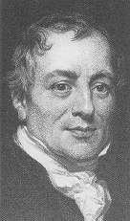
Ricardian Model of Trade
Due to David Ricardo (1772-1823)
Assumptions:
Production uses only labor
Technology:
  Constant unit labor requirements
  (labor per unit of output)
  Or equivalently, constant labor productivities
  (output per unit of labor)
  (“constant” here means “does not vary with output”)

Slide 39
Ricardian Model of Trade
Example 1 (Absolute Advantage):
2 goods | Food | Cloth
2 countries | A=US | B=UK
Data:
Labor requirements per unit | US | UK
Food (hr/lb) | .01 | .02
Cloth (hr/yd) | .02 | .01
Labor endowment (workers) | 10 | 10

Slide 40
Ricardian Model of Trade
Autarky Equilibrium (Example only)
 |  | US | UK
 | Food @ | .01 | .02
 | Cloth @ | .02 | .01
 | Labor | 10 | 10
Labor allocations | Food | 4 | 6
 | Cloth | 6 | 4
Production = Consumption | Food | 400 | 300
 | Cloth | 300 | 400
= 4/.01
= 6/.02

Slide 41
Ricardian Model of Trade
 | US | UK
Food | .01 | .02
Cloth | .02 | .01
Trade
  If countries had the same currency
  and same wage = $10/hr, then
  Thus
    US produces Food
    UK produces Cloth
  Suppose that they both completely specialize
    (i.e., US produces only food and UK only cloth)

Slide 42
Ricardian Model of Trade
 |  | US | UK
 | Food @ | .01 | .02
 | Cloth @ | .02 | .01
 | Labor | 10 | 10
Production | Food | 1000 | 0
 | Cloth | 0 | 1000
Possible Consumption | Food | 500 | 500
 | Cloth | 500 | 500
Trade Equilibrium

Slide 43
Ricardian Model of Trade
Compare consumption in autarky and trade:
Consumption in Autarky | Food | 400 | 300
 | Cloth | 300 | 400

Slide 44
Ricardian Model of Trade
Compare consumption in autarky and trade:
Trade permits consumption to be higher, of both goods, in both countries!
Both countries gain from trade
Consumption in Autarky | Food | 400 | 300
 | Cloth | 300 | 400
Consumption with Free Trade | Food | 500 | 500
 | Cloth | 500 | 500

Slide 45
Ricardian Model of Trade
 | US | UK
Food | .01 | .02
Cloth | .02 | .01
This example had “absolute” advantage; that is
  US used less labor to produce food than UK
  UK used less labor to produce cloth than US
But results don’t depend on that
Change the example
  UK → UK′ (United Klutzes)
    Assume UK’ needs ten times as much labor to do anything
    And also has ten times as much labor

Slide 46
Ricardian Model of Trade
Example 2 (Comparative Advantage):
Data:
Labor requirements | US | UK′
Food (hr/lb) | .01 | .20
Cloth (hr/yd) | .02 | .10
Labor endowment (workers) | 10 | 100
Now US has absolute advantage in both goods, i.e., it needs (a lot) less labor

Slide 47
Ricardian Model of Trade
Does this matter for production, consumption, or trade? NO!
  In autarky, UK could produce 300 food and 400 cloth, by allocating 6 workers to food and 4 to cloth.
  So can UK′: by allocating 60 workers to food and 40 to cloth.

Slide 48
Ricardian Model of Trade
  With trade, UK could produce 1000 cloth by allocating all 10 workers to cloth.
  So can UK′, by allocating all 100 workers to cloth.
  With trade, UK could consume 500 food and 500 cloth, by exporting 500 cloth.
  So can UK′, by trading as before!

Slide 49
Ricardian Model of Trade
How does this happen? Through prices and wages
Suppose initial wage is $10 in both US and UK′.
Then prices are:
Prices | US | UK′
Food | $.10 | $2.00
Cloth | $.20 | $1.00
DISEQUILIBRIUM!
  Nobody would buy from UK′
  No labor demand in UK′
  Wage in UK′ must fall
How far?
  At least to $2.00
    (so P_{C} = $.20)
  At most to $0.50
    (so P_{F} = $.10)

Slide 50
Ricardian Model of Trade
One possible trade equilibrium for US and UK′ |  |  | US | UK′
 | Wage of Labor |  | $10.00 | $1.50
 | Costs | Food | $0.10 | $0.30
 |  | Cloth | $0.20 | $0.15
This works! Free trade prices
Gains from trade | Wage in units of | US |  | UK′
 |  | Aut. | Trade | Aut. | Trade
 | Food | 100 | 100 | 5 | 15
 | Cloth | 50 | 67 | 10 | 10
What the wage can buy

Slide 51
Ricardian Model of Trade
Implications for Fears of Trade
  Low productivity country (UK′) can still compete, because of its low wage
  High wage country (US) can still compete because of its high productivity

Slide 52
Outline: Comparative Advantage and the Gains from Trade
Why Countries Trade
  Price Differences
  Supply and Demand
  Determinants of Prices
Ricardian Model of Trade
  Examples
  Wages and Prices in the Ricardian Model
  Lessons from the Ricardian Model
Generality of the Gains from Trade
Identifying Comparative Advantage
Critiques of Comparative Advantage

Slide 53
Gain from Trade in General
This is a very simple model
But it does generalize to less restrictive assumptions (trust me!)
  Many goods (not just 2)
  Many countries (not just 2)
  Many other assumptions can also be relaxed

Slide 54
Gain from Trade in General
Sources of gain from trade
  Most sources of gain are analogous to how individuals gain from trade
  Comparative advantage focuses on
    Differences in ability to produce goods
  Other sources of gain, not in this model
    Differences in tastes
    Economies of scale

Slide 55
Gain from Trade in General
What trade does not do:
  Trade does not help everybody
    There are losers from trade
      See Giles
      We’ll see later in the course who they are
  Trade does not reduce inequality
    At least not necessarily; it could, in some cases
    But there are also good reasons why it may increase inequality

Slide 56
Gain from Trade in General
What trade does not do:
  Trade may not cause countries to grow faster
  (There is debate on that. See Giles.)
  Trade certainly does not fix all problems
    Weak or corrupt government
    Failure to save
    Poor technology
    (Look at UK′. It gains from trade, but it is still very poor.)

Slide 57
Gain from Trade in General
Implications for Trade Policies
Autarky is not realistic, but “protection” (i.e., use of tariffs, quotas, etc.) is very realistic
Result that there is gain from trade does extend to reducing protection
  There are exceptions – we’ll see later
  But in most cases, countries (as a whole) do gain from reducing their tariffs
    Even if other countries do not reduce tariffs
  Countries also gain when other countries liberalize
  And today, countries lose from raising tariffs
    Even if others do not retaliate

Slide 58
Outline: Comparative Advantage and the Gains from Trade
Why Countries Trade
  Price Differences
  Supply and Demand
  Determinants of Prices
Ricardian Model of Trade
  Examples
  Wages and Prices in the Ricardian Model
  Lessons from the Ricardian Model
Generality of the Gains from Trade
Identifying Comparative Advantage
Critiques of Comparative Advantage

Slide 59
Identifying Comparative Advantage
Definition: A country has a comparative advantage in a good, relative to another good and another country, if its relative cost of producing the good is lower than the other country’s
(This comparison should be done in autarky, i.e., when they do not trade, because costs may change as a result of trade)

Slide 60
Identifying Comparative Advantage
If C_{gc} is the cost of producing 1 unit of good g in country c, then country 1 has a C-A in good 1 (compared to good 2 and country 2) if
Country 1’s C-A
Country 2’s C-A

Slide 61
Identifying Comparative Advantage
Examples
  Given data on unit labor requirements, since cost is proportional to these, look for where these are relatively low:
Here, Peru has C-A in ham because
Labor per unit output |  | Country
 |  | Iran | Peru
Good | Ham | 6 | 7
 | Eggs | 9 | 14
And Iran has C-A in eggs because

Slide 62
Identifying Comparative Advantage
Labor per unit output |  | Country
 |  | Iran | Peru
Good | Ham | 6 | 7
 | Eggs | 9 | 14
In this example, you could also compare across countries:
  Although Peru’s labor requirement is higher than Iran’s in both goods,
  it is only 1/6 higher in Ham and it is 5/9 (>1/6) higher in Eggs

Slide 63
Identifying Comparative Advantage
Examples in a different form:
  Given data on labor productivities (outputs per worker), since cost is inversely proportional to these, look for where these are relatively high:
Output per unit labor |  | Country
 |  | Blog | Slog
Good | Rugs | 400 | 200
 | Drugs | 8 | 5
Here, Blog has Abs Adv in both goods.
But Blog has C-A in rugs because

Slide 64
Identifying Comparative Advantage
Examples in a different form:
  Given data on labor productivities (outputs per worker), since cost is inversely proportional to these, look for where these are relatively high:
Output per unit labor |  | Country
 |  | Blog | Slog
Good | Rugs | 400 | 200
 | Drugs | 8 | 5
Here, Blog has Abs Adv in both goods.
But Blog has C-A in rugs because

Slide 65

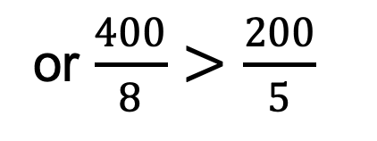
Identifying Comparative Advantage
Examples in a different form:
  Given data on labor productivities (outputs per worker), since cost is inversely proportional to these, look for where these are relatively high:
Output per unit labor |  | Country
 |  | Blog | Slog
Good | Rugs | 400 | 200
 | Drugs | 8 | 5
Here, Blog has Abs Adv in both goods.
But Blog has C-A in rugs because
$$\frac{400}{200}>\frac{8}{5}$$
or $\frac{400}{8}>\frac{200}{5}$

Slide 66
Is the Theory of Comparative Advantage Correct?
It’s not easy to test, for reasons explained in Dizikes article
  Model says countries don’t produce at all where they have no comparative advantage; so how can you measure productivity there?
  Economists Costinot and Donaldson get around this with data on land characteristics
  They find support for the theory

Slide 67
Is the Theory of Comparative Advantage Correct?
Problem: Comparative Advantage is defined in terms of autarky prices
  These normally cannot be observed
  Bernhofen & Brown do observe them from historical Japan, which was closed to trade prior to 1859
  They found:
    “Japan exported products with relatively low prices during autarky and imported products that had relatively high autarky prices.”
    Gains were 7% of GDP

Slide 68
How Large Are the Gains from Trade?
Costinot and Rodriguez-Clare use a model to estimate the gains from trade
  Their estimate for the US today ranges from 2% to 8% of GDP
  Why the large range?
    It depends crucially on the “elasticity of demand for imports”
    This determines how easily consumers are able to substitute domestic goods for imports
    If low, then we need imports more than if high

Slide 69
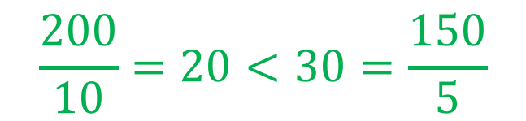
Clicker Question
For the countries and technologies in the table below, which country has a comparative advantage in good X?
  A
  B
  Both
  Neither
✓
Labor per unit output |  | Country
 |  | A | B
Good | X | 200 | 150
 | Y | 10 | 5
$$\frac{200}{10}=20<30=\frac{150}{5}$$

Slide 70
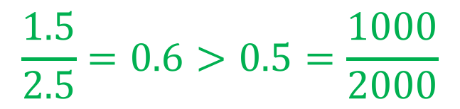
Clicker Question
For the countries and technologies in the table below, which country has a comparative advantage in good X?
  A
  B
  Both
  Neither
✓
Output per unit labor |  | Country
 |  | A | B
Good | X | 2.5 | 1.5
 | Y | 2000 | 1000
$$\frac{1.5}{2.5}=0.6>0.5=\frac{1000}{2000}$$

Slide 71
Outline: Comparative Advantage and the Gains from Trade
Why Countries Trade
  Price Differences
  Supply and Demand
  Determinants of Prices
Ricardian Model of Trade
  Examples
  Wages and Prices in the Ricardian Model
  Lessons from the Ricardian Model
Generality of the Gains from Trade
Identifying Comparative Advantage
Critiques of Comparative Advantage

Slide 72
Critiques of Comparative Advantage
Some argue that Ricardian assumptions no longer hold
  Some say the Ricardian Model assumes
    Factors are freely mobile within countries
    Factors are immobile between countries
  Without these assumptions, they say, countries lose from trade
  NOT TRUE! Relaxing either assumption does not interfere with the gains from trade

Slide 73
Critiques of Comparative Advantage - Prestowitz
Prestowitz cites a study by 3 very respected (by me) economists
  They measures losses from increased trade with China
  Find them to be significant
Prestowitz concludes that US may have lost from this trade
  Yes, there are both losses and gains
  Large losses, yes, but even larger gains

Slide 74
Critiques of Comparative Advantage - Prestowitz
Prestowitz also claims that the case for the gains from trade assumes:
  Perfect competition, No economies of scale
  No cross-border flows of investment, technology, or people
  Full utilization of all resources, No costs of adjustment
  Fixed exchange rates
  That losers from trade (who exist, but whose losses are temporary) will be compensated by the winners
And that these assumptions do not hold.
He’s
  Right that these assumptions do not hold
  Wrong that the gains from trade require them

Slide 75
Conclusion
Bottom line from all this
  Yes, there are losers from trade
  Gains from trade, especially from comparative advantage, outweigh the losses
  Note also (see Brooks) that countries have done much better with trade than without, and not just in income – also reduced child mortality and increased education

Slide 76
Next Time
Modern Theories and Additional Effects of Trade
  Other theories of trade that are more realistic than the Ricardian Model
  Effects of trade on other things, such as wages
  How some will lose from trade

