Slide 1
Lecture 1 Overview of the World Economy
Econ 340
Notes:
Revised for 2016 to replace Economist 2014 with Donnan 2016
Add for F17: Swanson

Slide 2
Announcements
We will start discussing news next week, on Monday Sep 16. You should be watching now for international economic news.
Be sure to register your clicker on the Canvas site for this course.
I will not be holding my usual office hour this Thursday, Sep 12.

Slide 3
Clicker Question
Are you here?
Yes
No
I’m not sure
✓

Slide 4
Lecture 1 Outline
Overview of the World Economy
“Globalization”
Elements of the World Economy
Ways that Countries Interact
Trade
Capital Flows
Migration
Policies that Affect Others
Institutions

Slide 5
Overview of the World Economy
“Globalization”
Means different things to different people
My definitions (see my online Glossary):
1. The increasing world-wide integration of markets for goods, services and capital.
2. Also the role of MNCs, IMF, WTO, World Bank.
3. Elsewhere: domination by United States.
Some see good, others see bad

Slide 6
Overview of the World Economy
“Globalization”
Some aspects of globalization, especially trade,
Declined with the world recession of 2008, then recovered
Slowed down in 2015-16
Resumed growth in 2017
What’s next? We don’t know!

Slide 7
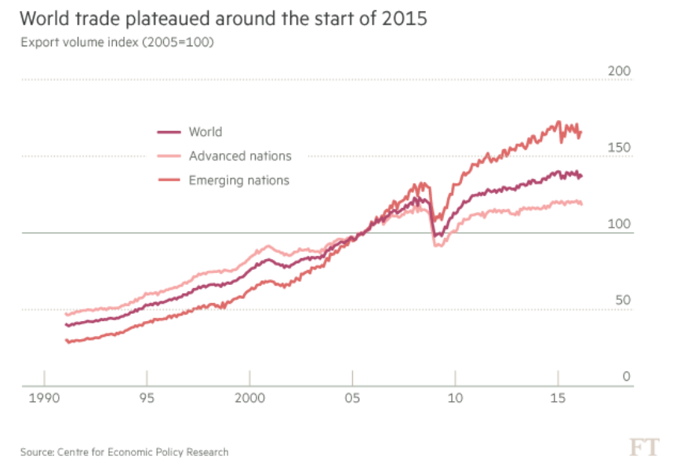
2015-16 Slowdown
World Recession
Notes:
From Donnan 2016

Slide 8
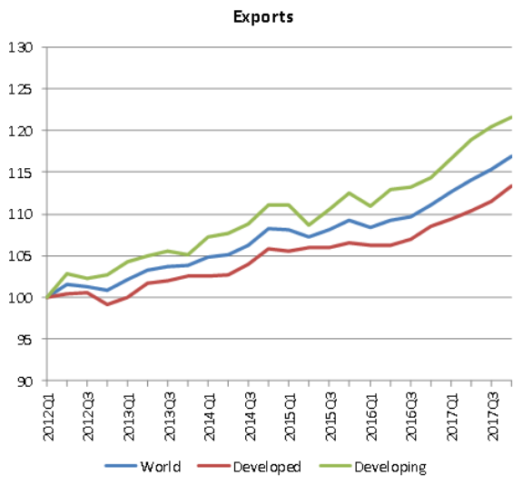
World Merchandise Exports by Level of Development, 2012Q1 – 2017Q4
(Volume index, 2012Q1=100)
2017 Growth
2015-16 Slowdown
Source: WTO
Notes:
https://www.wto.org/english/news_e/pres18_e/pr820_e.htm

Slide 9
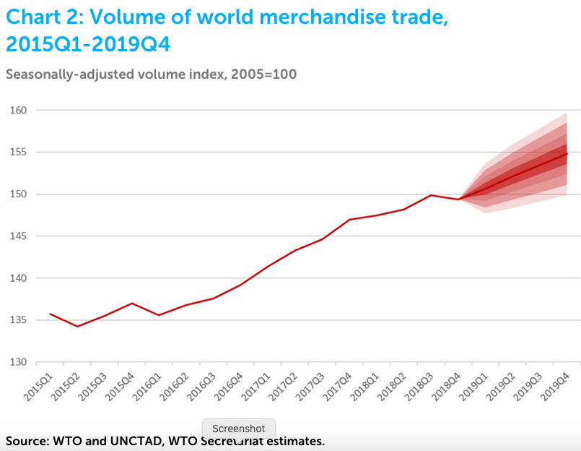
World Merchandise Exports by Level of Development, 2012Q1 – 2017Q4
(Volume index, 2012Q1=100)
Source: WTO
Notes:
https://www.wto.org/english/news_e/pres19_e/pr837_e.htm

Slide 10
Overview of the World Economy
Globalization Backlash
There is growing opposition to globalization
This happened before, with the “First Globalization” (See Swanson)
Both trade and migration grew strongly up to World War I in 1914
Inequality also grew
Trade and migration both declined for decades after

Slide 11
Globalization of Supply Chains
Much trade today is intermediate inputs.
Supply chains cross national borders multiple times
Example from Black

Slide 12
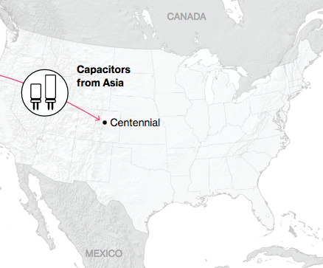
NAFTA and the Auto Supply Chain
Black, Diamond, and Merrill, “One Tiny Widget’s Dizzying Journey Shows Just How Critical Nafta Has Become,” Bloomberg, February 2, 2017.

Slide 13
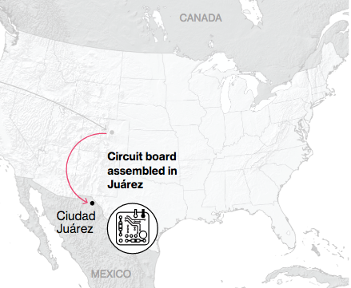
NAFTA and the Auto Supply Chain
Black, Diamond, and Merrill, “One Tiny Widget’s Dizzying Journey Shows Just How Critical Nafta Has Become,” Bloomberg, February 2, 2017.

Slide 14
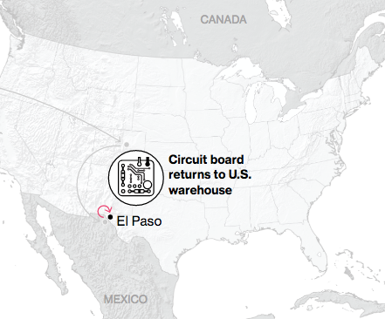
NAFTA and the Auto Supply Chain
Black, Diamond, and Merrill, “One Tiny Widget’s Dizzying Journey Shows Just How Critical Nafta Has Become,” Bloomberg, February 2, 2017.

Slide 15
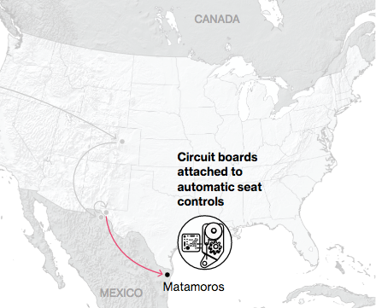
NAFTA and the Auto Supply Chain
Black, Diamond, and Merrill, “One Tiny Widget’s Dizzying Journey Shows Just How Critical Nafta Has Become,” Bloomberg, February 2, 2017.

Slide 16
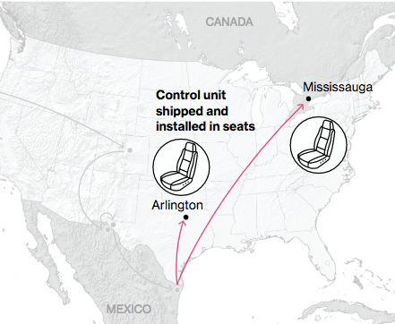
NAFTA and the Auto Supply Chain
Black, Diamond, and Merrill, “One Tiny Widget’s Dizzying Journey Shows Just How Critical Nafta Has Become,” Bloomberg, February 2, 2017.

Slide 17
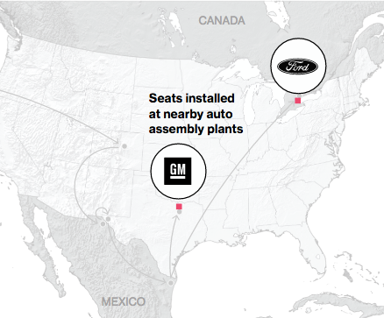
NAFTA and the Auto Supply Chain
Black, Diamond, and Merrill, “One Tiny Widget’s Dizzying Journey Shows Just How Critical Nafta Has Become,” Bloomberg, February 2, 2017.

Slide 18
Lecture 1 Outline
Overview of the World Economy
“Globalization”
Elements of the World Economy
Ways that Countries Interact
Trade
Capital Flows
Migration
Policies that Affect Others
Institutions

Slide 19
Overview of the World Economy
International Economics
Is NOT about countries
It IS about interactions among countries

Slide 20
Overview of the World Economy
World Economy consists of
Countries: a few hundred
(CIA lists about 240)
(WTO has 164 members)
People: over 7.5 billion
(7.504 billion 9/6/19,
compare 329 million US)
Land: about 15 times the US
Notes:
Source: World Fact Book: https://www.cia.gov/cia/publications/factbook/rankorder/2119rank.html
Census: https://www.census.gov/popclock/

Slide 21

(Aside, on getting information)
An excellent source of information about countries is the CIA World Fact Book
(Just Google “factbook”)

Slide 22
Overview of the World Economy
World Economy consists of
GDP (2017 est., per CIA, in US$)
World: Total = $80.27 trillion
per capita = $17,500
US: Total = $19.49 trillion
per capita = $59,800
Notes:
Fact Book

Slide 23
Overview of the World Economy
Implication
US is very unusual
Very rich
US has less than 5% of world population but almost 25% of world income
(This changes, as measured here in official exchange rates, as the exchange rates change.)
Notes:
http://www.heritage.org/index/

Slide 24
Lecture 1 Outline
Overview of the World Economy
“Globalization”
Elements of the World Economy
Ways that Countries Interact
Trade
Capital Flows
Migration
Policies that Affect Others
Institutions

Slide 25
Overview of the World Economy
Ways that countries interact economically
Trade (per CIA, 2017 est.)
World exports: $17.31 trillion
(compare world GDP of $80 trillion)
(That’s at official exchange rates)
(Exports = 22% of GDP)
World trade has grown faster than world GDP most years
But not during 2008-9, due to world recession
Or during 2015-16
But resumed in 2017
Notes:
Source: Factbook, country (world)

Slide 26
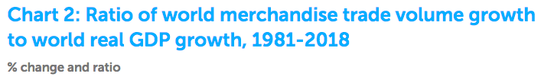
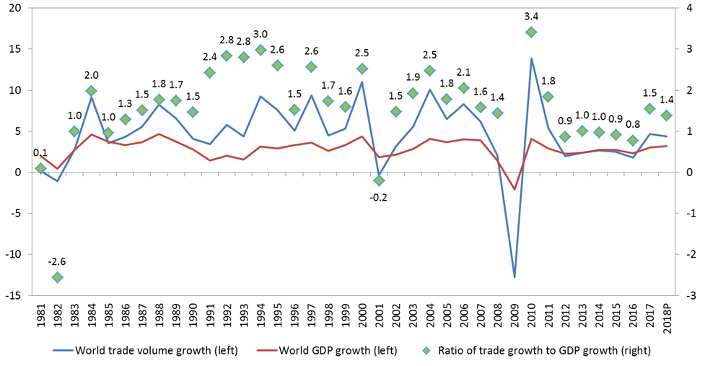
Trade growth faster than GDP
Source: WTO
Notes:
https://www.wto.org/english/news_e/pres18_e/pr820_e.htm

Slide 27
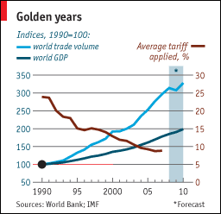
Notes:
From an Economist “Barriers to Entry” article

Slide 28
Overview of the World Economy
See tables below for
Who trades most?
Who trades with whom?
Share of trade in GDP
US:
What do we export/import?
To/from whom?
Notes:
Source: https://www.cia.gov/cia/publications/factbook/rankorder/2078rank.html

Slide 29
Who Trades the Most? ($ b. & % share, 2018)
Exporters |  |  | Importers
 | Value | Share |  | Value | Share
China | 2487 | 12.8 | US | 2614 | 13.2
US | 1664 | 8.5 | China | 2136 | 10.8
Germany | 1561 | 8.0 | Germany | 1286 | 6.5
Japan | 738 | 3.8 | Japan | 749 | 3.8
Netherlands | 723 | 3.7 | UK | 674 | 3.4
World | 19,475 | 100.0 | World | 19,867 | 100.0
Source: WTO, World Trade Statistical Review, 2019, Table A6
Notes:
https://www.google.com/url?sa=t&rct=j&q=&esrc=s&source=web&cd=11&ved=2ahUKEwi-rK2vs67kAhUFs54KHZ1jCCkQFjAKegQIARAC&url=https%3A%2F%2Fwww.wto.org%2Fenglish%2Fres_e%2Fstatis_e%2Fwts2019_e%2Fwts2019_e.pdf&usg=AOvVaw2dx7IgHZ00_-Y7RaptbMb_

Slide 30
Who Trades the Most? (Excluding intra-EU-28) ($ b. & % share, 2018)
Exporters |  |  | Importers
 | Value | Share |  | Value | Share
China | 2487 | 16.2 | US | 2614 | 16.6
EU-28* | 2309 | 15.1 | EU-28* | 2337 | 14.9
US | 1664 | 10.9 | China | 2136 | 13.6
Japan | 738 | 4.8 | Japan | 749 | 4.8
Korea, S. | 605 | 3.9 | Hng Kng | 628 | 4.0
World | 15,319 | 100.0 | World | 15,710 | 100.0
*EU external only
Source: WTO, World Trade Statistical Review, 2019, Table A7
Notes:
https://www.google.com/url?sa=t&rct=j&q=&esrc=s&source=web&cd=3&ved=2ahUKEwiCr9r6ta7kAhVNj54KHbdyCLUQFjACegQIBBAC&url=https%3A%2F%2Fwww.wto.org%2Fenglish%2Fres_e%2Fstatis_e%2Fwts2019_e%2Fwts2019_e.pdf&usg=AOvVaw2dx7IgHZ00_-Y7RaptbMb_

Slide 31
Who Trades the Most?
Developed countries are most of the biggest traders
China has caught up, in trade volume
It was the #3 exporter ten years ago when I taught the course; now it’s #1.
Others are gaining as well: Six years ago Canada was #5 exporter. Five years ago that was S Korea.

Slide 32
Who Trades the Most?
See Economist from five years ago: “Trading Up: Picking the world champion of trade”
China claimed to have surpassed US. True only for goods, not goods + services
But with time China will pass US in both
China’s trade per GDP was much larger than the US, but below world average
Much of the value in China’s exports is imported inputs, thus low “value added.”

Slide 33
Who Trades the Most?
“Emerging Markets” in general are catching up to, or surpassing, the developed countries
In GDP, trade, and more
See Economics Focus from The Economist, “Why the Tail Wags the Dog”

Slide 34
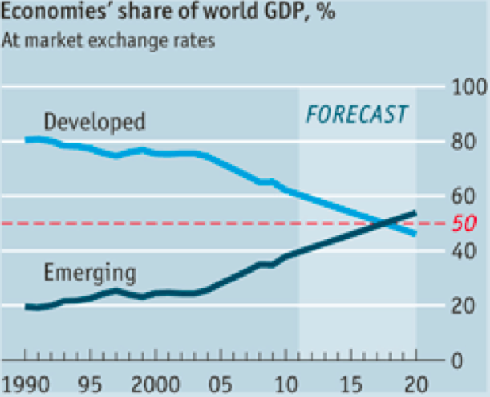

Slide 35
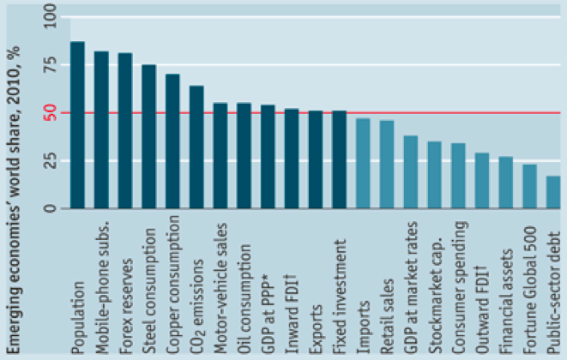

Slide 36
Who Trades with Whom? ($ b., 2014, Intra- and inter-regional merchandise trade)
 | Destination:
Origin: |  | North Amer. | Latin Amer. | Eur. | Asia | Africa | Other
North Amer. |  | 1251 | 214 | 379 | 504 | 43 | 97
Latin Amer. |  | 173 | 179 | 114 | 170 | 18 | 26
Europe |  | 540 | 119 | 4665 | 738 | 221 | 447
Asia |  | 1065 | 185 | 900 | 3093 | 207 | 428
Africa |  | 39 | 29 | 201 | 152 | 98 | 20
Other |  | 128 | 18 | 532 | 828 | 51 | 273
World |  | 3195 | 744 | 6792 | 5485 | 639 | 1292
Source: WTO, International Trade Statistics, 2015, Table I.4
Note: This source is no longer published, and its replacement lacks these data.
Notes:
Source: http://www.wto.org/english/res_e/statis_e/its2015_e/section1_e/i04.xls
[International Trade Statistics was replaced by World Trade Statistical Review in 2016, and the latter does not have these data, which I can’t find elsewhere]

Slide 37
North America, Europe, and Asia trade mostly within their group
Poorer regions – Latin America, Africa – trade mostly with the richer regions
This reflects what is not so clear in the table and charts:
Rich countries trade most with each other
Poor countries trade most with rich countries
But their trade with each other is growing

Slide 38
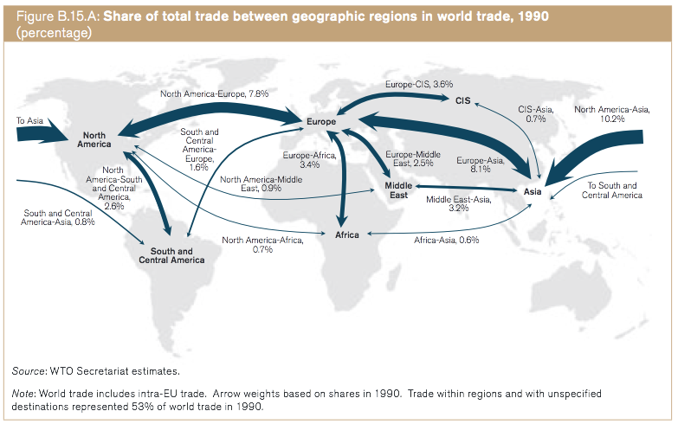
WTO, World Trade Report 2013
Notes:
WTO, World Trade Report 2013

Slide 39
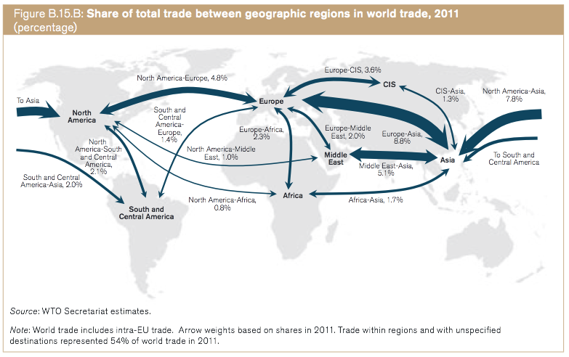
WTO, World Trade Report 2013
Notes:
WTO, World Trade Report 2013

Slide 40
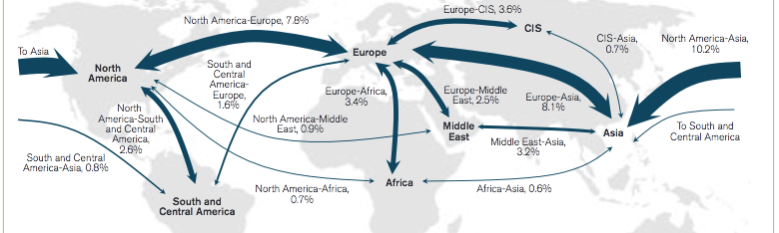
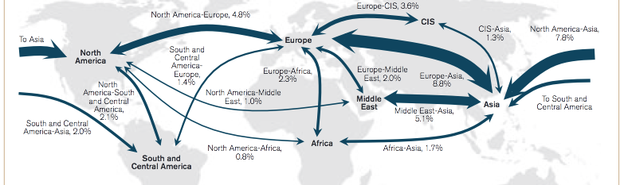
1990
2011
WTO, World Trade Report 2013
Notes:
WTO, World Trade Report 2013

Slide 41
What Does the World Trade? ($ b. 2014 merchandise exports)
 | Value
All Products | 17,797
Agriculture | 1,765
Fuels & Mining | 3,789
Manuf. | 12,243
Source: WTO, International Trade Statistics, 2015, Table II.1
Note: This source is no longer published, and its replacement lacks these data.
Notes:
Source: http://www.wto.org/english/res_e/statis_e/its2015_e/section2_e/ii01.xls

Slide 42
What Does the World Trade?
Biggest traded category: manufactures
Fastest growing, then shrinking, then growing: “fuels & mining”
Why?
Because this is the value of trade, and prices of oil and other raw materials were rising, and then falling.

Slide 43
What Does the US Trade? ($ b. 2011)
Did
(Not available since 2011)
 | Exports | Imports
Total | 1,497.4 | 2,235.8
Agriculture | 140.0
Petroleum |  | 462.3
Industrial supplies | 496.4 | 319.8
Capital goods, exc. auto | 493.2 | 513.4
Automotive | 133.1 | 255.2
Other non-ag | 234.6
Other non-petrol |  | 685.1
Source: Economic Report of the President, Feb 2013, Table B-104.
Notes:
Source: http://www.gpo.gov/fdsys/pkg/ERP-2013/xls/ERP-2013-table104.xls
NOTE: ERP no longer providing this table since 2014.

Slide 44
What Does the US Trade?
US imports are much larger than US exports
(We’ll see what that means later in the course.)
US is a big…
Exporter of agricultural products
Importer of oil (but that’s been falling)
Exporter and importer of capital goods (i.e., machines for making things)

Slide 45
Trade of US States
US states differ substantially in the importance of international trade to them

Slide 46
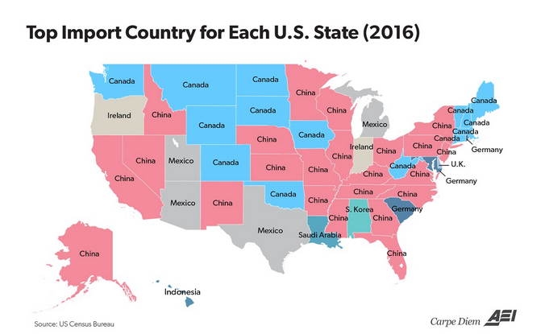
Source: Perry and Balliou (2017)
Notes:
Perry, Mark J. and Olivier Ballou, “Every state’s top foreign trading partner for imports and exports in 2016,” Washington Examiner, March 2, 2017. http://www.aei.org/publication/every-states-top-foreign-trading-partner-for-imports-and-exports-in-2016/ [Didn’t do notes on this.]

Slide 47
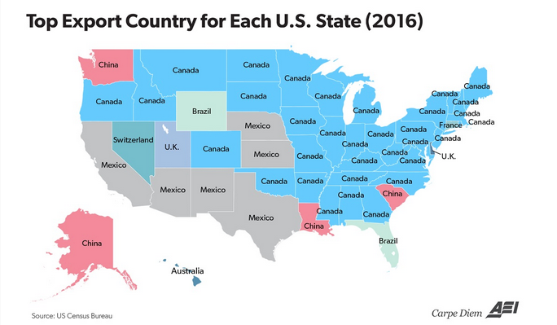
Source: Perry and Balliou (2017)
Notes:
Perry, Mark J. and Olivier Ballou, “Every state’s top foreign trading partner for imports and exports in 2016,” Washington Examiner, March 2, 2017. http://www.aei.org/publication/every-states-top-foreign-trading-partner-for-imports-and-exports-in-2016/ [Didn’t do notes on this.]

Slide 48
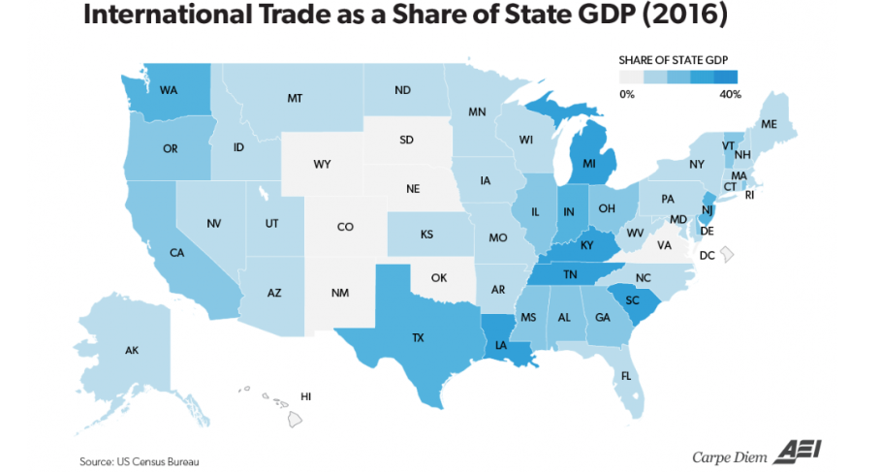
Source: Perry (2017)
Notes:
Perry, Mark J., “How important is international trade to each US state’s economy? Pretty important for a lot of our states,” American Enterprise Institute, October 22, 2017. [6p] http://www.aei.org/publication/how-important-is-international-trade-to-each-us-states-economy-pretty-important-for-a-lot-of-states/

Slide 49
Importance of Trade for Countries? (GDP in US$ b., Exports % of GDP, Selected countries, 2017)
 | Exports | Exports/GDP
United States | 1553.0 | 8%
Japan | 688.9 | 14%
Germany | 1434.0 | 39%
Canada | 423.5 | 26%
India | 304.1 | 12%
Mexico | 409.8 | 36%
Netherlands | 555.6 | 67%
Singapore | 396.8 | 123%
Philippines | 48.2 | 15%
Nepal | 0.8 | 3%
Source: CIA World Fact Book
Notes:
See Intro Data.xls Exports per GDP
(IMF data would be better here)

Slide 50
Importance of Trade for Countries?
Even though we trade more than most, US trade is a smaller part of US GDP than for many other countries
Others that are low: Japan, Nepal (even lower than US)
Note Singapore: Exports can be more than GDP.
Reason: Exports are made using imported inputs, so value of exports includes imports.

Slide 51
Importance of Trade for Countries? A Few More of Interest
 | GDP | Exports/GDP
China | 2216.0 | 18%
Hong Kong | 537.8 | 158%
Korea, South | 577.4 | 37%
Korea, North (2013) | 3.0 | 11%
Burma | 9.8 | 15%
Syria | 1.7 | 7%
Israel | 58.7 | 17%
Source: CIA World Fact Book
Notes:
See Intro Data.xls Exports per GDP
(IMF data would be better here)

Slide 52
Lecture 1 Outline
Overview of the World Economy
“Globalization”
Elements of the World Economy
Ways that Countries Interact
Trade
Capital Flows
Migration
Policies that Affect Others
Institutions

Slide 53
Overview of the World Economy
Ways that countries interact economically
Capital Flows
Financial (holdings of financial assets abroad)
Real (international ownership of real assets)

Slide 54
Overview of the World Economy
Ways that countries interact economically
Capital Flows
Financial (holdings of financial assets abroad)
Currency
Bank deposits
Bonds – private and government
Stocks
Bank loans
Real (international ownership of real assets)

Slide 55
Overview of the World Economy
Ways that countries interact economically
Capital Flows
Financial (holdings of financial assets abroad)
Real (international ownership of real assets)
Real estate
Capital assets (plant and equipment)
Stocks (equities) if ownership share is large
Other
Data, below, are stocks (i.e, amounts at a point in time)

Slide 56
US Investment Position ($ trillion at market value, end of 2018)
 | We “Own” US Assets | We “Owe” US Liabilities
Total* | 25.24 | 34.80
Direct investment | 7.50 | 8.48
Portfolio investment | 11.49 | 18.72
Other investment | 4.30 | 6.14
Reserve assets | 0.45
Compare: US GDP in 2017 = $19.39 trillion
*Excludes financial derivatives other than reserves. Would add net +0.06.
Source: Bureau of Economic Analysis, U.S. Net International Investment Position
Notes:
Source: http://www.bea.gov/newsreleases/international/intinv/intinvnewsrelease.htm

Slide 57
US Investment Position
(Qualification: “Owe” may not be quite right. This may include all assets in the US owned by foreigners, including land, buildings, etc. Not just what we’ve borrowed.)
Lessons:
US is a large net “debtor” (result of our spending more than we earn)

Slide 58
Lecture 1 Outline
Overview of the World Economy
“Globalization”
Elements of the World Economy
Ways that Countries Interact
Trade
Capital Flows
Migration
Policies that Affect Others
Institutions

Slide 59
Overview of the World Economy
Other ways that countries interact economically
Migration
Temporary
Guest workers
Day workers
Permanent
In practice, most (all?) countries limit migration severely

Slide 60
Clicker Question
Which category of goods is largest in world trade
Manufacturers
Fuels and mining
Agriculture
✓

Slide 61
Clicker Question
Which is the world’s largest importer?
China
European Union
US
Germany
✓

Slide 62
Clicker Question
Where does the largest share of Michigan’s imports come from?
Canada
China
Mexico
European Union
✓

Slide 63
Lecture 1 Outline
Overview of the World Economy
“Globalization”
Elements of the World Economy
Ways that Countries Interact
Trade
Capital Flows
Migration
Policies that Affect Others
Institutions

Slide 64
Overview of the World Economy
Other ways that countries interact economically
Policies that affect other countries
Direct
Indirect

Slide 65
Overview of the World Economy
Other ways that countries interact economically
Policies that affect other countries
Direct
Trade policies (tariffs, quotas)
Foreign aid
Capital controls
Exchange rate management
Immigration restrictions
Indirect

Slide 66
Overview of the World Economy
Aside on Tariffs
We will be dealing a lot with these
US tariffs are much lower than they used to be (average less than 4% now,
vs. 40% in 1946)
(Tariffs have gone up under Trump, but average is still low.)
US has gained a great deal from lowering tariffs
US still has much to gain from further lowering
But there are also severe costs for some people and firms who compete with imports

Slide 67
Overview of the World Economy
Aside on Tariffs
Tariffs could go up, even legally:
WTO enforces only upper limits on tariffs
Actual tariffs in many countries are below these limits, and could legally rise
There was danger that the world recession of 2008 would push countries to do that.
They didn’t – at least not much.
Some tariffs have gone up this year under Trump
We’ll see more next time

Slide 68
Overview of the World Economy
Aside on Tariffs
US tariffs are much higher against developing countries than against developed countries

Slide 69
Overview of the World Economy
Aside on Tariffs
Until recently, much trade policy has been Trade Agreements, by countries that reduce tariffs.
This trend has now stalled for the US under President Trump,
though he is trying for “deals” with EU and Japan.
But other countries are continuing it without Trump.

Slide 70
Overview of the World Economy
Other ways that countries interact economically
Policies that affect other countries
Indirect
Subsidies (esp. agriculture)
US farm subsidies > foreign aid
Macro policies (monetary, fiscal)
Environmental policies
Standards
Labor
Health & safety
Norms

Slide 71
Lecture 1 Outline
Overview of the World Economy
“Globalization”
Elements of the World Economy
Ways that Countries Interact
Trade
Capital Flows
Migration
Policies that Affect Others
Institutions

Slide 72
The Three Main Institutions
Functions
IMF (International Monetary Fund): Financial Assistance
World Bank: Development Assistance
WTO (World Trade Organization): Trade Policy Regulation and Negotiation

Slide 73
The Three Main Institutions
History
Before World War II
Great Depression
High Tariffs on trade
Competitive Devaluations
of Currencies
“Beggar Thy Neighbor Policies”
(we’ll see why later)

Slide 74
The Three Main Institutions
History
End of World War II
Bretton Woods Meeting (Bretton Woods, NH)
IMF
World Bank
GATT (General Agreement on Tariffs and Trade)
Succeeded by WTO in 1995

Slide 75
The Three Main Institutions
History: Changes since 1940s
IMF
Originally enforced pegged exchange rates
IMF now provides financial assistance
E.g., Argentina just asked IMF for help
World Bank (=IBRD, International Bank for Reconstruction and Development)
Originally intended for reconstruction from war
Now mainly assists development
GATT/WTO
Rules of international trade policy
Ministerial Meetings

Slide 76
Clicker Question
Compared to the 1940s, US tariffs today (as of 2017) are?
Higher
About the same, on average
Half as large
Only about 1/10 as large
Gone
✓

Slide 77
Clicker Question
Which institution also goes by the acronym IBRD?
International Monetary Fund
World Bank
World Trade Organization
✓
IBRD = International Bank for Reconstruction and Development

Slide 78
Next Time
Current Tensions in the International Economy
NAFTA
Brexit
Trade War
WTO
Currencies

