Slide 1
Growth of Ice Dendrite In Supercooled Water: The Phase Field Model
Archie Yao
Advisor: Prof. Venkat Viswanathan
May 14th 2021
Lightning Talk Series
Notes:
The set of values of the order parameter over the whole volume is the phase field.
The total free energy G of the volume is then described in terms of the order parameter and its gradients,
and the rate at which the structure evolves with time is set in the context of irreversible thermodynamics,
and depends on how G varies with w.
It is the gradients in thermodynamic variables that drive the evolution of structure.

Slide 2
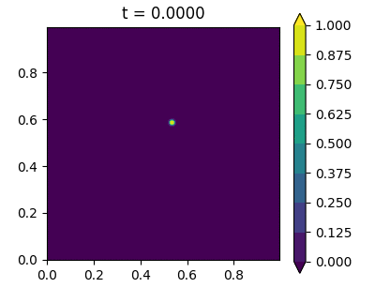
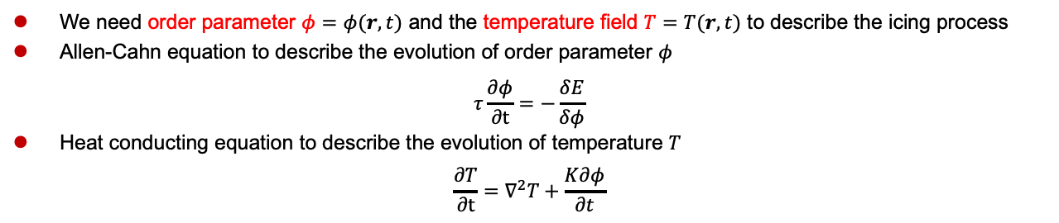
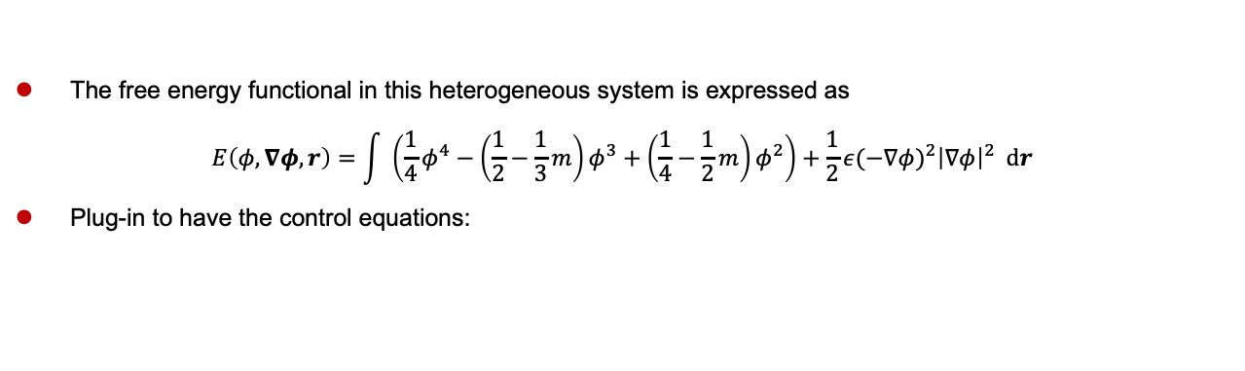

Overview: The Control Equations
We need order parameter $φ=φ(r,t)$ and the temperature field $T=T(r,t)$ to describe the icing process
Allen-Cahn equation to describe the evolution of order parameter $φ$
$$τ\frac{∂φ}{∂t}=−\frac{δE}{δφ}$$
Heat conducting equation to describe the evolution of temperature $T$
$$\frac{∂T}{∂t}=∇^{2}T+\frac{K∂φ}{∂t}$$
The free energy functional in this heterogeneous system is expressed as
$$E\left(φ,∇φ,r\right)=\int{ \left(\frac{1}{4}φ^{4}−\left(\frac{1}{2}−\frac{1}{3}m\right)φ^{3}+\left(\frac{1}{4}−\frac{1}{2}m\right)φ^{2}\right)+\frac{1}{2}{ε(−∇φ)}^{2}{\left|∇φ\right|}^{2} dr}$$
Plug-in to have the control equations:
$$τ\frac{∂φ}{∂t}=−∇∙\left({\left|∇φ\right|}^{2}ε\frac{∂ε}{∂ν}\right)+∇∙\left(ε^{2}∇φ\right)+φ(1−φ)(φ−\frac{1}{2}+m)$$
$$\frac{∂T}{∂t}=∇^{2}T+\frac{K∂φ}{∂t}$$
$$Initial Condition+Zero Flux Boundary Condition$$
Kobayashi, Physica D (1993)
Notes:
Temperature is dimensionless, so that the characteristic cooling temperature is 0 and the equilibrium temperature is 1
Boundary Conditions: Adiabatic Condition for T (zero-flux condition for the temperature field at the boundaries), zero-flux boundary condition for w

Slide 3
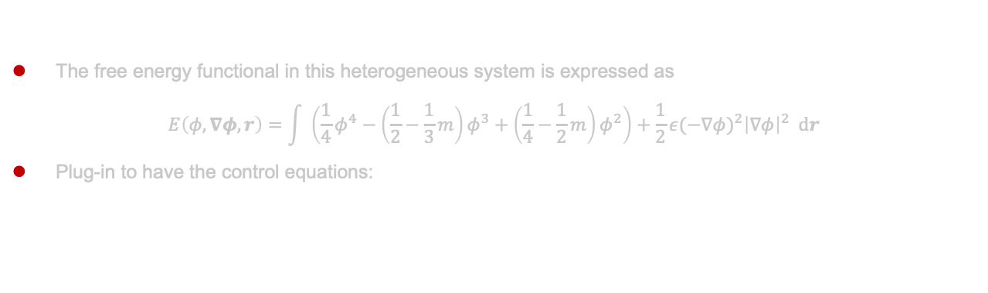
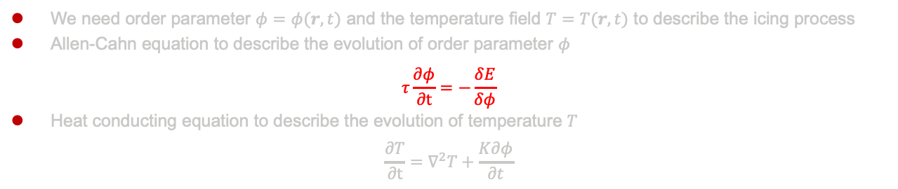

Overview: The Control Equations
We need order parameter $φ=φ(r,t)$ and the temperature field $T=T(r,t)$ to describe the icing process
Allen-Cahn equation to describe the evolution of order parameter $φ$
$$τ\frac{∂φ}{∂t}=−\frac{δE}{δφ}$$
Heat conducting equation to describe the evolution of temperature $T$
$$\frac{∂T}{∂t}=∇^{2}T+\frac{K∂φ}{∂t}$$
The free energy functional in this heterogeneous system is expressed as
$$E\left(φ,∇φ,r\right)=\int{ \left(\frac{1}{4}φ^{4}−\left(\frac{1}{2}−\frac{1}{3}m\right)φ^{3}+\left(\frac{1}{4}−\frac{1}{2}m\right)φ^{2}\right)+\frac{1}{2}{ε(−∇φ)}^{2}{\left|∇φ\right|}^{2} dr}$$
Plug-in to have the control equations:
$$τ\frac{∂φ}{∂t}=−∇∙\left({\left|∇φ\right|}^{2}ε\frac{∂ε}{∂ν}\right)+∇∙\left(ε^{2}∇φ\right)+φ(1−φ)(φ−\frac{1}{2}+m)$$
$$\frac{∂T}{∂t}=∇^{2}T+\frac{K∂φ}{∂t}$$
$$Initial Condition+Zero Flux Boundary Condition$$
Kobayashi, Physica D (1993)
Notes:
Temperature is dimensionless, so that the characteristic cooling temperature is 0 and the equilibrium temperature is 1
Boundary Conditions: Adiabatic Condition for T (zero-flux condition for the temperature field at the boundaries), zero-flux boundary condition for w

Slide 4
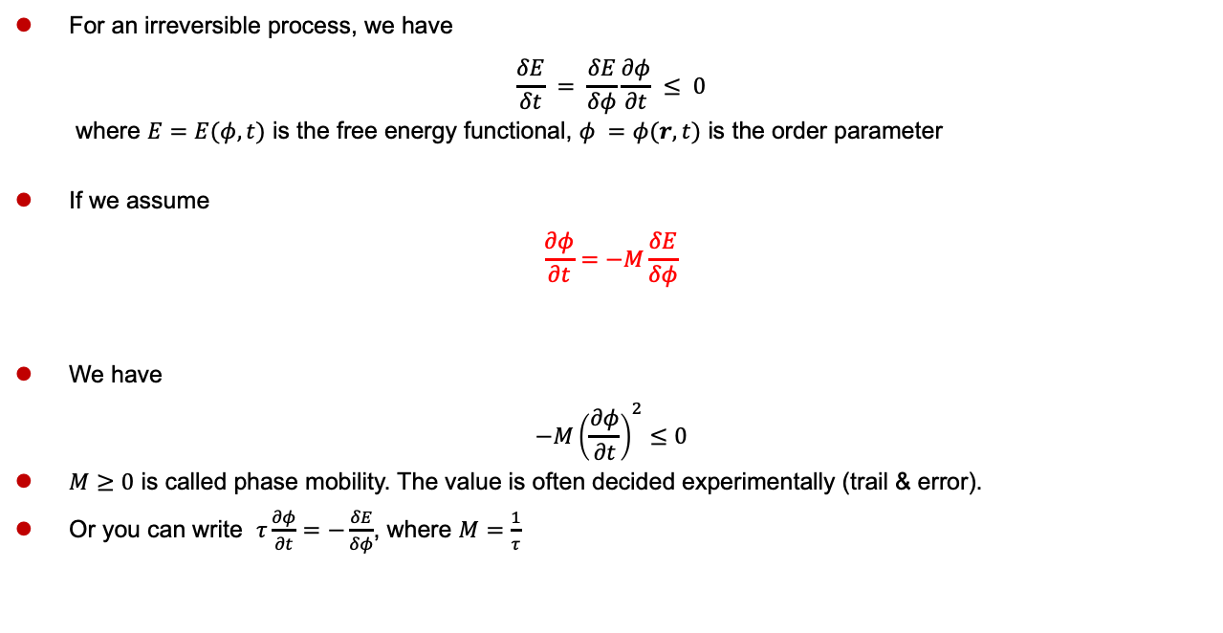
Allen-Cahn Equation
For an irreversible process, we have
$$\frac{δE}{δt} = \frac{δE}{δφ}\frac{∂φ}{∂t} ≤ 0$$
where $E=E(φ,t)$ is the free energy functional, $φ =φ(r,t)$ is the order parameter
If we assume
$$\frac{∂φ}{∂t}=−M\frac{δE}{δφ}$$
We have
$$−M{\left(\frac{∂φ}{∂t}\right)}^{2}≤0$$
$M≥0$ is called phase mobility. The value is often decided experimentally (trail & error).
Or you can write $τ\frac{∂φ}{∂t}=−\frac{δE}{δφ}$, where $M=\frac{1}{τ}$
“flux”
“driving force”
Qin et al, Materials Science and Technology (2010)

Slide 5
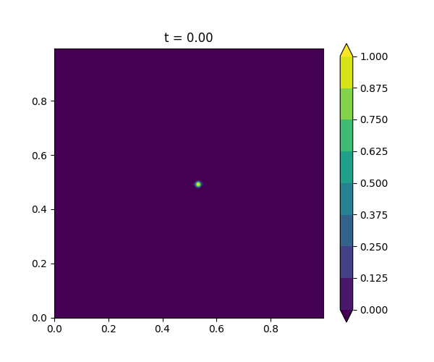






The Effect of Phase Mobility
$$\frac{1}{τ}=1000$$
$$\frac{1}{τ}=2000$$
$$\frac{1}{τ}=3000$$
The base case, $\frac{1}{τ}=3000$, $K=1.8$, $n=6$
In these 3 cases, only the phase mobility change, all other parameters are the same
Notes:
The larger the phase mobility M, the faster the dendrite will grow

Slide 6
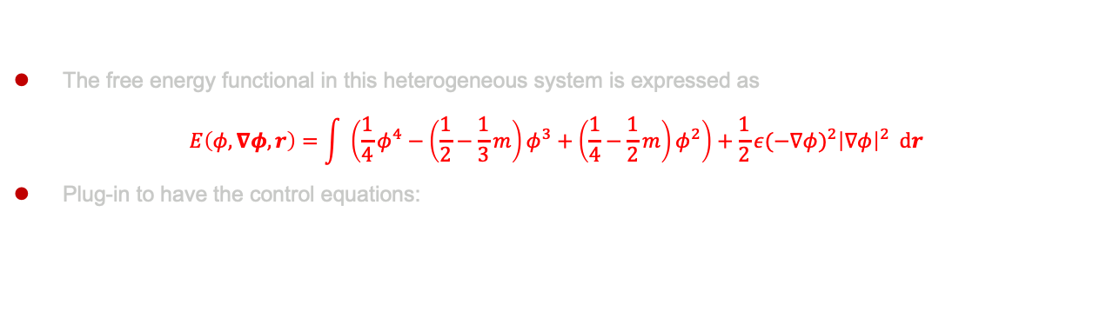
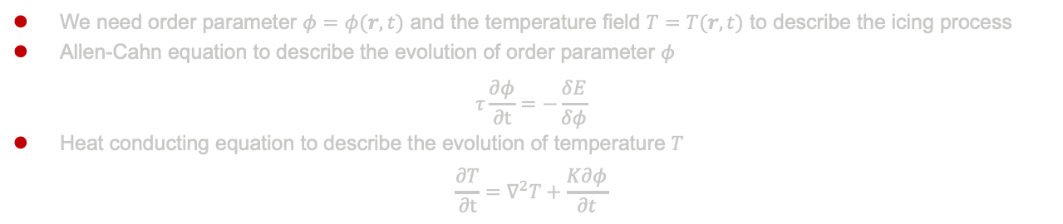
Overview: The Control Equations
We need order parameter $φ=φ(r,t)$ and the temperature field $T=T(r,t)$ to describe the icing process
Allen-Cahn equation to describe the evolution of order parameter $φ$
$$τ\frac{∂φ}{∂t}=−\frac{δE}{δφ}$$
Heat conducting equation to describe the evolution of temperature $T$
$$\frac{∂T}{∂t}=∇^{2}T+\frac{K∂φ}{∂t}$$
The free energy functional in this heterogeneous system is expressed as
$$E\left(φ,∇φ,r\right)=\int{ \left(\frac{1}{4}φ^{4}−\left(\frac{1}{2}−\frac{1}{3}m\right)φ^{3}+\left(\frac{1}{4}−\frac{1}{2}m\right)φ^{2}\right)+\frac{1}{2}{ε(−∇φ)}^{2}{\left|∇φ\right|}^{2} dr}$$
Plug-in to have the control equations:
$$τ\frac{∂φ}{∂t}=−∇∙\left({\left|∇φ\right|}^{2}ε\frac{∂ε}{∂ν}\right)+∇∙\left(ε^{2}∇φ\right)+φ(1−φ)(φ−\frac{1}{2}+m)$$
$$\frac{∂T}{∂t}=∇^{2}T+\frac{K∂φ}{∂t}$$
$$Initial Condition+Zero Flux Boundary Condition$$
Kobayashi, Physica D (1993)

Slide 7
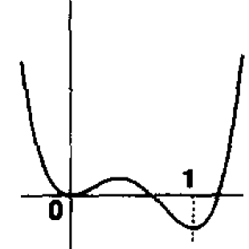
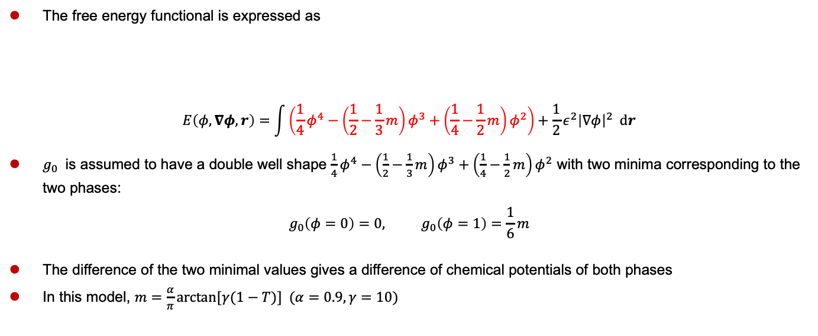



The Double-Well Potential
The free energy functional is expressed as
$$E\left(φ,∇φ,r\right)=\int{\left(\frac{1}{4}φ^{4}−\left(\frac{1}{2}−\frac{1}{3}m\right)φ^{3}+\left(\frac{1}{4}−\frac{1}{2}m\right)φ^{2}\right)+\frac{1}{2}ε^{2}{\left|∇φ\right|}^{2} dr}$$
$g_{0}$ is assumed to have a double well shape $\frac{1}{4}φ^{4}−\left(\frac{1}{2}−\frac{1}{3}m\right)φ^{3}+\left(\frac{1}{4}−\frac{1}{2}m\right)φ^{2}$ with two minima corresponding to the two phases:
$$g_{0}\left(φ=0\right)=0, g_{0}\left(φ=1\right)=\frac{1}{6}m$$
The difference of the two minimal values gives a difference of chemical potentials of both phases
In this model, $m=\frac{α}{π}arctan[γ(1−T)] (α=0.9, γ=10)$
The free energy per unit volume of a homogeneous system, $g_{0}$
Gradient energy term
$$g_{0}$$
$$φ$$
Notes:
Taking the derivative of g0, we get p(1-p)(p-1/2+m). Therefore, the absolute value of $m$ should be less than 0.5, in order that there is a local maxima between the two minima. Otherwise, the function is no longer a “double-well shape”

Slide 8
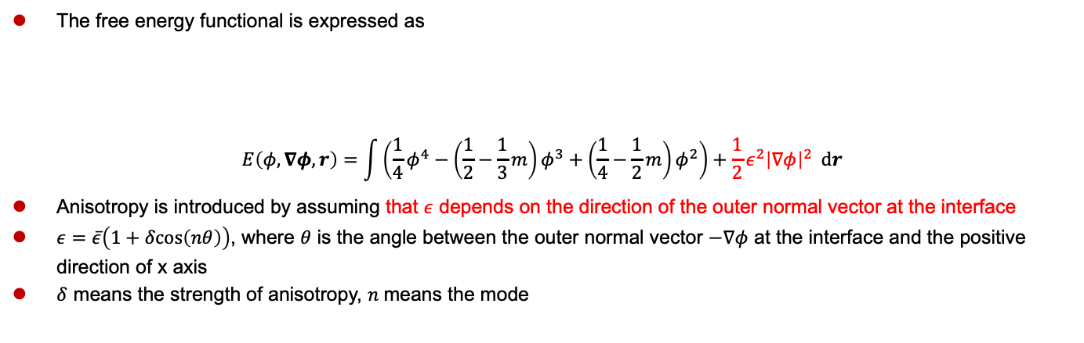
Anisotropy
The free energy functional is expressed as
$$E\left(φ,∇φ,r\right)=\int{\left(\frac{1}{4}φ^{4}−\left(\frac{1}{2}−\frac{1}{3}m\right)φ^{3}+\left(\frac{1}{4}−\frac{1}{2}m\right)φ^{2}\right)+\frac{1}{2}ε^{2}{\left|∇φ\right|}^{2} dr}$$
Anisotropy is introduced by assuming that $ε$ depends on the direction of the outer normal vector at the interface
$ε=\overline{ε}\left(1+δcos\left(nθ\right)\right)$, where $θ$ is the angle between the outer normal vector $−∇φ$ at the interface and the positive direction of x axis
$δ$ means the strength of anisotropy, $n$means the mode
The free energy per unit volume of a homogeneous system, $g_{0}$
Gradient energy term
Notes:
$ε$ depends on the direction of the outer normal vector at the interface. When not located at the interface, the normal vector is substituted by grad_w

Slide 9




The Effect of Anisotropy Mode
$$n=3$$
$$n=4$$
$$n=6$$
The base case, $\frac{1}{τ}=3000$, $K=1.8$, $n=6$
In these 3 cases, only the anisotropy mode change, all other parameters are the same

Slide 10

Overview: The Control Equations
We need order parameter $φ=φ(r,t)$ and the temperature field $T=T(r,t)$ to describe the icing process
Allen-Cahn equation to describe the evolution of order parameter $φ$
$$τ\frac{∂φ}{∂t}=−\frac{δE}{δφ}$$
Heat conducting equation to describe the evolution of temperature $T$
$$\frac{∂T}{∂t}=∇^{2}T+\frac{K∂φ}{∂t}$$
The free energy functional in this heterogeneous system is expressed as
$$E\left(φ,∇φ,r\right)=\int{ \left(\frac{1}{4}φ^{4}−\left(\frac{1}{2}−\frac{1}{3}m\right)φ^{3}+\left(\frac{1}{4}−\frac{1}{2}m\right)φ^{2}\right)+\frac{1}{2}{ε(−∇φ)}^{2}{\left|∇φ\right|}^{2} dr}$$
Plug-in to have the control equations:
$$τ\frac{∂φ}{∂t}=−∇∙\left({\left|∇φ\right|}^{2}ε\frac{∂ε}{∂ν}\right)+∇∙\left(ε^{2}∇φ\right)+φ(1−φ)(φ−\frac{1}{2}+m)$$
$$\frac{∂T}{∂t}=∇^{2}T+\frac{K∂φ}{∂t}$$
$$Initial Condition+Zero Flux Boundary Condition$$
Kobayashi, Physica D (1993)

Slide 11





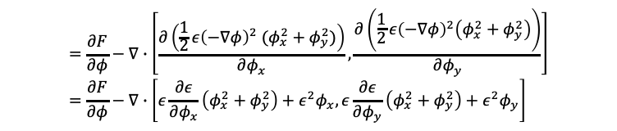



Derivation of Evolution Equation for Order Parameter
$$ν=−∇φ=\left[−φ_{x},{−φ}_{y}\right]$$
$$\frac{∂L}{∂∇φ}=[\frac{∂L}{∂φ_{x}},\frac{∂L}{∂φ_{y}}]$$
$$E\left(φ,∇φ,r\right)=\int{\frac{1}{2}{ε(−∇φ)}^{2}{\left|∇φ\right|}^{2}+F\left(φ,m\right) dr}=\int{L\left(φ,∇φ,r\right)dr}$$
$${\left|∇φ\right|}^{2}=[φ_{x},φ_{y}]∙[φ_{x},φ_{y}]=φ_{x}^{2}+φ_{y}^{2}$$
$$F\left(φ,m\right)=\frac{1}{4}φ^{4}−\left(\frac{1}{2}−\frac{1}{3}m\right)φ^{3}+\left(\frac{1}{4}−\frac{1}{2}m\right)φ^{2}$$
$$\frac{δE}{δφ}≝\frac{∂L}{∂φ}−∇∙\frac{∂L}{∂∇φ}=\frac{∂F}{∂φ}−∇∙\left(\frac{∂\left(\frac{1}{2}{ε\left(−∇φ\right)}^{2}{\left|∇φ\right|}^{2}\right)}{∂∇φ}\right)$$
$$=\frac{∂F}{∂φ}−∇∙\left[\frac{∂\left(\frac{1}{2}{ε\left(−∇φ\right)}^{2} (φ_{x}^{2}+φ_{y}^{2})\right)}{∂φ_{x}},\frac{∂\left(\frac{1}{2}{ε\left(−∇φ\right)}^{2}\left(φ_{x}^{2}+φ_{y}^{2}\right)\right)}{∂φ_{y}}\right]=\frac{∂F}{∂φ}−∇∙\left[ε\frac{∂ε}{∂φ_{x}}\left(φ_{x}^{2}+φ_{y}^{2}\right)+ε^{2}φ_{x},ε\frac{∂ε}{∂φ_{y}}\left(φ_{x}^{2}+φ_{y}^{2}\right)+ε^{2}φ_{y}\right]$$
$$=\frac{∂F}{∂φ}−∇∙(ε\left(φ_{x}^{2}+φ_{y}^{2}\right)\left[\frac{∂ε(−∇φ)}{∂φ_{x}},\frac{∂ε(−∇φ)}{∂φ_{y}}\right]+ε^{2}\left[φ_{x}, φ_{y}\right])$$
$$=\frac{∂F}{∂φ}−∇∙(−ε{\left|∇φ\right|}^{2}\left[\frac{∂ε(−∇φ)}{∂(−φ_{x})},\frac{∂ε(−∇φ)}{∂(−φ_{y})}\right]+ε^{2}\left[φ_{x}, φ_{y}\right])$$
$$=\frac{∂F}{∂φ}−∇∙(−ε{\left|∇φ\right|}^{2}\frac{∂ε}{∂ν}+ε^{2}∇φ)$$
$$τ\frac{∂φ}{∂t}=−\frac{δE}{δφ}=−∇∙\left({\left|∇φ\right|}^{2}ε\frac{∂ε}{∂ν}\right)+∇∙\left(ε^{2}∇φ\right)+φ(1−φ)(φ−\frac{1}{2}+m)$$
$$→$$
Notes:
Euler-Lagrange Equation

Slide 12



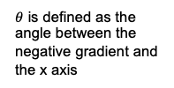











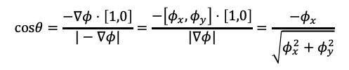
Derivation of Evolution Equation for Order Parameter (cont’d)
$$τ\frac{∂φ}{∂t}=−∇∙\left({\left|∇φ\right|}^{2}ε\frac{∂ε}{∂ν}\right)+∇∙\left(ε^{2}∇φ\right)+φ(1−φ)(φ−\frac{1}{2}+m)$$
Mean value
Anisotropy
$$ε=ε\left(θ\right)=ε=\overline{ε}⋅(1+δ⋅cos\left(nθ\right))$$
Given a specific $θ$, $φ_{x}$ and $φ_{y}$ are not independent. If $φ_{x}$is seen as the independent variable, then $φ_{y}$is dependent of $φ_{x}$.
$$−∇φ$$
$θ$ is defined as the angle between the negative gradient and the x axis
$$\frac{dε}{dθ}=\frac{∂ε}{∂φ_{x}}\frac{∂φ_{x}}{∂θ}=\frac{∂ε}{∂φ_{x}}\frac{∂φ_{x}}{∂cosθ}\frac{dcosθ}{dθ}$$
$$\frac{dε}{dθ}=\frac{∂ε}{∂φ_{y}}\frac{∂φ_{y}}{∂θ}=\frac{∂ε}{∂φ_{y}}\frac{∂φ_{y}}{∂cosθ}\frac{dcosθ}{dθ}$$
$$θ$$
$$x$$
$$=−sinθ\frac{∂ε}{∂φ_{x}}\frac{∂φ_{x}}{∂cosθ}$$
$$=−sinθ\frac{∂ε}{∂φ_{y}}\frac{∂φ_{y}}{∂cosθ}$$
$$cosθ=\frac{−∇φ⋅\left[1,0\right]}{|−∇φ|}=\frac{−\left[φ_{x},φ_{y}\right]⋅\left[1,0\right]}{|∇φ|}=\frac{−φ_{x}}{\sqrt{φ_{x}^{2}+φ_{y}^{2}}}$$
or
$$=−\frac{−φ_{y}}{\sqrt{φ_{x}^{2}+φ_{y}^{2}}}\frac{∂ε}{∂φ_{x}}\frac{{\left(φ_{x}^{2}+φ_{y}^{2}\right)}^{\frac{3}{2}}}{−φ_{y}^{2}}$$
$$=−\frac{−φ_{y}}{\sqrt{φ_{x}^{2}+φ_{y}^{2}}}\frac{∂ε}{∂φ_{y}}\frac{{\left(φ_{x}^{2}+φ_{y}^{2}\right)}^{\frac{3}{2}}}{φ_{x}φ_{y}}$$
$$\frac{∂cosθ}{∂φ_{x}}=\frac{−φ_{y}^{2}}{{\left(φ_{x}^{2}+φ_{y}^{2}\right)}^{\frac{3}{2}}}$$
$$\frac{∂cosθ}{∂φ_{y}}=\frac{φ_{x}φ_{y}}{{\left(φ_{x}^{2}+φ_{y}^{2}\right)}^{\frac{3}{2}}}$$
$$=−\frac{∂ε}{∂φ_{x}}\frac{φ_{x}^{2}+φ_{y}^{2}}{φ_{y}}=−{\left|∇φ\right|}^{2}\frac{∂ε}{∂φ_{x}}\frac{1}{φ_{y}}$$
$$=\frac{∂ε}{∂φ_{y}}\frac{φ_{x}^{2}+φ_{y}^{2}}{φ_{x}}={\left|∇φ\right|}^{2}\frac{∂ε}{∂φ_{y}}\frac{1}{φ_{x}}$$
Therefore,
$$−∇∙\left({\left|∇φ\right|}^{2}ε\frac{∂ε}{∂ν}\right)=−∇∙\left({\left|∇φ\right|}^{2}ε\left(−\frac{∂ε}{∂φ_{x}},−\frac{∂ε}{∂φ_{y}}\right)\right)=−∇∙\left(ε\frac{dε}{dθ}\left[φ_{y},−φ_{x}\right]\right)=−\frac{∂}{∂x}\left(ε\frac{dε}{dθ}φ_{y}\right)+\frac{∂}{∂y}(ε\frac{dε}{dθ}φ_{x})$$
which is the same as Eq (3) in Kobayashi, Physica D (1993).
Notes:
$ε$is a function of $∇φ$, while $∇φ$ is a function of $θ$, therefore $ε$is a function of $θ$

Slide 13
Overview: The Control Equations
We need order parameter $φ=φ(r,t)$ and the temperature field $T=T(r,t)$ to describe the icing process
Allen-Cahn equation to describe the evolution of order parameter $φ$
$$τ\frac{∂φ}{∂t}=−\frac{δE}{δφ}$$
Heat conducting equation to describe the evolution of temperature $T$
$$\frac{∂T}{∂t}=∇^{2}T+\frac{K∂φ}{∂t}$$
The free energy functional in this heterogeneous system is expressed as
$$E\left(φ,∇φ,r\right)=\int{ \left(\frac{1}{4}φ^{4}−\left(\frac{1}{2}−\frac{1}{3}m\right)φ^{3}+\left(\frac{1}{4}−\frac{1}{2}m\right)φ^{2}\right)+\frac{1}{2}{ε(−∇φ)}^{2}{\left|∇φ\right|}^{2} dr}$$
Plug-in to have the control equations:
$$τ\frac{∂φ}{∂t}=−∇∙\left({\left|∇φ\right|}^{2}ε\frac{∂ε}{∂ν}\right)+∇∙\left(ε^{2}∇φ\right)+φ(1−φ)(φ−\frac{1}{2}+m)$$
$$\frac{∂T}{∂t}=∇^{2}T+\frac{K∂φ}{∂t}$$
$$Initial Condition+Zero Flux Boundary Condition$$
Kobayashi, Physica D (1993)
Notes:
Temperature is dimensionless, so that the characteristic cooling temperature is 0 and the equilibrium temperature is 1
Boundary Conditions: Adiabatic Condition for T (zero-flux condition for the temperature field at the boundaries), zero-flux boundary condition for w

Slide 14




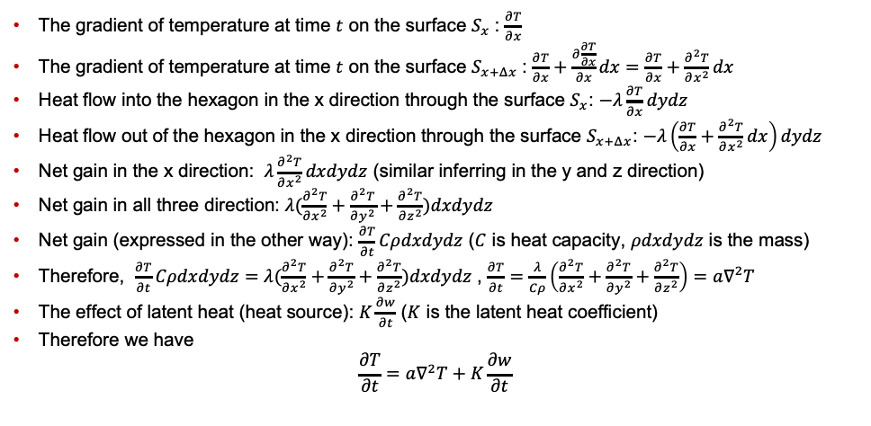

Derivation of Evolution Equation for Temperature
The Fourier Heat Conducting Law: $q=−λ∇T$
The gradient of temperature at time $t$ on the surface $S_{x}$: $\frac{∂T}{∂x}$
The gradient of temperature at time $t$ on the surface $S_{x+Δx}$: $\frac{∂T}{∂x}+\frac{∂\frac{∂T}{∂x}}{∂x}dx=\frac{∂T}{∂x}+\frac{∂^{2}T}{∂x^{2}}dx$
Heat flow into the hexagon in the x direction through the surface $S_{x}$: $−λ\frac{∂T}{∂x}dydz$
Heat flow out of the hexagon in the x direction through the surface $S_{x+Δx}$: $−λ\left(\frac{∂T}{∂x}+\frac{∂^{2}T}{∂x^{2}}dx\right)dydz$
Net gain in the x direction: $λ\frac{∂^{2}T}{∂x^{2}}dxdydz$ (similar inferring in the y and z direction)
Net gain in all three direction: $λ(\frac{∂^{2}T}{∂x^{2}}+\frac{∂^{2}T}{∂y^{2}}+\frac{∂^{2}T}{∂z^{2}})dxdydz$
Net gain (expressed in the other way): $\frac{∂T}{∂t}Cρdxdydz$ ($C$ is heat capacity, $ρdxdydz$ is the mass)
Therefore, $\frac{∂T}{∂t}Cρdxdydz=λ(\frac{∂^{2}T}{∂x^{2}}+\frac{∂^{2}T}{∂y^{2}}+\frac{∂^{2}T}{∂z^{2}})dxdydz$ , $\frac{∂T}{∂t}=\frac{λ}{Cρ}\left(\frac{∂^{2}T}{∂x^{2}}+\frac{∂^{2}T}{∂y^{2}}+\frac{∂^{2}T}{∂z^{2}}\right)=a∇^{2}T$
The effect of latent heat (heat source): $K\frac{∂w}{∂t}$ ($K$ is the latent heat coefficient)
Therefore we have
$$\frac{∂T}{∂t}=a∇^{2}T+K\frac{∂w}{∂t}$$
$$Δz$$
$$S_{x}$$
$$S_{x+Δx}$$
$$Δy$$
$$Δx$$
Notes:
Non-dimensionless: $\tilde{T}=\frac{T−T_{c}}{T_{e}−T_{c}}$ ($T_{c}$ is the characteristic supercooling temperature, $T_{e}$ is the equilibrium temperature)
For simplicity, the diffusion constant $a=1$

Slide 15





The Effect of Latent Heat Constant
$$K=0.6$$
$$K=1.2$$
$$K=1.8$$
The base case, $\frac{1}{τ}=3000$, $K=1.8$, $n=6$
In these 3 cases, only the latent heat constant change, all other parameters are the same

Slide 16
Thanks

Slide 17
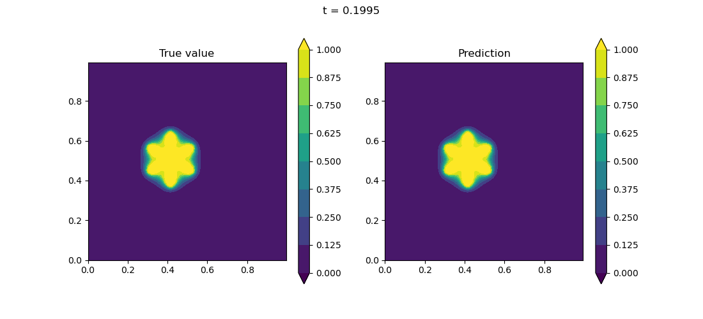
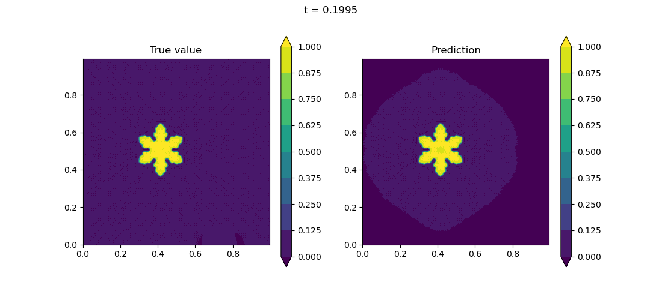
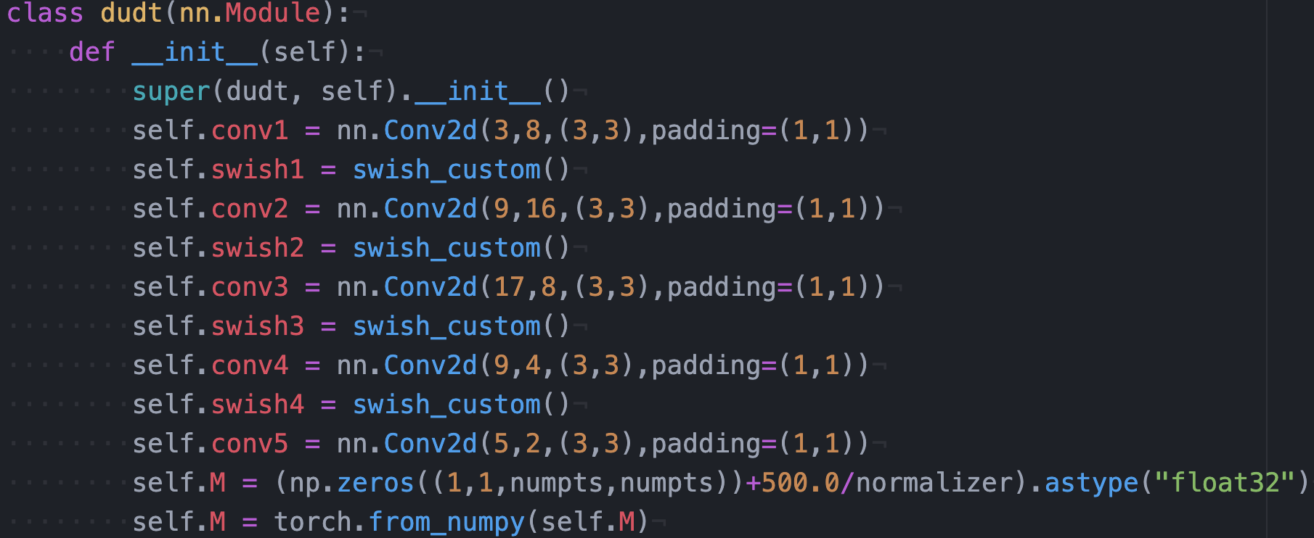
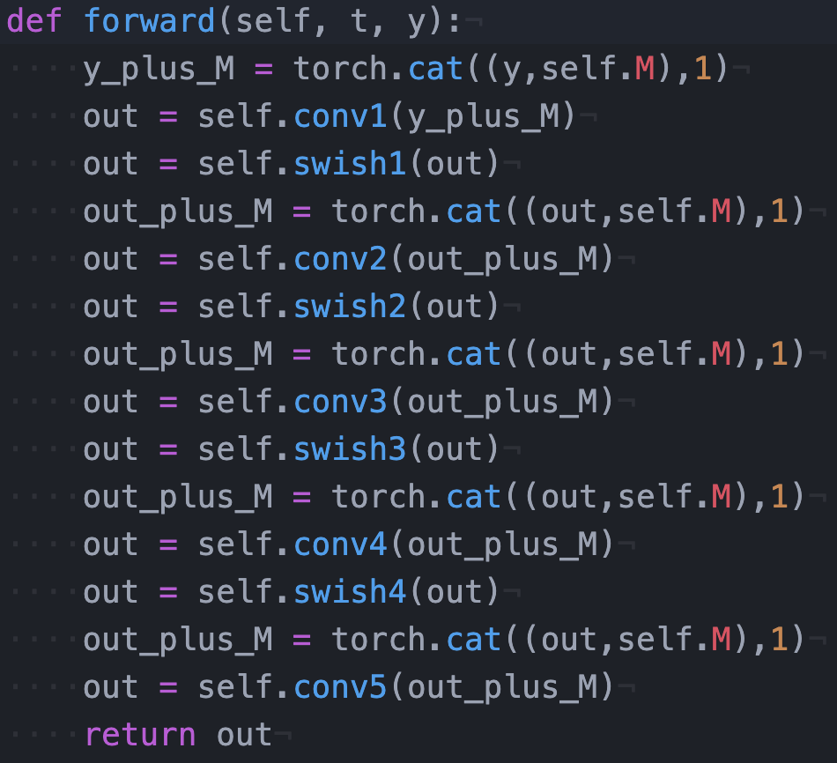


An Update
$$T$$
$$w$$

Slide 18
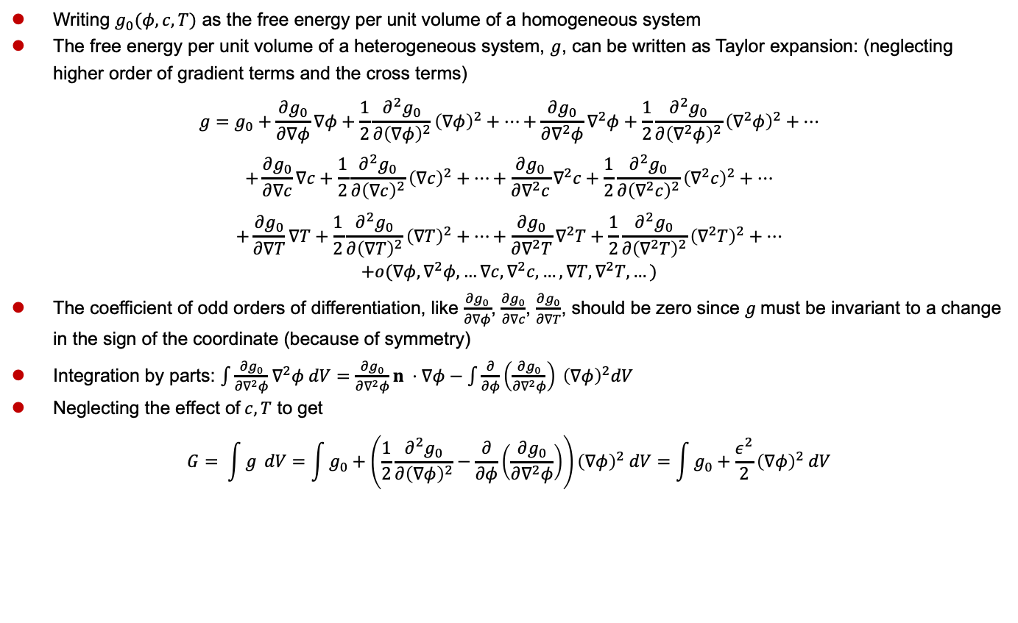
The Free Energy Functional
Writing $g_{0}(φ, c, T)$ as the free energy per unit volume of a homogeneous system
The free energy per unit volume of a heterogeneous system, $g$, can be written as Taylor expansion: (neglecting higher order of gradient terms and the cross terms)
$$g=g_{0}+\frac{∂g_{0}}{∂∇φ}∇φ+\frac{1}{2}\frac{∂^{2}g_{0}}{∂{\left(∇φ\right)}^{2}}{\left(∇φ\right)}^{2}+…+\frac{∂g_{0}}{∂∇^{2}φ}∇^{2}φ+\frac{1}{2}\frac{∂^{2}g_{0}}{∂{\left(∇^{2}φ\right)}^{2}}{\left(∇^{2}φ\right)}^{2}+…$$
$$+\frac{∂g_{0}}{∂∇c}∇c+\frac{1}{2}\frac{∂^{2}g_{0}}{∂{\left(∇c\right)}^{2}}{\left(∇c\right)}^{2}+…+\frac{∂g_{0}}{∂∇^{2}c}∇^{2}c+\frac{1}{2}\frac{∂^{2}g_{0}}{∂{\left(∇^{2}c\right)}^{2}}{\left(∇^{2}c\right)}^{2}+…$$
$$+\frac{∂g_{0}}{∂∇T}∇T+\frac{1}{2}\frac{∂^{2}g_{0}}{∂{\left(∇T\right)}^{2}}{\left(∇T\right)}^{2}+…+\frac{∂g_{0}}{∂∇^{2}T}∇^{2}T+\frac{1}{2}\frac{∂^{2}g_{0}}{∂{\left(∇^{2}T\right)}^{2}}{\left(∇^{2}T\right)}^{2}+…$$
$$+o(∇φ,∇^{2}φ,…∇c,∇^{2}c, …,∇T,∇^{2}T,…)$$
The coefficient of odd orders of differentiation, like $\frac{∂g_{0}}{∂∇φ}$, $\frac{∂g_{0}}{∂∇c}$, $\frac{∂g_{0}}{∂∇T}$, should be zero since $g$must be invariant to a change in the sign of the coordinate (because of symmetry)
Integration by parts: $\int{\frac{∂g_{0}}{∂∇^{2}φ}∇^{2}φ dV}=\frac{∂g_{0}}{∂∇^{2}φ}n ⋅∇φ−\int{\frac{∂}{∂φ}\left(\frac{∂g_{0}}{∂∇^{2}φ}\right) {\left(∇φ\right)}^{2}dV}$
Neglecting the effect of$c, T$ to get
$$G= \int{g} dV=\int{g_{0}+\left(\frac{1}{2}\frac{∂^{2}g_{0}}{∂{\left(∇φ\right)}^{2}}−\frac{∂}{∂φ}\left(\frac{∂g_{0}}{∂∇^{2}φ}\right)\right){\left(∇φ\right)}^{2} dV}=\int{g_{0}+\frac{ε^{2}}{2}{\left(∇φ\right)}^{2} dV}$$
Qin et al, Materials Science and Technology (2010)
Notes:
Since the diffusion length of solute and particularly of heat are generally large,
the spatial gradients of c and T are likely to be small.
There are of course circumstances where concentration gradients are the key phenomena studied,
such as in spinodal decomposition, in which case the solute gradient term clearly must be retained.

