Slide 1
Lecture 22
Chemical Reaction Engineering (CRE) is the field that studies the rates and mechanisms of chemical reactions and the design of the reactors in which they take place.

Slide 2
Web Lecture 22
Class Lecture 18-Thursday 3/28/2013
Review of Multiple Steady States (MSS)
Reactor Safety (Chapter 13)
Blowout Velocity
CSTR Explosion
Batch Reactor Explosion

Slide 3
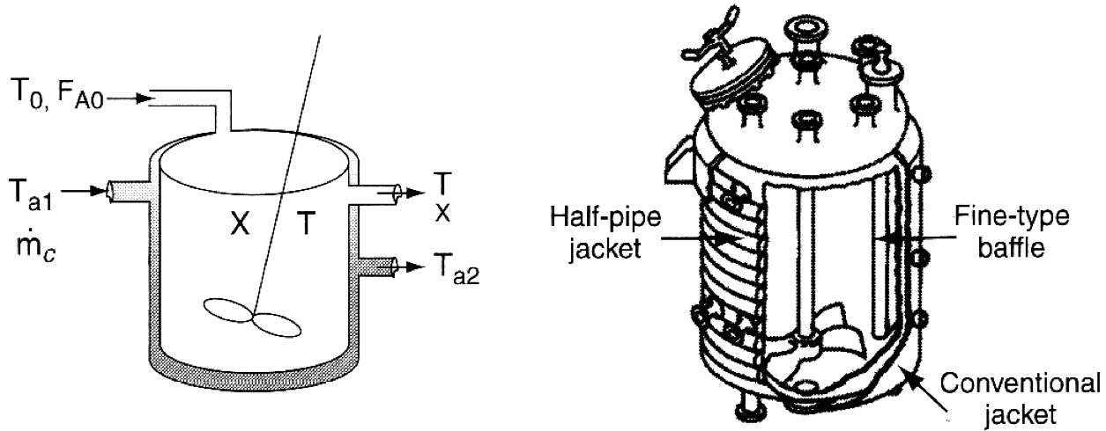
CSTR with Heat Effects
Review Last Lecture

Slide 4
Energy Balance for CSTRs
Review Last Lecture

Slide 5
Energy Balance for CSTRs
Review Last Lecture
R(T)
Increasing T₀
T
Variation of heat removal line with inlet temperature.

Slide 6
Energy Balance for CSTRs
Review Last Lecture
κ=∞
κ=0
R(T)
Increase κ
T_{a}
T₀
T
Variation of heat removal line with κ (κ=UA/C_{P0}F_{A0})

Slide 7
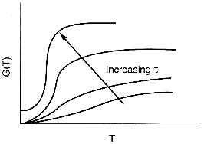
Multiple Steady States (MSS)
Review Last Lecture
Variation of heat generation curve with space-time.

Slide 8
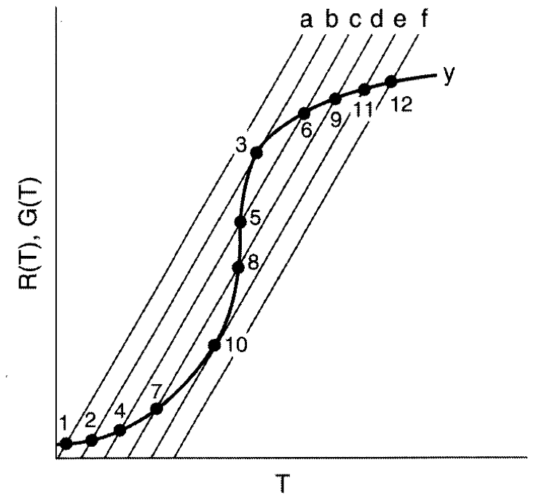
Multiple Steady States (MSS)
Review Last Lecture
Finding Multiple Steady States with T₀ varied

Slide 9
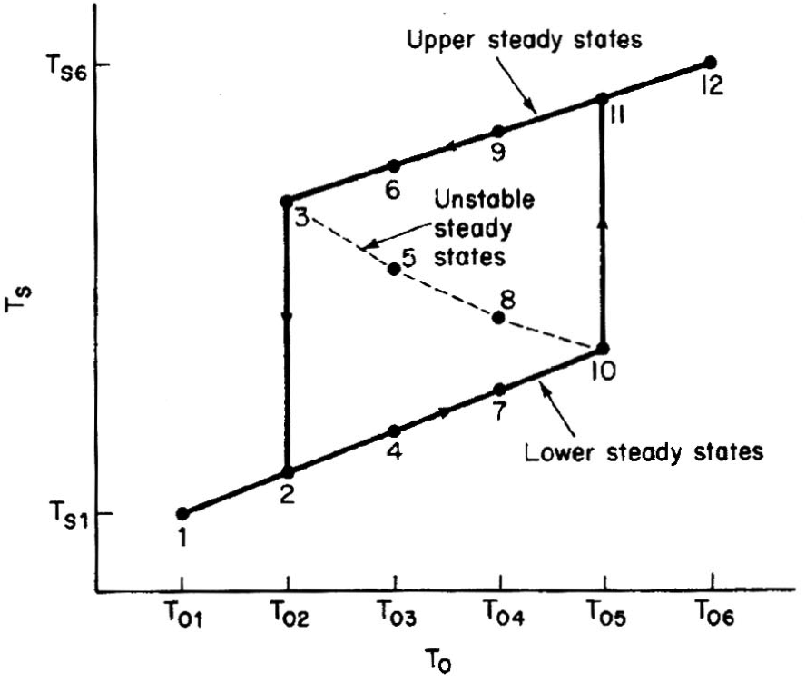
Multiple Steady States (MSS)
Review Last Lecture
Temperature ignition-extinction curve

Slide 10
Multiple Steady States (MSS)
Review Last Lecture
Bunsen Burner Effect (Blowout)

Slide 11
Multiple Steady States (MSS)
Review Last Lecture
Bunsen Burner Effect (Blowout)

Slide 12
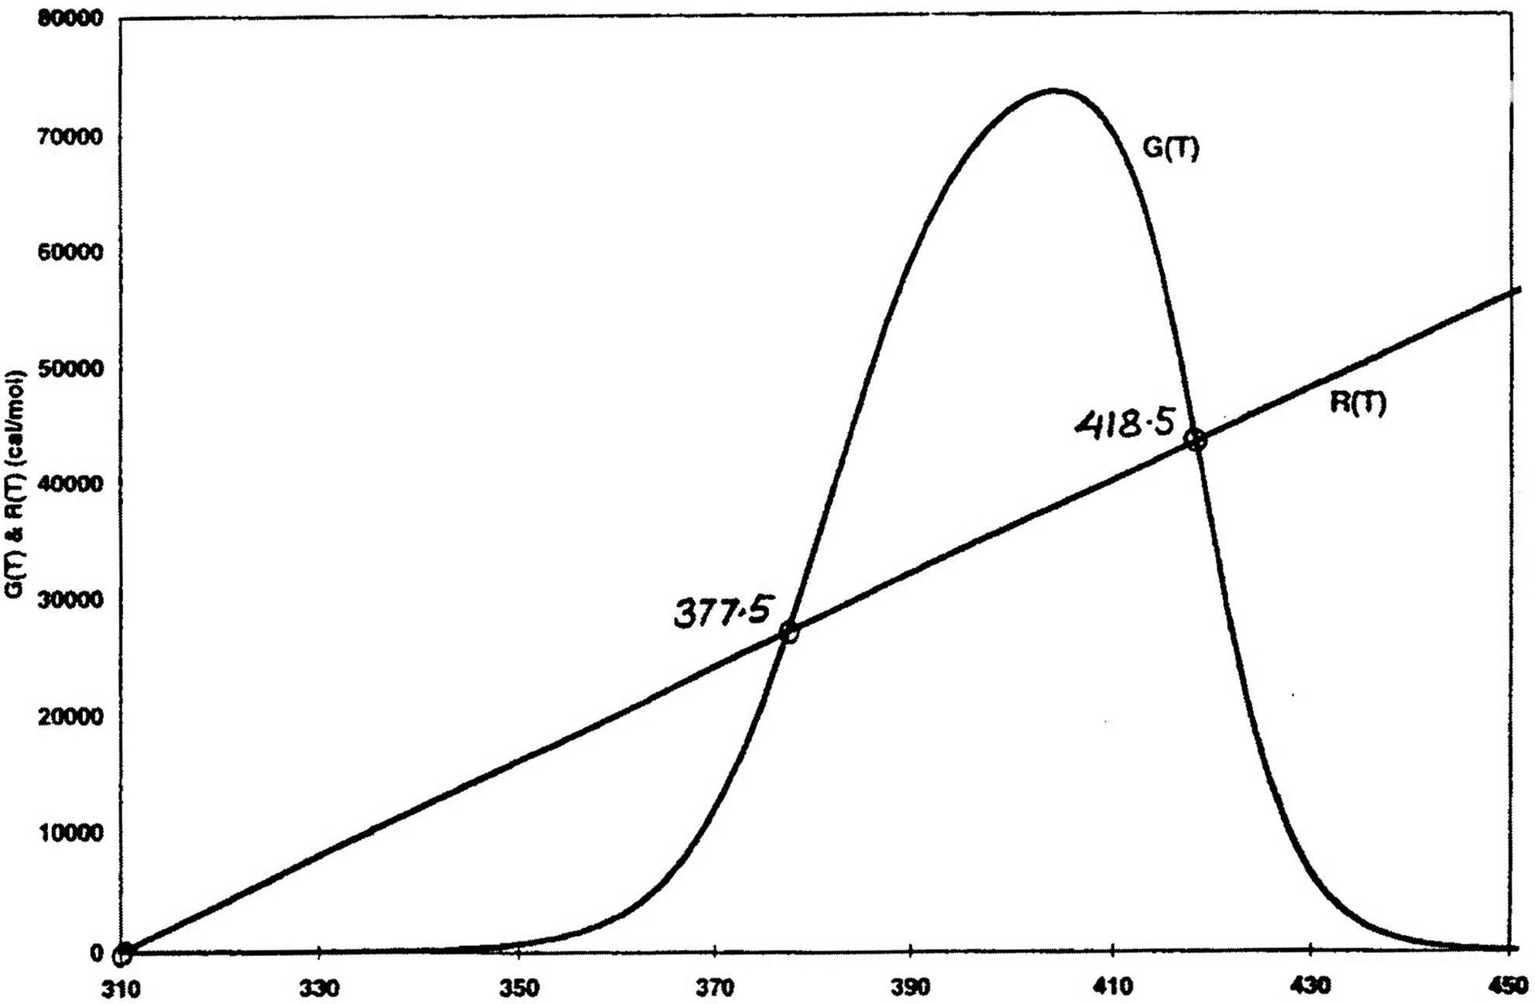
Reversible Reaction
Gas Flow in a PBR with Heat Effects
A ↔ B

Slide 13
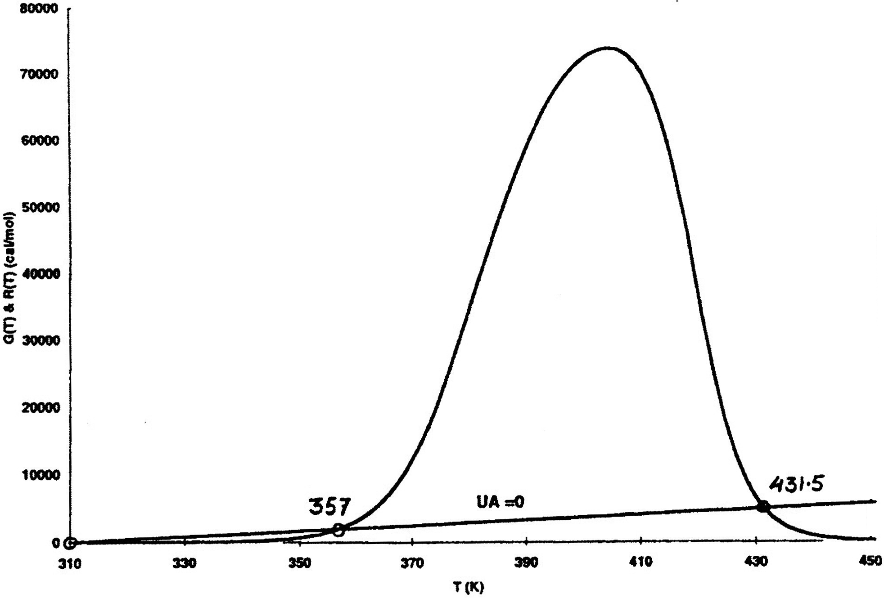
Reversible Reaction
Gas Flow in a PBR with Heat Effects
A ↔ B
UA = 73,520
UA = 0

Slide 14
Reversible Reaction
Gas Flow in a PBR with Heat Effects
A ↔ B

Slide 15
Reversible Reaction
Gas Flow in a PBR with Heat Effects
A ↔ B
Exothermic Case:
K_{C}
X_{e}
T
T
Endothermic Case:
~1
K_{C}
X_{e}
T
T

Slide 16
Adiabatic Equilibrium Conversion
Conversion on Temperature
Exothermic ΔH is negative
Adiabatic Equilibrium temperature (T_{adia}) and conversion (X_{e,adia})
X
X_{eadia}
T_{adia}
T

Slide 17
Gas Phase Heat Effects
Trends:
Adiabatic:
exothermic
endothermic
X
X
Adiabatic T
and X_{e}
T
T
T₀
T₀

Slide 18
Gas Phase Heat Effects
X
X_{eadia}
T

Slide 19
Gas Phase Heat Effects
Effect of adding inerts on adiabatic equilibrium conversion
Adiabatic:
X
Adiabatic Equilibrium Conversion
T
T₀

Slide 20
Q₁
Q₂
F_{A0}
F_{A1}
F_{A2}
F_{A3}
T₀
X₁
T₀
X₂
T₀
X₃

Slide 21
X
X_{e}
X_{EB}
X₃
X₂
X₁
T₀
T

Slide 22
Adiabatic Exothermic Reactions
The heat of reaction for endothermic reaction is positive, i.e.,
Energy Balance :
We want to learn the effects of adding inerts on conversion. How the conversion varies with the amount, i.e., Θ_{I}, depends on what you vary and what you hold constant as you change Θ_{I}.

Slide 23
A. First Order Reaction
Combining the mole balance, rate law and stoichiometry
Two cases will be considered
Case 1 Constant υ₀, volumetric flow rate
Case 2: Variable υ₀, volumetric flow rate

Slide 24
A.1. Liquid Phase Reaction
For Liquids, volumetric flow rates are additive.

Slide 25
Effect of Adding Inerts to an Endothermic Adiabatic Reaction
What happens when we add Inerts, i.e., vary Theta I??? It all depends what you change and what you hold constant!!!
\

Slide 26
A.1.a. Case 1. Constant υ₀
To keep υ₀ constant if we increase the amount of Inerts, i.e., increase Θ_{I} we will need to decrease the amount of A entering, i.e., υ_{A0}. So Θ_{I} ↑ then υ_{A0} ↓

Slide 27
A.1.a. Case 2. Constant υ_{A,} Variable υ₀

Slide 28
A.2. Gas Phase
Without Inerts With Inerts and A
Taking the ratio of C_{TA} to C_{TI}
Solving for υ_{I}
We want to compare what happens when Inerts and A are fed to the case when only A is fed.

Slide 29
Nomenclature note: Sub I with Inerts I and reactant A fed
Sub A with only reactant A fed
F_{TI} = Total inlet molar flow rate of inert, I, plus reactant A, F_{TI} = F_{A0} + F_{I0}
F_{TA} = Total inlet molar flow rate when no Inerts are fed, i.e., F_{TA} = F_{A0}
P_{I}, T_{I} = Inlet temperature and pressure for the case when both Inerts (I) and A are fed
P_{A}, T_{A} = Inlet temperature and pressure when only A is fed
C_{A0} = Concentration of A entering when no inerts are presents
C_{TA} = Total concentration when no inerts are present
C_{TI} = Total concentration when both I and A are present
C_{A0I} = Concentration of A entering when inerts A are entering
υ_{I} = Entering volumetric flow rate with both Inerts (I) and reactant (A)

Slide 31
A.2.a. Case 1
Maintain constant volumetric flow, υ₀, rate as inerts are added. I.e., υ₀ = υ_{I} = υ_{A}. Not a very reasonable situation, but does represent one extreme. Achieve constant υ₀ varying P, T to adjust conditions so term in brackets, [ ], is one.
For example if Θ_{I} = 2 then υ_{I} will be the same as υ_{A}, but we need the entering pressures P_{I} and P_{A} to be in the relationship P_{I} = 3P_{A} with T_{A} = T_{I}

Slide 32
A.2.a. Case 1
That is the term in brackets, [ ], would be 1 which would keep υ₀ constant with υ_{I} = υ_{A} = υ₀. Returning to our combined mole balance, rate law and stoichiometry

Slide 33
A.2.b. Case 2: Variable υ₀ Constant T, P i.e., P_{I} = P_{A}, T_{I} = T_{A}

Slide 34
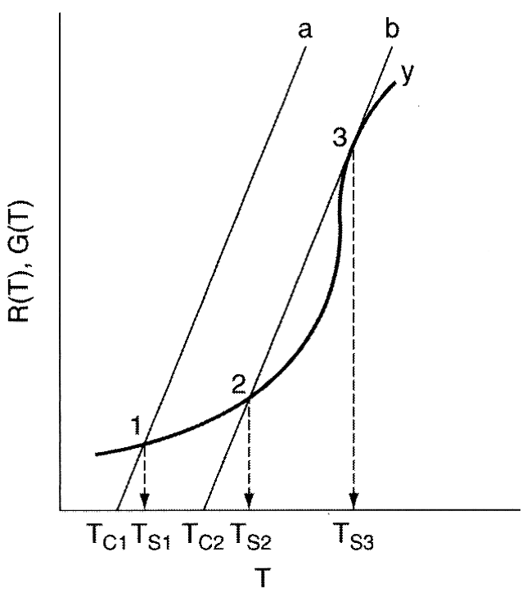
B. Gas Phase Second Order Reaction
Pure A Inerts Plus A

Slide 35
B. Gas Phase Second Order Reaction

Slide 36
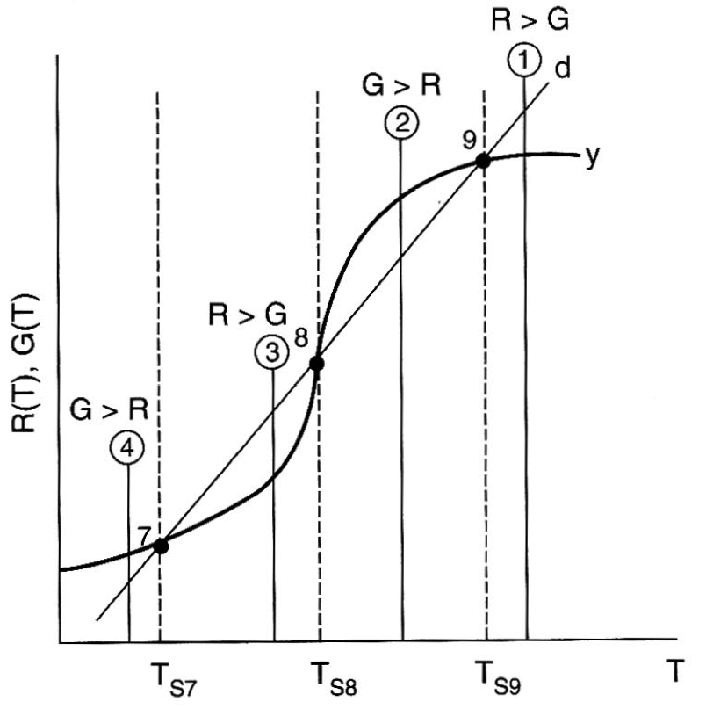
B. Gas Phase Second Order Reaction
For the same temperature and pressures for the cases with and without inerts, i.e., P_{I} = P_{A} and T_{I} = T_{A}, then

Slide 37
Heat Effects
Isothermal Design
Stoichiometry
Rate Laws
Mole Balance

Slide 38
Isothermal Design
Heat Effects
Rate Laws
Stoichiometry
Mole Balance

Slide 39
End of Web Lecture 22
Class Lecture 20

