Slide 1
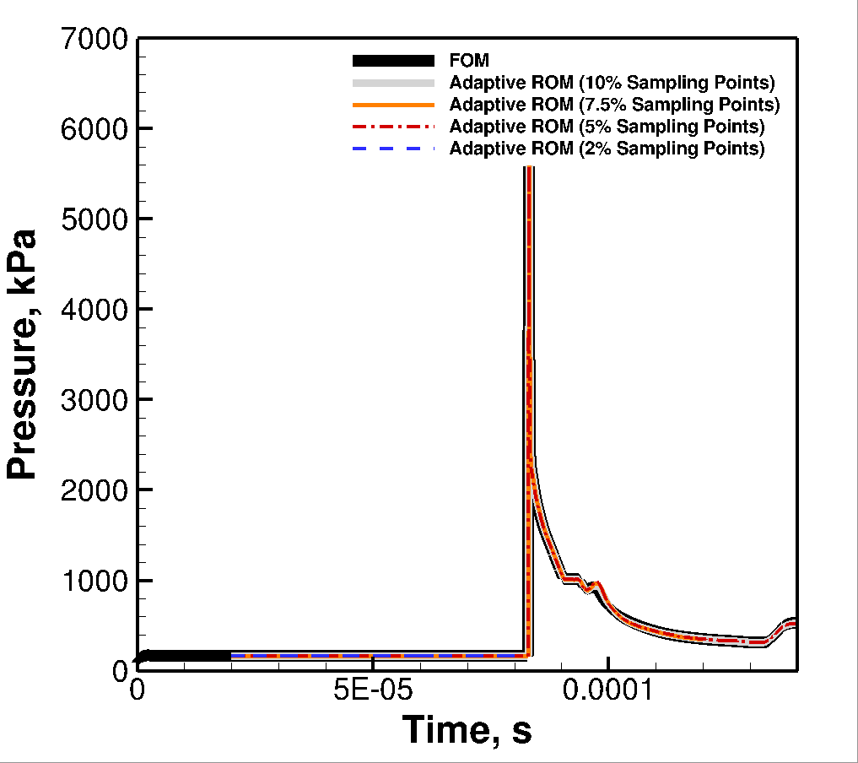
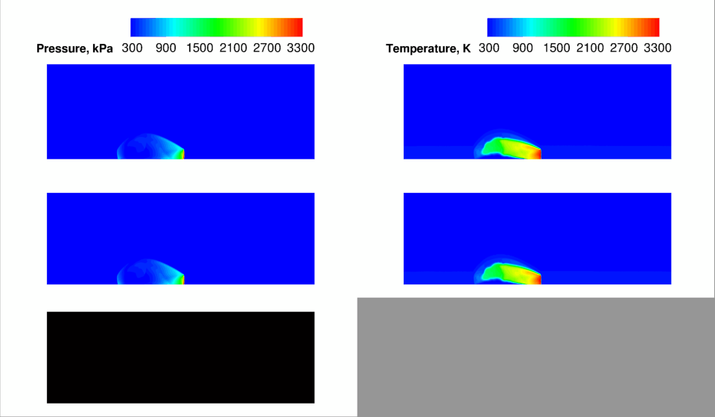
FOM vs Online Adaptive ROM (V_{in} = 150m/s initial transients)
Initial offline training window: 10 snapshots : 0 < t < 0.02ms
Online Prediction : t > 0.02 ms
Sampling points update frequency: z_{s} = 5
unstable
FOM
Adaptive ROM
(5% sampling)
FOM initial condition
Sampling Points
ROM start

